Slide 1
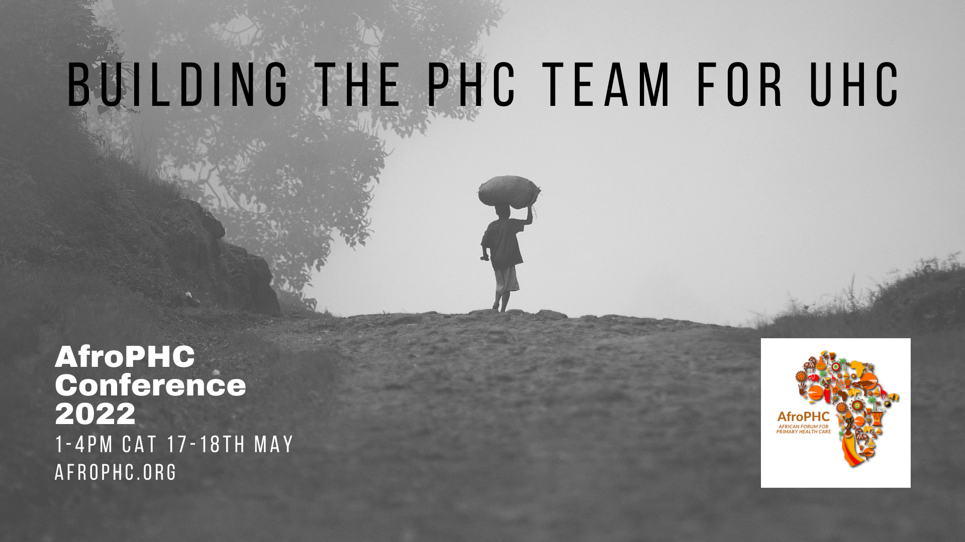
Welcome

Slide 2
Policy Framework – Process (1)
Process in 2020 Meetings
  AfroPHC Team Workshop 9-11 Sept → PHC Teamwork?
    AfroPHC Statement: “The African Forum for Primary Care (AfroPHC) consists of diverse multidisciplinary primary health care (PHC) workforce stakeholders from across Africa who share a vision for African PHC service delivery: It should be comprehensive, accessible, high quality, responsive to local needs, in partnership with communities and delivered by strong teamwork, training and supportive supervision”
  AfroPHC for UHC Workshop 9 Dec → Priorities for PHC Workforce?
    Jim Campbell (WO HR) /Suraya Dalil (WHO PHC) “Support for wide multidisciplinary PHC teamwork. Task shifting does not equal teamwork. Enable environment. Include private sector. Address HR nomenclature challenge and education. Widen team to include SGDs”

Slide 3
Policy Framework – Process (2)
Process in 2021 Meetings
  16th March 2021: PHC HR Management
  18th May 2021: Development of PHC Clinicians in Africa
  15th June 2021: Supporting CHWs and Health Promotion in PHC
  27th July 2021: PHC funding / payment reforms in Africa
  17th August 2021: Exploring complexities in PHC/UHC
  18th August 2021: PHC Teamwork (IPCEP)
  21st September 2021: Quality-safety for PHC/UHC
  19th October 2021: Rural PHC in Africa
  16th November 2021: Digital health for PHC/UHC

Slide 4
Policy Framework – Process (3)
Process in 2022 Meetings
  18th January 2022: Models of Team Practice
  15th February 2022: Rehab in PHC
  15th March 2022: Pharmacists in PHC
  19th April 2022: Oral Health in African PHC
  21st June 2022: Labs/POCT in African PHC
  19th July 2022: Mental Health in African PHC
  16th August 2022: One Health and African PHC
  20th September 2022: Women in African PHC
  18th October 2022: Workers Health in African PHC
  15th November 2022: Health Equity in African PHC

Slide 5
Policy Framework –Content (1)
Latest draft on AfroPHC 2022 Conference webpage | Executive Summary
BACKGROUND: AfroPHC supports the African Union and various UHC efforts in Africa, especially those that focus on PHC. However, the implementation of PHC/UHC is challenged both by factors outside our control and more importantly by factors within our control. We see great opportunity in Africa to deliver on PHC/UHC. There are many important milestones on the global journey to PHC/UHC: the Alma Ata Declaration in 1978, the World Health Report of 2008 on PHC and the Astana Declaration in 2018. The report of the Africa Health Agenda International Conference (AHAIC) Commission on UHC is to be commended for its focus on re-orienting health systems to respond to population needs and to prioritise and strengthen PHC as the foundation for UHC.

Slide 6
Policy Framework –Content (2)
Latest draft on AfroPHC 2022 Conference webpage | Executive Summary
ASPIRATIONS: AfroPHC aims to deepen the discourse. Whilst primary health care (PHC) is a broader concept than primary care (PC), good quality primary care services – as the cornerstone of frontline PHC service delivery and the principal tool of governments’ provision of first contact health care for their populations - needs to be better understood and structured to achieve PHC . The nature of PHC is complex. Common PHC conditions are easily complicated by a patient’s psychosocial and spiritual issues. The role of PHC service delivery is often to address the complex and uncertain. PHC needs to be delivered in a wider spectrum of care in the context of family and community. PHC roles need flexibility and teamwork. AfroPHC strongly advocates for multi-disciplinary and interprofessional PHC teamwork with supervised and supported task-sharing where needed.

Slide 7
Policy Framework –Content (3)
Latest draft on AfroPHC 2022 Conference webpage | Executive Summary
MODEL OF PHC: “A culture of distributed leadership and clinical accountability should be created to improve PHC team cohesion and thereby quality of care for populations in Africa. This is best realised in a decentralised model of PHC team practice, what we call “community practice”. In this model CHWs take care of defined sections of the enrolled population strongly linked to clinicians at a local clinic where care is provided in patient- and family-centred manner by a PHC team with a mix of skills. This link between personal/individual/facility and public/community/self care is enhanced by stakeholder engagement and targeted health promotion based on data collected from the enrolled population. Panel sizes of enrolled populations can be larger than the global averages. We propose 10 000-30 000 across Africa as an aspirational target. This is based on experience with PHC teams in Africa e.g., Chiawelo Community Practice. PHC team configurations can also vary across Africa, taking available resources and skills mix needed into account”

Slide 8
Policy Framework –Content (4)
Latest draft on AfroPHC 2022 Conference webpage | Executive Summary
MODEL OF PHC: “Community health workers (CHWs) are an essential part of the PHC team and need to be respected as such. They perform important educational and support tasks for rural / marginalised communities in Africa. However, they should not be seen to substitute professionals but rather extend their reach as a PHC team. CHWs are essential to balance the bio-medical focus of health professionals and to engender community engagement by the PHC team. Policymakers need to support the PHC team to manage resources and integrate care around the patient and around a defined population enrolled for care by the PHC team. We can leapfrog bureaucratic hurdles by managing the organisation of African PHC as a complex adaptive system.”

Slide 9
Policy Framework –Content (5)
Latest draft on AfroPHC 2022 Conference webpage | Executive Summary
MODEL OF PHC: “This decentralised community practice model needs to be supported by reforms in PHC funding and payment reform. Budget systems make services unresponsive to “populations” served. Mixed capitation payment (including some fee-for-service and performance payment) can allow small, decentralized, and empowered PHC teams to take care of empaneled populations. Such an approach cannot work without a commitment to allocate sufficient resources to PHC and to pool funding”

Slide 10
Policy Framework –Content (5)
Latest draft on AfroPHC 2022 Conference webpage | Executive Summary
(OTHER) RESOURCE IMPLICATIONS: “The framework for this PHC contracting to work includes defining primary care services in a standardized manner across Africa , including the human and financial resources used in each country. This approach must include private sector PHC providers. There are examples of PHC contracting that can show a simple way forward, given some lateral thinking by African policymakers. Human resource management for PHC is very important. Once the framework of PHC definition is in place then current global and African guidance on human resource management needs to be used to strengthen the range of human resource challenges that bedevil African PHC . This includes addressing rural human resource challenges and the need for human resource development that is sensitive to the PHC context. Training for rural/marginalised communities in Africa can benefit from global guidance. A blueprint for rural health must address deep inequities particularly of access in rural areas of Africa. E-health is a vital part of the solution in making for quality PHC and UHC at scale across Africa”

Slide 11
Policy Framework –Content (6)
Latest draft on AfroPHC 2022 Conference webpage | Executive Summary
WAY FORWARD: “AfroPHC is not only advocating for this policy framework but is also doing its bit in building PHC teams for UHC across Africa: continuing professional development, management training of healthcare workers, UHC-based postgraduate training of clinicians and research on PHC/UHC in Africa. We urge all AfroPHC members to review this document and ensure that it reflects the ideas of the wide array of PHC team members in Africa. We hope that once we adopt it that we can use it in parts to target various stakeholders to advocate for appropriate PHC for UHC in Africa”

Slide 12
Questions
What do you like?
What do you not understand?
What do you NOT like and what are your alternative suggestions?
What should the five key recommendations of the document be?
Give examples of PHC teamwork and African evidence for the document, wherever possible.

