Slide 1

AfroPHC
2022 Conference
Jeff Markuns, MD, EdM, FAAFP
Executive Director, PHCPI
Executive Director, BU Global Health Collaborative
Director, BU Health Professions Education program
NA Region President, WONCA

Slide 2
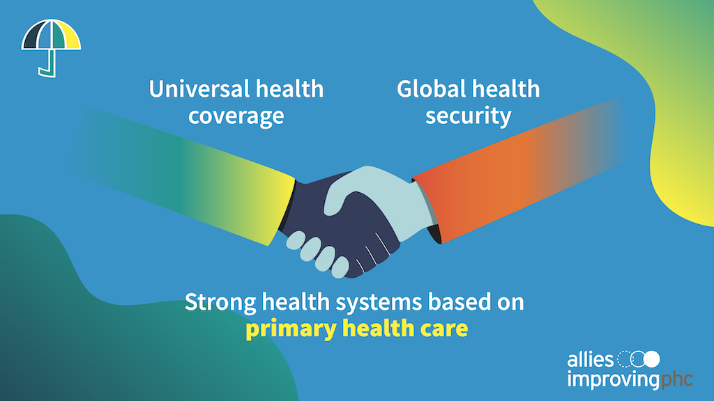
Notes:
You all know this all too well, but some of the biggest breakdowns we saw in health systems during COVID and long before happened at the primary health care level.
INTEGRATION/COMPREHENSIVENESS --- QUALITY / TRUST --- PROACTIVE APPROACH --- MOST EQUITABLE PATH
Strong primary health care can meet the vast majority of people’s diverse health needs across a lifetime.
- promoting healthy behaviors and routine check-ups
- preventing disease and injuries
- providing and coordinating any curative, rehabilitative, and palliative care that people need.
In the face of a crisis like COVID-19, frontlines of epidemic response:
- ensuring people get tested and vaccinated
- supporting contact tracing and information sharing
- helping people manage short- and long-term symptoms.
***Health workers in primary health care settings are more likely to know the unique needs and context of the community, and can build long-term relationships with people they serve.
Strong primary health care also makes the health system more resilient. Even in an emergency, people need other essential health services—including for maternal or newborn health, sexual and reproductive health, non-communicable diseases and more—to continue without disruption. We’ve missed so many opportunities during COVID by not integrating in other essential health care or establishing a touch point for future health needs.
Basic recap of key PHC functions:
-

Slide 3
How services are delivered matters.
But it’s often an afterthought.
Notes:
Availability just the beginning – must be accessible, integrated, people-centered and good quality in every community.
- People-centered, tell the anecdote about needing to treat people’s headache for them to come back

Slide 4

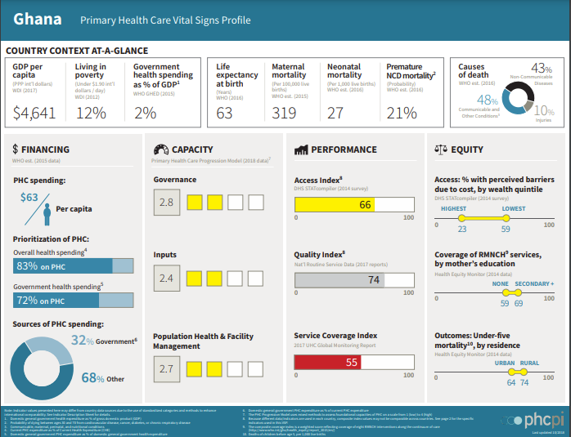
Notes:
But even where there is political will, too many leaders are forced to make tough decisions about their health system in the dark – with little to no information on where primary health care is strong or weak.
PHCPI origin story

Slide 5
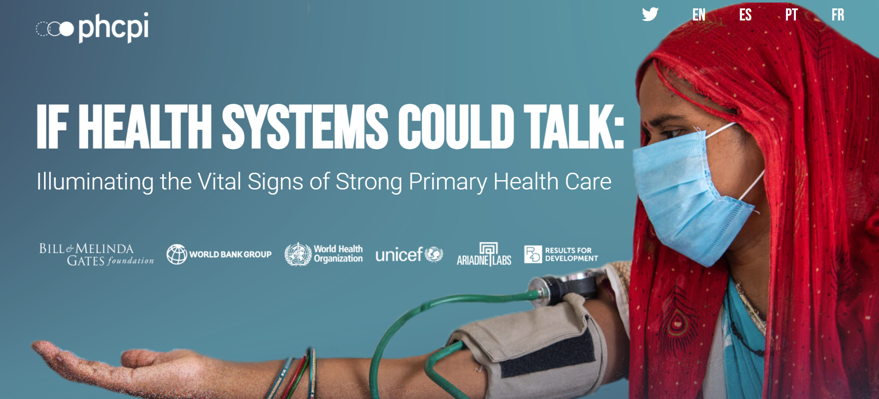
PHCVitalSigns.org
Notes:
Transition to live website at this point, and can talk through the high-level takeaways from each section; any points of particular interest to watch going forward.
Plus your ‘what’s next’ for data section.
Financing: Area to watch – exciting things happening but still a ton of question marks that need filling. How much money, where it’s going, if it’s paying off. Big priority for PHCPI / Allies Improving PHC is to call for greater attention to measuring PHC Financing and calling for greater proportion of health spending going to PHC as a start. (THIS HAS BEEN GROUPED INTO THE NEXT PILLAR FOR VSP 2.0 – it’s an element of capacity).
Capacity: We now know it’s possible to measure this now! And while our sample size of 23 countries made it hard to draw any statistically significant results, interesting and not that surprising to see trends of areas of capacity that have been historically prioritized (surveillance, inputs) doing a lot better than areas that require long-term relationship building, population health outreach, etc.
Performance: Access, Coverage, Quality. (And in VSP 2.0 – moved coverage to impact pillar, added management of services). Big thing to watch: QUALITY QUALITY QUALITY. PHC 5 Cs moment.
Equity: Can’t use just a single measure; equity is not a one-and-done result. Need to count everyone and examine from multiple angle to be really sure you’re not leaving anyone behind.

Slide 6
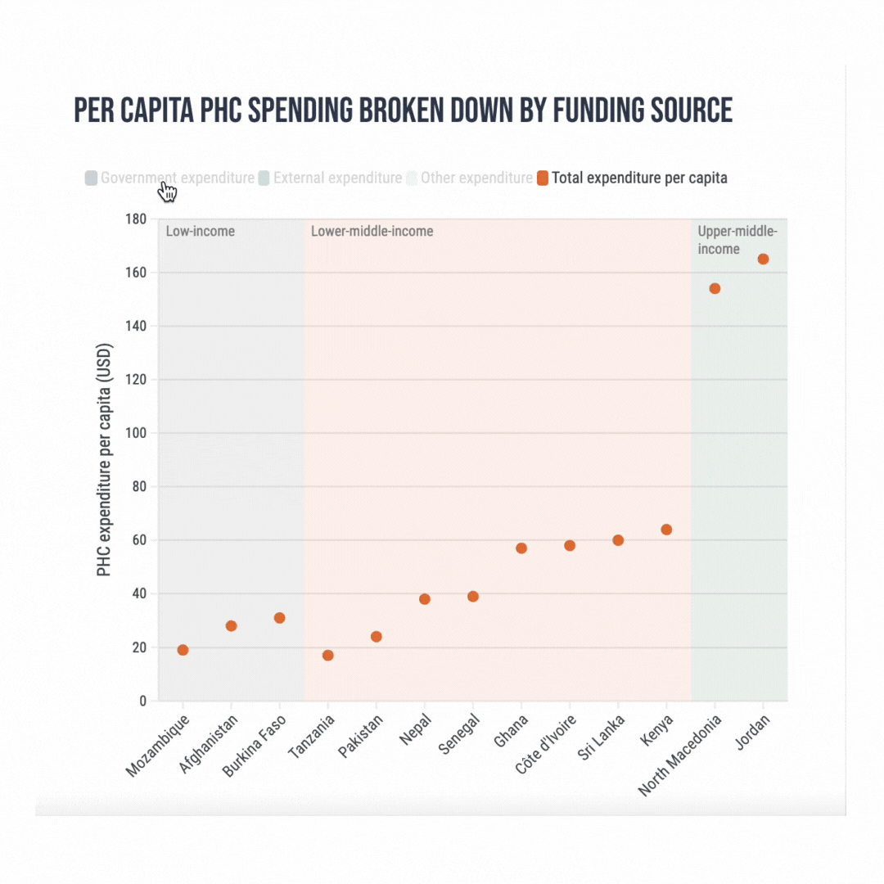
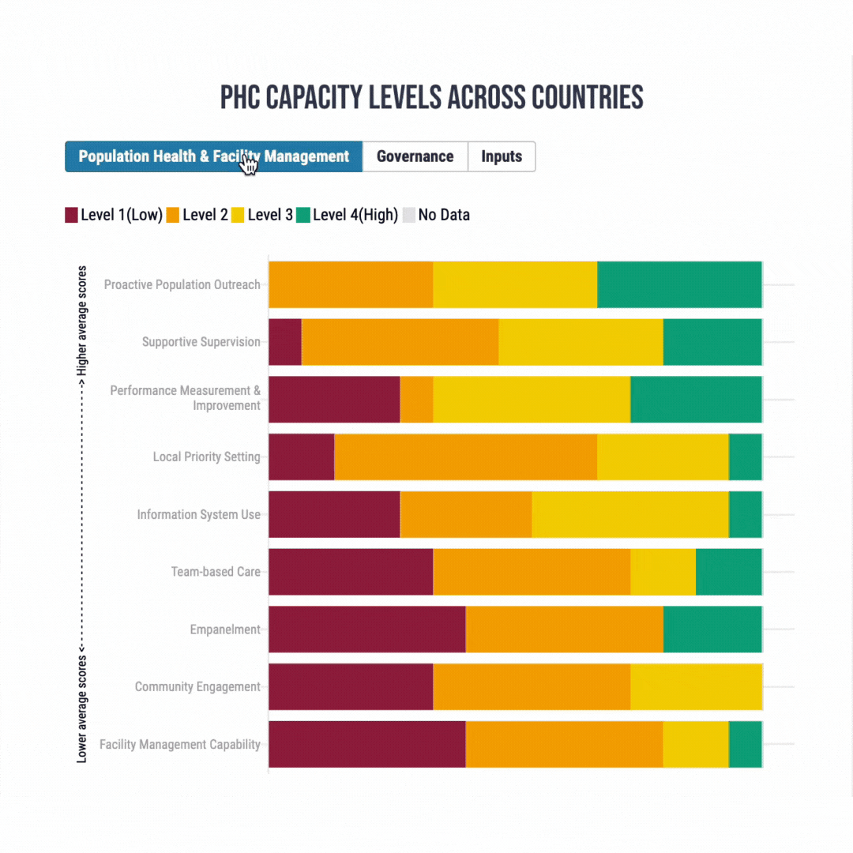
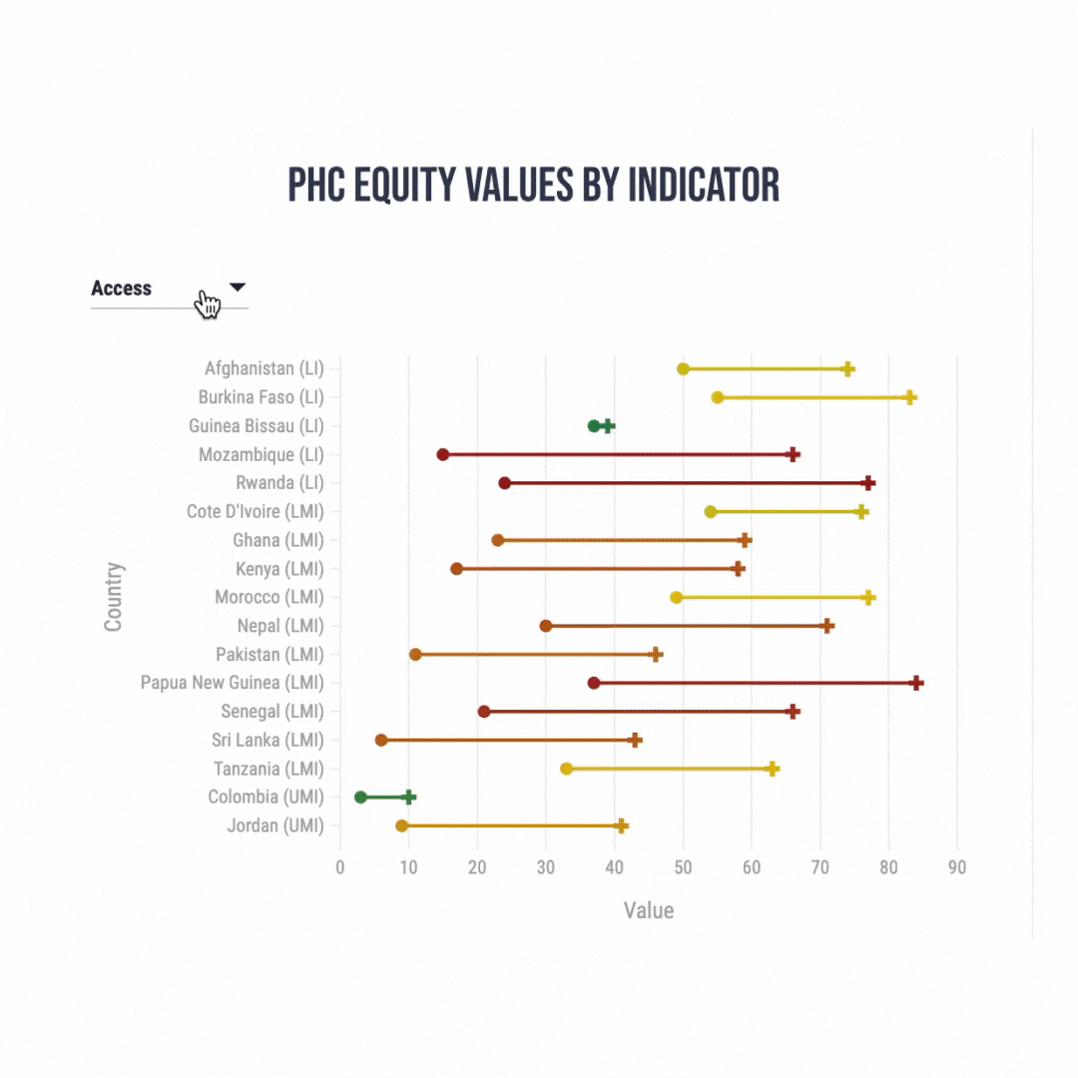
PHCVitalSigns.org

Slide 7
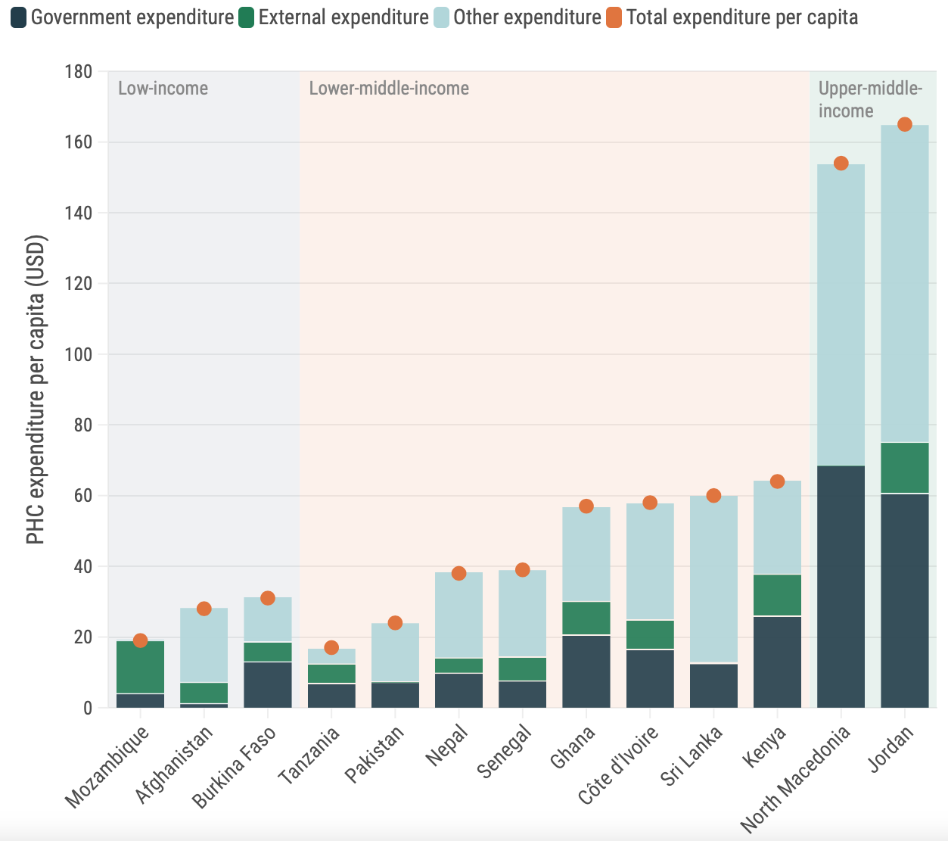
Per capita PHC spending by funding source
Financing
Less than half of PHC spending comes from government sources in LMICs
Out-of-pocket spending thus comprised a substantial portion of other sources of funding for PHC
Efforts to strengthen PHC financing cannot focus solely on increasing overall spending
Leaders need more and better information on PHC-specific financing to have a clearer picture of where funds are coming from
Notes:
Financing
Ensure country mechanisms for standardizing, collecting, analyzing and reporting PHC Financing data are fit-for-purpose and focus on PHC
Even with the Lancet Commission, there still isn’t sufficient detail in the data to set a target.
We do know government investment isn’t enough to protect people from financial harm in relation to health.
Less than half of PHC spending comes from govt sources in LMICs
As a result, OOP spending likely makes up the majority of other funding for PHC
Existing data lacks the detail to determine where and how these dollars are being spent on PHC, and if that spending is effective.

Slide 8
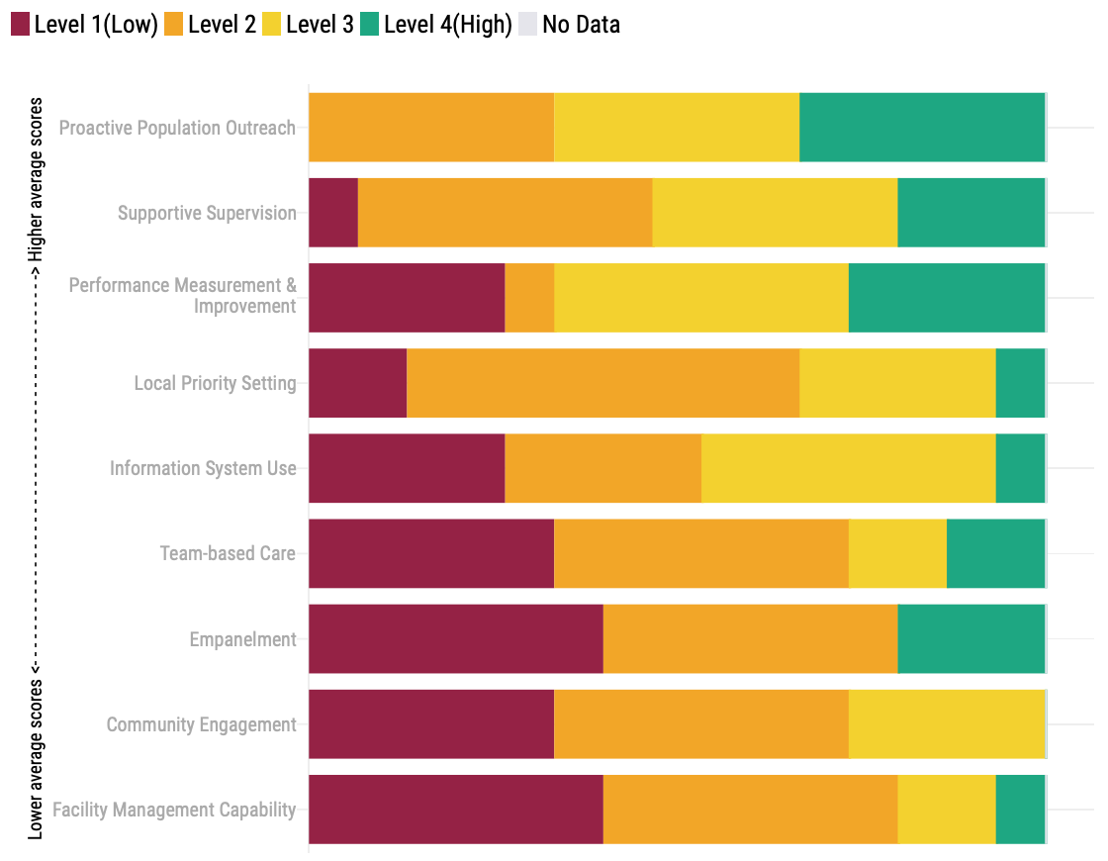
Population Health & Facility Management
Capacity
Notes:
Capacity: Health system measurement should be led and driven by the people and communities it is intended to help
Progression Model assessments should that capacity for Population Health & Facility Management including community engagement and social accountability remains quite poor in many countries,

Slide 9
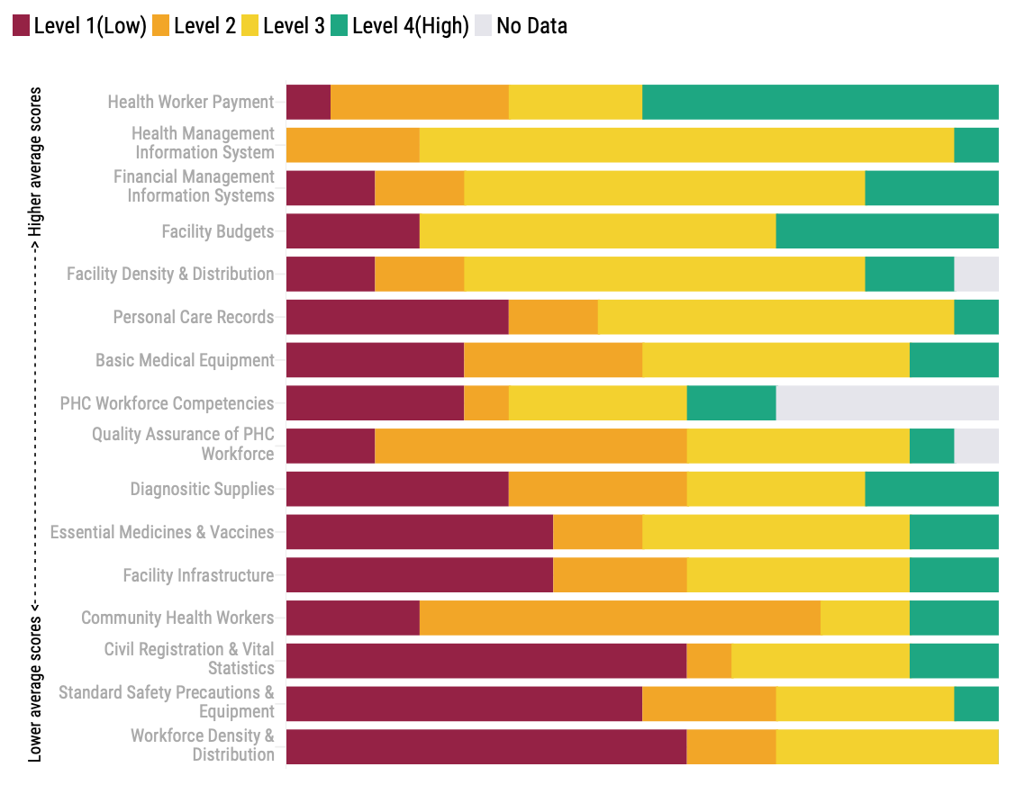
Capacity
Inputs
Notes:
Inputs such as human resources for health, safety precautions and vital statistics, facilities, diagnostics, essential medicines and vaccines are all often critically low.

Slide 10
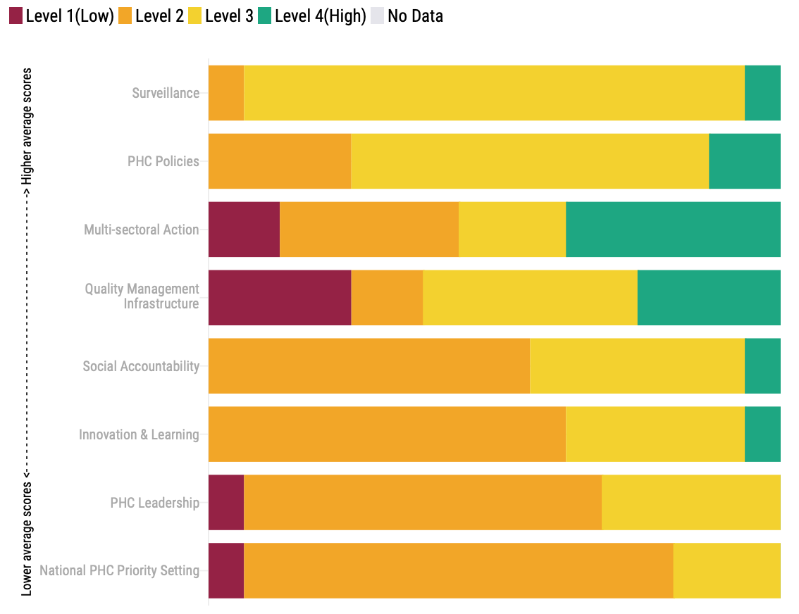
Capacity
Governance

Slide 11
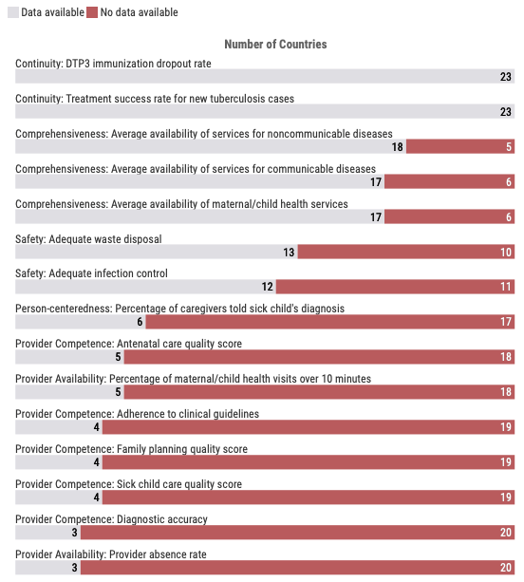
Data Gaps in Quality
Performance
Access
Coverage
Quality
Data gaps in quality
Notes:
Overall room for improvement (not shown)
Access is variable and nearly a third of people report substantial barriers, financial >geography
Major deficits in Quality and probably worse than data shows due to data gaps
Barely over half of all people across VSP countries received necessary or recommended services
the best performing country barely topped 70%
these measures do not consider effective service coverage (need, use & quality – see above)
Missing Data
Missing performance data poses a major obstacle to ensuring strong, equitable PHC

Slide 12
PHC Equity Values by Indicator - Access
Equity
Notes:
Equity must be front and center in all health system measurements, especially for PHC
Disparities across diverse areas – financial barriers, coverage of MCH services, and under 5 mortality – and an assortment of social determinants such as wealth, gender, education and location – were varied but significant across all countries, with wide-ranging profiles from country to country, proving targeted solutions for one inequity will not necessarily provide improvements for another.

Slide 13
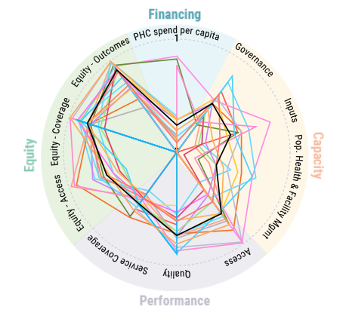
Every Country Has a Unique Fingerprint
Notes:
Each country has a unique fingerprint for it’s progress on strengthening PHC. This is a spiderplot showing the 23 countries with VSPs and how they are performing in the various pillars, domains and subdomain areas.
Overall
We can define and examine the strength of PHC in a rigorous, standardized way – and so now we need to move forward with action – while prioritizing further collection of PHC data in a standardized way to monitor our progress
While the direction is usually the same, the precise best approach to get there will differ significantly from country to country based on their existing PHC profile - every country’s path to strong PHC should be tailored to maximize local resources and impact
We still need more and better PHC data on a global and sub-national scale

Slide 14
World Bank PHC Flagship Report
Seeks to advance deeper collaboration across the GAP collaborators, the wider community of bilateral and multilateral agencies, foundations and CSOs as well as within the World Bank Group Building through broad collaborative alliances such as PHCPI focused on:
  Protecting human capital within a multisectoral architecture including OneHealth
  Raising the profile of PHC in World Bank lending
  Four categories of strategies:
    Personalized care coordination (shift from gatekeeping)
    People-centered integration (shift from fragmentation)
    PHC essential service package with measured outcomes (shift from inequities and lack of accountability)
    Public health surveillance and outreach capacity (shift from fragility)
  Requires:
    PHC teams w internal collaboration and communication
    Responsive care
    Coordination and continuity across health system and communities
  Uses:
    Reformed interprofessional education focused on competencies
    Financing from general government revenue
    Integrated health information and coordination systems
    Explicitly defined PHC service packages
    Upfront investments and routine operations
https://www.worldbank.org/en/topic/health/publication/walking-the-walk-reimagining-primary-health-care-after-covid-19-a-health-nutrition-and-population-global-practice-flagsh
Notes:
What they need is your recommendations on HOW to most effectively invest in the workfroce

Slide 15
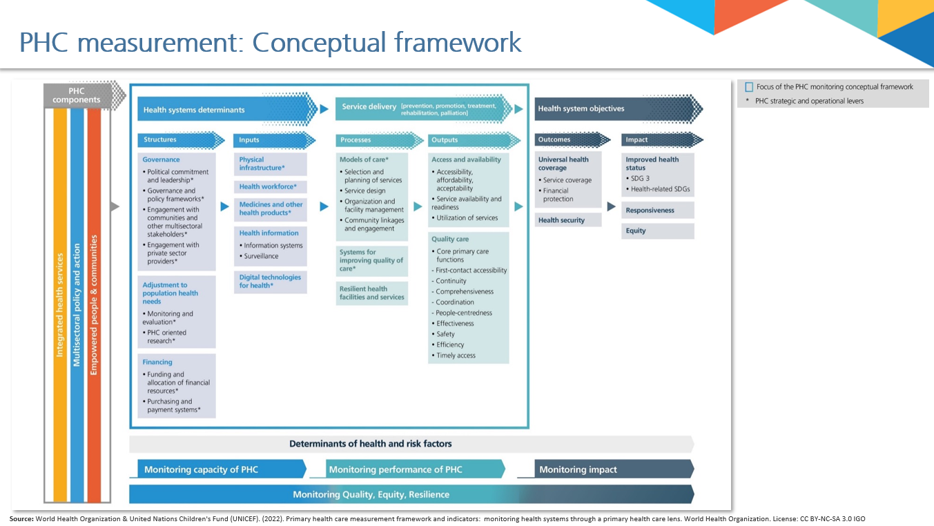
Notes:
Draw from PHCME launch TPs

Slide 16
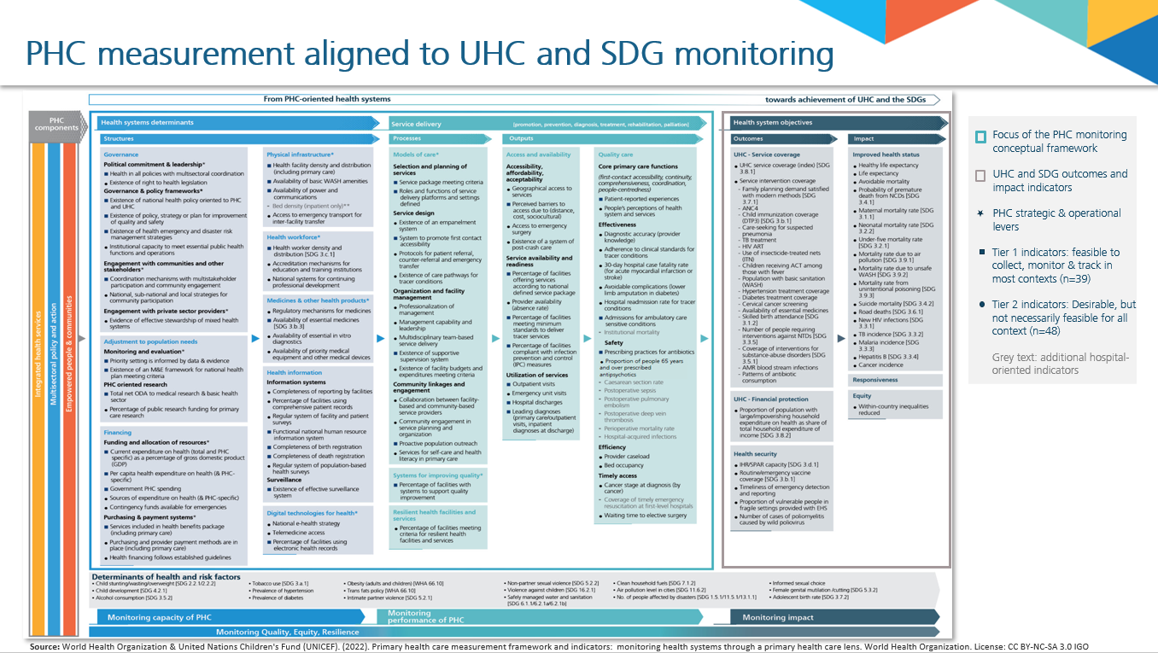

Slide 17
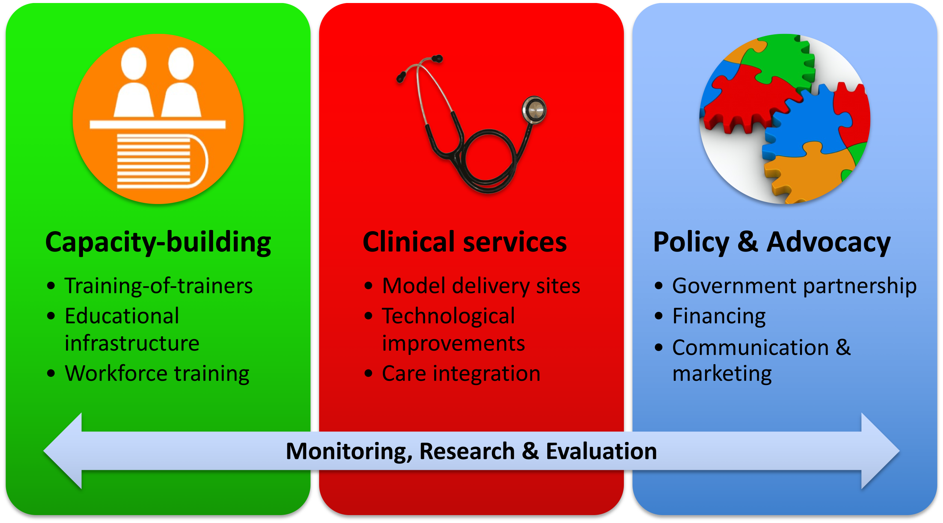
Our Approach to Primary Care
System Strengthening

Slide 18
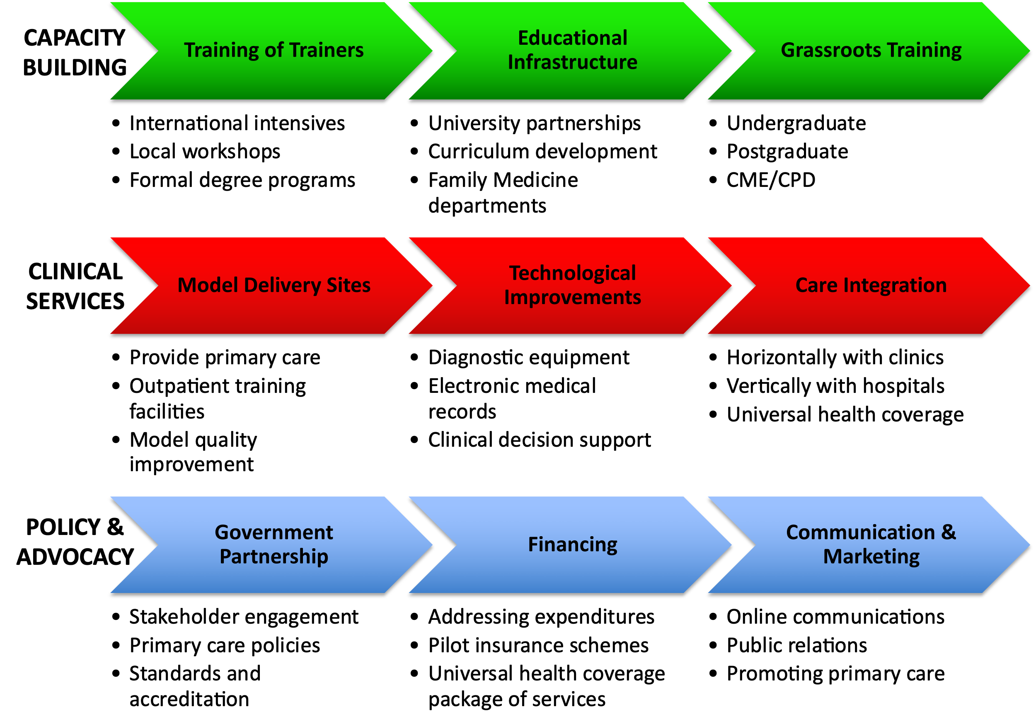

Slide 19
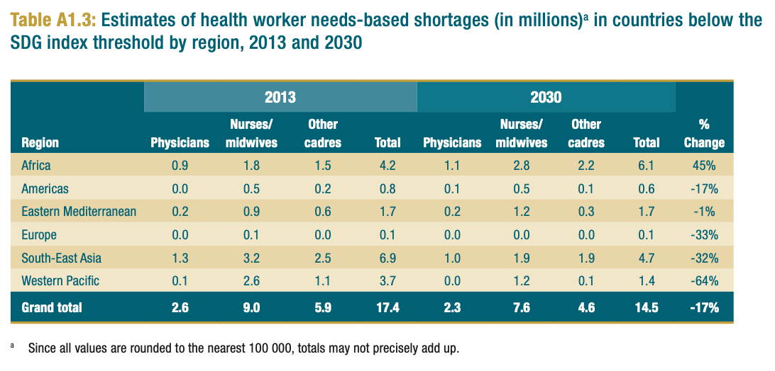
Workforce Needs
Global Strategy on Human Resources for Health: Workforce 2030, WHO

Slide 20
Consider adding Recommendations
  Investment in building a strong foundation for the PHC workforce using the following principles:
    CHWs should professionalized and remunerated in all countries in Africa
    Complete and robust pre-service and in-service educational, training and credentialing infrastructture should be in place to build up and implement effective PHC teams capable of providing strong high-quality PHC including:
      A strong and supported medical discipline (i.e. family medicine/GP) committed to comprehensive primary health care as its focus without limitations in regards to age, gender, problem or disease complete with the identical educational, training and accreditation systems of all other medical workforce disciplines in the country
      A professional pathway to strengthen competency of and support for advanced practice providers specifically in relation to comprehensive PHC
      A commitment to having both CHWs and skilled birth attendants/midwives fully integrated with and backed up by PHC teams
      Dedicated training on principles of delivering high quality PHC for nurses, midwives, pharmacists and all other members of the PHC team
      Development and implementation of a core curriculum for CHWs on comprehensive PHC
    Supportive supervision is implemented specifically in support of interprofessional PHC teams dedicated to comprehensive PHC service delivery
    Developing empanelment systems to ensure all people in all communities have access to a fully equipped and staffed PHC team
      Set targets here? i.e. one CHW per 500 population, one family doc per 2500 population - I think these numbers might have some evidence behind them, but whatever you think for Africa - maybe even incremental targets (immediate target, medium term, and fully aspirational?) on the way to addressing the massive health workforce shortage in Africa over the next decades

Slide 21
Consider adding Recommendations
  Recommendations on HOW to do this – how to build, how to integrate the PHC team? For instance:
    Invest in pre- and in-service training
    Build model training programs and services
    Develop supportive policies for incentivizing and raising the stature of the PHC workforce

