Slide 1
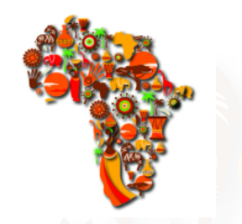
Integrating oral health care in primary health care
DR.ANBAR GANATRA
BDS(MANIPAL, INDIA), MIPH/MHM(UNSW, AUSTRALIA)

Slide 2
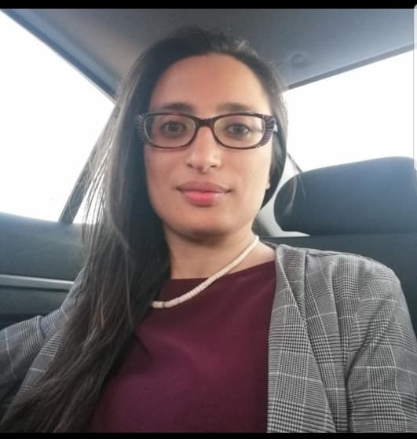

BRIEF BIO
BDS (MANIPAL,2010)
GENERAL DENTIST – 2013-2016
DUAL MASTERS IN INTERNATIONAL PUBLIC HEALTH AND HEALTH MANAGEMENT- UNSW
SCMOH – GATUNDU SOUTH , KIAMBU COUNTY
COUNTY DENTIST- KIAMBU COUNTY
COUNCIL MEMBER: KENYA DENTAL ASSOCIATION
PASSION: POLICY, ADVOCACY , AND PRIMARY HEALTH CARE
Contact : dr.anbarganatra@gmail.com
+254706480001

Slide 3
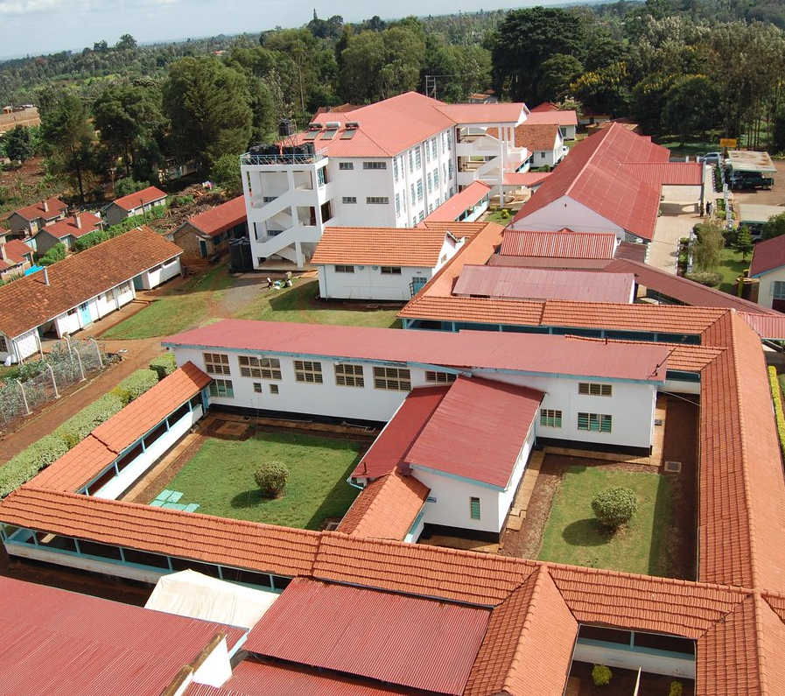
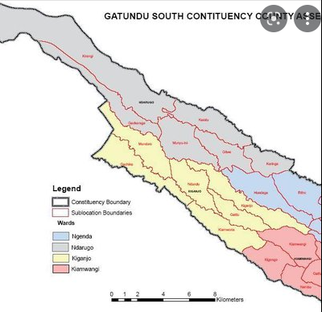

FROM CLINICIAN TO PRIMARY HEALTH MANAGER:

Slide 4
OBJECTIVES
Define Oral Health, Primary Health Care and Universal Health Care
Understand the oral disease burden worldwide, In Africa and in Kenya
Why Integrate Oral Health Care into Primary Health Care: Linking prevalence to availability of care.
Policy documents in Place for oral Health care and Primary Health care
Where are we at? Situational Analysis: Kenya, Is it the Same in Africa?
Challenges, barriers and Opportunities? Is it a lack of Policy or Policy Implementation?

Slide 5
What is universal health coverage
Target 3.8 of the Sustainable Development Goals
Universal health coverage means that all people have access to the health services they need, when and where they need them, without financial hardship. It includes the full range of essential health services, from health promotion to prevention, treatment, rehabilitation, and palliative care.
The Alma Ata 1978- Health For All declaration- identified PHC as a means to achieve HFA

Slide 6
What is primary health care
essential health care made accessible to individuals and families in the community, by means acceptable to them, through their full participation and at a cost that the community and the country can afford. It forms an integrated part of the country's health care system, of which it is the nucleus, and of the overall social and economic development of the country (WHO, 1978)
Primary health care (PHC) is the first level of contact for individuals, the family, and the community with the national health system and “addresses the main health problems in the community, providing health promotion, preventive, curative and rehabilitative services accordingly.”

Slide 7
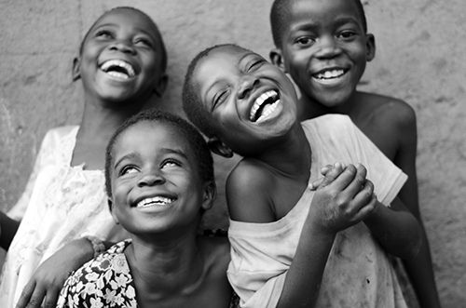
What is oral health
Defined as:
“a state of being free from mouth and facial pain, oral diseases and disorders that limit an individual’s capacity in biting, chewing, smiling, speaking and psychosocial well-being”
(WHO)

Slide 8
THE COMMON ORAL DISEASES:
Oral diseases are considered as one of the most common And Preventable Non- Communicable diseases (FDI)
1. Dental Caries- A silent epidemic
2. Gum disease
3. Oral Cancers
4. Oral Manifestations of HIV
5. Oro- dental trauma
6. Cleft lip and Palate

Slide 9
Oral diseases cause:
Pain
Disfigurement
Social Isolation
Distress
Even Death
Affect quality of life.
And the treatment of oral diseases place an economic burden on individuals.

Slide 10
Therefore:
Oral health is imperative to the general Health and Well-Being of Individuals.
Oral Health care forms an integral part of UHC
As health care workers , we all play a role in improving the oral health of the communities we serve.

Slide 11
GLOBAL BURDEN OF oral DISEASE
Findings From the Global Burden of Diseases, Injuries and Risk Factors Study (2010)
Untreated dental caries in permanent teeth: was the most prevalent condition, (out of 291 conditions)with a global prevalence of 35%.
Severe Periodontitis- 6th most prevalent condition world wide
Untreated dental carries in milk teeth- 10th most prevalent condition world wide

Slide 12
Global burden of disease study 2017- funded by bill and Melinda gates
Studied Non-Fatal Burden of disease or rather non fatal health loss- takes into account the incidence prevalence and years lived with disability for 354 causes in 195 countries
Aim was to study the health loss and challenge health inequities. Life expectancy has improved, has Quality adjusted life year
Globally – Oral disorders are among the top three (3.07 Billion), TB (1.93 Billion)
What is interesting is that Oral disorders remained unchanged between 1990 to 2017 as the top most prevalent condition and the prevalence increased by 21%

Slide 13
Global burden of disease 2019
oral diseases affect close to 3.5 billion people worldwide,
with caries of permanent teeth being the most common condition.
Globally, it is estimated that 2 billion people suffer from caries of permanent teeth and
520 million children suffer from caries of primary teeth

Slide 14
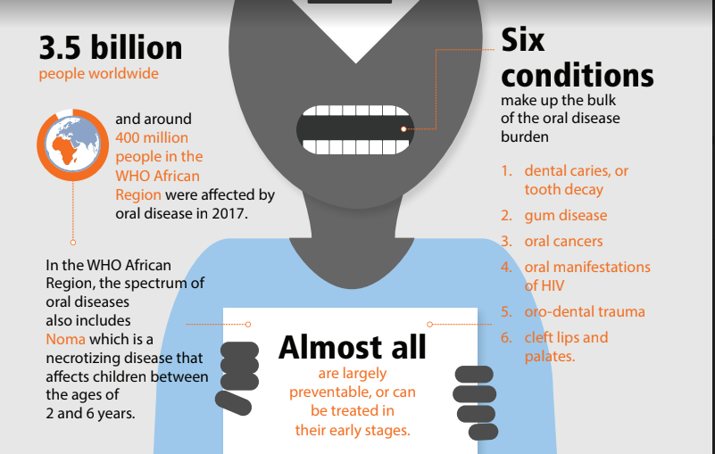
UNDERSTANDING THE BURDEN OF ORAL DISEASES in africa

Slide 15
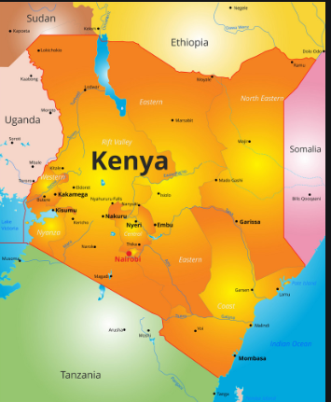
ORAL DISEASE BURDEN IN KENYA
Based on The First Kenya National Oral Health Survey conducted in 2015:
Caries Prevalence in Children is 23.9%
Caries Prevalence In adults is: 34.3%
Gum disease in adults: 98.1%

Slide 16
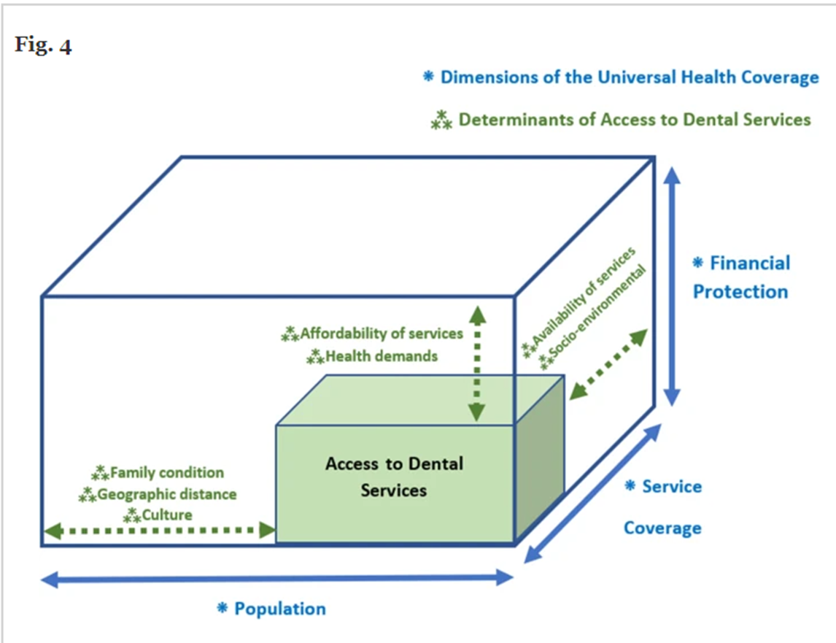
Oral health care worldwide
Access to Oral Health Care Varies in High Income Countries and Low Income Countries
Access is 35% In Low Income Countries, 60% In lower Middle income Countries and Up to 82% in High Income Countries
Access is determined by factors such as: Human resource, Infrastructure, Financial barriers such as Out of Pocket expenses

Slide 17
Human resource
No. of dentists to population ratio varies from country to country, and also within a country from urban to rural areas.
Australia: Number 1 dentist: 1700
Africa: 1 dentist: 150,000 population
USA: 1 dentist to 1600 population
OR Africa has 3.3 dentists per 100,000 population in comparison to the developed world that has 32.8 dentists per 100,000 population

Slide 18
Cost of oral health care
Majority of dental services are Out of Pocket Expenses
In Europe, oral health care cost 90 Billion, that is more than cancer related costs of 86 billion Euros
In USA 111 billion is used in restorative dentistry

Slide 19
ORAL health care in kenya
Kenya Population: 51.3 million
Number of dentists retained as of 2019: 842
Ratio: 1:60,000
Communuty oral health officers 1:2000
Uneven distribution between rural and urban areas
Basic Oral Health care Package : covers extractions mainly, access and availability?
Mainly out of pocket expenditure

Slide 20
WHY INTEGRATE ORAL HEALTH INTO PRIMARY HEALTH CARE?
As suggested by W.H.O, there is need to increase focus on oral health through health promotion and disease prevention.
Limited access to oral health care- Need to integrate into PHC

Slide 21
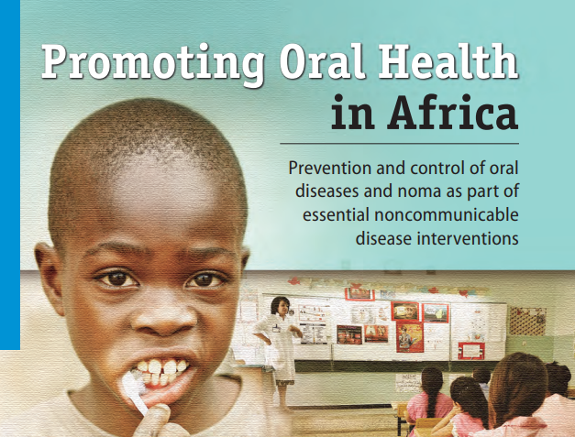
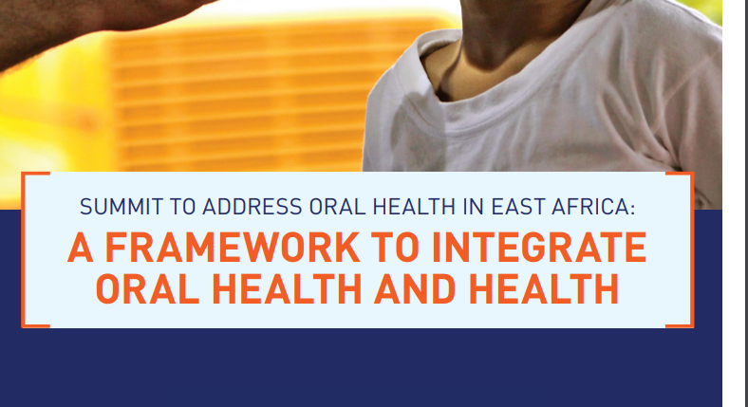
IS IT A NEW CONCEPT
In 2009, at the WHO 7th Global Conference- integration of Dental care Into Primary Health Care
In 2016- Package of Essential Services forNCD interventions in Primary Health care
The Common Risk Factor Approach

Slide 22
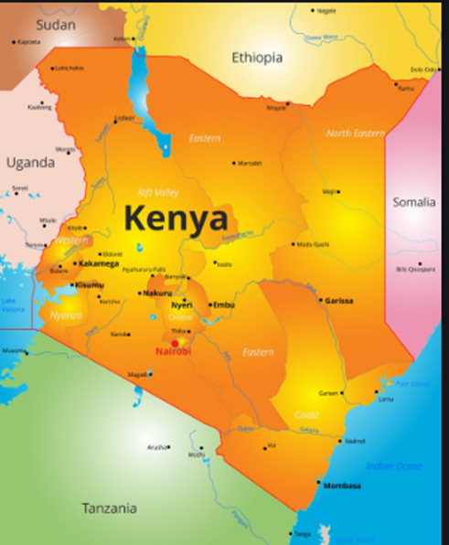
Where are we at?
Primary Health Care?
Oral Primary Health Care
The African Continent has 25% of global disease burden, 3% of the world’s health workers and 1% of the World’s Health Expenditre

Slide 23
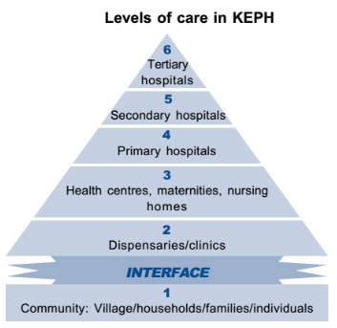
LEVELS OF CARE : KENYA
Majority Of Oral Health care services:
In secondary and tertiary Hospitals
Private> Public Sector
How it should be- Ideal vs Reality

Slide 24
CHALLENGES AND OPPORTUNITIES FOR INTEGRATING ORAL HEALTH INTO PHC
At individual level- Fear, Anxiety, Oral Health Seeking barriers
At Meso Level- Availability of dental services, transport.
At macro level- Oral Health Overlooked in policies, Eg NCD policy . Value of sugar tax as a sin tax, Africa still lags behind in implementation of sin taxes as a continent- tobacco tax .
Challenges of Primary Health Care itself

Slide 26
LEADERSHIP and governance IN ORAL HEALTHCARE
Silo Effect
Majority of dentists- clinical Practice
Lack of governance structures in place for oral health sector
Oral Health Policy- Not translated into action?- Political Influence, Health is mostly political in the Kenyan Context
Kenya- 47 counties
Overall Political Neglect Internationally
Lack of supportive supervision, managerial leadership At PHC level
Opportunity: New draft Policy 2021-2030 (Kenya)has givernance structures in place for County and National Government , requires implementation
More involvement of dentists in oral health advocacy
Need for African Continent to lead in oral health integration in PHC

Slide 27
FINANCING IN ORAL HEALTH CARE AND PHC
Abuja Declaation: Allocate 15% of budget towards health
Primary Health care remains Under financed
Focus on curative health Sector
Oral health sector- receives negligible budget , 0.036% in Kenya in the year 2015 2016
PHC- donor dependent- vertical programs, fragment our health systems further
County health finance bill? Limiting? Replicated ?
Need for increased advocacy

Slide 28
Human resource-
Shortage of Oral Health Care workers
Attempts to address this shortage through the introduction of Community Oral Health Officers in Kenya, In South Africa the Dental Hygienists and Dental Technologists
General shortage in Health sector
Primary health care workers over worked, carry out several roles and adding on oral health
Community Health Volunteers- Lack of renumeration- ? Questionable sustainability
In South Africa, more dentists than dental hygienistsd and dental technicians- More focus on curative vs preventive and promotive
Training for primary health Workers: Being taken up by WHO And Harvard School of dental Medicine- with pilots to be launched soon

Slide 29
Health information
Lack of clear data, little research on oral health sector
No monitoring and evaluation of PEN
Lack of integration of oral health indicators in Health Information Systems
Invest in evidence based data
Monitoring and evaluation of programs in place

Slide 30
Way forward:
Health should be a priority of the African Continent- Increased investment and need for supervisory role
Integrate oral health programs into existing successful programs such as HIV, Malaria, and strengthen NCD programs with Oral Health, and ensure there is monitoring and evaluation
Commit to Primary health care for Universal Health care, with clear outputs
Understand the political influences that lead to policy implementation

Slide 31
REFERENCES:
Benzian H Hobdell M Holmgren C et al. Political priority of global oral health: an analysis of reasons for international neglect.Int Dent J. 2011; 61: 124-130
Crisp N. Global health capacity and workforce development: turning the world upside down. Infect Dis Clin North Am. 2011 Jun;25(2):359-67. doi: 10.1016/j.idc.2011.02.010. PMID: 21628051; PMCID: PMC7127544.
Ghanbarzadegan, A., Balasubramanian, M., Luzzi, L. et al. Inequality in dental services: a scoping review on the role of access toward achieving universal health coverage in oral health. BMC Oral Health 21, 404 (2021). https://doi.org/10.1186/s12903-021-01765-z
Mash R, Howe A, Olayemi O, et alReflections on family medicine and primary healthcare in sub-Saharan AfricaBMJ Global Health 2018;3:e000662.
Peres MA, Macpherson LMD, Weyant RJ, Daly B, Venturelli R, Mathur MR, Listl S, Celeste RK, Guarnizo-Herreño CC, Kearns C, Benzian H, Allison P, Watt RG. Oral diseases: a global public health challenge. Lancet. 2019 Jul 20;394(10194):249-260. doi: 10.1016/S0140-6736(19)31146-8. Erratum in: Lancet. 2019 Sep 21;394(10203):1010. PMID: 31327369.
R.G. Watt1 , B. Daly2 P. Allison3 L.M.D. Macpherson4, The Lancet Oral Health Series: Implications for Oral and Dental Research

Slide 32
BRIEF BIO
BDS (MANIPAL,2010)
GENERAL DENTIST – 2013-2016
DUAL MASTERS IN INTERNATIONAL PUBLIC HEALTH AND HEALTH MANAGEMENT- UNSW
SCMOH – GATUNDU SOUTH , KIAMBU COUNTY
COUNTY DENTIST- KIAMBU COUNTY
DIRECTOR- DENTCONNENCT CONSULTANCY
PASSION: POLICY, ADVOCACY , AND PRIMARY HEALTH CARE
Contact : dr.anbarganatra@gmail.com
+254706480001

Slide 33
Link to resources
https://www.researchgate.net/figure/Levels-of-health-care-delivery-in-the-Kenya-Package-of-Health-MoH-2004_fig2_279534243

