Slide 1
Approach to arthritis
Dr Sarah Swartbooi
14/10/21

Slide 2
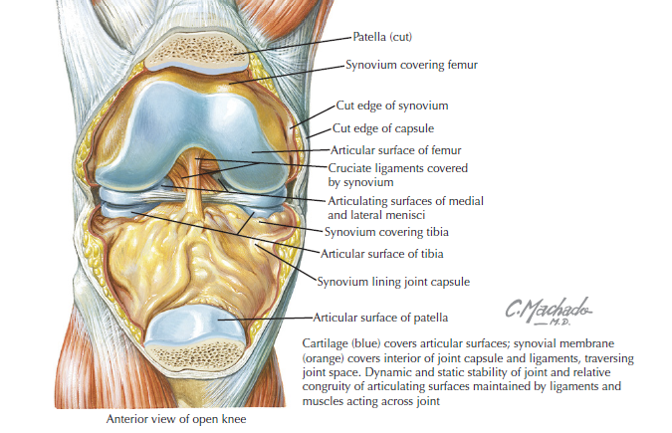

Slide 3
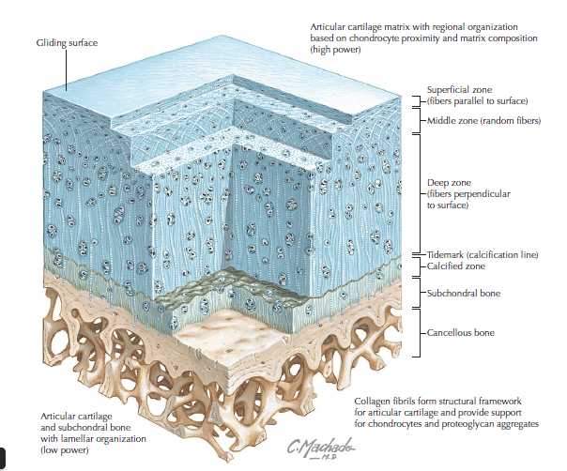

Slide 4
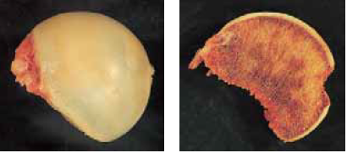

Slide 5
Arthritis
A chronic disorder characterized by
Softening and disintegration of articular cartilage
Associated reactive phenomena
  osteoblastic activity in the subarticular bone
  new growth of cartilage and bone (osteophytes) at the joint margins
  capsular fibrosis
  vascular congestion

Slide 6
Degenerative
Primary osteoarthritis
Secondary osteoarthritis
Inflammatory
Seropositive
Seronegative
Rheumatoid Arthritis
SLE
Spondyloarthropathy
Ankylosing Spondylosis
Psoriatic arthritis
Reiters syndrome
Trauma
Avascular Necrosis
Septic arthritis
Tuberculosis
Infection
Arthritis
Neuropathic Joint Disease
Crystal deposition arthropathy

Slide 7
Degenerative
Primary osteoarthritis
Secondary osteoarthritis
Post-traumatic
Avascular Necrosis
Haemophilia
Neuropathic Joint Disease

Slide 8
Inflammatory
Seropositive
Rheumatoid Arthritis
SLE
Seronegative
Spondyloarthropathy
Ankylosing Spondylosis
Psoriatic arthritis
Reiters syndrome
Infection
Septic arthritis
Tuberculosis
Gout
Pseudogout
Scleroderma
Inflammatory Bowel dx
Crystal deposition arthropathy

Slide 9
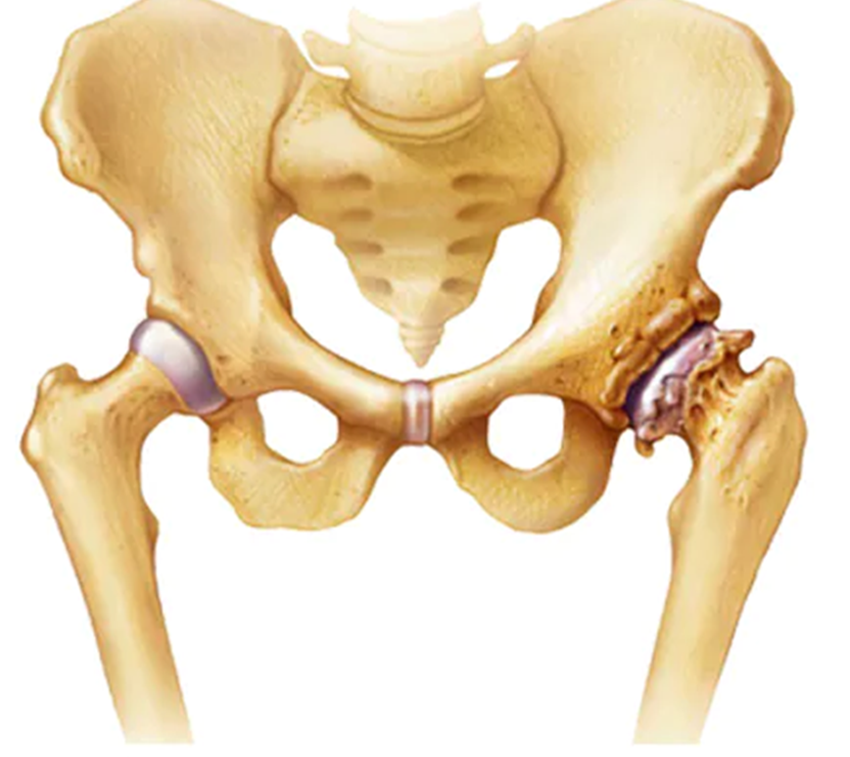
Osteoarthritis
Definition
  Degenerative joint disorder with progressive loss of articular cartilage
Incidence
  Most common joint disorder – universal disease
  Age: prevalence ↑ with age
  80% symptomatic > 75 years
Gender
  Male = female
  Females more symptomatic
Site
  hip, knee, spine most commonly involved

Slide 10
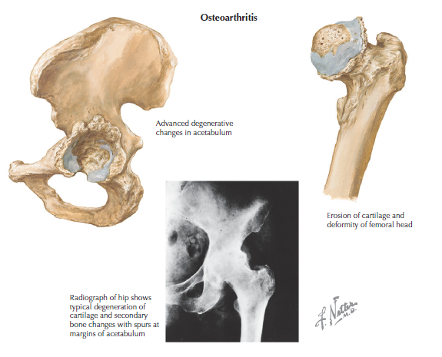
Risk factors
Systemic predisposition
  • Genetics
  • Age
  • Gender
  • Diet and obesity
Local biomechanical factors
  • Abnormal joint shape and size
  • Previous injury
  • Neuromuscular problems
  • Obesity
  • Loading/occupational factors
Bone mineral density

Slide 11
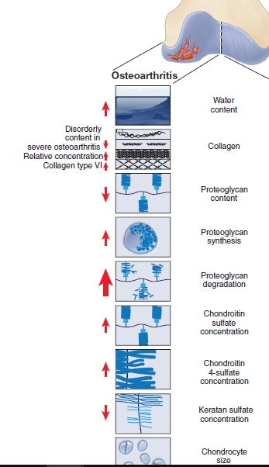
Pathophysiology
Articular cartilage
  Increased water content
  subsequent decrease in modulus of elasticity
  Increased proteoglycan content
  Disrupted collagen orientation and organisation
Synovium and joint capsule
  Becomes inflamed and thickened
  Increased vascularity of synovium
Bone
  Subchondral bone attempts to remodel
    Lytic lesions with sclerotic edges form
  Osteophyte formation

Slide 12
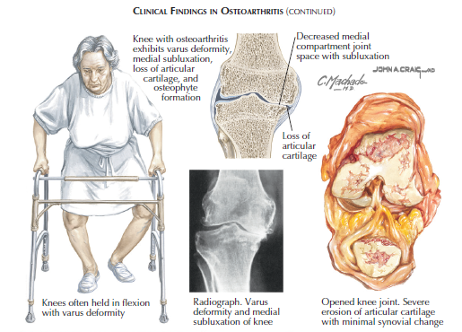

Slide 13
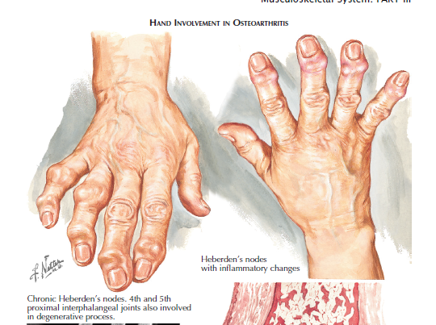

Slide 14
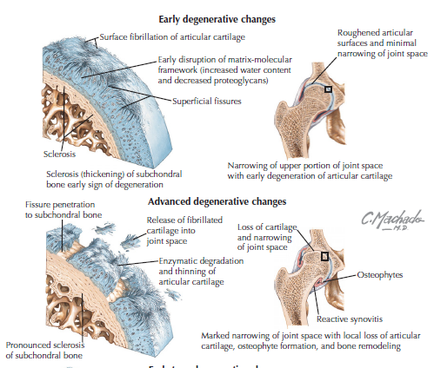

Slide 15
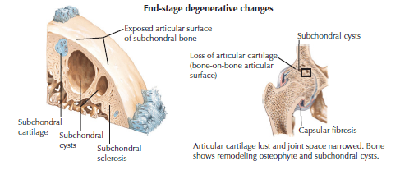

Slide 16
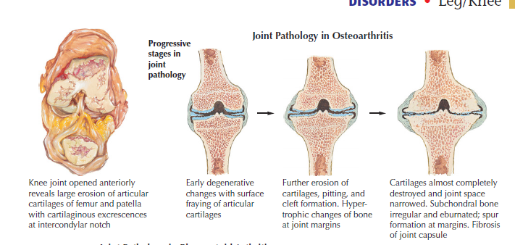

Slide 17
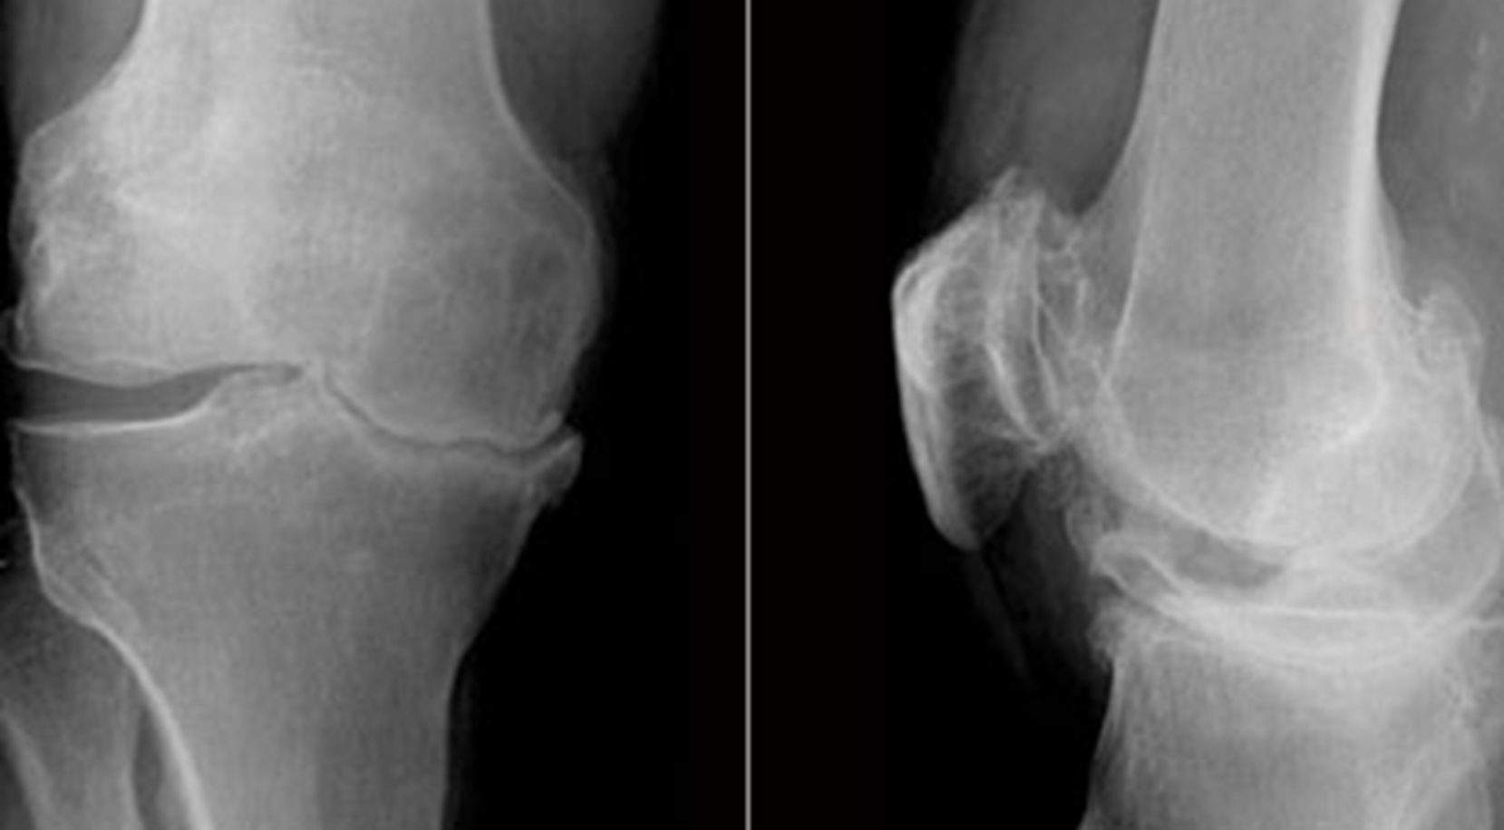

Slide 18
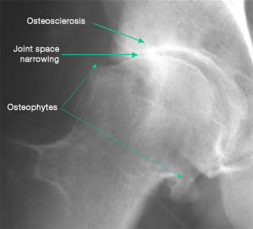
Radiographs
Degenerative
Joint Space Narrowing
Subchondral sclerosis
Osteophytes
Subchondral cysts

Slide 19
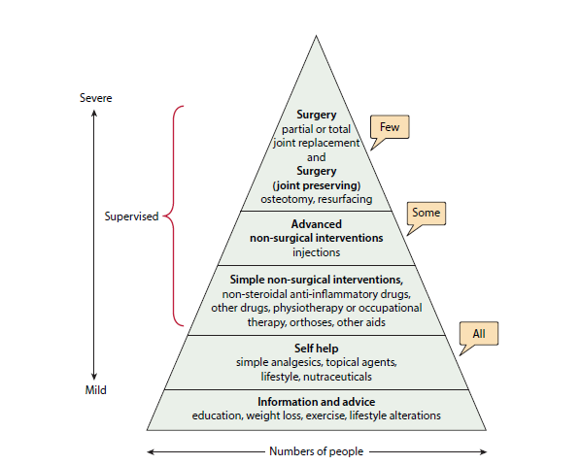
Treatment
Non operative
  NSAIDS + Tramal
  Walking stick
  Weight loss
  PT and activity modification
  Exercise program
  Intra articular corticosteroids

Slide 20
Treatment
0perative
  Arthroscopic debridement
  Osteotomies
  Hip resurfacing
  THR
  Femoral head resection ; girdle stone

Slide 21
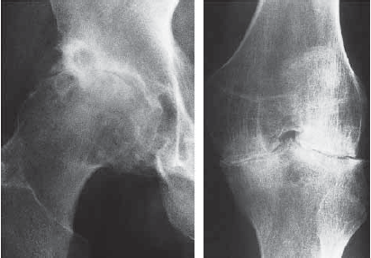
Rheumatoid Arthritis
Definition
  autoimmune disease caused by cell-mediated immune response against soft tissues, cartilage, and bone
Incidence
  Most common form of inflammatory arthritis
  Global prevalence of RA 1-3%
  South African prevalence estimated at 1%
Gender
  Male: Female 1:3
Site
  Small joints of hands and feet
  most commonly initially involved

Slide 22
Pathophysiology of RA
Inflammatory response predominantly in synovial tissues
Synovial inflammation results in synovial hypertrophy and pannus formation
Synovial Pannus is characterised histologically by:
  new vessel formation
  cellular and molecular components of the immune response
  synovial fibroblasts
  destruction of adjacent cartilage and bone

Slide 23
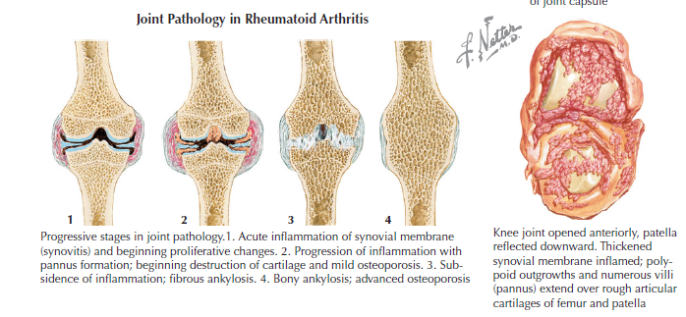

Slide 24
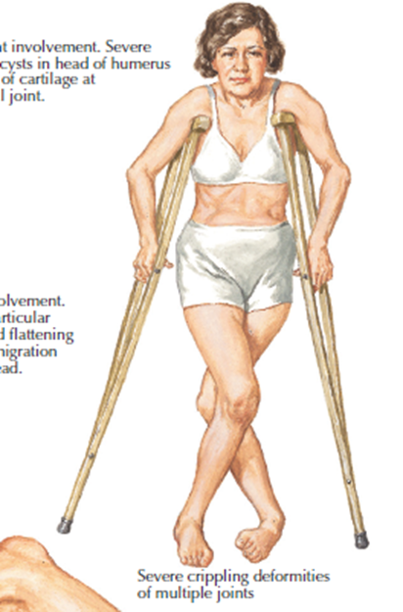
Clinical Presentation
Insidious subacute onset over 6 weeks
Fatigue, malaise, anaemia
Morning stiffness
Polyarthritis with
Swelling

Slide 25
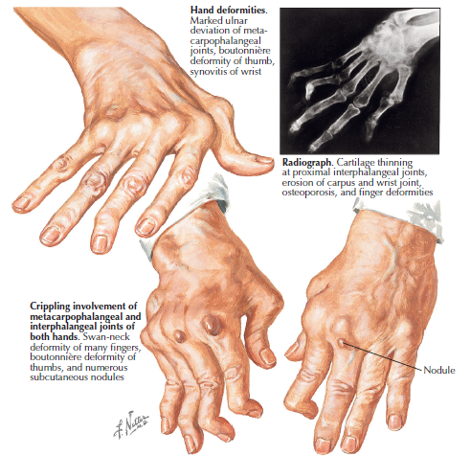

Slide 26
Extra Articular Manifestations
Organ/System | Manifestation
Skin/Soft Tissue | Rheumatoid Nodules Ulcers
Occular | Keratoconjunctivitis Episcleritis
Oral | Sjogren’s Syndrome
CNS | Peripheral Neuropathy
CVS | Pericarditis Vasculitis (inc risk of MI, CVA) Atherosclerosis
RESP | Interstitial Lung Disease Pulmonary Fibrosis
Haematological | Anaemia Neutropenia Thrombocytopenia Thrombocytosis Lymphoma

Slide 27
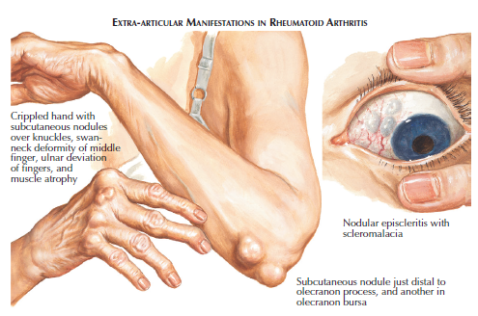

Slide 28
Diagnostic Assessment

Slide 29
American College of Rheumatology Diagnostic Criteria (1987)
1. Morning stiffness lasting minimum 60min
2. Arthritis of three or more joint areas
3. Arthritis of hand joints
4. Symmetrical arthritis
5. Rheumatoid nodules
6. Serum rheumatoid factor positive
7. Radiographic changes: peri-articular osteopaenia, marginal erosions
*1-4 must be present for at least 6weeks
*4 of 7 criteria over 6month period

Slide 30
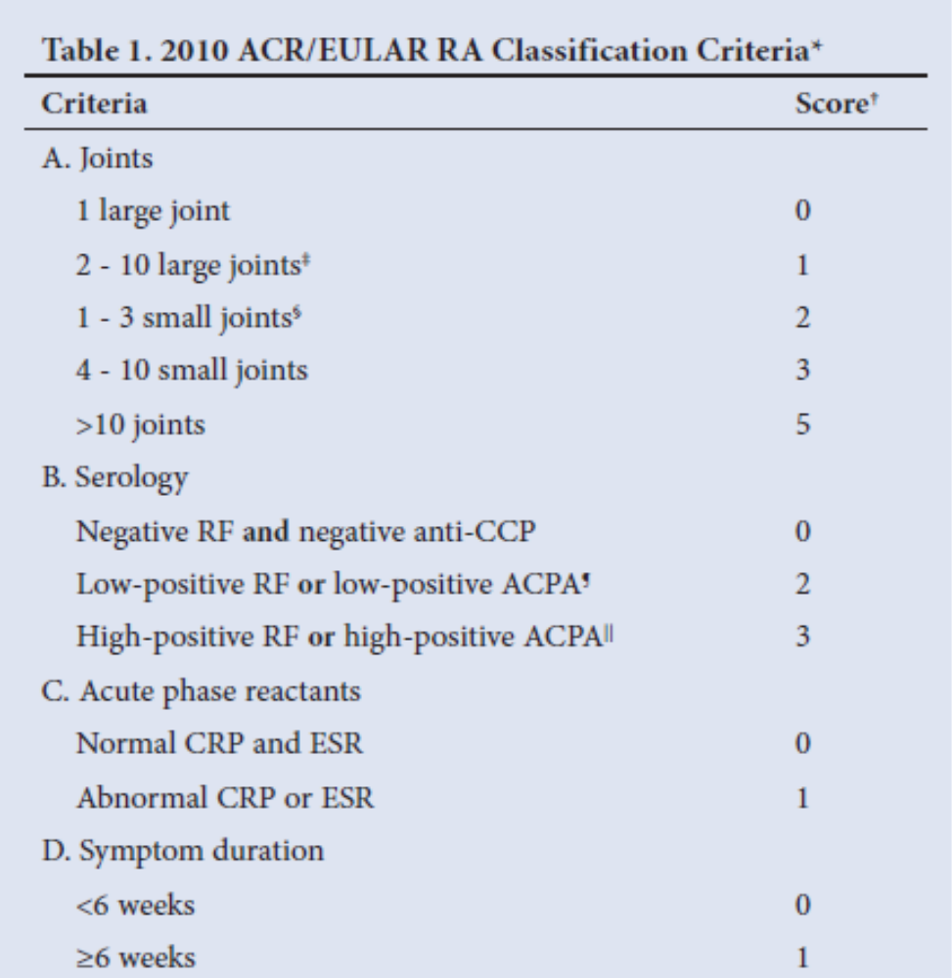
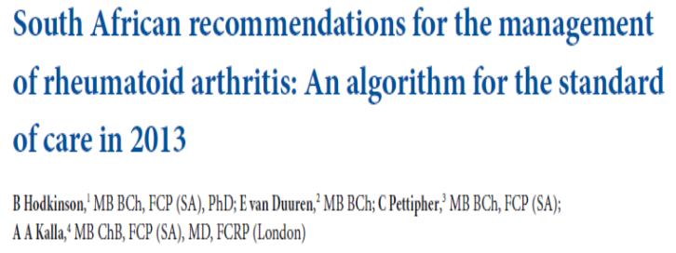
ACR/EULAR (2010) RA CRITERIA
SUM OF SCORE FOR CATEGORIES A-D IS 6 OR MORE PATIENT CLASSIFIED AS HAVING DEFINITE RA

Slide 31
Special Investigations: Laboratory Studies
Acute Phase Markers | ESR and CRP Useful to monitor disease activity Prognostic role
Rheumatoid Factor | RF is an IgM antibody against the Fc component of immunoglobulins Not essential for diagnosis of RA 20% remain negative through-out disease Presence is associated with a poorer prognosis.
Anti CCP | Cyclic Citrullinated Peptide Antibodies (CCP) Antibody to a chemically altered synovial protein (a process called citrullination) The presence of both RF and CCP have a specificity of >98% for the diagnosis of RA

Slide 32
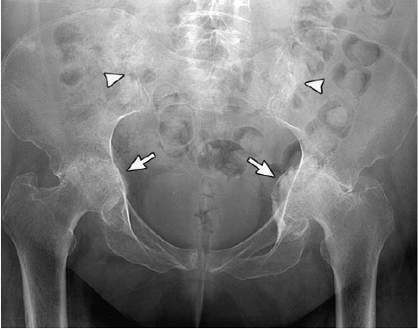
Radiographs
Inflammatory
Narrowing of joint space
Marginal bony erosions
Articular destruction and deformity
Periarticular osteopaenia
Soft tissue swelling
Symmetrical involvement

Slide 33
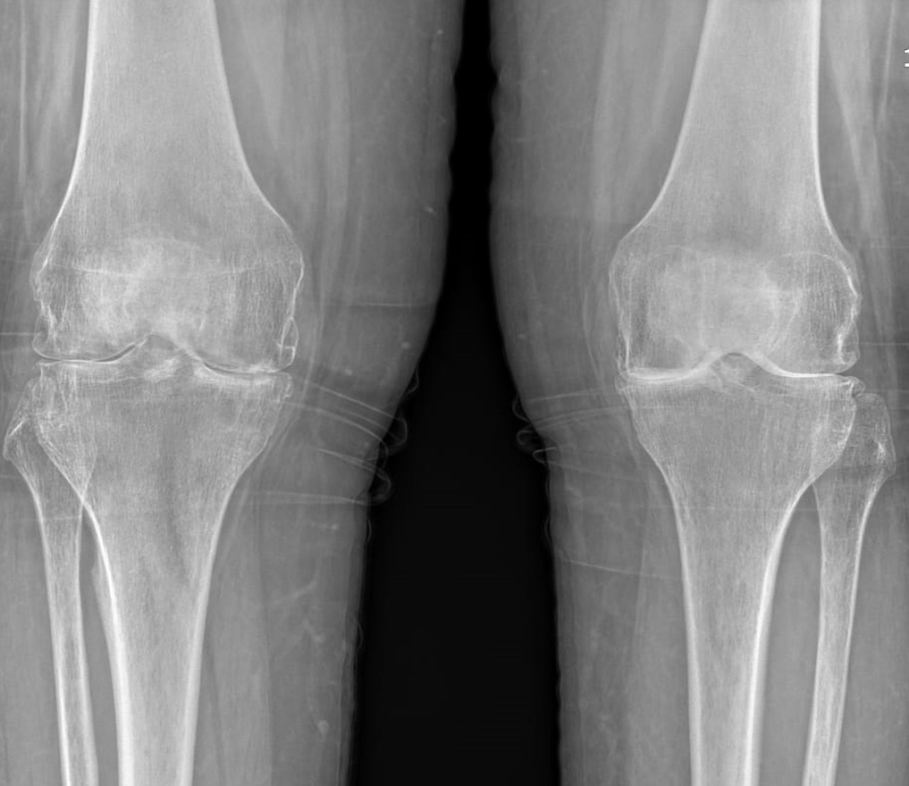
Special Investigations: Imaging
X-rays
  Osteopenia
  Periarticular erosions
    10% Early
    70% within 3 years
  Symmetrical Joint Space Narrowing

Slide 34

Management of RA
MULTI-DISCIPLINARY APPROACH
  Patient and Family
  Rheumatologist
  Orthopaedic Surgeon
  Occupational Therapist
  Physiotherapist
  Social Worker

Slide 35
Management Goals
Optimize Patient Quality of Life
  Limit progression of disease
  Control Pain
  Preserve/optimize function
  Correction of Deformity

Slide 36
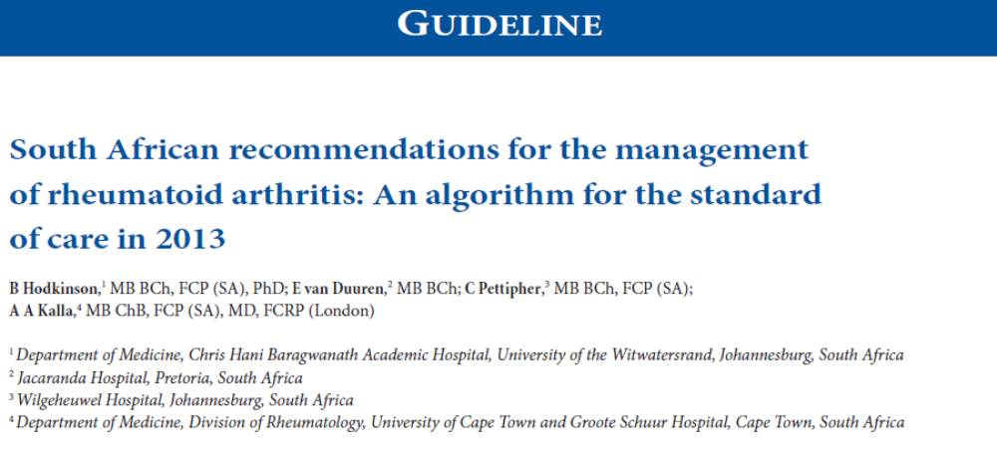
Medical Management
Hodkinson B. Kalla A. South African Recommendations for the management of Rheumatoid Arthritis An Algorithm for standard of care in 2013. SAMJ. 2013

Slide 37
Goals of Medical Management
Early Diagnosis
Determining Diseases Activity
Goal Directed Therapy
Limiting Progression of Disease

Slide 38
Pharmacological Agents
TYPE | Drug
SMARDS | NSAIDS, Paracetamol, Opiods
DMARDS
Non Biological
Synthetic | MTX Chloroquine Sulphasalazine
Steroids | Prednisone
Biological
TNF Inhibitors | Infliximab Etanercept
Non TNF Inhibitors | Abatacept Rituiximab

Slide 39
Concerns Regarding Pharmacological Management
Risk of Sepsis
Effects on HIV Positive Patients
If and when to stop treatment prior to surgery

Slide 40
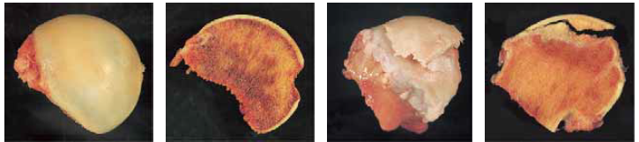
AVASCULAR NECROSIS
Due to local injury or non trauma conditions
Sites:
  Femoral head and condyles
  Head of humerus
  Scaphoid
  Talus
  Lunate

Slide 41
RISK factors/ causes
PLASTICRAGS
Pancreatitis: vasculitis Also Protease inhibitors
Lupus /SLE: vasculitis
Alcohol: dyslipidaemia, pancreatitis
Sickle cell/Smoking
Trauma
Infection/ idiopathic
Caissons disease
RA + RVD + radiation
Amyloidosis
Gaucher’s
Steroids

Slide 42
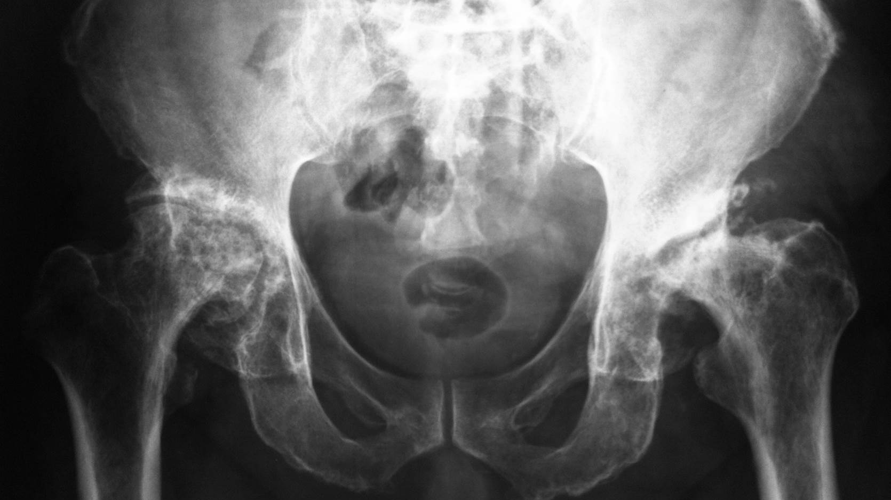

Slide 43
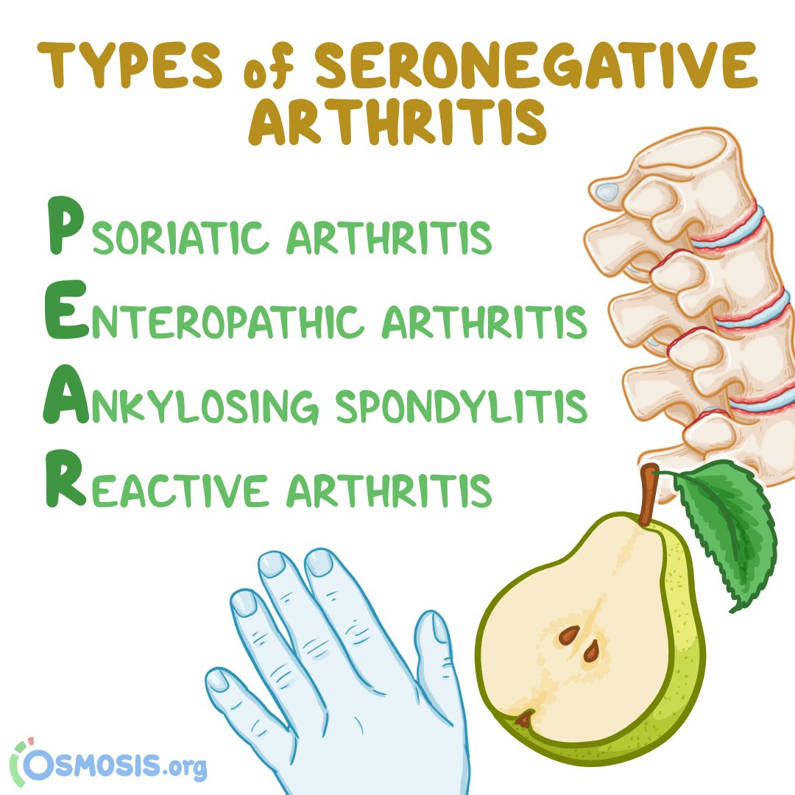

Slide 44
Ankylosing Spondylitis
Seronegative autoimmune spondyloarthropathy
Characterized by
Bridging spinal osteophyte formation
Enthesitis
Sacroiliitis
Uveitis.

Slide 45
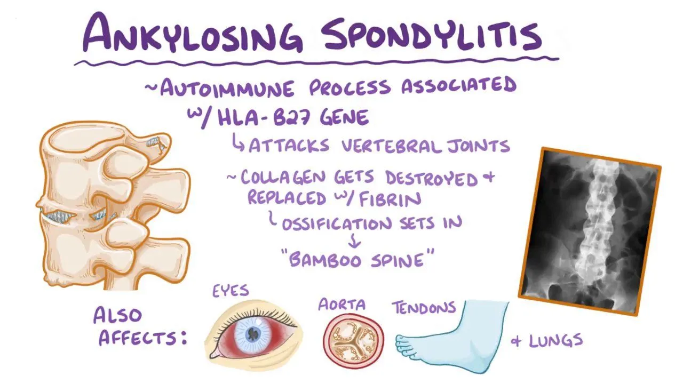

Slide 46
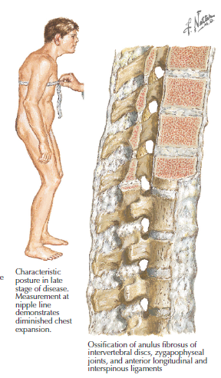
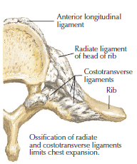

Slide 47
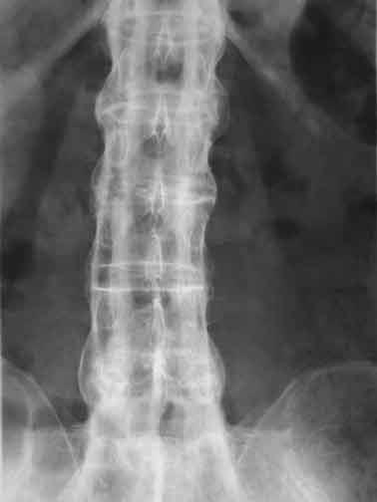
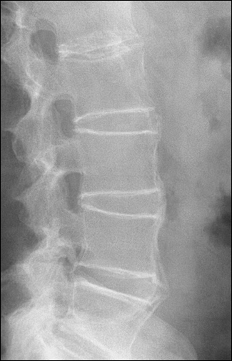
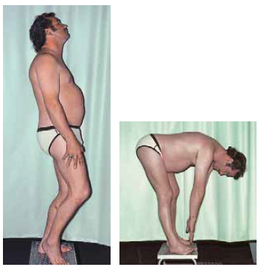

Slide 48
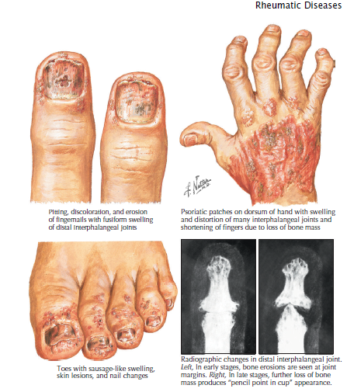
Psoriatic Arthritis
Seronegative spondyloarthropathy
Presents with
DIP predominant arthritis
Rash with silvery plaques
Uveitis
Dysmorphic nails

Slide 49
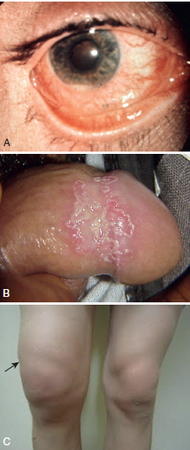
Cant see
Cant pee
Cant bend the knee

Slide 50
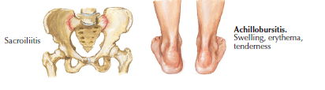
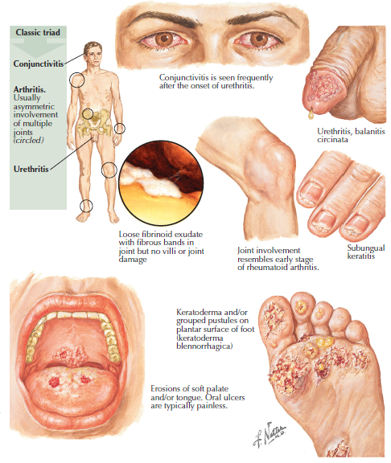
Reiter's syndrome
Seronegative spondyloarthropathy
Caused by an underlying infection
Presents with
  Urethritis
  Ocular conjunctivitis, uveitis,
  Arthritis.

Slide 51
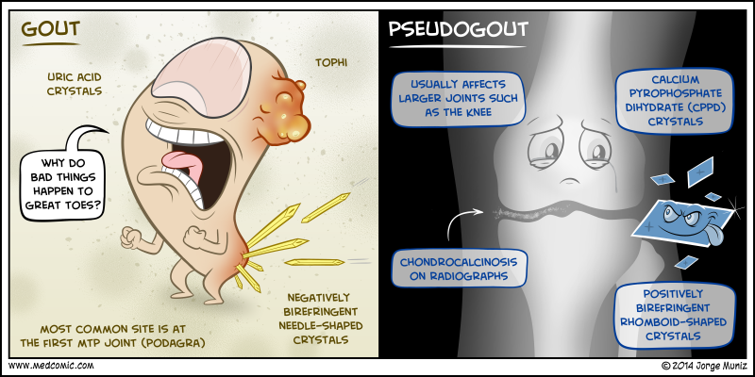
Crystal deposition arthropathy
Pathology from accumulation of crystal formation or deposition in or around joints
• Gout—monosodium urate
• CPPD “pseudogout”—calcium pyrophosphate

Slide 52
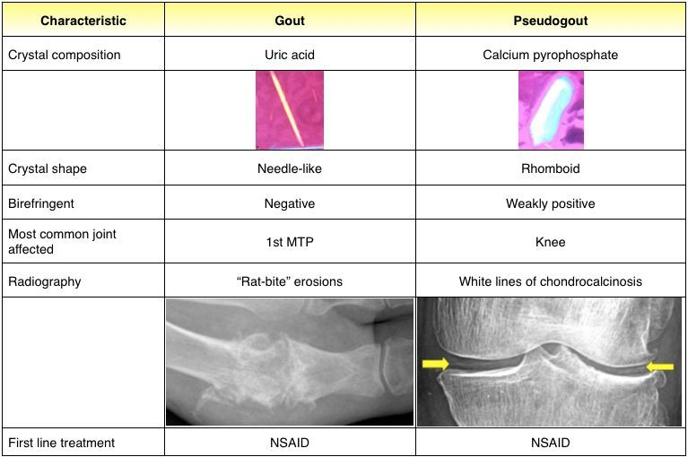

Slide 53
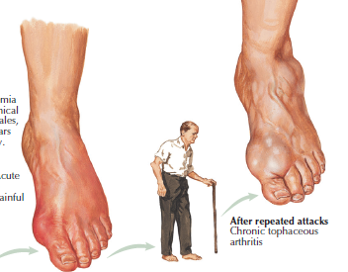
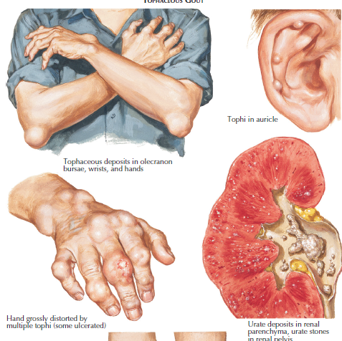
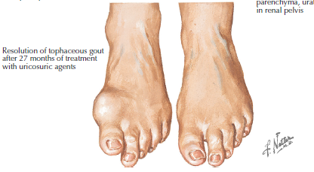

Slide 54
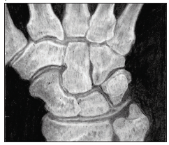

Slide 55
Differentiate Inflammatory from Degenerative causes
History
Main compliant
  Pain
    SOCRATES
  Deformity
  Loss of function
    Large vs small joints
    Number of joints involved
    Symmetrical Vs Asymmetrical

Slide 56
History cont.
PMHx
PSHx
Trauma
Occupational
Social/Recreational Hx

Slide 57
History cont.
Systemic enquiry
Respiratory
Cardiovascular
CNS
GIT
Skin
Genitourinary
Musculoskeletal

Slide 58
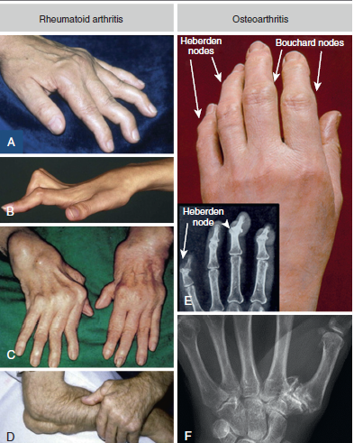
Examination
General exam
Eyes
Hands
Feet
Joint involved

Slide 59
Investigations
Xrays
Serological

Slide 60
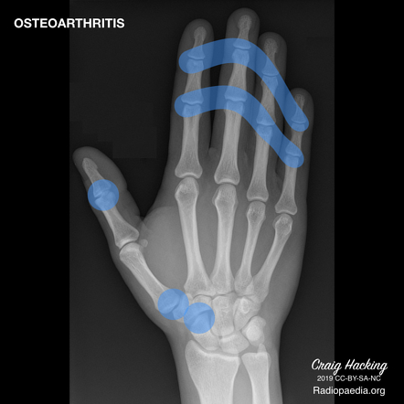
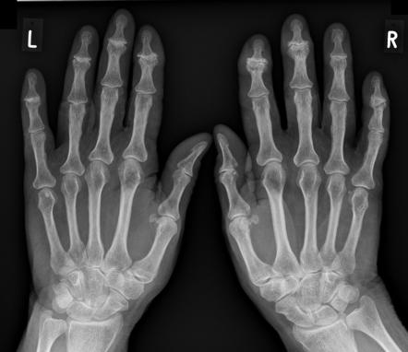
XRAYS

Slide 61
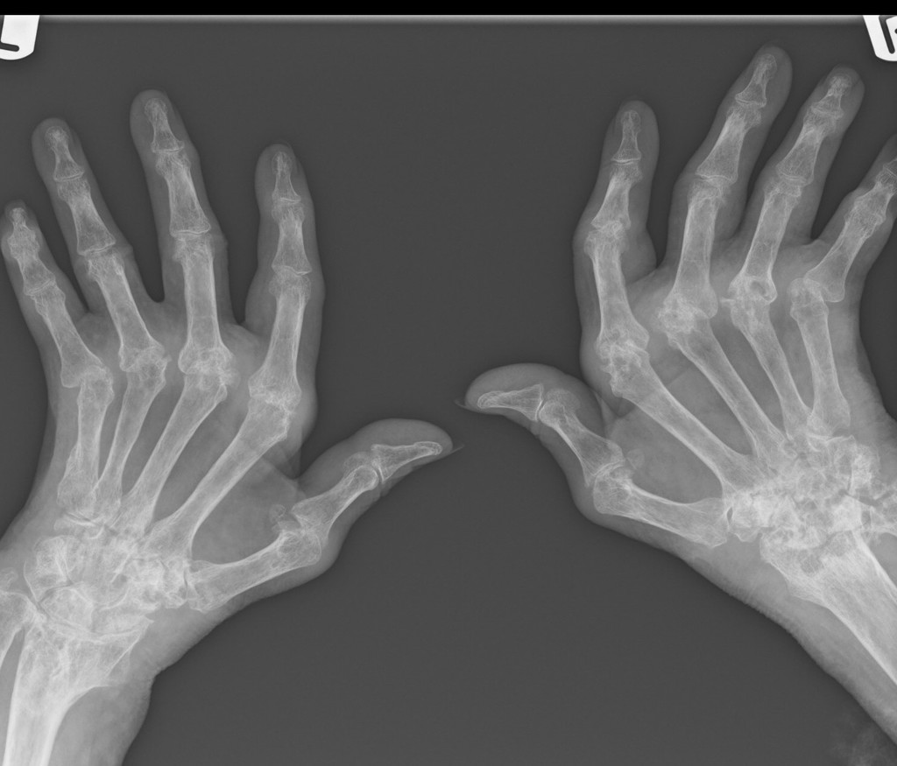

Slide 62
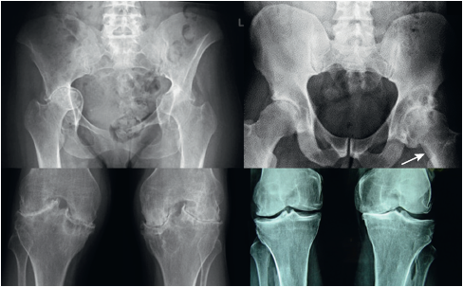

Slide 63
 | Osteoarthritis | Rheumatoid Arthritis
Cause | Degenerative condition of articular cartilage Eventually this leads to exposure of underlying bone | Autoimmune condition which attacks the synovial lining of synovial joints
Pathophysiology | Articular cartilage wear and damage Synovitis and joint capsule fibrosis | Pannus formation (growth of vascular tissue into joint)
Epidemiology | Old: >50 Many RFs: Obesity, FH, gender, hypermobility, sports, previous injury | Young: 30-50yo Women: 3x more common HLA-DR4 association Familial – increased incidence in first degree relatives
Joint manifestations | Early morning stiffness <30 mins Pain after exercise/at end of day Reduced joint function | Early morning stiffness/pain >60 mins EASES with use

Slide 64
 | Osteoarthritis | Rheumatoid Arthritis
Physical examination/signs | Heberdens nodes (DIPJs) Bouchards nodes (PIPJs, later on) Hard swelling, may not be red/inflamed Crepitus | Ulnar deviation Swan neck deformity (fixed hyperextension) Boutonierre deformity (fixed flexion) Z thumb Active synovitis – red, hot, swollen joints
Pattern of joint involvement | Asymmetrical Targets most stressed joints in body Base of thumb and base of big toe often first joints affected Hip and knees also common → joint replacement | Symmetrical Most commonly: wrists and MTPJs Rarely DIPJs
Extra-articular manifestations | None | Nodules Carpal tunnel syndrome Lungs - Caplan’s, nodules Eyes – sjogren’s, scleritis, episcleritis Felty’s syndrome – RA + splenomegaly + neutropenia Kidneys – due to amyloidosis

Slide 65
 | Osteoarthritis | Rheumatoid Arthritis
Bloods | Bloods – usually all normal No autoantibodies | FBC - anaemia ESR/CRP – raised RF – 80% sensitive but low specificity Anti-CCP – 80% sensitive. High specificity
Signs on Xray | LOSS Loss of joint space Osteophytes Subchondral sclerosis Subchondral cysts | LESS Loss of joint space Erosion Soft tissue swelling Soft bones (osteopenia)
Management | Weight loss, exercise Analgesia Steroid injections Physiotherapy –quadriceps strength – muscle wasting Surgery | Early disease control- pharmacological agents Weight loss, exercise Analgesia Steroid injections Physiotherapy –quadriceps strength – muscle wasting Surgery

Slide 66
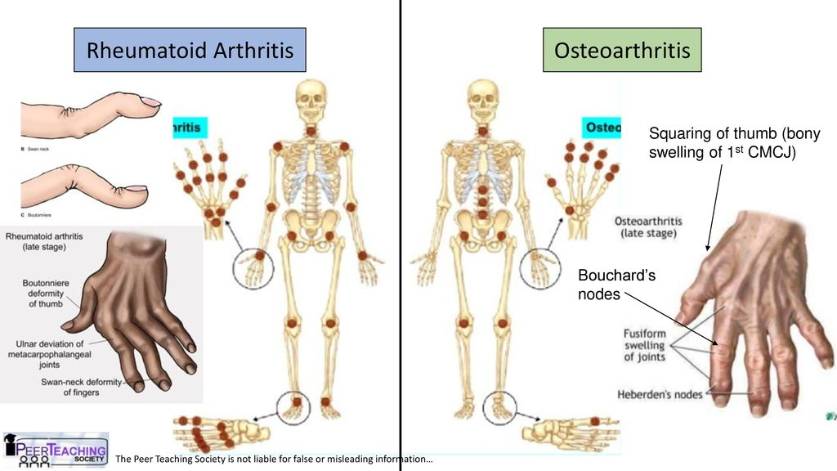

Slide 67
