Slide 1

Development of PHC Clinicians in Africa -FAMILY NURSE PRACTITIONERS (fnp) – Update
18/5/21
Bongi Sibanda , AfroPHC Executive Board Member
Consultant Nurse in Advanced Practice /ICN APNN Alumna

Slide 2
Background overview – ANGLOPHONE apn coalition
Drivers to APN work in Africa (2014-2018)
Schober et al (2016) Conceptual Policy Framework for Advanced Practice Nursing
Collaborators and key stakeholders – Regional/International
Purpose: Combine efforts by individual countries/organisations, coordination and advocacy for APN policy dialogue at regional level.
Vision: A competent APN workforce providing safe, high quality integrated care – RACE.
Adapting the APRN Consensus Model (within an African context) in setting minimum standards for APNs - a baseline towards an Afrocentric framework/model

Slide 3
2018-2019
Rotterdam meeting - ICN/Jhpiego/NursingNow/WONCA/AfriPEN/Afrehealth/ICN APNN/AANP, senior academics/leaders
2018 October WHO Health Systems –APN Policy Proposal submission
2019: Ghana Lead Nurse Africa Conference – LACE workshops ICN APNN/Jhpiego.
University of Massachusetts Boston – Clinical Africa APN faculty development support/presentation
Nairobi –Family Nurse Practitioner workshop (AfriPEN/WONCA support) LACE model application for Africa

Slide 4

SoWN (2020) /SoWMy 2021
Education and training - aimed to progress PHC and UHC
Underscores the importance of nurses as key contributors towards UHC, health related SDGs, national health strategies
High quality care, patient safety and collaborative practice
WHO global Strategic Directions for Nursing/Midwifery –WHA74 (?Regional)
The State of the World’s Midwifery (SoWMy) 2021 - Sexual, Reproductive, Maternal, Newborn and Adolescent Health (SRMNAH) workforce

Slide 5
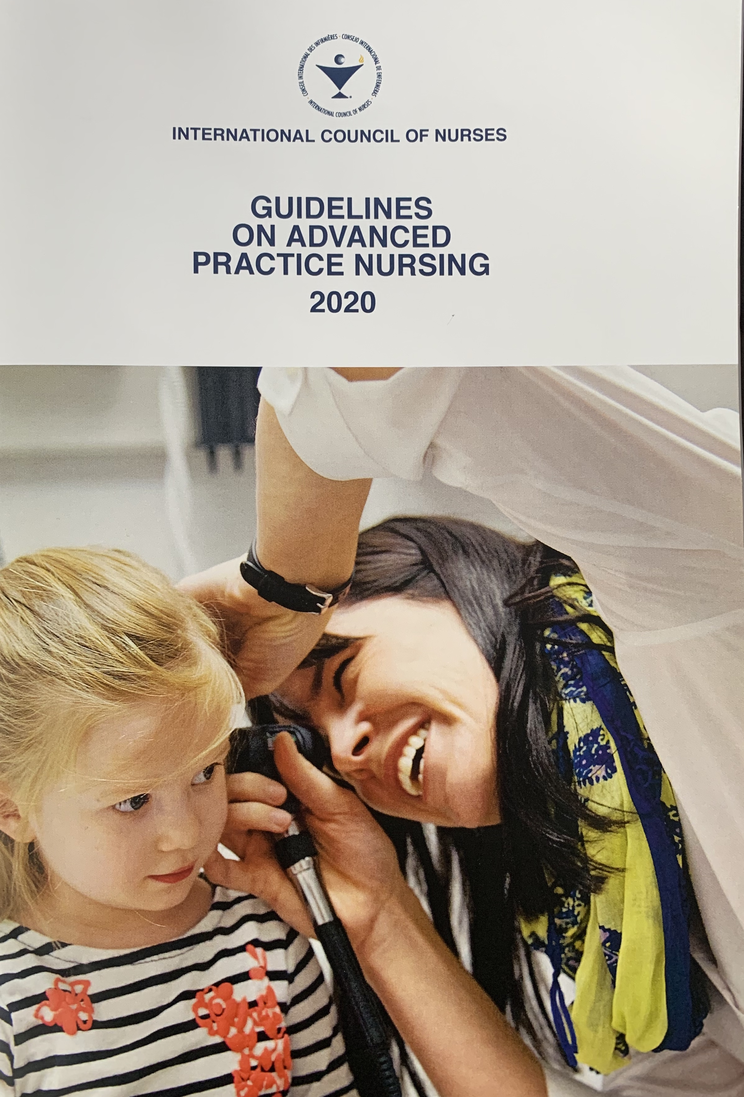
APN Guidelines - Afrocentric PHC focus
4 Pillars of advanced practice – Clinical Practice, Education, Leadership/Management & Research/Innovation
Anglophone Africa APN coalition (p.36)
Family Nurse Practitioners (FNPs) Botswana, Eswatini (Formerly Swaziland)
In development/Planning?

Slide 6

IND202i: Nurses A VOICE TO LEAD: A VISION FOR FUTURE HEALTHCARE
Transformation to healthcare and nursing solutions – Advanced Practice roles
Supporting nurses to leverage a better health system – Policy decision-making
A vision for future healthcare – reimagining education/practice

Slide 7

Astana Declaration on PHC (2018)
Inclusive and Collaborative Leadership - AfroPHC
Interprofessional Education e.g WPBA
PHC - Hospital interface
Partnerships/Collaborations & Interprofessional Education (NGOs, private, government etc.).
November 2020: Educational Leadership Symposium –LACE (Afrocentric) Hosted by ICN APNN/ AfroPHC/WONCA President collaborative leadership

Slide 8
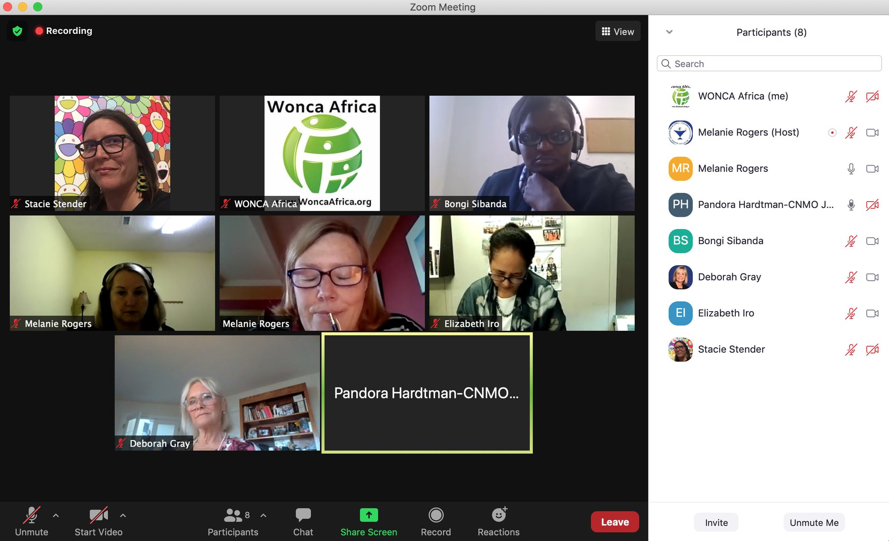
WHO afro – ANGLOPHONE AFRICA APN (FAMILY NURSE PRACTITIONER) MEETING
2018-2021 Completion: WHO Afro Presentation
ICN NP/APNN Academy of Research and Enterprise/Jhpiego
Situational Analysis
A global example on collaborative practice and interprofessional education in advanced practice policy advocacy
CELEBRATION TIME …..MORE WORK AHEAD!

Slide 9
Next Steps : Situational Analysis

Slide 10
Selected References
Christmals C and Armstrong S (2019) The essence, opportunities and threats to Advanced Practice Nursing in Sub-Saharan Africa: A scoping review. https://www.ncbi.nlm.nih.gov/pmc/articles/PMC6812225/ (Accessed 15th of May 2021)
Asamani et al (2021) Predicting Primary Healthcare Workforce Needs Towards Health Professions Education and Employment Investment. Planning: A Mathematical Model. Centre for Health Professions Education, NWU (Presentation online -3rd of May 2021).
(ICN 2020) Guidelines on Advanced Practice Nursing
The State of the World’s Nursing Report: Investing in Education, Jobs and leadership (WHO 2020)
Nurses: A Voice to Lead – A Vision for Future Health care (ICN 2020)
The Astana Declaration (2018)

