Slide 1
PBRNs: A Fifty-Year History of Primary Care Laboratories
Presentation to AfroPHC
On the 5th of April 2022
Anna Dania, MPH (minor International Health), PhD Candidate FHML, CAPHRI Institute, Maastricht University

Slide 2
What is a PBRN?
Practice-Based Research Network (PBRN) is a collaboration of researchers and primary care practitioners who are engaged in conducting healthcare research, addressing questions and problems that emerge from daily practice, translating research findings into evidence-based practice, and improving the quality of healthcare.

Slide 3

PBRNs are the laboratories of primary care

Slide 4
PBRNs
Are cost-effective way to conduct research in the primary care settings
Make academic research more community-focused and more relevant to primary care

Slide 5
How PBRNs started?
UK, late 1800s
James Mackenzie at first
Will Pickles and John Fry later
conducted research in their own practices
Netherlands, 1945
F. J. A. Huygen
Started research activity in his
practice for about 2 decades

Slide 6
1967 in the UK and Netherlands
Weekly Returns Service (WRS)
A group of general practitioners in Birmingham, started collecting morbidity data systematically in their practices and developed the first primary care research collaboration
Continuous Morbidity Registration (CMR)
Four family practices in Nijmegen area started collecting morbidity data systematically and developed the first research collaboration

Slide 7

Why we look so far in the past?

Slide 8
We studied 115 PBRNs using 260 sources and 56 interviews
Geographical distribution of PBRNs
Bi-national
Multinational
Australia
Belgium
Canada
Finland
France
Greece
Germany
Ireland
Italy
Netherlands
New Zealand
Norway
Singapore
South Africa
Spain
Sweden
Switzerland
UK
USA

Slide 9
Similarities among the PBRNs
PBRNs share many similar characteristics, facilitators and barriers, across countries and contexts, even if they differ in their trajectory of development, maturity, sustainability and operational focus.
As new PBRNs are created in an “evolved” PBRN environment, they still undergo their own stages of development, which sometimes assimilates the state of earlier PBRNs, albeit on a different timescale

Slide 10
Missions met in bibliography
“ to monitor health problems and morbidity encountered in general practice” (van Weel, 2008)
“understanding and promoting optimal child health” (LeBailly et al, 2003)
“to facilitate practice-based research partnerships between academic researchers and community based clinical teams that can lead to improved primary care clinical outcomes” (Jame et al, 2015)
“not only to conduct research but to translate that research into practice” (Slora and Wasserman, 2010)
“to inform and influence decisions along the continuum of service to patients, from research to practice and policy.” (http://acornpbrn.org/mission/ accessed 8-11-2019)
“to improve the quality and safety of health care in primary care settings by identifying and solving problems commonly encountered in practice”. (Kuo et al, 2008)
“to support primary care research and education in order to improve the quality of care delivered to patients in the community” (Kavanagh et al, 2010)

Slide 11
Purposes met in bibliography
“To study problems as they present in the primary care setting and to increase the knowledge base regarding how modern primary care medicine is practiced”. (Iverson et al, 1988)
“for the purpose of facilitating research on chronic disease and related health care problems commonly addressed in primary care settings.” (Sloane et al, 2006)
“to provide a forum for communication and collaboration among consortium members; and support the growth of professionals” (Lundeen 2002)
“to offer a managed approach to hosting high quality research in the health service and to assuring recruitment and retention of study participants” (Sullivan et al, 2007)
“to improve the health and health care of underserved, low-income, multiethnic populations” (Sinclair-Lian et al, 2008)
“to participate in clinical research for the benefit of their patients and to enhance the discipline of general practice through research training and activity”. (www.IPCRN.ie accessed 17/5/2017)

Slide 12
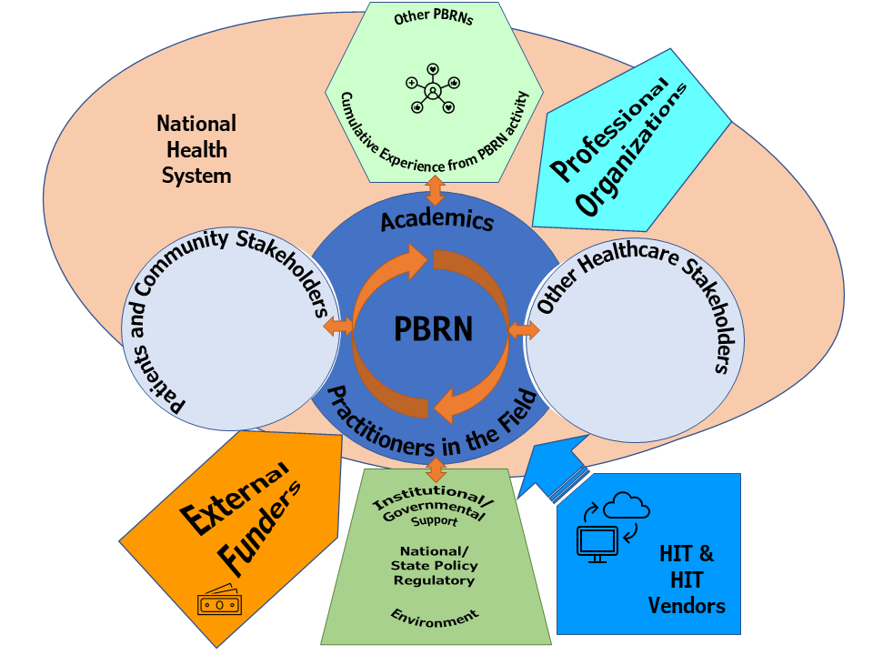

Slide 13
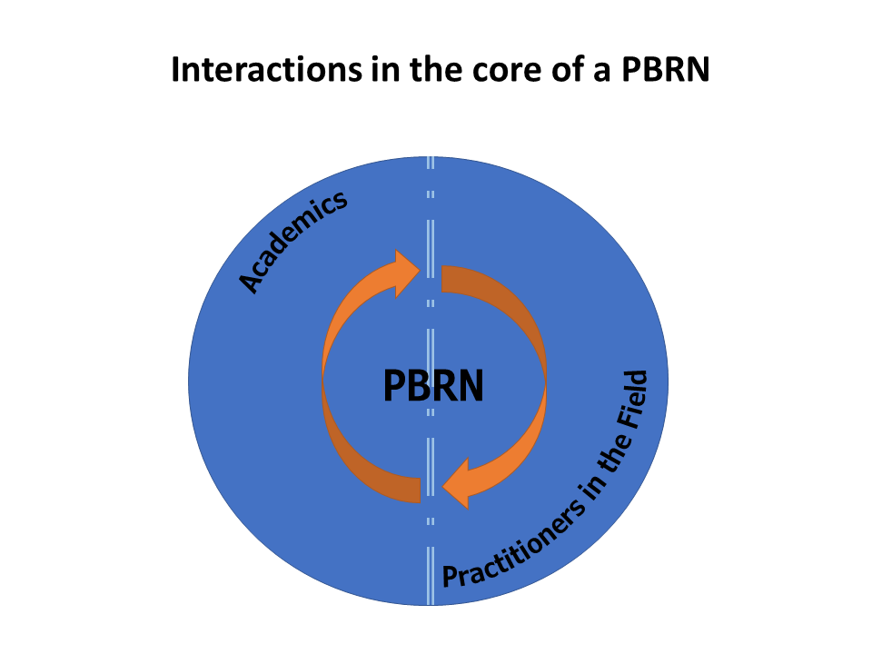

Slide 14
Key actors:
Academics (professors and researchers/academic institutes)
Practitioners in the field (family physicians, nurses, other primary healthcare specialists such as pharmacists, chiropractors, podiatrists)

Slide 15
Drivers of the key actors
Academic drivers
Practitioner drivers
Development of scholarly output for Family Medicine
Recognition of the importance of practice-based research for the discipline, professional growth, academic education, and careers
Raising the value of Family medicine and primary care and their professionals
Development of academic centers of excellence for research and training
Motivation for patient care excellence
Interest in research topics that are closely related to their daily work and real-world conditions
Desire to support to generation of new knowledge, implementation of research findings, and engagement in healthcare policy or advocacy
Professional development, increased job satisfaction, collegiality and peer learning

Slide 16
Contributions of the key actors
Academic contributions
Practitioner contributions
Research questions
Data
Participation in research activity
Co-investigators or principal investigators
New knowledge translation and implementation in practice
Guideline development and implementation
Advocation for populations
Mentoring, training, Fellowships, intellectual support
Hosting and supporting financially (monies and in-kind) PBRNs
Leadership to networks
Sustainable research agenda, research expertise, quality, reputation that secures fundraising
Institutional Review Boards (IRBs)
QI and quality assurance support

Slide 17

The importance of relationship building
This Photo by Unknown Author is licensed under CC BY

Slide 18
To accomplish their mission, PBRNs created “ties” and “properties”
“Ties” refer to relationships characterized by respect, reciprocity, synergy and trust
“Properties” refer to new knowledge, organizational infrastructure, including research data and databases, and a learning environment based on multi-directional communication

Slide 19
Solid foundation for a PBRN
Shared vision between practitioners in the field and academics
Learning community function (dissemination of value-added resources and knowledge diffusion)
Reciprocal benefits for practices e.g., data quality audit cycles, professional credits from participation in research, remuneration for the time spend in research
Practice facilitators
Ongoing mentorship and practitioner empowerment

Slide 20
PBRNs go hand-in-hand with the Family Medicine development
In countries where the discipline of Family Medicine is strongly developed e.g., the UK and Netherlands, the PBRNs emerged together with the academic discipline.
In countries where the discipline is not well supported until more recently, the development of PBRNs also has lagged significantly

Slide 21
Thank you!
I

