Slide 1



Clinical Officers in Primary Care - An international perspective
“Development of PHC Clinicians in Africa”
Scott Smalley, MSPAS, PA-C, Clinical Associate
President International Academy of Physician Associate Educators (IAPAE)
Head of Division of Clinical Associates, University of Witwatersrand, Johannesburg, South Africa

Slide 2

WHO - Universal Health Coverage and Primary Health Care - three related objectives:
UHC embodies equity in access to health services - everyone who needs services should get service
The quality of health services should be good enough to improve the health of those receiving services; and
People should be protected against financial-risk (access), ensuring that the cost of using services does not put people at risk of financial harm.
Primary Health Care is an approach to health and wellbeing centred on the needs and circumstances of individuals, families and communities
Notes:
WHO – link to India doing UHC

Slide 3
Equity, Quality & Access
“We live in an unequal world and we cannot leave anyone behind. Currently, 50 million people are displaced from their homes and communities. Just 62 people control half of the world’s wealth. Twenty-two million people lack access to HIV treatment and 17.1 million people still do not know their HIV status.”
Michel Sidibé, Executive Director of UNAIDS and Under Secretary General of the United Nations. January 2016

Slide 4
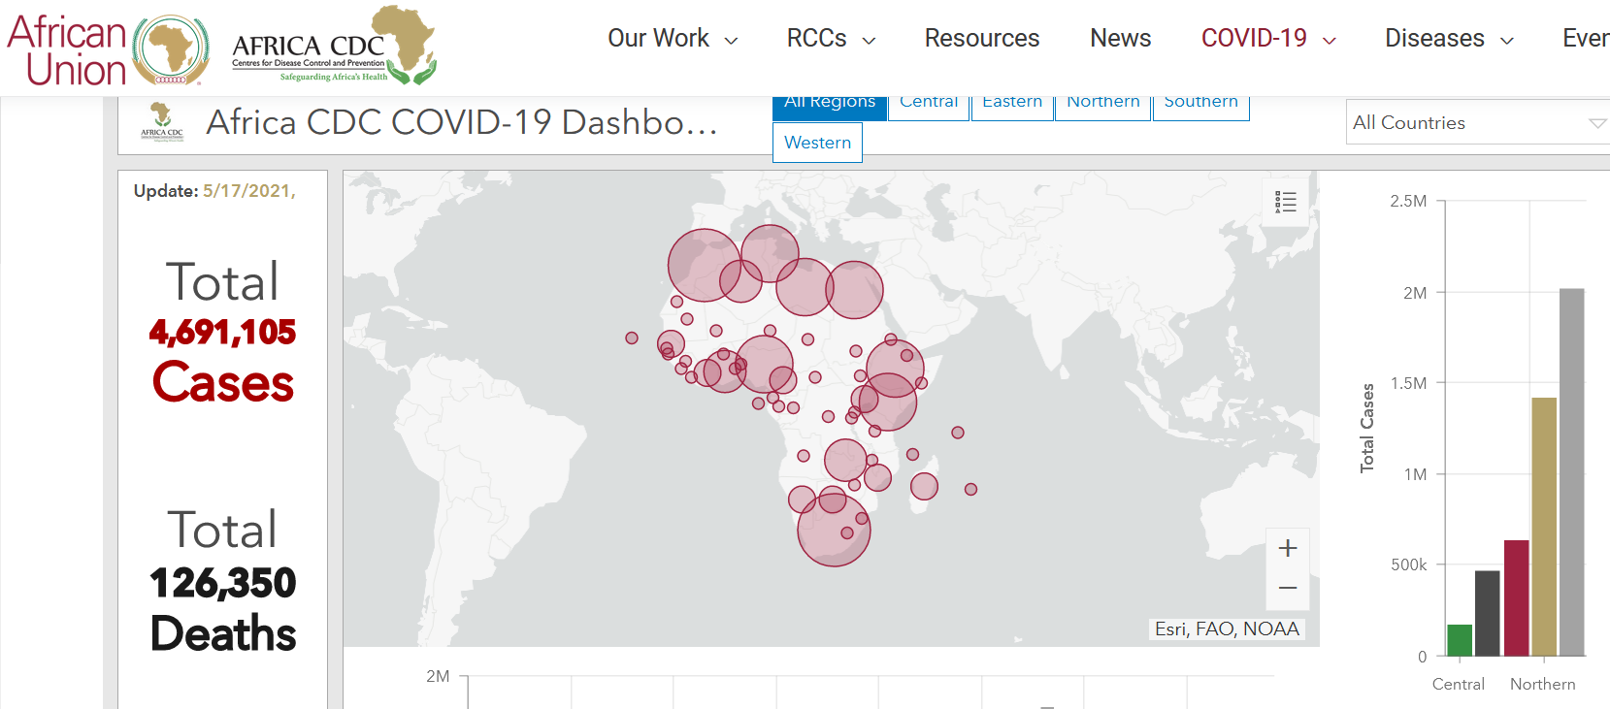
COVID-19 Pandemic – The need for PHC

Slide 5
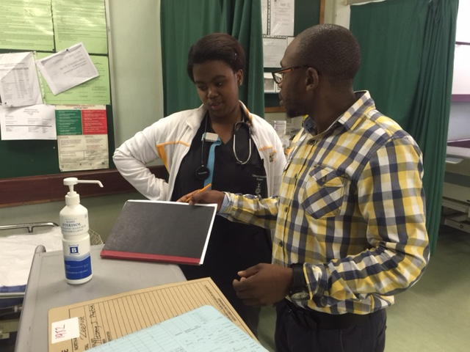
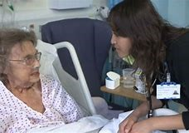
Define Clinical Officer, Physician Assistant, Clinical Associate, Medical Assistant & Comparable
Terms in the literature: Auxiliary Health Worker, Non-Physician Clinician, Mid-Level Provider, Advanced Practice Provider
WHO Definition: “Health workers trained at a higher education institution for at least 2-3 years. They are authorized to work autonomously to diagnose, manage and treat illness, disease and impairments, as well as engage in preventive and promotive care” (WHO 2007)
Notes:
Many country-specific terms- here for many years. Fill gap, not replace doctors, PAs complement, not compete

Slide 6
History of CO/PA Analogue terms by countries
Feldsher – 1400s. In Russia, they were regarded as "Middle Medical Workers"
Barefoot doctor – 1930, In China, provide health to rural areas, promotive healthcare. End 1981, now with Doctor Assistant
Health Auxiliaries were used in India since the late 19th century to work in disease control and eradication
In Africa 1918. Medical Assistant, Health Assistant, Health Officer. Grew into Clinical Officer 1928, also Assistant Medical Officer 1984, Medical Licentiate 2002
United States & Liberia Physician Assistant 1965, UK-Physician Associate 2003, South Africa -Clinical Associate 2008
55+ countries with a Mid Level Healthcare Provider (MLP)

Slide 7


ISCO 2008 – In Major Group 2: Health Professionals Health Professional – Paramedical Practitioner
Paramedical practitioners provide advisory, diagnostic, curative and preventive medical services for humans more limited in scope and complexity than those carried out by medical doctors. They work autonomously, or with limited supervision of medical doctors, and apply advanced clinical procedures for treating and preventing diseases, injuries and other physical or mental impairments common to specific communities.
Tasks include –
(a) conducting physical examinations of patients and interviewing them and their families to determine their health status, and recording patients’ medical information;
(b) performing basic or more routine medical and surgical procedures, including prescribing and administering treatments, medications and other preventive or curative measures, especially for common diseases and disorders;
(c) administering or ordering diagnostic tests, such as X-ray, electrocardiogram and laboratory tests;
(d) performing therapeutic procedures such as injections, immunizations, suturing and wound care, and infection management;
Inclusions:
Advanced care paramedic, Clinical officer, Feldscher, Primary care paramedic, Surgical technician

Slide 8
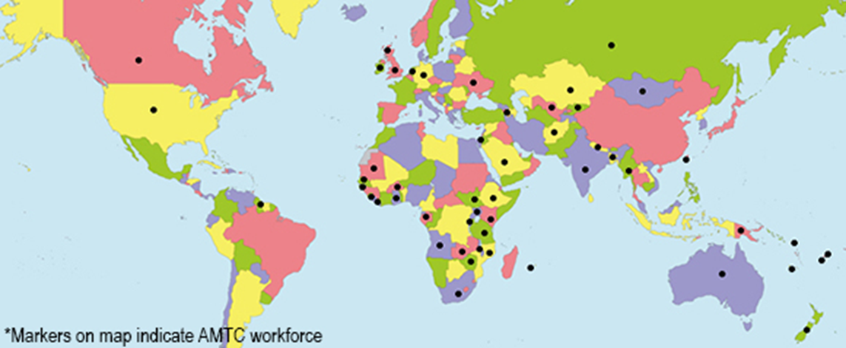
55+ countries with CO/PA Analogue world wide
CO/PA Analogues trained in the medical model. Complement not compete.
Team-based. Fit-for-Purpose. Primary Health Care

Slide 9
17 Different CO/PA Analogue titles

Slide 10
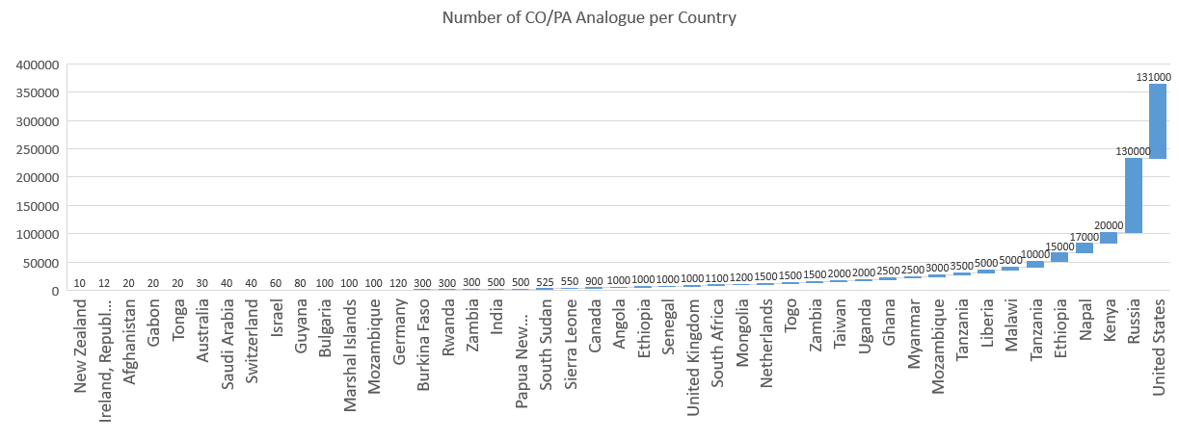
Estimated 364,000 CO/PA workforce worldwide

Slide 11
Number of Countries within Continents with CO/PA Analogues

Slide 12
Timeline of CO/PA Analogue start dates
1905 Russia | 1970 Mozambique | 1992 India | 2010 Saudi Arabia
1918 Uganda | 1970 Nepal | 1992 Senegal | 2010 Afghanistan
1928 Kenya | 1970 Papua New Guinea | 1992 Taiwan | 2014 Bulgaria
1931 Mongolia | 1970 Malaysia | 1995 Gabon | 2015 Laos
1936 Zambia | 1972 Togo | 1998 South Sudan | 2015 New Zealand
1953 Myanmar | 1977 Guyana | 2002 Zambia | 2016 Ireland, Republic of
1954 Ethiopia | 1979 Tonga | 2003 Netherlands | 2016 Israel
1960 Ghana | 1980 Malawi | 2003 United Kingdom | 2016 Republic of Ireland
1960 Tanzania | 1980 Sierra Leone | 2005 Germany | 2017 Afghanistan
1965 United States | 1984 Canada | 2008 South Africa | 2017 Switzerland
1965 Liberia | 1984 Tanzania | 2010 Australia | 2020 Kosovo (planning)
Need to add Burundi, Rwanda start dates; Other countries Nigeria, Guinea Bissau, Cape Verde, Burkina Faso

Slide 13
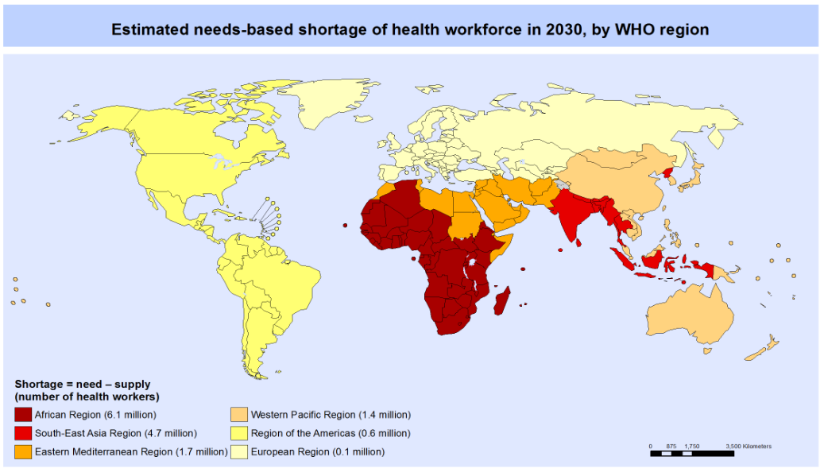

Development of Mid Level Provider for PHC
Shortage of doctors & healthcare providers world wide
Increase in disease burden, non-communicable diseases & injuries
Increase in population and life expectancy
Increased expense in healthcare costs & delivery

Slide 14
Value added of the Profession
1. Most Clinical Officers provide Primary Health Care- deliver care in communities
WHO in 1978: Declaration of Alma-Ata, Health for All.
“Primary health care ... relies, at local and referral levels, on health workers, physicians, nurses, midwives, auxiliaries, and community workers as needed, suitably trained socially and technically to work as a health team and to respond to the expressed health needs of the community”
2. COs are the ideal health professional for Task Shifting & Task Sharing:
WHO states “a process of delegation whereby tasks are moved, where appropriate, to less specialized (PHC) health workers.”
3. COs are trained in the medical model, to practice medicine- Diagnose & Treat common conditions. Generalist PHC training leading to advanced practice.

Slide 15
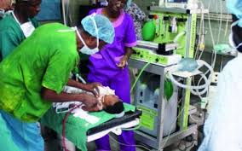
Tanzania Clinical Officer (1960) and the
Assistant Medical Officer (1984)
Maternal mortality is 398/100,000 live births, more than 28 times higher than in the United States.
0.03 physicians per 1,000 population. India ratio 7/1000
CO 3 years and AMO 2 years training- PHC & Surgery
AMO is 20% to 33% the cost of training a physician
AMOs provided 85% of obstetric surgery with
no difference in outcomes vs obstetricians.

Slide 16
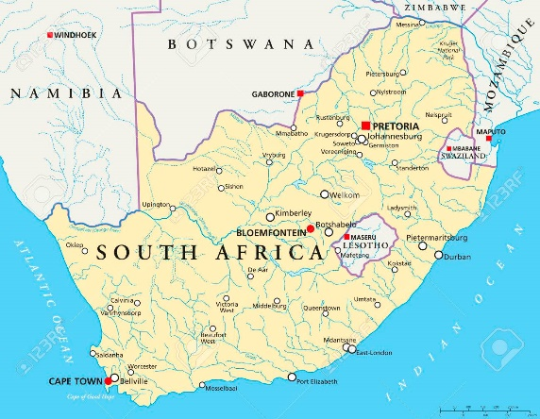
South Africa- Clinical Associate (2008)
South Africa with highest burden of HIV globally. 14 million people
7 million patients on ARVs.
Study of Clinical Associates:
  78% of supervisors consider ClinA competent
  82% said fit in with team and
  90% want more ClinAs
Can train 3 ClinA for cost of 1 Doctor
Employee in public healthcare 2.4 ClinA for cost of 1 Doctor
A team of 8 doctors becomes 5 Doctors and 7 ClinA for a team of 12
Notes:
Supervision 0-2yrs Direct, 2-4yrs Indirect, 5+ yrs Collaborative

Slide 17
Case Study: Mozambique –Tecnicos de Cirurgia
Study found Tecnicos de Cirurgia decision making and quality of care were comparable to obstetricians by indications
for surgery, postoperative deaths, and major complications.
Evidence from Mozambique suggests that training more mid-level health workers in surgery is a good investment in responding to the
health worker shortage
 | Tecnicos de cirurgia | Physician
First Degree (Tecnico de Medicina, 2 years) | $ 4820.70
Second Degree (Tecnicos de Cirurgia, 3 years or physician, 6 years) | $14,644.3 | $21,437.0
Residency (physician, 5 years) |  | $52,692.8
TOTAL EXPENSE to Train 1 provider | $19,464.7 | $74,129.8
Cost to deploy 1 provider per year | $3859.00 | $10,367.70
Number of Surgeries performed by 1 provider per year | 6914 | 5264
Cost per Surgery | $38.87 | $144.1
Notes:
Mozambique with 600 doctors and 30 Obstetricians for 30 mill people. Not replacing the doctor, not trying to be the doctor.

Slide 18
Training: Four different Degrees awarded for CO/PA education in different countries

Slide 19
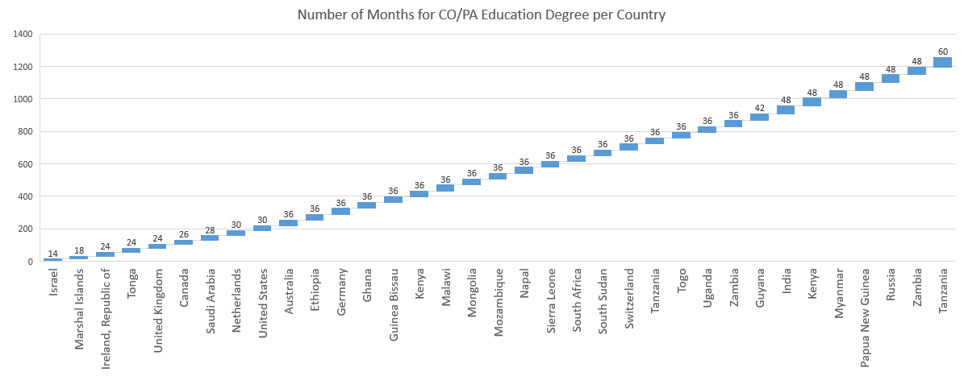
The Number of months for CO/PA Education Degrees are different in Countries

Slide 20
Need to Increase recognition & value-add of CO/PA
Educate – National-International Framework, Core standards
Advocate - Recognition with structured Regulations, Scope of Practice
Collaborate – Join forces intra-country, inter-country and globally
Promote Primary Health Care - core medical delivery

Slide 21
Educational Standards for Clinical Officers
  Is it time for International Accreditation Standards?
  Core set of competencies – Knowledge, Skills and Attitude
  Common Exit Outcomes – Entrustable Professional Activities (EPAs)
  Local, National, Regional, Global

Slide 22
Advocate for National/International Structures
1. Define the CO role, use EBM for needs of country. ID Gaps
2. Develop core Exit Outcomes. EPAs for graduates. Job description
3. A common curriculum. Content, Learning Objectives, Assessment, Evaluation
4. Develop a National Exam with Certification process
5. Create an Accreditation body. Process for training. National & International
6. Develop and implement Scope of Practice. Laws/regulations
7. Identify and/or create a Regulatory Body for Registration
8. Legislate for Prescription authority
9. Employment Remuneration, Reimbursements and workplace satisfaction
10. Develop and support Professional, Union & Educational Associations/Academies

Slide 23
Collaborate – together we can go forward
  Professional Associations - National, Regional/Continental and Global
  Educational Academies – Accredit curricula, national exams, certification
  Unions – promote work-based recognition
  Produce Research and disseminate – publish, marketing

Slide 24
International & Regional Representation
International Physician Assistant Organisation (IPAO)
Global Association of Clinical Officers and Physician Assistants (GACOPA)
International Academy of Physician Associate Educators (IAPAE)
African Network of Clinical Practitioners (ANCP)
West African Association of Physician Assistants (WAAPA)
European Physician Assistants Certified (EuroPA-C)
European Network of PA Educators (ENPAE)

Slide 25
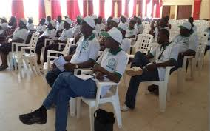
Country-wide CO/PA Representation
Kenya Clinical Officer Association (KCOA)
Tanzania Clinical Officer Association (TCOA)
Uganda Association of Clinical Officer Association (UACO)
Ethiopia Professional Association for Emergency Surgical Officers (PAESO)
Zambia Clinical Officer Association (ZCOA)
Zambia Medical Licentiate Association (ZMLA)
Malawi Clinical Officer Association (MCOA)
Liberian National Physician Assistants Association (LINPAA)
Ghana Physician Assistants Association (GPHA)
Graduate Physician Associates Association of Ghana (GPAAG)
Professional Association of Clinical Associates of South Africa (PACASA)
Malaysian Association of Medical Assistants (MAMA)
American Association of Physician Assistants (AAPA)
Canadian Association of Physician Assistants (CAPA)
Royal College of Physicians Faculty of Physician Associate (RCPFPA)
Ireland Professional PA Association (IPAA)
Netherlands Association Physician Assistants (NAPA)
Deutsch German Physician Assistant Association (DGPA)
Israel Association of Physician Assistants (IAPA)
Indian Association of Physician Assistants (IAPA)
Australian Society of Physician Assistants (ASPA)
New Zealand Physician Associate Society (NZPAS)
National Liberian PAs Convention 2019 August in Kakata, Margibi County

Slide 26

International Academy of Physician Associate Educators - IAPAE
IAPAE brings together global Physician Associate Educators to develop and share best educational practice respecting regional cultures.
IAPAE AIMS:
To represent Physician Associate educators globally;
To develop maintain and share a dynamic repository
To undertake, commission and disseminate research
To promote recognition of Physician Associate education
  Quarterly Webinar, 21 May, Friday 10:00EST. Visit www.iapae.com

Slide 27
Conclusion: COs effective, efficient, equitable contribution to UHC & PHC
Global medical professional improves team-based practice
Improves patient care
Reduces workload of doctors, free up time for complex tasks
Reduces patient waiting times, hospital stay
Reduces cost to train and employ
Same quality of medical care
Proven model: The Clinical Officer, Clinical Associate, Physician Assistant/Associate, Medical Assistant - Mid Level Provider

Slide 28
Resources/References
Brown A, Cometto G, Cumbi A, et al. Mid-level health providers: a promising resource. Rev Peru Med Exp Salud Publica [Internet]. 2011 [cited 2019 May 6];28(2): 308–15. Available from: http://www.who.int/workforcealliance/media/photos/MLP_Article_Jul2011.pdf?ua=1
Cobb N, Meckel M, Nyoni J, et al. Findings form a survey of an uncategorized cadre of clinicians in 46 countries – increasing access to medical care with a focus on regional needs since the 17th century. World Health & Population. 2014;16(1):72-86. DOI:10.12927/whp.2015.24296
del Pino-Jones A, Wolfe B, Wimmer K et al. Physician Perceptions of Advanced Practice Providers on Hospitalist Teams. The Journal for Nurse Practitioners. 2019. https://doi.org/10.1016/j.nurpra.2018.08.030
Findings from the Global Burden of Disease Study 2017. Institute for Health Metrics and Evaluation (IHME) through core funding from the Bill & Melinda Gates Foundation. 2017
Fréchette D, Shrichand A. 2016. Insights into the physician assistant profession in Canada Density of Physicians. JAAPA. 2016; 29(7). DOI: 10.1097/01.JAA.0000484302.35696.cd
Hamm J, van Bodegraven P, Bac M, Louw JM. Cost effectiveness of clinical associates: A case study for the Mpumalanga province in South Africa. Afr J Prm Health Care Fam Med. 2016;8(1), a1218. http://dx.doi.org/10.4102/phcfm.v8i1.1218
http://www.ilo.org/public/english/bureau/stat/isco/isco08/index.htm
Kruk M, Pereira C, Vaz F, Bergstrom S, Galea S. Economic evaluation of surgically trained assistant medical officers in performing major obstetric surgery in Mozambique. BJOG 2007;114:1253–1260.
Lehmann U. Mid-level health workers. The state of the evidence on programmes, activities, costs and impact on health outcomes. A literature review. WHO Glob Heal Work Alliance [Internet]. 2008 [cited 2019 May 6;42. Available from: http://www.who.int/hrh/MLHW_review_2008.pdf
Merkle F, Ritsema, T. Bauer S, Kulman L. The physician assistant: Shifting the Paradigm of European medical practice? HSR Proceedings in Intensive Care and Cardiovascular Anesthesia 2011; 3(4): 255-262
Mulder H, ten Cate O, Daalder R, Berkvens J. Building a competency-based workplace curriculum around entrustable professional activities: The case of physician assistant training. Medical Teacher 2010; 32: e453–e459. DOI: 10.3109/0142159X.2010.513719.
Mullan, Fitzhugh and Frehywot, Seble, "Non-physician clinicians in 47 sub-Saharan African countries" (2007). Health Policy and Management Faculty Publications. Paper 334. http://hsrc.himmelfarb.gwu.edu/sphhs_policy_facpubs/334
Muula A. Case for Clinical Officers and Medical Assistants in Malawi. Croat Med J. 2009 Feb; 50(1): 77–78. doi: 10.3325/cmj.2009.50.77
Ramer S. The Russian feldsher: A PA prototype in transition. JAAPA. 2018:31(11). DOI:10.1097/01.JAA.0000546484.94936.30
Rick T, Moshi D. AMO The Tanzanian assistant medical officer. JAAPA. 2018; 31(4). DOI:10.1097/01.JAA.0000531051.04879.59
Sidibe M. Prince Mahidol Award Conference Speech. United Nations. 28 January 2016. Bangkok, Thailand.
Ten Cate O. A primer on entrustable professional activities. Korean J Med Educ 2018;30(1): 1-10. https://doi.org/10.3946/kjme.2018.76
Total Number per 1000 Population, Latest Available Year, Global Health Observatory (GHO) Data. Situation and Trends. Available from: http://www.who.int/gho/health_workforce/physicians_density/en/. [Last accessed on 2018 Aug 10].
WHO Global Health Workforce Alliance. Mid-level health workers for delivery of essential health services: a global systematic review and country experiences [Internet]. Reference no. WHO/hss/hwa/mlp 2013/ENG. Geneva: World Health Organization; 2013 [cited 2019 May 6 ]. Available from: http://www.who.int/workforcealliance/knowledge/resources/mlp2013/en/

Slide 29
Clinical Officers in Primary Care - An international perspective
“Development of PHC Clinicians in Africa”
Scott Smalley, MSPAS, PA-C, Clinical Associate
President International Academy of Physician Associate Educators (IAPAE)
Head of Division of Clinical Associates, University of Witwatersrand, Johannesburg, South Africa

