Slide 1

PHC Team Practice Models for UHC in Africa
Prof S. Moosa, Executive Coordinator
African Forum for Primary Health Care

Slide 2
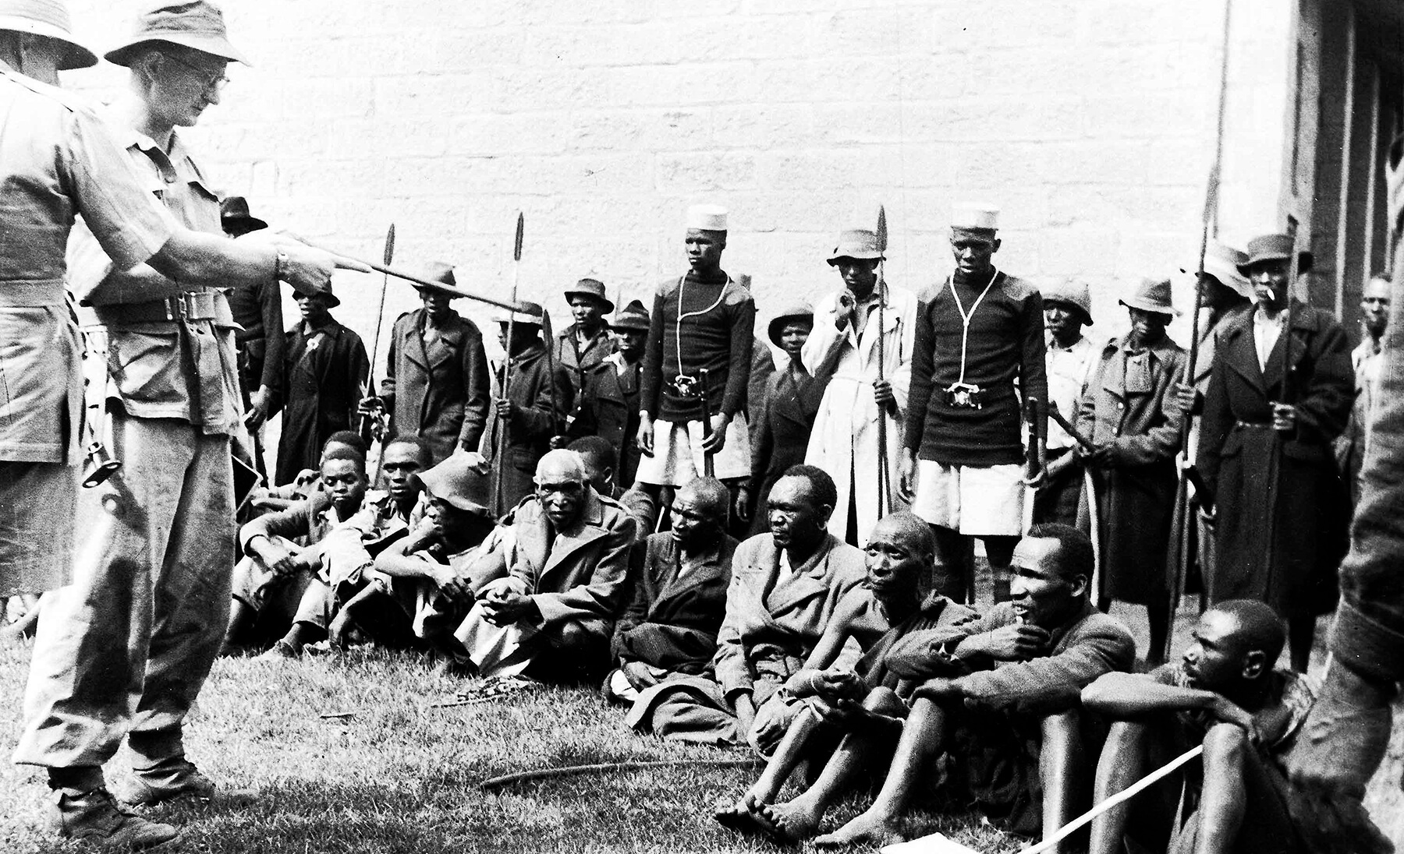
History of Africa
The State of Universal Health Coverage in Africa: Report of AHAIC Commission. Nairobi. Kenya. 2021

Slide 3



History of PHC in Africa
Notes:
2008 –Ouagadougou Declaration
Commitment vs. Action? Use priority programmes as entry point to strengthen national health systems using PHC
2012 HRH a priority [NO mention of PHC]

Slide 4



History of PHC in Africa
Notes:
2017 WHO AFRO Report/Resolutions Leave no one behind Strengthening health systems for UHC and the SDGs in Africa
“A holistic approach to strengthening health systems, moving away from the programme-specific approach of the MDG era”
Efficient integrated person-centred delivery
Inter-sectoral collaboration for SDGs
2018: WHO Contribution to WHO Global Report
Challenges: poor decentralisation!
2019 WHO AFRO “THE STATE OF HEALTH in the WHO African Region” “WHO’s concept of six building blocks approach has led in practice to the verticalization of the efforts at improving health systems, with a focus on intervention within specific blocks, as opposed to the interactions across building blocks” → poor person-centredness

Slide 5

2021 AHAIC Report
State of Universal Health Coverage in Africa: Report of the Africa Health Agenda International Conference Commission. Nairobi. Kenya. 2021
  Performance
  Challenges
  Opportunities
  Recommendations

Slide 6

UHC performance in Africa
Effective coverage is poor
Financial risk protection(8.2% catastrophic expenditure pa)
Health outcomes improving but globally low.

Slide 7
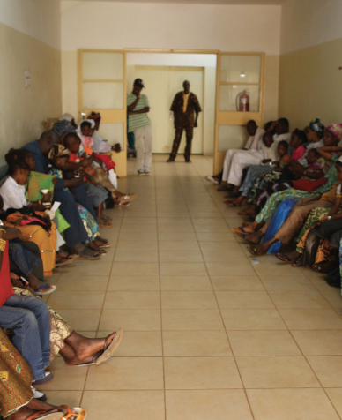
UHC challenges in Africa
Context
  Legacy of colonization
  Neo-colonial influence
  Inadequate economic growth / high dependency
  Political instability / wars
  Rising / unplanned urbanization
  Climate change

Slide 8
UHC challenges in Africa
System
  Poorly managed health sector resources
  Weak governance and accountability of health systems
  High disease burden
  Low trust/ownership in health systems
  Societal practices/norms/beliefs

Slide 9

UHC opportunities in Africa
Africa’s economic trajectory
AU is pro-people
African Free Trade Area
Network of traditional healthcare providers
Political commitment
Demographic dividend

Slide 10
UHC opportunities in Africa
Developed private sector
Innovation ecosystem
Strong civil society
Well-trained and competent health professionals
COVID 19 health system strengthening efforts

Slide 11

UHC Recommendations for Africa (Health)
Re-orient health systems towards population health needs (preventive/promotive care)
Prioritise and strengthen PHC
  Prioritise PHC/Health in All Policies - integrating developmental decentralised government.
  Reallocate existing health system resources and increase investments to strengthen PHC systems.

Slide 12
UHC Recommendations for Africa (Health)
Prioritise and strengthen PHC (Contd)
  Strengthen PHC facilities first point contact healthcare - physical access, explicitly assign population groups to primary healthcare units, and implement robust referral systems.
  Strengthen PHC delivery with flexible non-hierarchical multidisciplinary teams of clinical and non-clinical staff to provide integrated care to defined empanelled populations.
  Implement integrated care models of service delivery, contracting, and reimbursement - integrate horizontally, diagonally with programmes; and vertically with secondary.

Slide 13

UHC Recommendations for Africa (Health)
Invest in strengthening health system inputs, especially PHC e.g., skilled workers / infrastructure
Invest in system-wide approaches to improve the quality of healthcare delivered to people e.g. resource, health workforce constraints
Invest in health technologies

Slide 14
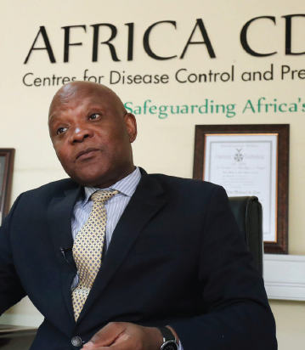
UHC Recommendations for Africa (Health)
Reform health financing systems to support UHC
  Increase domestic financing
  Pool tax-financed funds
  Implement strategic purchasing
  Reform public finance management/inefficiencies
  Prioritise systems-for-health vs health systems

Slide 15

UHC Recommendations for Africa (Health)
Strengthen governance and accountability
  Health as cross-cutting development strategy in sectoral plans
  Leverage/govern public-private partnerships
  Strengthen community participation
  Reaffirm political commitment
  Comprehensive legal and policy frameworks
  Invest in leadership capacity development
  Anti-corruption strategies
  …..

Slide 16


Payment systems
Budgets/Salaries
Fee-for-Service (FFS)
Performance-based
Capitation

Slide 17
Population
National Treasury
NDOH
OOP
MAS
PDOH
Private Administrators
District
LG
NS
CHC
Clinic
Clinic
Clinic
Clinic
Clinic
GP
GP
Pharm
GP
Nurse
Pharm

Slide 18
Population
National Treasury
NDOH
NHI
OOP
MAS
PDOH
Private? Administrators
Private Administrators
District
LG
NS
CHC
Clinic
Clinic
Clinic
Clinic
Clinic
GP
GP
Pharm
GP
Nurse
Pharm

Slide 19
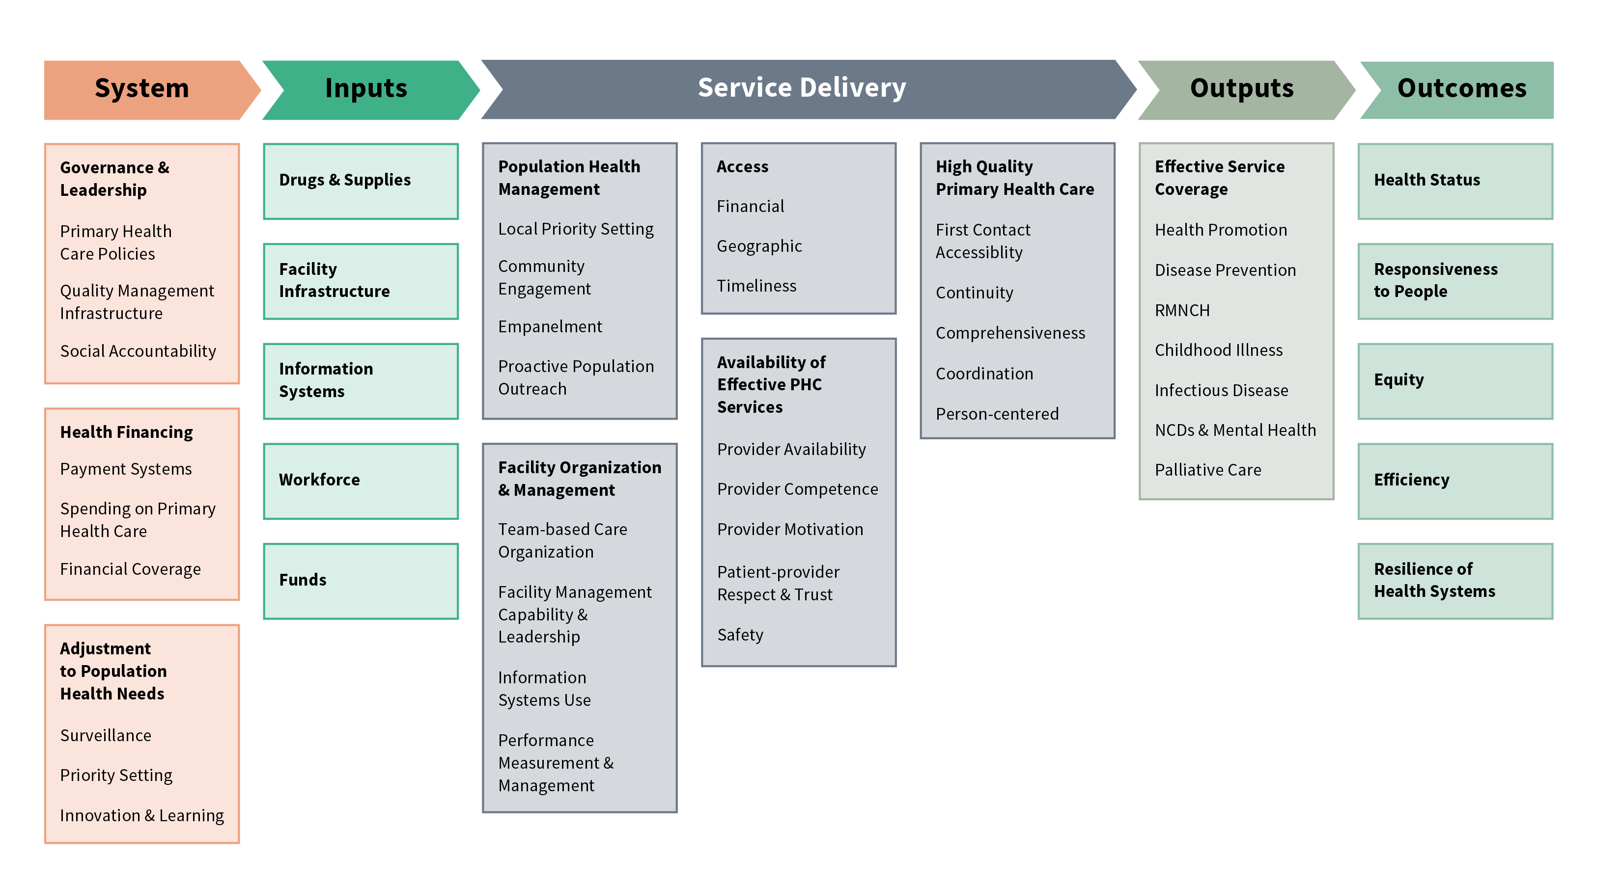
PHC Performance Initiative
https://improvingphc.org/phcpi-conceptual-framework

Slide 20
Community Practice Service Package
Clinic
Facility-based care:
Minor acute ailments, HIV/TB and other communicable diseases, non-communicable diseases, mother and child health (incl. IMCI, FP, EPI, ANC/ PNC), violence/trauma, mental health
Community-based care:
Community-level home-based care, directly-observed treatment strategy, integrated nutrition programme, community-based rehabilitation, health promotion (incl. dietary advice/exercise), social work, environmental health, school health
CHC
After Hours / 24 Hr Emergency
Shared Services
Radiology
Pharmacy
Maternity obstetric unit (MOU)
Minor procedure theatre (MMC)
Short stay beds
Large CHC
Multi-disciplinary team:
Dentistry
Optometry
Physiotherapy
Occupational Therapy
Speech Audiology
Podiatry
PHC Team
+ CHW
+ Dr
Leadership vs. Clinical Governance
Inclusion of after-hours care
“Links” to school & environmental Health
± Social Worker, Dietician, Biokinetics (BONUS)
  Progressively contract Additional Services

Slide 21
Proposed contracting framework (NT work)
Community Practice
Enrolled population of 2000-10 000
with performance accountability
Community-oriented primary care (COPC)
  Understand your population in their homes
  Understand how they use services at the facility
  Engage community stakeholders and build priorities together
  Embark on targeted health promotion based on community diagnosis
Clinic / GP
facility-based curative
“Catchment population” of
±10 000

Slide 22
Community Practice Service Package
Defined by
  PHC elements of 285 guidelines in SA (based on SAGE audit)
  Medicines List (Starting with Extended PHC Formulary)
  Lab List (Starting with Extended NHLS PHC List)
  Office Procedure List (136 from NHRPL to limit hospital
  referrals) e.g. cautery, intra-articular injection
  Preventive Services (ANC, FP, Immunization…)
  Performance Outcomes (5-year plan)
Refine service package annually with Peer Review / Service Benefits Committee / National Institute of Clinical Excellence
Could be Comprehensive PHC PMB for medical schemes
Cap (70%)
FFS (20%)
P4P 10%

Slide 23
Utilisation
Practice |  |  | Acute/Chronic |  |  |  |  |  | FP etc.
 |  | Visits pa | 1 | 2 | 3 | 4 | 5 | 6 | 2
 | Pop.Size
 | 2500 |  | 10 | 20 | 30 | 40 | 50 | 60 | 20
 | 5000 |  | 20 | 40 | 60 | 80 | 100 | 120 | 40
 | 7500 |  | 30 | 60 | 90 | 120 | 150 | 180 | 60
 | 10000 |  | 40 | 80 | 120 | 160 | 200 | 240 | 80
?

Slide 24
Clinical Teamwork
Community-orientation
District coordination
Supply-side innovation
Referral Support
Key Principles for delivery

Slide 25
Clinical Teamwork
Encourage clinical teamwork (doctor, nurses, clinical associate, CHW) for horizontal integration
MINIMUM Personnel Standards
  1 doctor per 10 000 (clinical accountability)
  1 clinical associate/officer per 5000
  1 nurse per 2 000
  All healthcare workers should be registered with NHI
  All healthcare workers should be indicated in claims / data submissions / EHR
1 CHW per 1 000 (paid for additional to cap)
?Bonuses for multidisciplinary teamwork: health promoter, social worker, dietician, biokineticist, case managers

Slide 26
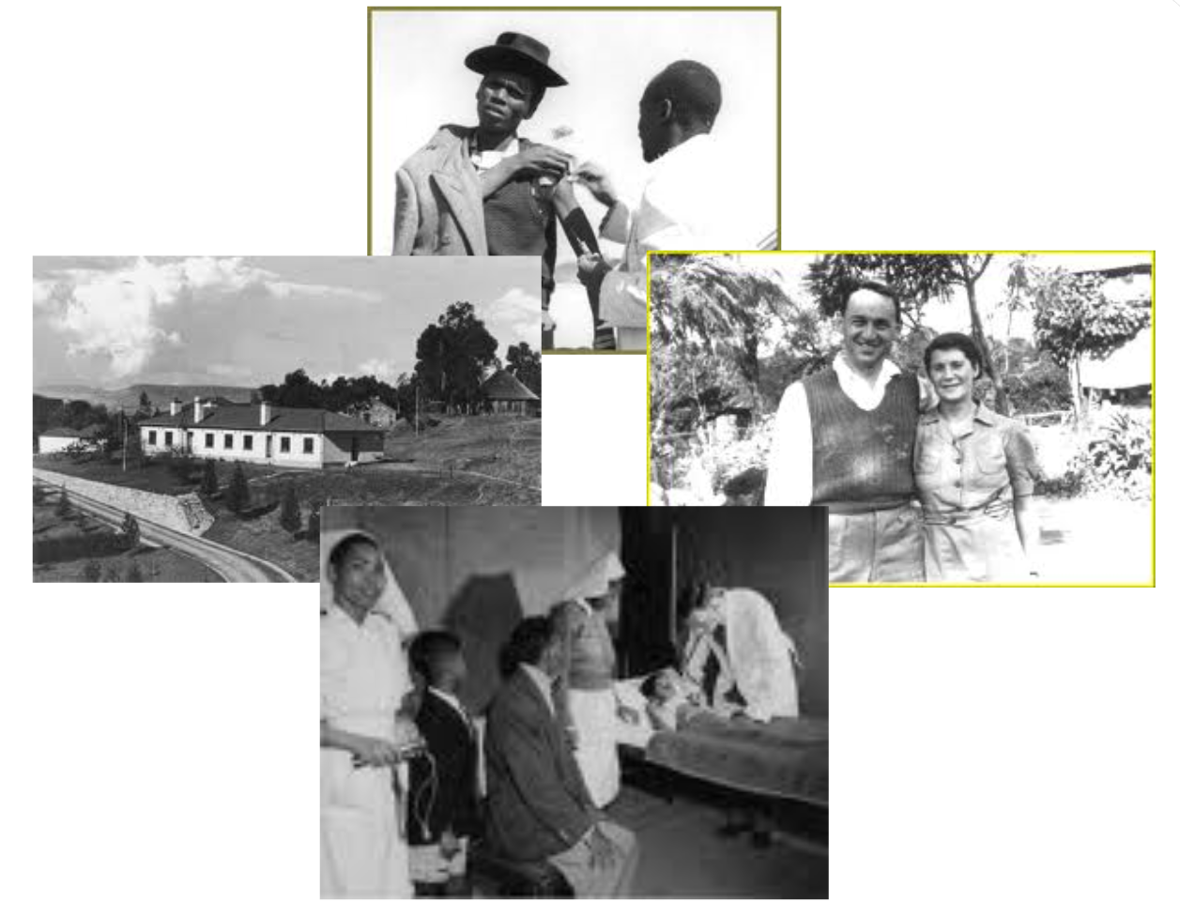
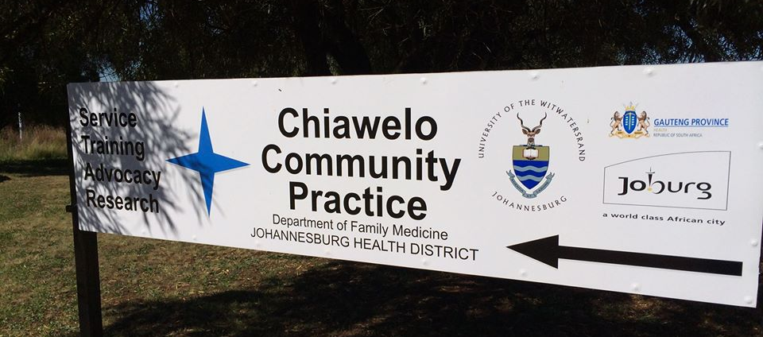
COPC
Chiawelo “Community” Practice
Video at ProfMoosa.com>CCP

Slide 27
COPC
Population
Management
by CHWs
PHC
're'-orientation
Targeted
Health
Promotion
Stakeholder
collaboration

Slide 28
Community Orientation
Profile and actively manage panel population (with CHWs)
‘Comprehensive Health Checks’ for everyone in panel every 5 years
Engage community for targeted health promotion
  Annual Panel Community Meeting / Open Day (prioritizing/election)
  Monthly Community Forum (including health promotion)
  Simple practice leaflet of services updated annually
  Detailed annual review of practice
No discrimination between NHI and non-NHI (back and front sections)
Home visits by doctor for medical need

Slide 29
Referral Support
Risk of over-referral → vertical integration needed
Proposed NHI Referral Point at local hospital
  Data collected for ALL referrals + Facilitated entry into hospital system for all services not covered currently (allied, specialist, hospital admission…..)
    Office with clerk/nurse
    Vula/Hotline to specialists panel at local public hospital/s
    Coordinated by NHI-appointed/DCST family physician
Until other layers of contracting are organised to include private specialists and hospitals

Slide 30
District Coordination
Health District creates a Forum for coordination and integration of all service providers
  Each Community Practice to send representative / liaise
  District supports, monitors and evaluates programmatic priorities for diagonal integration
  Explores gaps for further contracting by NHI Fund
Support linkages
  Hospital referrals
  Referrals from non-NHI clinic to contracted NHI GP

Slide 31
Supply-side innovation
Important that contracting does not introduce rigidity - allow for supply-side to re-organize
Provided in own facility - Basic Allowance? (rent space in clinics/CHCs)
Form groups – incentives?
Supply chain: Meds – State Wholesalers / Lab Tests – National Labs
Additional services contracted for groups of community practices in economies of scale strongly linked to community-orientation / prevention
  24 Hour Emergency Care
  Dentistry / Optometry
  Allied Health Care (Physiotherapy, Occupational Therapy, Podiatry)
  Maternity Obstetric Unit (MOU) services
  Specialist-Hospital Referral Saving-Commissioning

Slide 32
Accreditation
Enrolment
Data Submission
Peer Review
Training
Operational Requirements

Slide 33
Accreditation
Criteria
  National (OHSC) Standards
Plan
  Self-assessment with application
  1.25 audits per 5-year cycle by OHSC (as and when they have capacity)
  Subcontract COHSASA in interim?

Slide 34
Enrolment
Residents on Health Patient Registry System (HPRS) make a choice from contracted providers
  Within district
  Administrative ‘allocations’ to contracted providers
  Contracted provider may enroll other residents from district
Contracted provider must fully register the resident to their practice with HPRS before payment starts
  Resident able to change 12 monthly (6mthly in first year)
  Primary choice ± motivated secondary choice (2/yr for work-school reasons)
  Out-of-province visits?
Panel Changes / Closures need formal approval

Slide 35
Data submission
Initially fee-for-service data (incl. ICD) using Payment Management Systems with Electronic Data Interchange (EDI) – immediate claim
Need a long-term plan to evolve to Electronic Health Record (EHR) data
  Essential for stronger Payment for Performance (P4P) / M&E
  Need to accredit EHRs and develop inter-operability standards
  Include Mobile Health for CHWs

Slide 36
Peer-review
Monthly peer-review meeting
  Mandatory attendance of accountable doctor
  Chaired by DCST family physician
  Review Referrals / Utilisation
  Support education / CPD / up-skilling

Slide 37
Training
Online work-based 18mth Diploma in Family Medicine
  Mandatory for accountable doctor with less than 15 years experience
  Use peer review process to focus on clinical needs
  Focus on practice management issues for population management
  With supportive practice visits by NHI-appointed family Physician
  Career pathing
Incentivise young doctors NMFC / Community Service Doctors with Diploma cost claim on completion and facility / 6-12 months cash flow support
Make Diploma a substantial element of Payment for Performance

Slide 38
NHI PHC CONTRACT RULES
Service Package
Preventive Services
Payment
Procedures
Medicines
Investigations
COPC
Service Standards
Personnel Standards
DHMO Coordination
Accreditation.
Audit
Enrolment
Data Management
Referral Management
Quality Management
Performance Management

Slide 39
Way forward?
Approve draft contract, operational manual and costing framework (including pay-for-performance).
Approve feasibility sites (Sub-Districts of 50 000-80000) and political, project and change management strategy
Tender out Monitoring & Evaluation (5%)
Tender out administration of accreditation (practice/software), NHI patient hotline and regular Cap/FFS/P4P payments (5%)
Arrange / Support operational elements of contract
  Enrolment (including HPRS set up and link to Administrator)
  Drugs access (including pharmaceutical wholesaler arrangements)
  Lab access (including NHLS arrangements)
  Radiology access (developing contract and pricing)

Slide 40
Research required for Africa
Define PHC facilities/HR
Quantify HR type / numbers / distribution
Explore team composition vs population
Experimentally test panels / teams for inputs / outputs / outcomes / impacts in country and multi-country sites across Africa.

Slide 41
Prof. Shabir Moosa
Shabir@ProfMoosa.com
Family Physician Wits/Jhb Health District) https://profmoosa.com/
WONCA Africa President https://www.woncaafrica.org/
AfroPHC Executive Coordinator https://afrophc.org/

