Slide 1


State of the training of family doctors in Africa and lessons to be learnt
Prof Bob Mash
Primafamed Network
Stellenbosch University

Slide 2
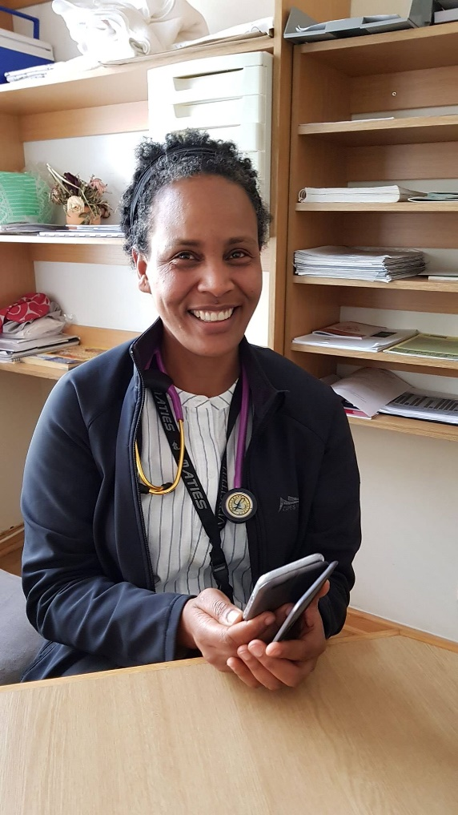
Family doctors – who do we mean?
Family physicians – specialists in family medicine
Medical officers – working in public sector
General practitioners – working in private sector
Working in primary care, primary/district hospitals and higher levels of care
Notes:
MO/GP usually junior/young waiting to move elsewhere

Slide 3
What training do these family doctors have?
Family doctors | Training level
Family physicians | 4-years of postgraduate training
Medical officers/general practitioners | Only undergraduate Most have no postgraduate training Diploma in Family Medicine (very few)

Slide 4
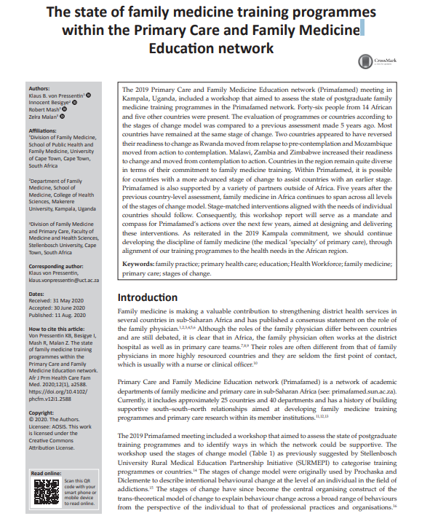
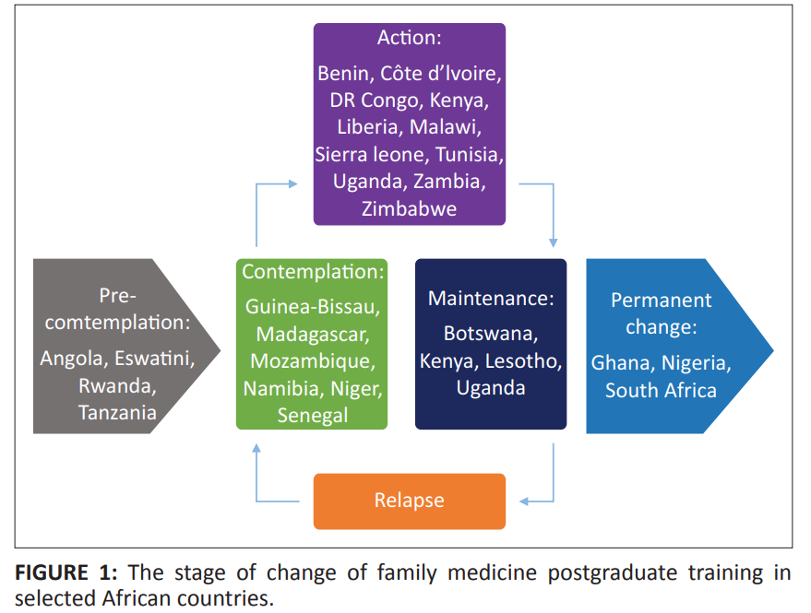
The state of PG family medicine training
Mash R, de Villiers M, Moodley K, Nachega J. Guiding the Development of Family Medicine Training in Africa through Collaboration in the Medical Education Partnership Initiative. Academic Medicine 2014; 89(8 Suppl):S73-7. doi: 10.1097/ACM.0000000000000328.

Slide 5
High level support linked to stages of change
Stage of change | Type of support needed
Pre-contemplation | Share evidence with ministry of health, council and higher education bodies
Contemplation | Meet with ministry of health, council and higher education bodies – discuss pros and cons, advocacy
Preparation | Curriculum design and accreditation Training site selection and preparation Faculty development
Action | Implementation of training programme Support for teaching, training and assessment
Maintenance | Prepare health system for first graduates Ongoing faculty development and development of training sites

Slide 6
Lessons learnt in implementing family medicine training
Curriculum content
Educational approach
Assessment
Programmatic learning outcomes
Roles and responsibilities in the health system

Slide 7
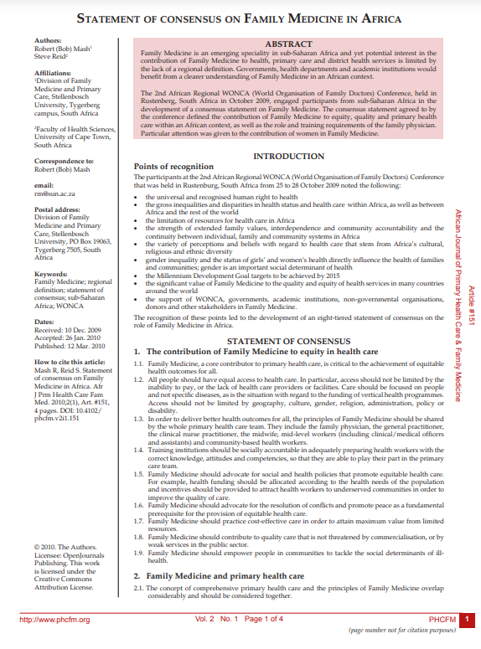
Define the contribution of family medicine in the region in broad terms
Regional statement of consensus in 2010
Wonca Africa Conference
4-day participatory process
Supported by prior research studies – Delphi.
Mash B, Reid S. Statement of consensus on Family Medicine in Africa. Afr J Prm Health Care Fam Med. 2010;2(1), Art. #151, 4 pages. DOI: 10.4102/ phcfm.v2i1.151
Mash R, Downing R, Moosa S, de Maeseneer J. Exploring the key principles of Family Medicine in sub-Saharan Africa: international Delphi consensus process. SA Fam Pract 2008;50(3):60-65

Slide 8
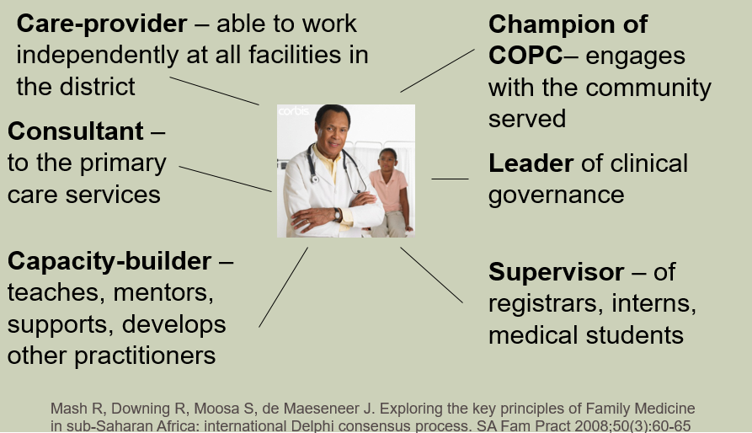
Define the roles and responsibilities at a national level in the health system
National coordinating body to support dialogue and collaboration (FaMEC in South Africa and later SAAFPs)
6 roles of the family physician
Embed and align with HRH policy
Mash R, Ogunbanjo G, Naidoo SS, Hellenberg D. The contribution of family physicians to district health services: a national position paper for South Africa. South African Family Practice. 2015 May 1;57(3):54-61.

Slide 9
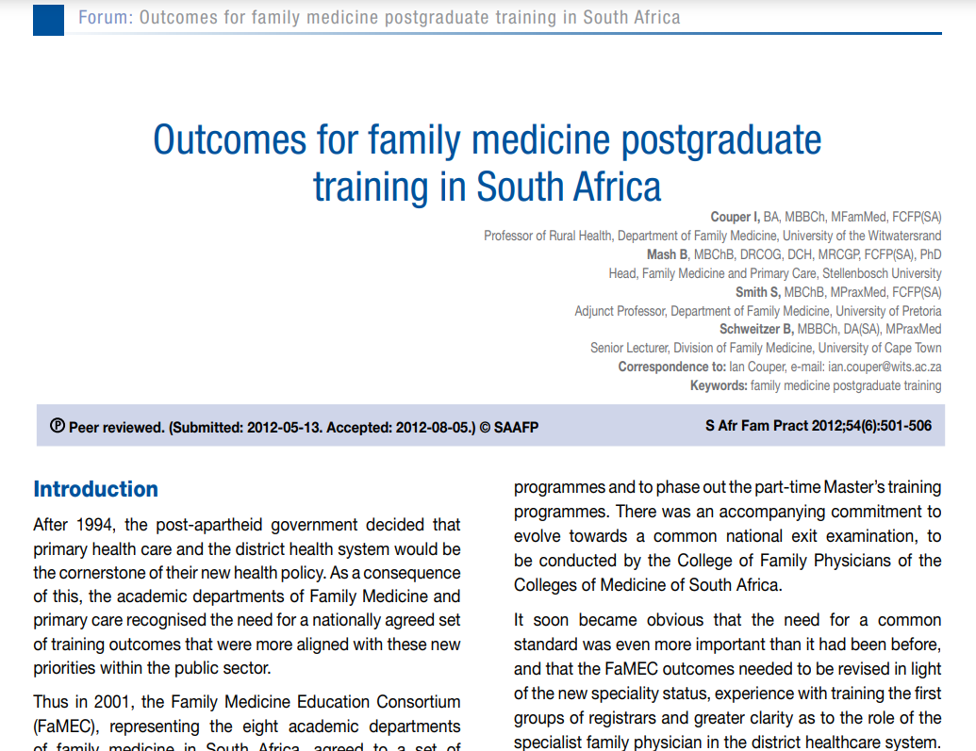
Define national programmatic learning outcomes
Five unit standards:
  Leadership and governance
  Clinician and consultant
  Community-orientated care
  Clinical trainer and capacity builder
  Ethics and professionalism
National Delphi process with final consensus by national professional body
Aligned with all nine training programmes
Revise periodically
Couper I, Mash B, Smith S, Schweitzer B, Outcomes for family medicine postgraduate training in South Africa. South African Family Practice Journal 2012; 54(6): 501-506. Akoojee Y, Mash R. Reaching national consensus on the core clinical skill outcomes for family medicine postgraduate training programmes in South Africa. African Journal of Primary Health Care and Family Medicine 2017; 9(1):1-8.

Slide 10
Curriculum design at level of programme
E-learning
NOT silos
CFM domains with
Portfolio every year
Class mark 50%
Final exam
Research
 | Year | Module 1 |  | Module 2 |  | Module 3 |  | Exam
 |  | February 1st |  | May 9th |  | August 15th |  | November 11th and 12th
 | 1 | Consultation |  | Ethics |  | Evidence-based Medicine |  | Clinical Family Medicine I
 | 2 | Applied Research |  | Principles of family medicine |  | Community-oriented primary care |  | Clinical Family Medicine II
 | 3 | Family-oriented primary care |  | Teaching and Learning |  | Leadership and Clinical Governance |  | Clinical Family Medicine III
 | 4 | Rehabilitation |  | Geriatrics |  | Forensics
 |  | or |  | or |  |  |  | Final clinical exam
 |  | Cancer care |  | Palliative Care |  |  |  | Research assignment

Slide 11
Curriculum design at level of programme
Anesthetics
Surgery
General
Adult
Medicine
Mental
Health
Child
Health
10 clinical
domains
NT, Eyes,
Skin
Women’s
Health
HIV/AIDS
TB
STI
Ortho-
Paedics
Emergencies

Slide 12
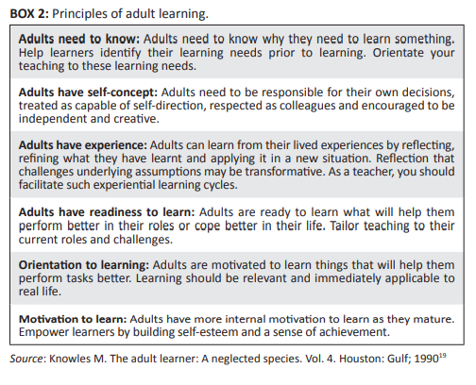
Educational approach: Adult learning
Mash B, Edwards J. Creating a learning environment in your practice or facility. S Afr Fam Pract. 2020;62(1), a5166. https://doi.org/ 10.4102/safp.v62i1.5166

Slide 13

Educational approach: Hybrid

Slide 14
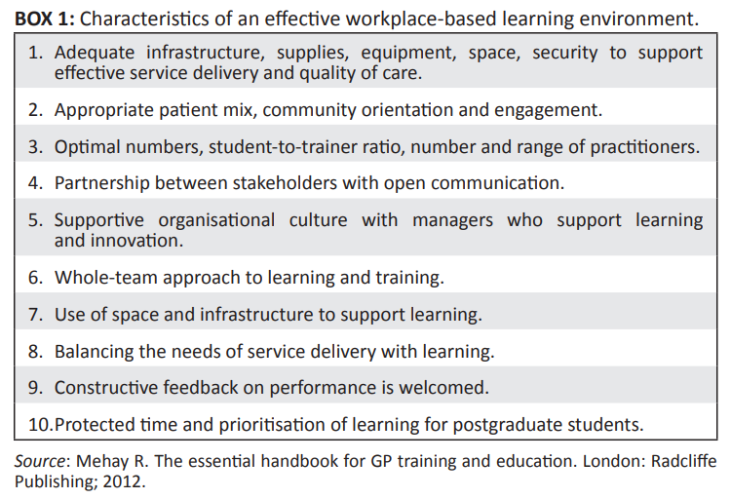
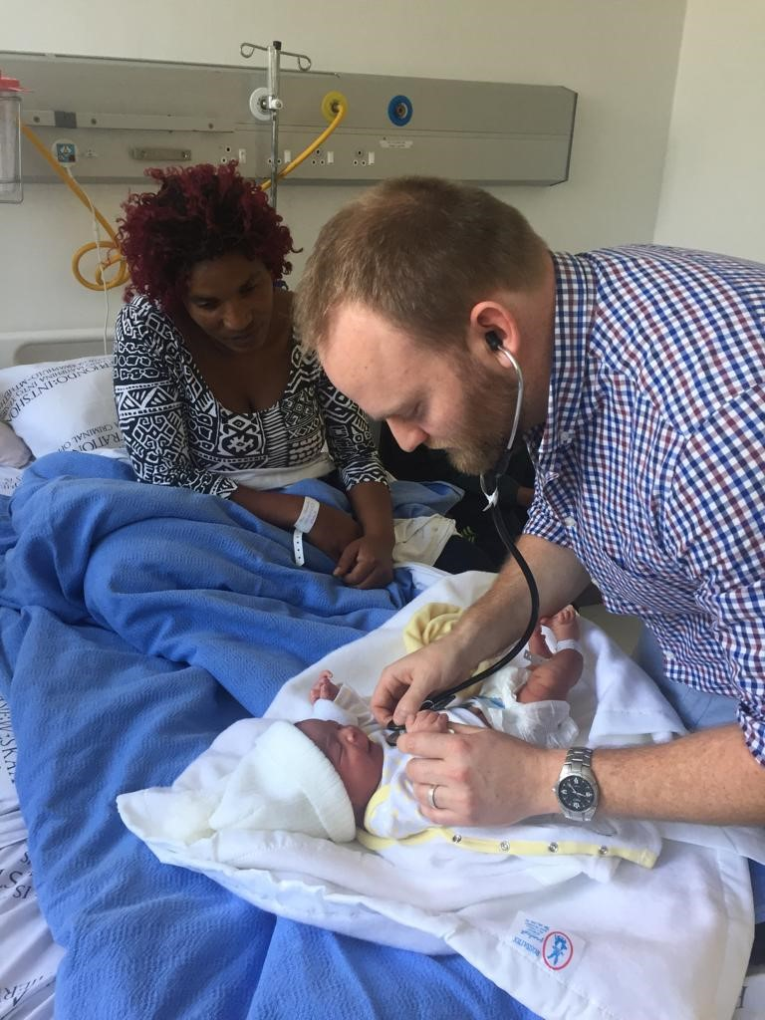
Educational approach: Workplace based
Mash B, Edwards J. Creating a learning environment in your practice or facility. S Afr Fam Pract. 2020;62(1), a5166. https://doi.org/ 10.4102/safp.v62i1.5166

Slide 15

Training of clinical trainers
Establishing and maintaining a learning environment
Curriculum design and alignment
Working with adult learners (including reflective practice)
Assessment methods
Giving feedback
Teaching consultation skills
Small group teaching
Learning in the clinical setting
Leadership and strategic capacity
Mash R, Blitz J, Edwards J, Mowle S. Training of workplace-based clinical trainers in family medicine, South Africa : Before-and-after evaluation. African Journal of Primary Health Care and Family Medicine 2018; 10(1):1-6.

Slide 16
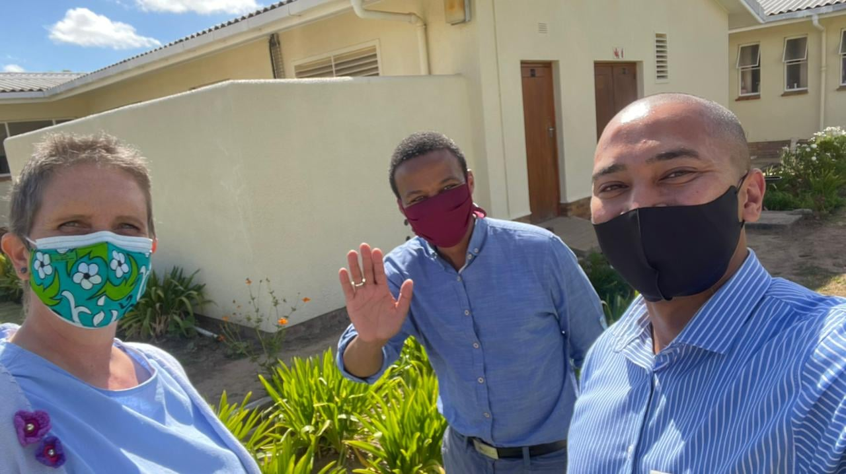
Formative assessment visits
Five key areas:
Ensuring safe and effective patient care through training
Establishing and maintaining an environment for learning
Teaching and facilitating learning
Enhancing learning through assessment
Supporting and monitoring educational progress
Mash R, Malan Z, Blitz J, Edwards J. Improving the quality of clinical training in the workplace: implementing formative assessment visits. South African Family Practice. 2019 Nov 18;61(6):264-72.

Slide 17
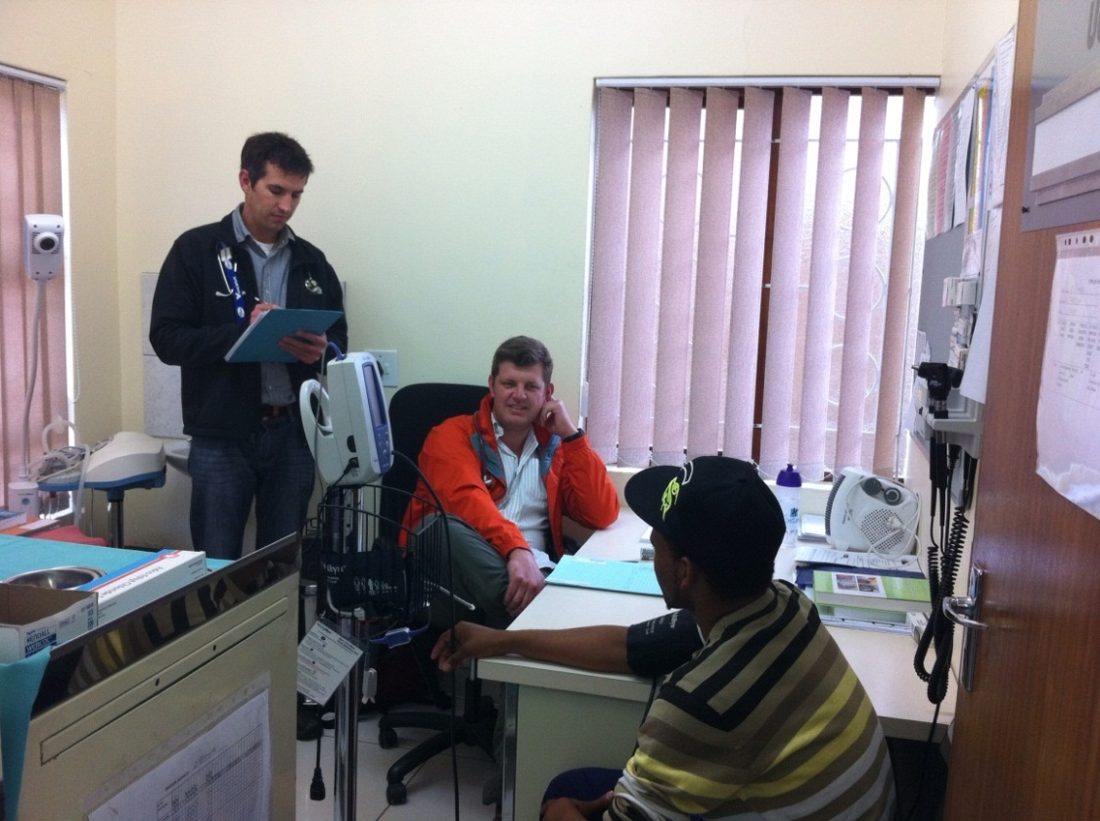
Workplace based assessment
Assesses activities at the top of Miller’s pyramid
Multiple (direct) observations
Sample widely across curriculum
Many sources (methods/observers)
Over time and different settings
Focus on effective verbal and narrative feedback more than scores
Harness power of reflection-on-action
Assessment is activity and context bound
Sharpen the assessor not the instrument
Separate formative from summative judgements
Swanwick, T and Chana,N 2005 Workplace assessment for licensing in general practice
British Journal of General Practice
Burch VC. The Changing Landscape of Workplace-Based Assessment. Journal Appl Testing Technology, Vol 20(S2), 37-59, 2019

Slide 18
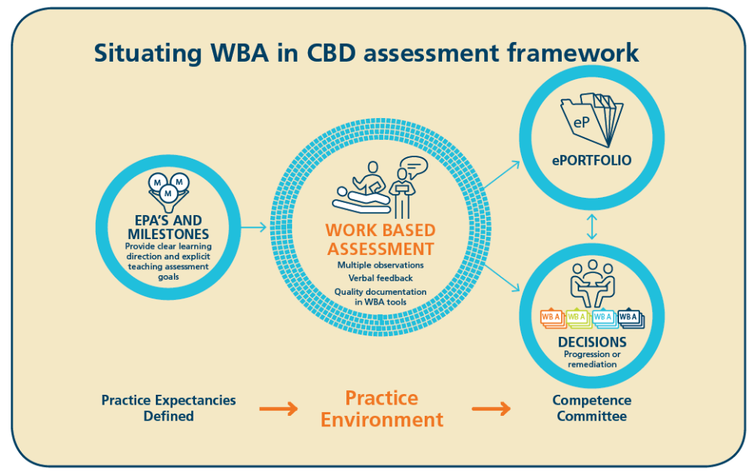
Workplace based assessment

Slide 19
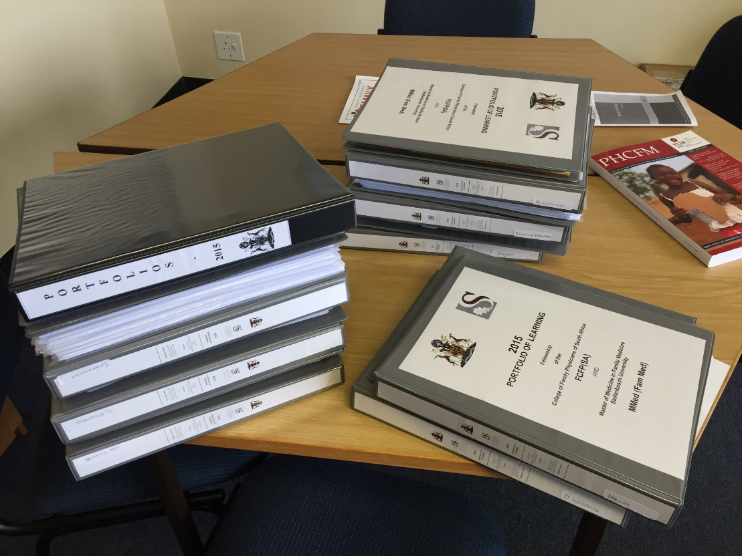
Portfolio – assessment for learning
Introduction
Alignment with learning outcomes
Allocations
Learning plans, reflections, periodic assessments
Educational meetings
Observations and feedback
Multisource feedback
Assignments
Logbook of clinical skills
Other learning
Portfolio assessment tool

Slide 20
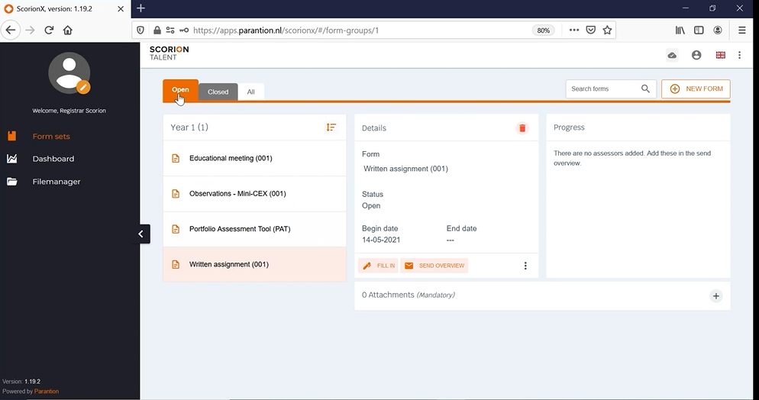
E-portfolio of learning

Slide 21
Other types of programmatic assessment
Annual clinical family medicine assessment (MCQ exam and Portfolio)
Module mark – assignments, quizzes, participation
Research assignment

Slide 22
National licensing examination
Constructive alignment - blueprinting
Validity – removal of invalid forms of assessment
Reliability – increase in sampling of curriculum
Writing groups – improve quality of questions
Training of examiners – improve quality of assessment
Standard setting – set an appropriate threshold
Workplace based assessment – the future

Slide 23
Issues for the future
Advocacy for appropriate HRH policy
Development of workplace based assessment and one national e-portfolio
Accreditation of clinical trainers
Improving throughput and pass rate in national exam
Tripling the output of family physicians by 2025
Developing career pathway

