Slide 1
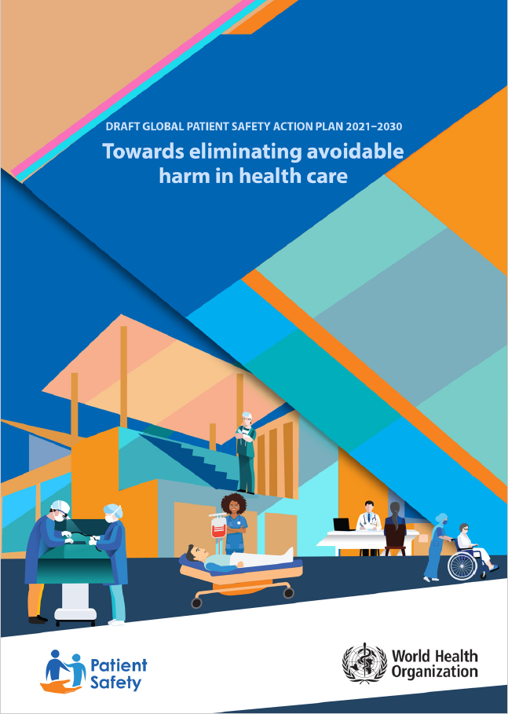


Global Patient Safety Action Plan 2021–2030
An Overview

Slide 2

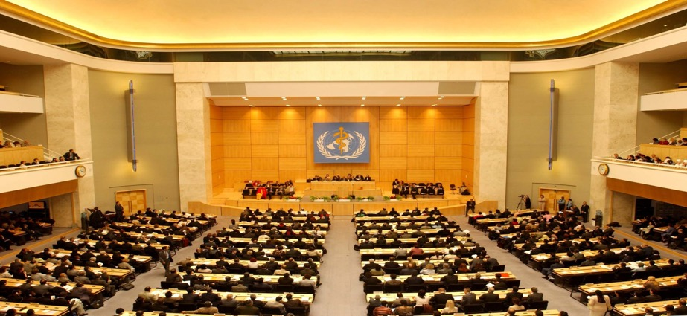

72nd World Health Assembly (WHA)
May 2019
Watershed moment for patient safety!
Adopted WHA resolution on Global action on patient safety (WHA72.6)
Recognized Patient Safety as a global health priority
Established an annual World Patient Safety Day on 17 September
Formulate a Global Patient Safety Action Plan, aligned with SDGs

Slide 3
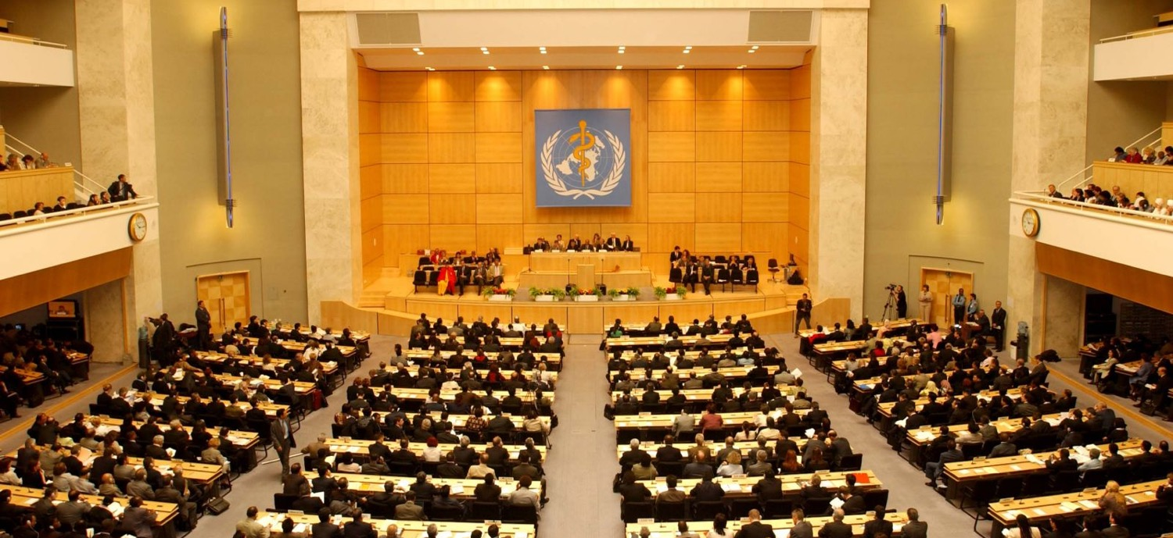
The Mandate
WHA 72.6: Global Action on Patient Safety
“to formulate a global patient safety action plan in consultation with Member States and all relevant stakeholders, including in the private sector, for submission to the Seventy-fourth World Health Assembly in 2021 through the 148th session of the Executive Board”

Slide 4

Purpose of the global action plan
Provide strategic direction for all stakeholders through policy actions
Provides a framework to develop national action plans on patient safety
Align existing strategic instruments for promoting patient safety in all clinical and health-related programmes
Provide implementation guidance for mandate provided by WHA72.6: Global action on patient safety

Slide 5
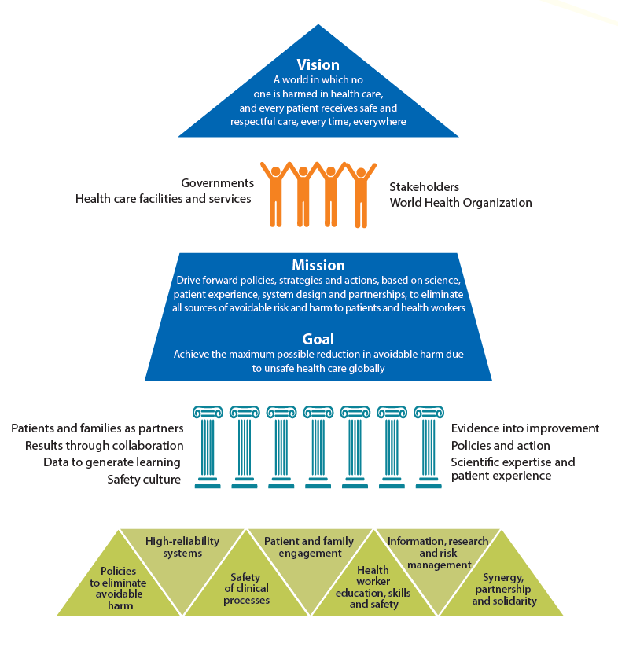

Slide 6




Partners in Actions
Health Care Facilities
and Services
Governments
Stakeholders
The WHO Secretariat

Slide 7
Seven Strategic Objectives
SO1
Policies to eliminate avoidable
harm in health care
SO2
High-reliability
systems
SO3
Safety of clinical
processes
SO4
Patient and family
engagement
SO5
Health worker education,
skills and safety
SO6
Information, research and
risk management
SO7
Synergy, partnership
and solidarity

Slide 8
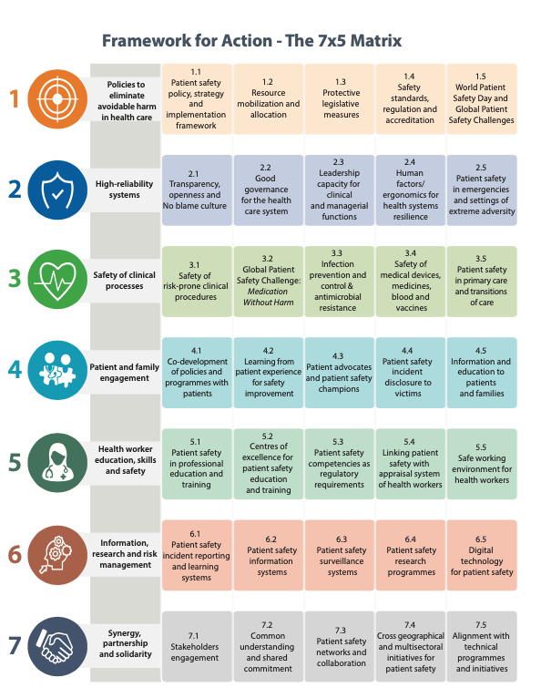

Slide 9


Slide 10

Strategy 1.1:
Patient safety policy, strategy and implementation framework
Strategy 1.2:
Resource mobilization and allocation
Strategy 1.3:
Protective legislative measures
Strategy 1.4:
Safety standards, regulation and accreditation
Strategy 1.5:
World Patient Safety Day and Global Patient Safety Challenges

Slide 11
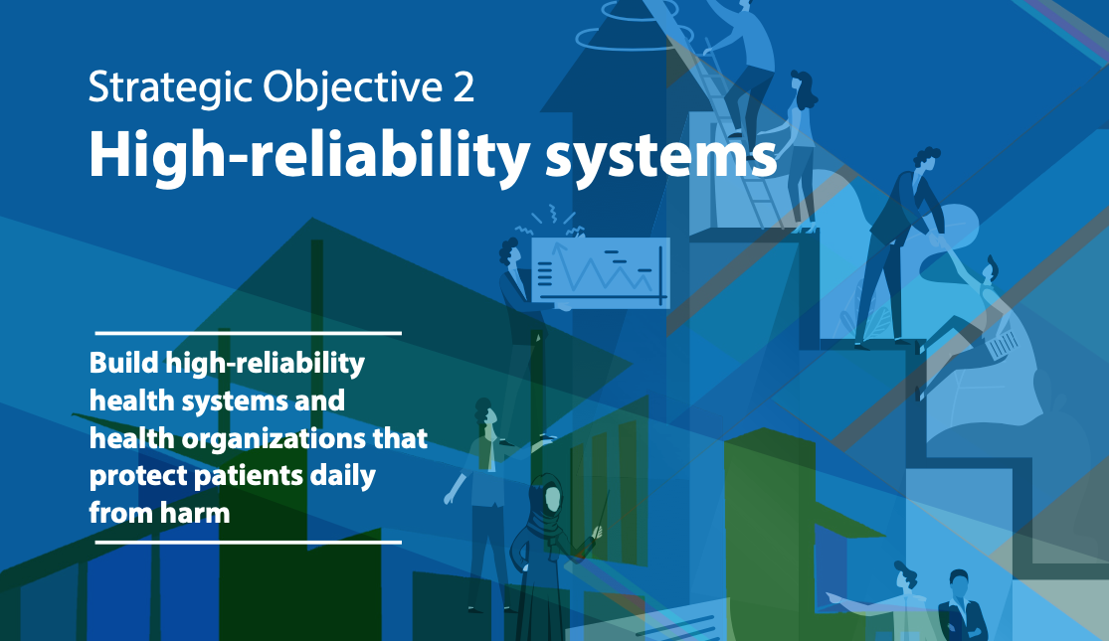

Slide 12

Strategy 2.1:
Transparency, openness and ‘No blame’ culture
Strategy 2.2:
Good governance for the health care system
Strategy 2.3:
Leadership capacity for clinical and managerial functions
Strategy 2.4:
Human factors/ ergonomics for health systems resilience
Strategy 2.5:
Patient safety in emergencies and settings of extreme adversity

Slide 13


Slide 14

Strategy 3.1:
Safety of risk-prone clinical procedures
Strategy 3.2:
Global Patient Safety Challenge: Medication Without Harm
Strategy 3.3:
Infection prevention and control & antimicrobial resistance
Strategy 3.4:
Safety of medical devices, medicines, blood and vaccines
Strategy 3.5:
Patient safety in primary care and transitions of care

Slide 15
Strategy 3.5:
assure the safety of patients in all settings, including in mental health settings and care homes, with a focus on primary care and transitions of care

Slide 16
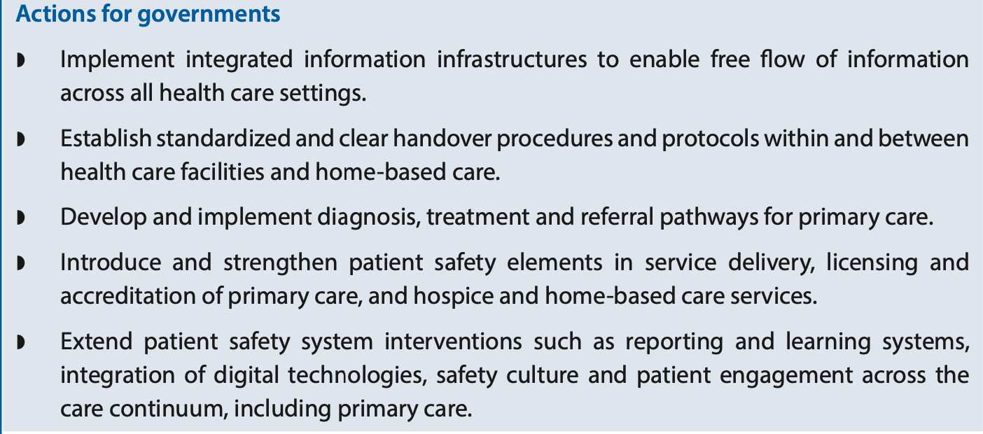

Slide 17
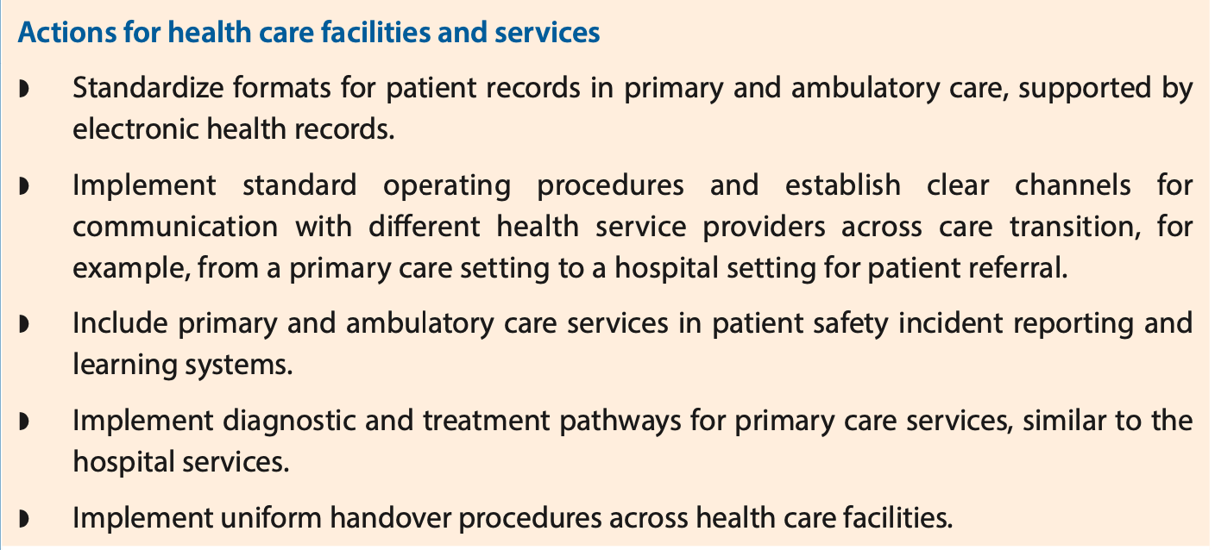

Slide 18
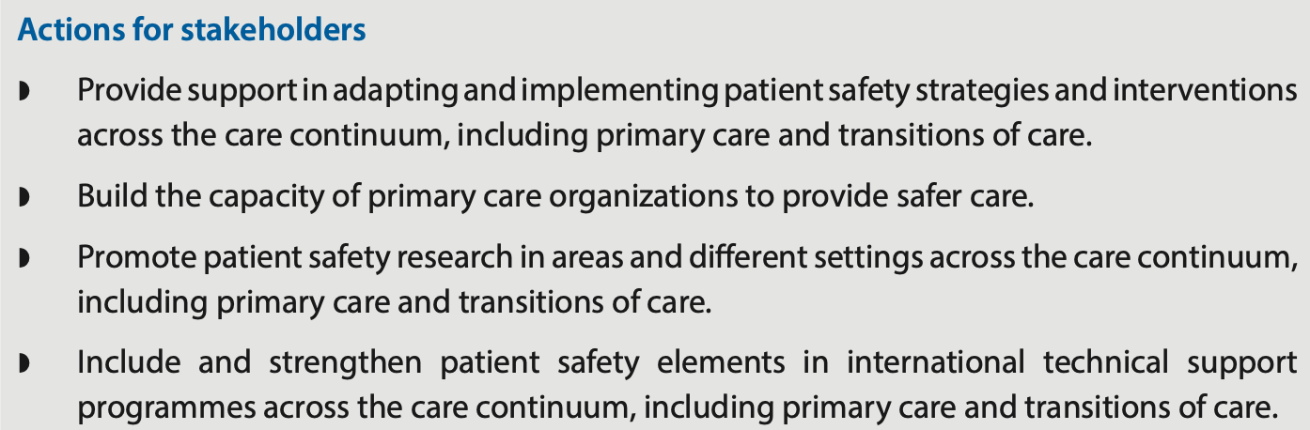

Slide 19
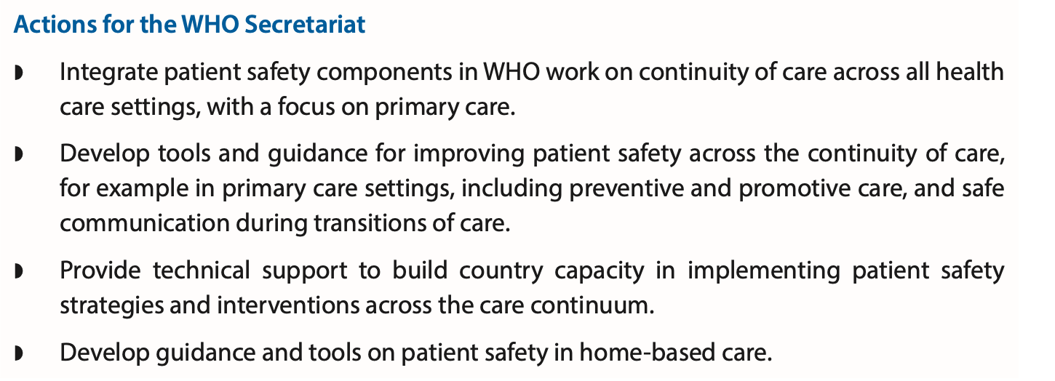

Slide 20


Slide 21

Strategy 4.1:
Co-development of policies and programmes with patients
Strategy 4.2:
Learning form patient experience for safety improvement
Strategy 4.3:
Patient advocates and patient safety champions
Strategy 4.4:
Patient safety incident disclosure to victims
Strategy 4.5:
Information and education for patient and families

Slide 22


Slide 23

Strategy 5.1:
Patient safety in professional education and training
Strategy 5.2:
Centres of excellence for patient safety education and training
Strategy 5.3:
Patient safety competencies as regulatory requirements
Strategy 5.4:
Linking patient safety with appraisal system of health workers
Strategy 5.5:
Safe working environment for health workers

Slide 24


Slide 25

Strategy 6.1:
Patient safety incident reporting and learning systems
Strategy 6.2:
Patient safety information systems
Strategy 6.3:
Patient safety surveillance
systems
Strategy 6.4:
Patient safety research programmes
Strategy 6.5:
Digital technology for patient safety

Slide 26


Slide 27

Strategy 7.1:
Stakeholder engagement
Strategy 7.2:
Common understanding and shared commitment
Strategy 7.3:
Patient safety networks and collaboration
Strategy 7.4:
Cross geographic and multisectoral initiatives for patient safety
Strategy 7.5:
Alignment with technical programmes and initiatives

Slide 28

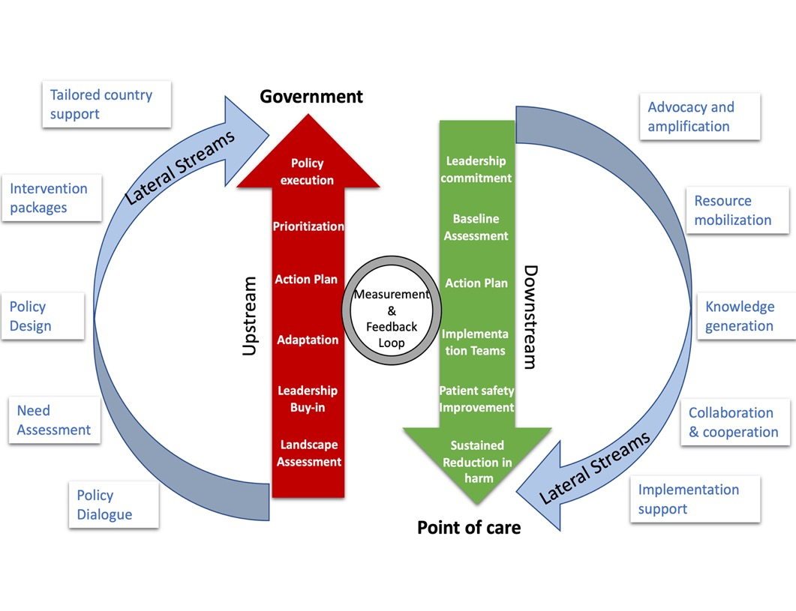
The Patient Safety Implementation Ecosystem
Steps
Landscape assessment of safety risks and barriers to improvement
Commitment from political and organizational leadership
Sustainable mechanism for implementation
National context and priorities
Model of change

Slide 29
1
Number of countries that have developed a national action plan (or equivalent) for implementing patient safety policy and strategies
2
Number of countries that have implemented a system for reporting of never events (or sentinel events)
3
Significant reduction in health care-associated infections (measured by % of countries achieving their national targets)
3
Significant reduction in medication-related harm (adverse drug events) (measured by % of countries achieving their national targets)
4
Number of countries that have a patient representative on the governing board (or an equivalent mechanism) in 60% or more hospitals
Core Indicators
5
Number of countries that have incorporated a patient safety curriculum in education programmes or courses for health care professionals
5
Number of countries that have signed up for implementation of the WHO Health Worker Safety Charter1
6
Number of countries that have 60% or more health care facilities participating in a patient safety incident reporting and learning system
6
Number of countries that publish an annual report on patient safety
7
Number of countries that have established a national patient safety network

Slide 30
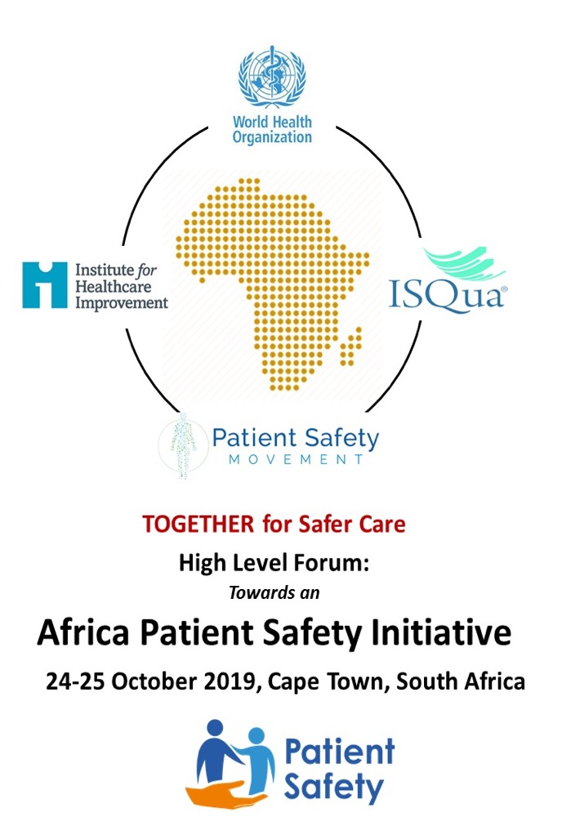
World Health Organization
WHA resolution WHA 72.6 'Global action on patient safety' (May 2019)
'Global patient safety action plan' as foundation for action in Africa
Institute for Healthcare Improvement
Launched 'Africa Hospital Patient Safety Initiative', to reduce severe medication-related harm by 25% over 2 years
10 hospitals (Ghana, Ethiopia, South Africa)
International Society for Quality in Healthcare
Launched 'African Community of Practice'
Patient safety & QI specialists in health and social care settings across Africa
The Patient Safety Movement Foundation
Goal of 'ZERO preventable deaths by 2020'
Implementing 'Actionable Patient Safety Solutions' in hospitals across several countries

Slide 31

23 Countries, 4 Partners, 140 Delegates and unlimited possibilities ……

Slide 32
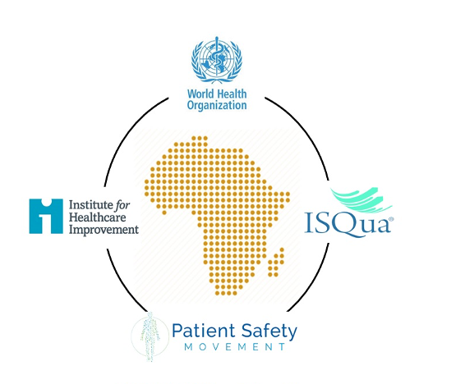
TOGETHER for safer care: recommendations on patient safety in Africa

Slide 33


Slide 34
T. O. G. E. T. H. E. R
T
Translating the WHA resolution on ‘Global Action on Patient Safety’ into reality
O
Observing World Patient Safety Day
G
Generating evidence, and developing guidelines and tools
Establishing coordination and collaboration mechanisms
E
T
Training for patient safety
H
Harmonizing health systems efforts
E
Engaging and empowering patients
R
Reporting and learning from adverse events

Slide 35

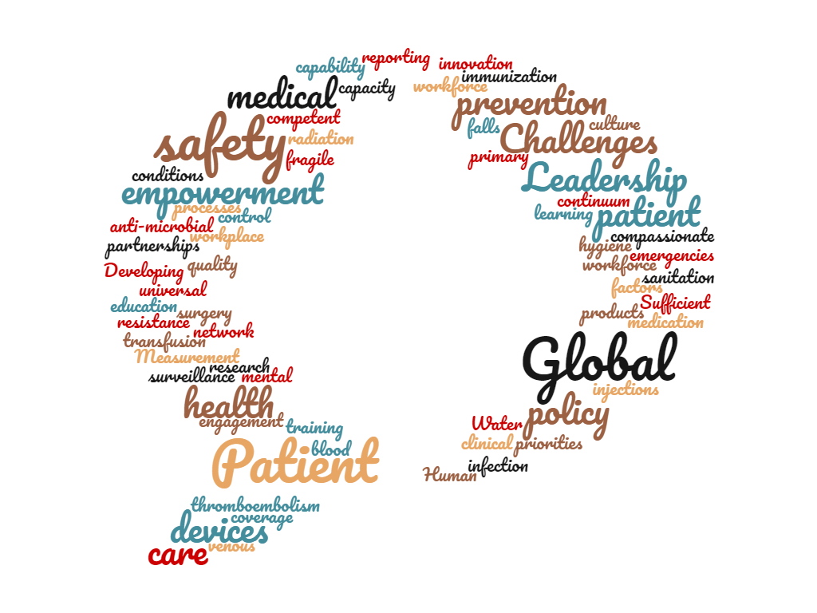

Thank you

