Slide 1


The role and value of oral healthcare workers in the PHC team
Dr Ansuyah Magan
BSc(Hons), BDS, MSc(Dent), PhD(Paeds)

Slide 2

The Mouth – Body Connection
Source: https://greencitydental.com

Slide 3
AIMS
Oral health and General
health
Oral health and Primary
health care

Slide 4


Slide 5
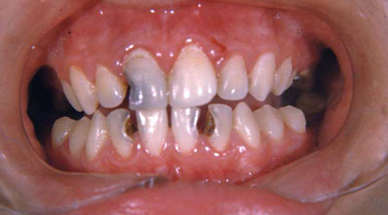
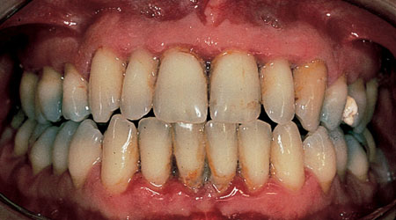
Caries
Periodontal disease
Source: American Dental Association https://www.mouthhealthy.org

Slide 6
Global Health Crisis
Global Burden of Diseases Study (2015)
Oral conditions affected 3.5 billion people
Untreated caries in permanent teeth rated highest of all diseases (34.1%)
Untreated caries in primary dentition (7.8%)
Periodontal disease (7.4%)

Slide 7
South Africa
National Oral Health Survey (NOHS) - 2002
  Age 6 years
  60% caries
  75.2% untreated
Western Cape – low SES (n=659)
  Age 6 months – 6 years
  71.6% caries
  67.5% untreated (Mohamed et al, 2018)
Johannesburg metropolitan area (n=459)
  Age 4 – 6 years
  44% caries
  97% untreated (Mothupi et al, 2016)

Slide 8
Caries Aetiology
Tooth
Diet
Time
Socioeconomic factors
Saliva
Fluoride
CARIES
Bacteria
Immunity
Oral hygiene
Notes:
Figure 12.27 Interactions necessary for the development of dental caries. Author’s own

Slide 9
Periodontal disease (PD) - Aetiology
Bacteria
Risk factors
Susceptible
host
PD
Poor oral hygiene;
Smoking;
Excessive alcohol

Slide 10
Caries, Periodontitis and Non-communicable Diseases
Modifiable Risk Factors
Pathophysiologic Pathways
NCDs
Periodontitis
Caries
Modifiable Risk Factors
High sugars content in diet
Tobacco use
Excessive alcohol use
Pathophysiologic Pathways
Inflammation
Altered host responses
Altered tissue homeostasis

Slide 11
WHO - Ten threats to global health (2019)
Air pollution and climate change
Noncommunicable diseases
Global Influenza Pandemic
Fragile and vulnerable settings
Antimicrobial resistance
Ebola and other high-threat pathogens
Weak primary health care
Vaccine hesitancy
Dengue
HIV

Slide 12
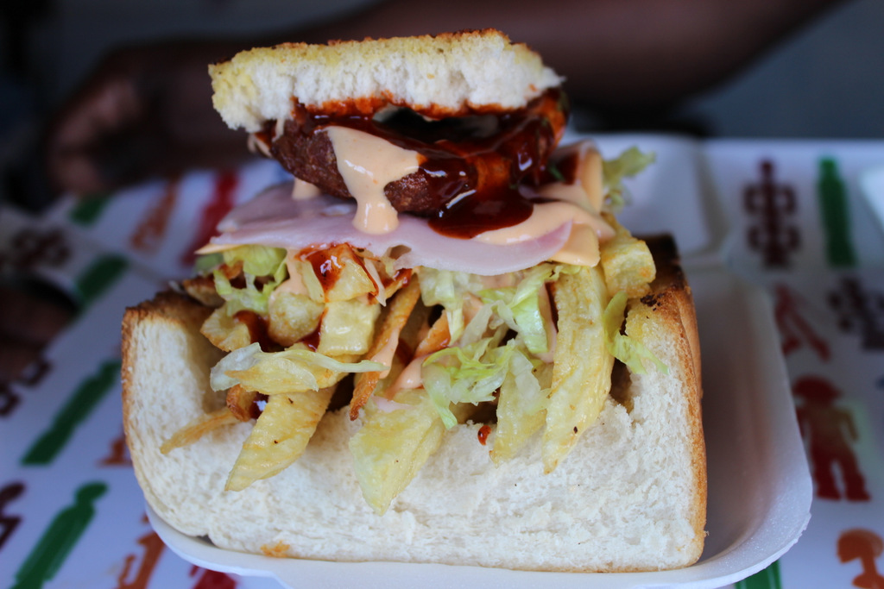
The Kota – the most popular fast food in Soweto
Source: Nearly Born Free. Strategic Marketing Kasi Style – Ingwazi and Chips. 2014. https://nearlybornfree.wordpress.com/

Slide 13
Nutrition transition – Double burden of malnutrition
Over-nutrition - overweight & obesity
2013 – 26% adolescent girls overweight or obese
2021 – 43% adolescent girls overweight or obese – rural Limpopo (Debeila et al)
Under-nutrition - stunting (low height for age Z-scores)
> 20% South Africa
34% West Africa
43% East Africa
>50% Burundi and Niger

Slide 14
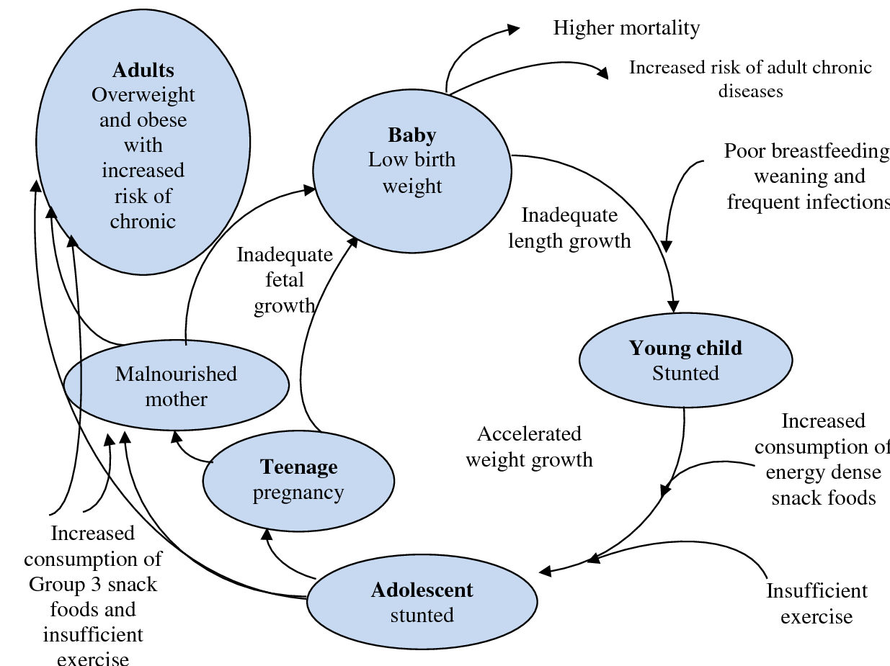
Double burden of malnutrition: Causes and effects across the lifecourse
Shrimpton et al (2012) www.worldbank.org/hnppublications

Slide 15
Maternal oral health during pregnancy
Saliva composition and flow rate vary
  more cariogenic environment
Fluctuations in oestrogen and progesterone
  inflammatory mediators
  vascular permeability
  connective tissue turnover
Poor oral hygiene
  Caries
  Periodontal disease

Slide 16
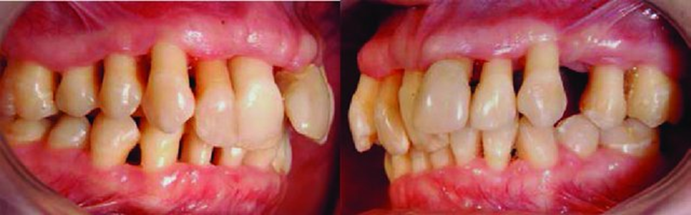
The Effects of Maternal Periodontal Disease
Maternal outcomes
Adverse birth outcomes
Diabetes
Preterm birth
Cardiovascular disease
Small for gestational age
Cerebrovascular disease
Low birthweight
Photo source: Zasciurinskiene, E (2018) PhD thesis, Jonkoping University, Lithuania

Slide 17
Periodontal disease and adverse birth outcomes
Turton and Africa (2017)
442 pregnant women (74% had PD)
75.5% mothers with severe PD had low birthweight infants
severity PD – mean gestational age
Bi et al (2021)
20 Randomised control trials (N= 8171)
Maternal periodontal therapy
  Reduced risk preterm birth
  Increase in birthweight

Slide 18
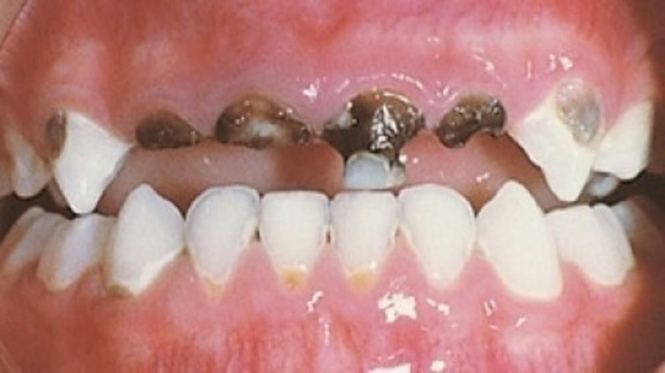
Early childhood caries (ECC)
Source: www.momspresso.com

Slide 19
Prolonged breastfeeding
EARLY CHILDHOOD CARIES
Maternal biological, socioeconomic, and demographic factors
Poor nutrition
Enamel hypoplasia
Premature tooth loss
Altered jaw bone growth pattern
Poor oral health related
quality of life
Malocclusion
Obesity
Airway & breathing
dysfunction
Decreased growth hormone secretion
Linear growth affected
Hyperlipidaemia
Depression
Systemic hypertension
ADHD and behavioural problems
Poor school performance
Ventricular hypertrophy
Copyright: Magan, A.
Notes:
Figure 12.26 Framework of the associations between poor nutrition, early childhood caries, and oral and general health through the life course. Author’s own

Slide 20
Early childhood caries, Malnutrition and Stunting
Sokal-Gutierrez et al (2016)
Rural Ecuador
1575 children (6 months - 6 years)
Intervention - educational, behavioural, clinical
At Baseline
  >50% consumed junk daily
  Caries prevalence: 1-yr-old group (53.8%)
After 2 years
  Junk food consumption halved
  Caries prevalence: 1-yr-old group (30.3%)
Longitudinal subsample of 66 children <4 years
  39.5% reduction in stunting

Slide 21
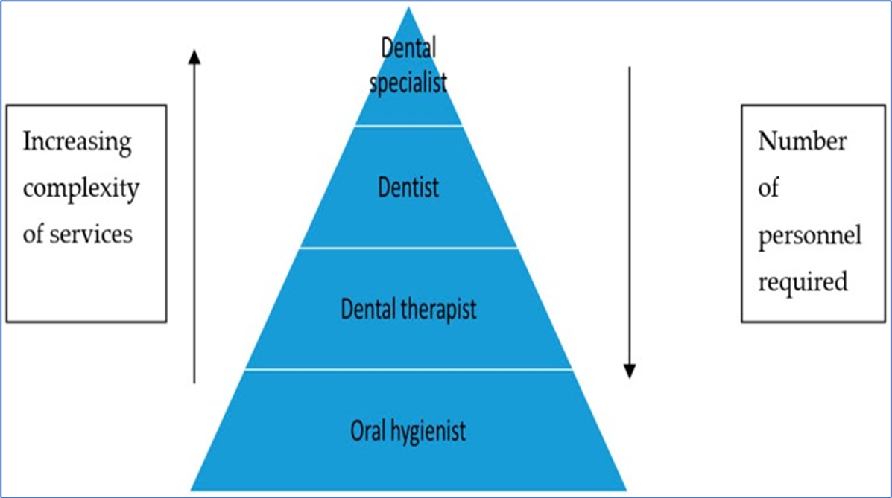
Oral health personnel in South Africa
Source: Bhayat A, Chikte U. Human resources for oral health care in South Africa: A 2018 update. Int J Environ Res Pub Health. 2019;16(10).10.3390/ijerph16101668

Slide 22
Recommendations - Research
Adopt a common risk factor approach to address the determinants of oral diseases and NCDs.
Oral disease prevention & management studies should adopt broader conceptual frameworks that include NCD-related biological, social and psychological factors.
Cohort and intervention studies are required to establish the intergenerational effects of maternal factors on child oral and general health.

Slide 23
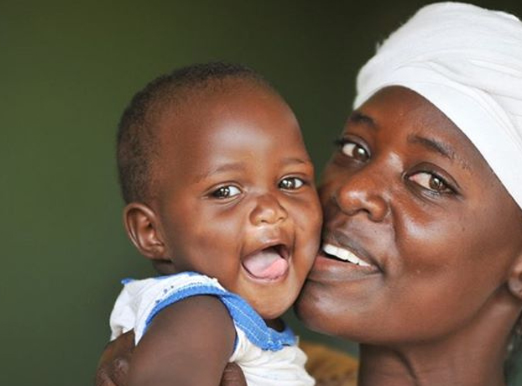
Source: USAID Africa Bureau

Slide 24
Thank You

