Slide 1
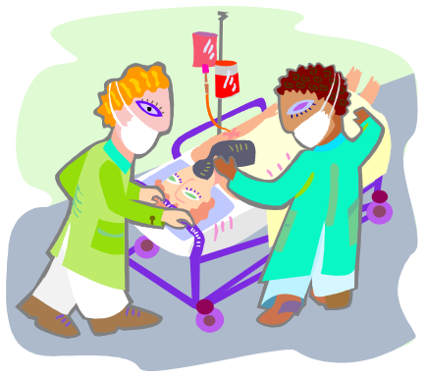
Sprains, Strains, Contusions & Bruises
Presented by
Dr Sarah Swartbooi

Slide 2
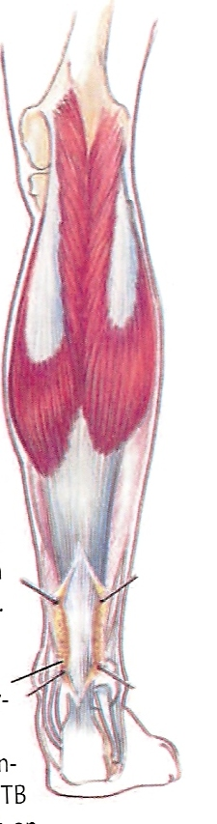
Sprains, Strains, Contusions & Bruises
Definition:
  Sprains = refer to ligamentous injury
  Strains = any soft tissue injury

Slide 3
Grading of ligamentous sprains
Grade I - Stretched/ slight tearing
            Leading to pain + swelling
            Stable joint
Grade II - Incomplete rupture
            > 50% the fibres are torn
            May lead to instability
Grade III - Complete rupture
    - Marked joint instability

Slide 4
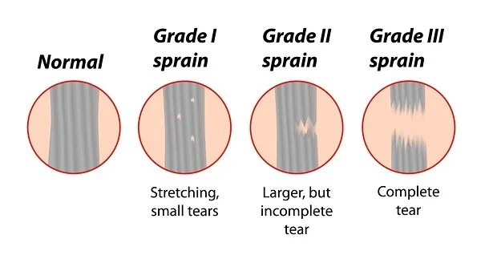

Slide 5
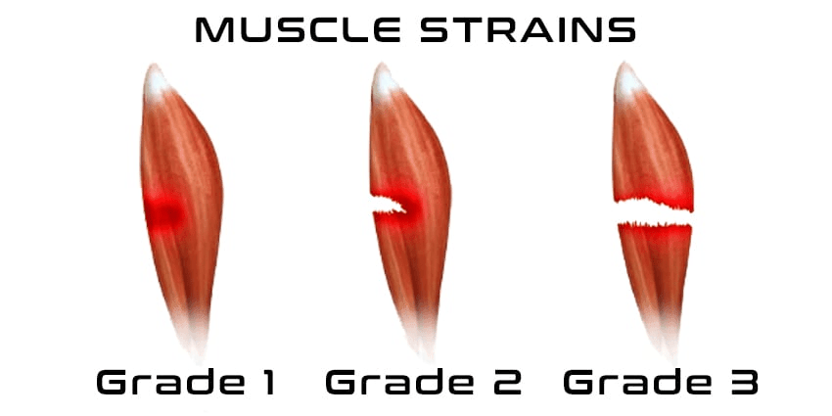
Sprains

Slide 6
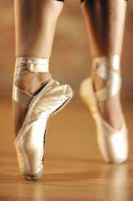
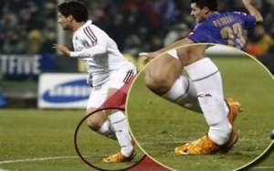
Mechanism of injury
Solitary incidence
Recurrent injuries
Degenerative

Slide 7
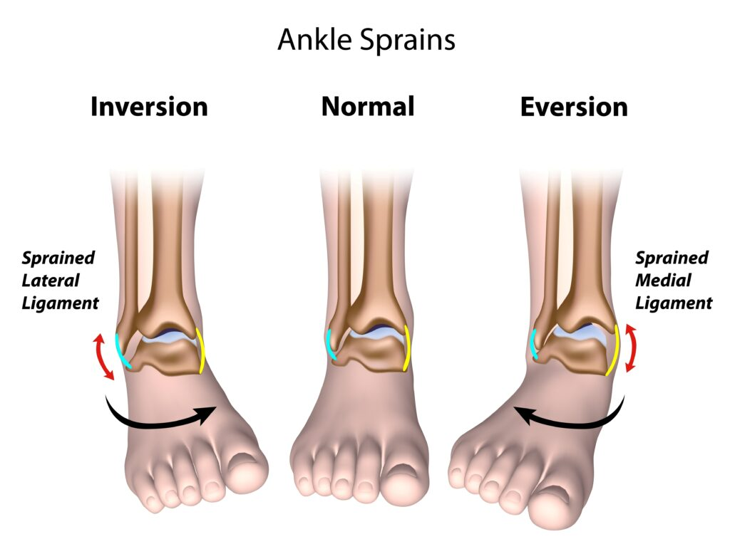
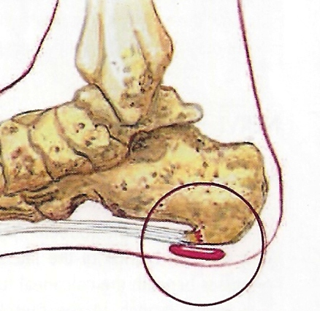
Areas of concern
Foot and ankle
    deltoid ligament
    spring ligament
    heel pain - plantar fasciitis
    - achilles tendonitis
    - Sever’s Disease

Slide 8
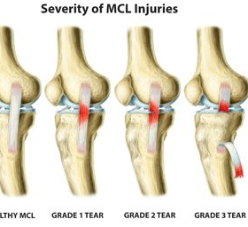
2. Around knee
- collateral ligaments
- cruciate ligaments
- meniscus
- iliotibial band
- hamstrings
- gastrocnemius
    - Traction apophysitis

Slide 9
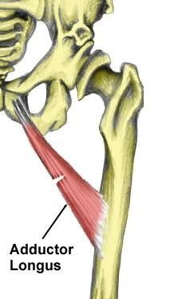
3. Hip & Pelvis
- Adductor Strain

Slide 10
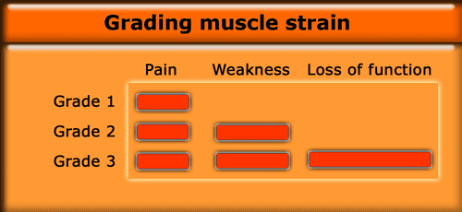

Slide 11
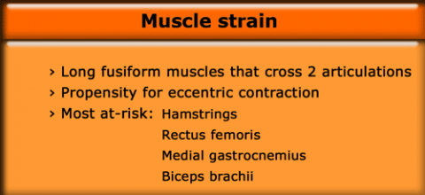

Slide 12
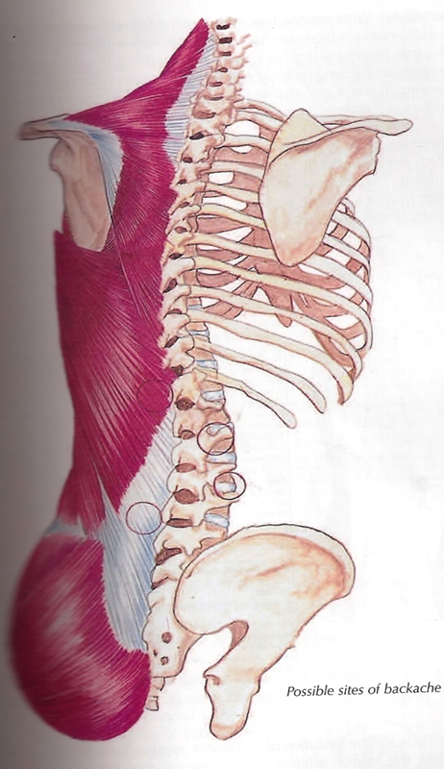
5. Back
- Ligamentous sprains/strains versus
- spondylitis/spondylosis
Ligaments (Sprains)
- Anterior longitudinal ligament -
- Post longitudinal
- Interspinous ligaments
- ligamentum flavum
Paraspinal muscles (Strains)

Slide 13
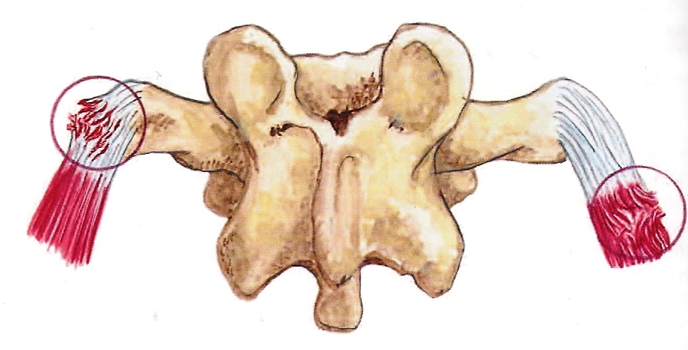
6. Whiplash
- Huge problem
- Economic
- Social
- Disability
No bony involvement - ligaments
- muscle
- blood vessels
- nerves
Therefore:
- physical treatment is the gold standard
Associated factors:
eg. Spondylosis and hence, for too many unnecessary
operations

Slide 14
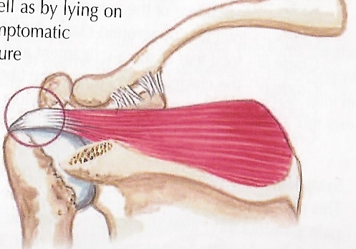
7. Shoulder
ACJ disruption
Rotator cuff injury
Biceps tendonitis
Throwers shoulder
Complications
Adhesive capsulitis

Slide 15
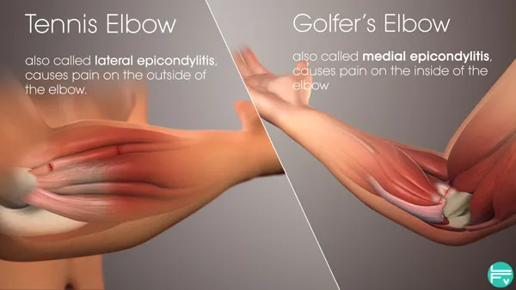
8. Elbow
  Epicondylitis
    Tennis elbow
    Golfer's elbow

Slide 16
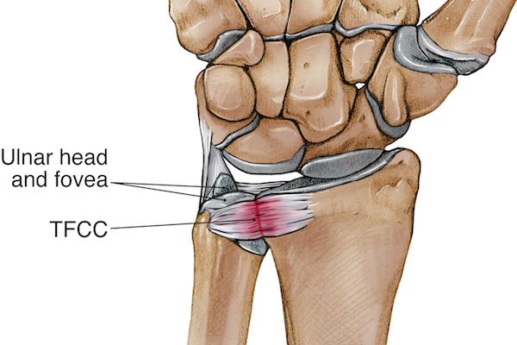
9. Wrist
  TFCC injury
  Capsule injury

Slide 17
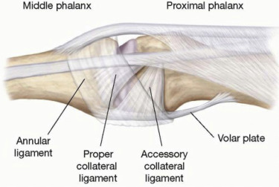
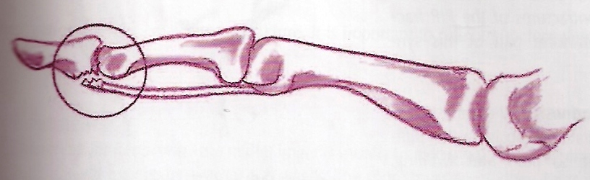
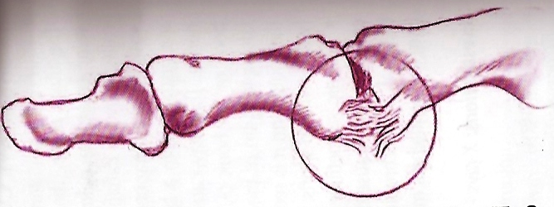
10.Digits
  Volar plate injuries
  Collateral ligaments
  Tendons

Slide 18
Important
History taking
eg. Age – traction apophysitis
Mech. of injury
co-morbidities and habits

Slide 19
Examination
REMEMBER
    Look
    Feel
    Move
REMEMBER
    Joint above
    Joint below
REMEMBER
    Atls principles
      Contusions - heart
      - lungs
      - ribs etc.

Slide 20
Investigations
X-ray always to exclude fractures
Stress x-rays - varus/valgus
- bending
U/S – especially soft tissue tears, ruptures etc.
MRI – good for soft tissue
Bone scan – if pain does not reduce:
      maybe stress fractures

Slide 21
Treatment
RICE
Physiotherapy
Bracing
NSAID

