Slide 1


Malnutrition
T De Maayer

Slide 2
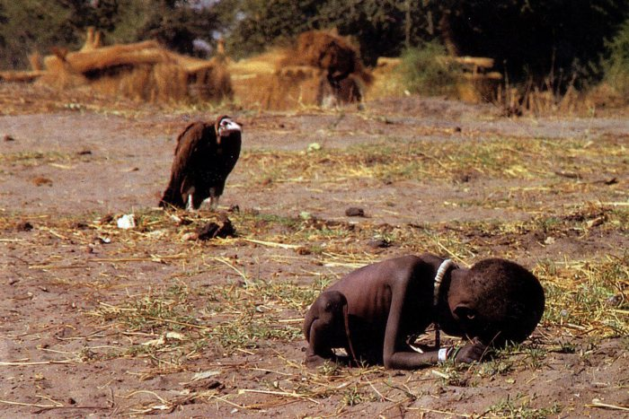
Severe Acute Malnutrition
Kevin Carter, Sudan, 1993

Slide 3
Content
Aetiology
Epidemiology
Pathophysiology
Management
Outcomes

Slide 4
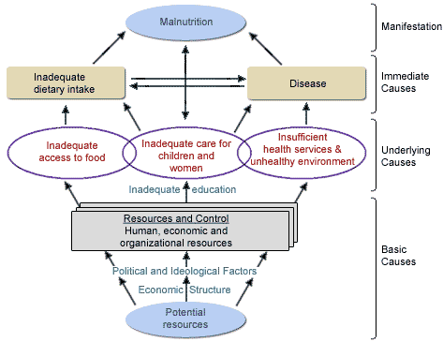
Aetiology
UNICEF framework 1990

Slide 5
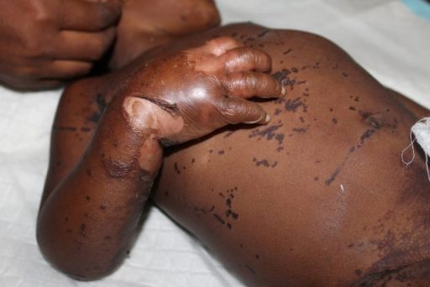
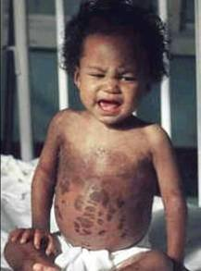
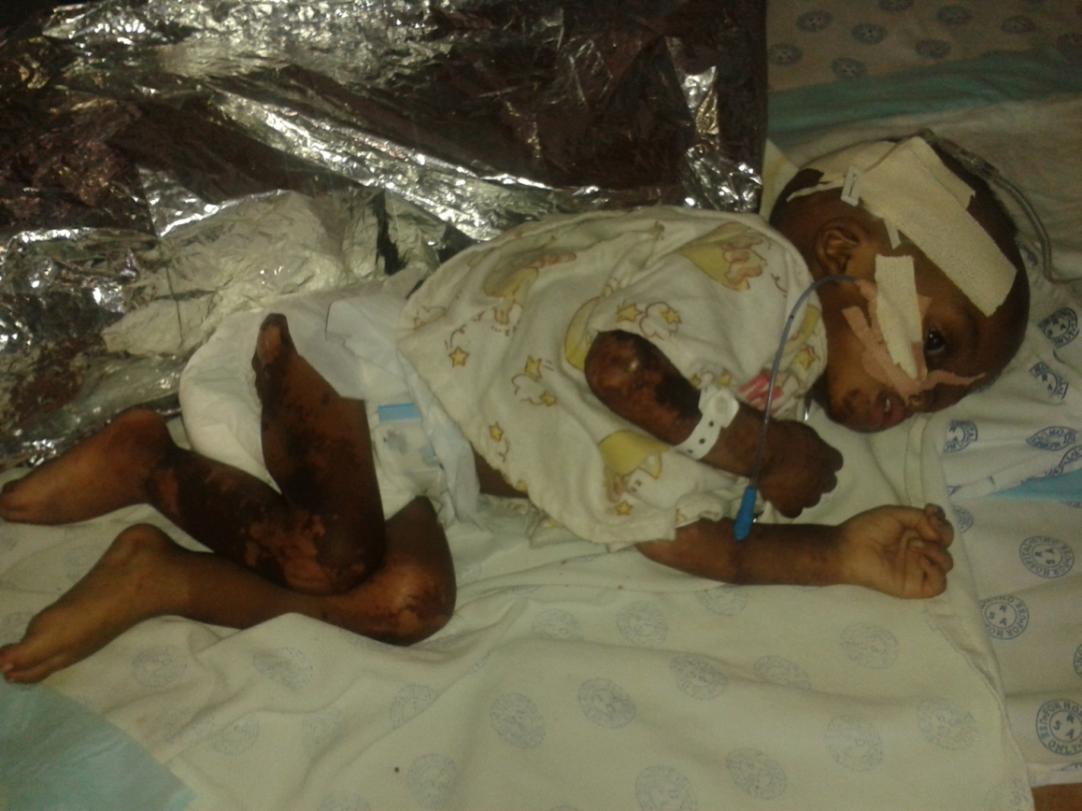
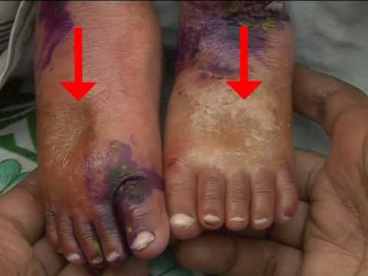

Slide 6
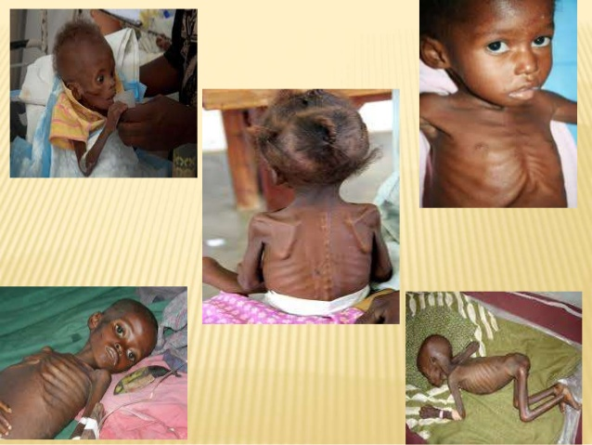

Slide 7
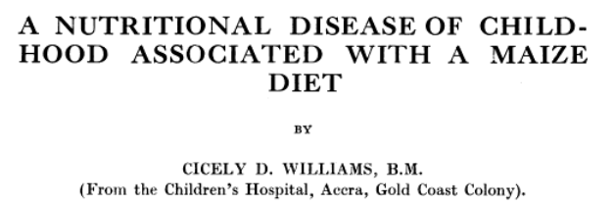
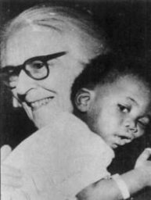
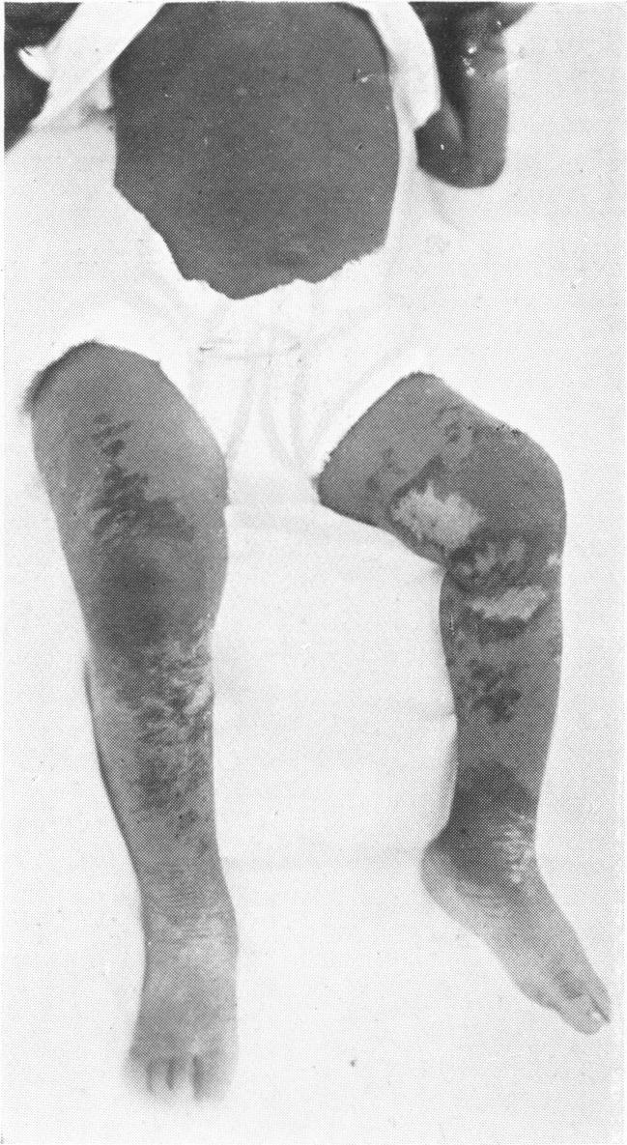
Cicely Williams
Arch Dis Child. 1933 Dec; 8(48): 423–433.
“Breast milk is probably deficient in some factors, which are at present uncertain. As maize is the only source of supplementary food, some amino acid or protein deficiency cannot be excluded as a cause. As regards vitamin deficiency, there is no evidence pointing to lack of vitamin A, C, D or E. That there is a deficiency of some part of vitamin B complex cannot be excluded, although the disease described here does not resemble either pellagra or beri-beri.”.”

Slide 8
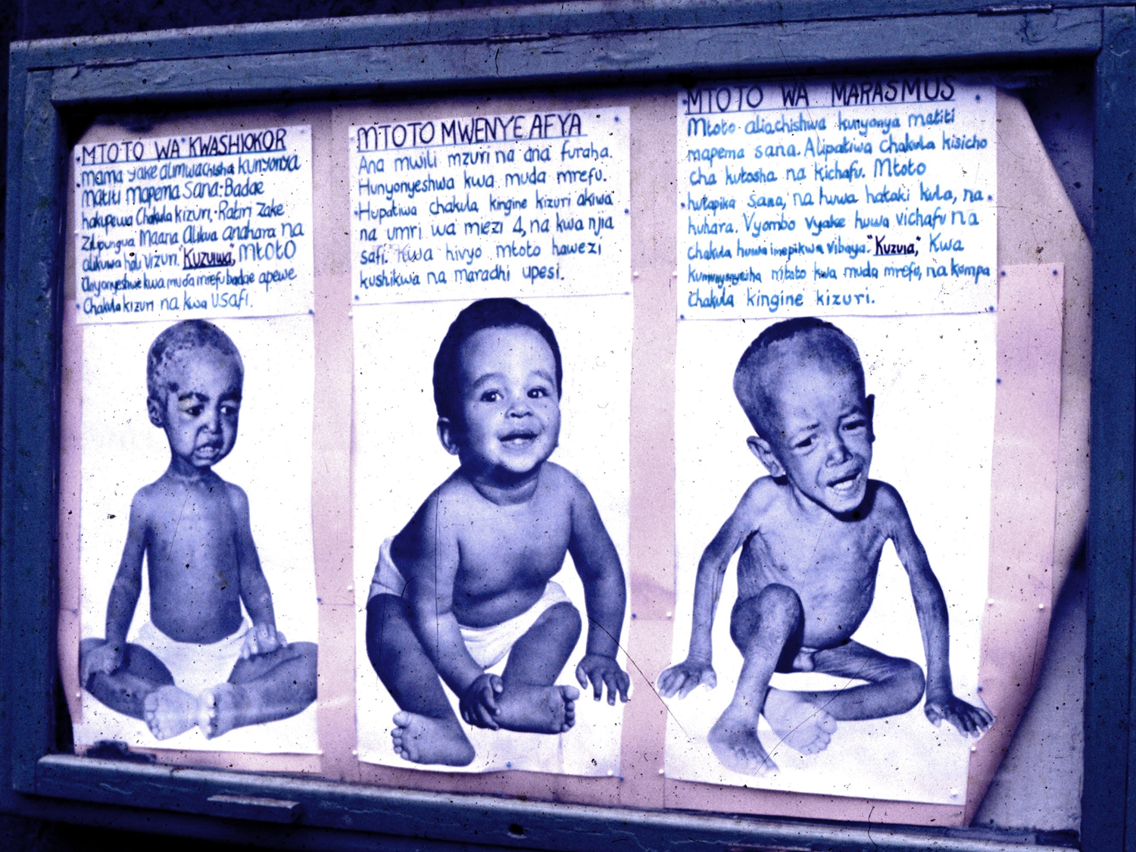
Kwashiorkor
Marasmus

Slide 9
What is not the cause of kwashiorkor
Treatment with Niacin (Vit B3) did not improve outcomes
Acceptance that protein deficiency was cause
Evidence against:
  Recognition that child protein requirements were lower than thought earlier
  Studies did not show intake differences between children with kwashiorkor/marasmus

Slide 10
Sulphur amino acid deficiency?
Cysteine (conditionally essential) & methionine (essential)
Deficiency can explain many of the clinical features seen
NAC supplementation hastens disappearance of oedema, but does not prevent disease

Slide 11
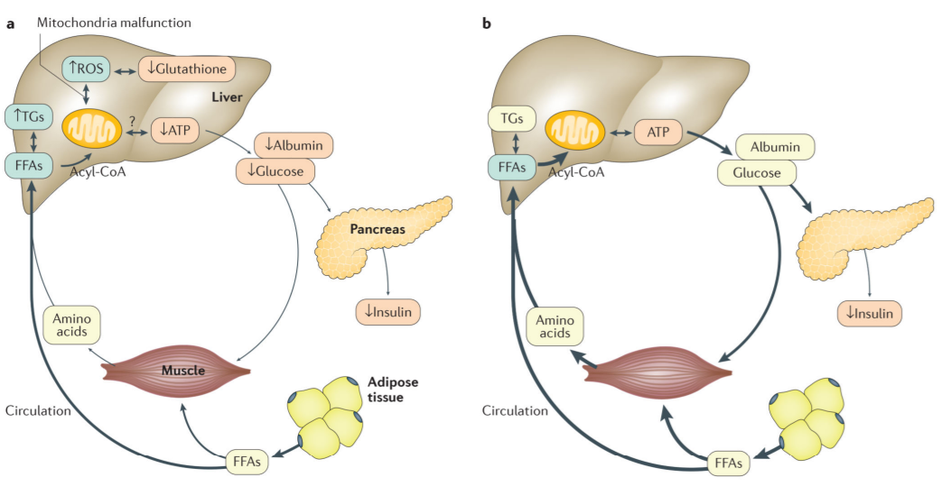
Oxidative stress – the free radical hypothesis
Ciliberto et al: BMJ 2005
  2332 children
  Anti-oxidant cocktail vs placebo
  Incidence of Kwashiorkor: 3.3% in study group vs 1.9% in placebo group
(relative risk 1.70, 95% confidence interval 0.98 to 2.42)
Bhutta et al. Nat Rev Dis Primers. 2017
Protection against oxidative stress: sulphur amino acids, several vitamins (E, riboflavin, nicotinic acid), carotene, selenium, copper, zinc and manganese

Slide 12
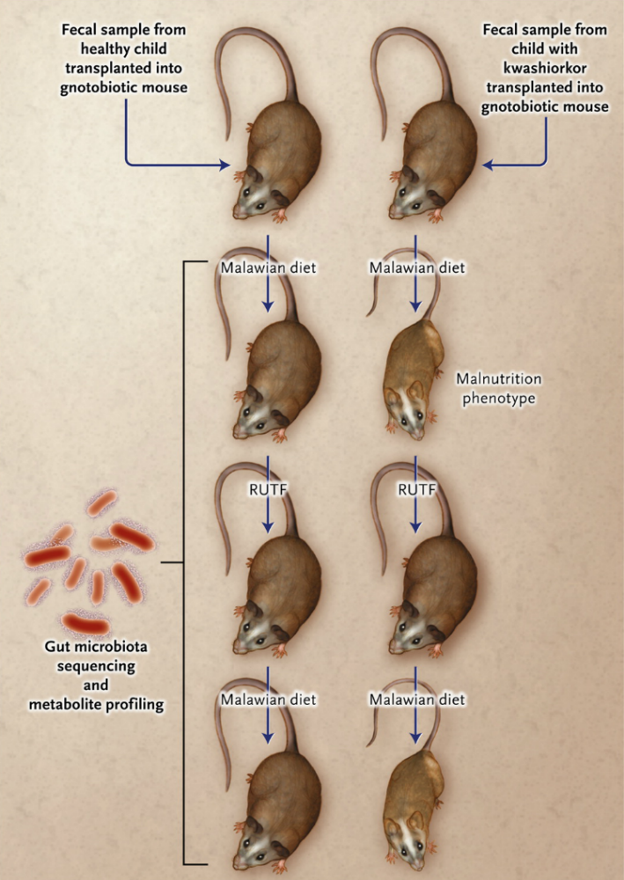
Kwashiorkor and the microbiome -
The Malawian twin study
Smith. Science. 2013

Slide 13
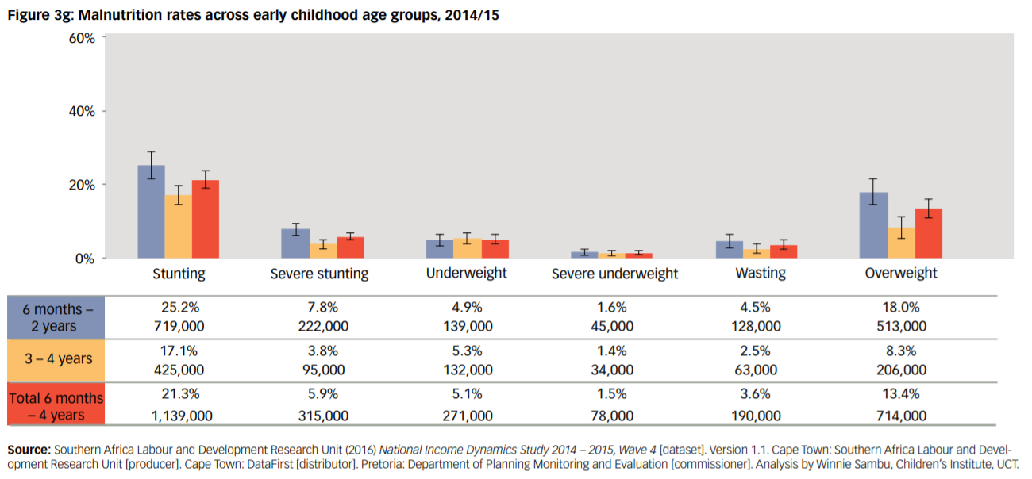
Malnutrition in RSA
Jamieson L, Berry L & Lake L (eds) (2017) South African Child Gauge 2017. Cape Town: Children’s Institute, University of Cape Town.

Slide 14
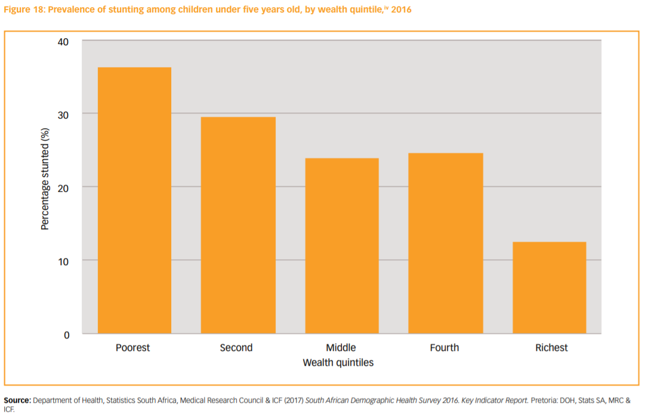
Inequality
Jamieson L, Berry L & Lake L (eds) (2017) South African Child Gauge 2017. Cape Town: Children’s Institute, University of Cape Town.

Slide 15
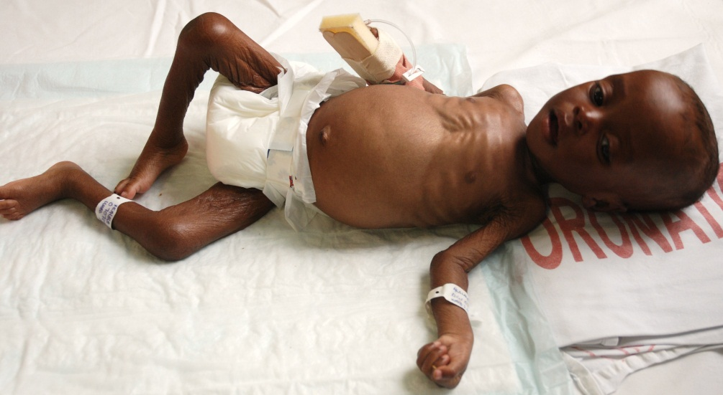
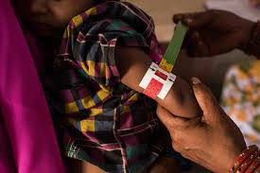
Moderate and severe acute malnutrition (in children 6 to 60 months)
Assessment | Weight for height Z-score | MUAC | Other
Moderate malnutrition | -2 to -3 | 11.5 – 12.5cm
Severe malnutrition | < -3 | <11.5cm | Visible wasting or bipedal oedema
WHO, 2009

Slide 16
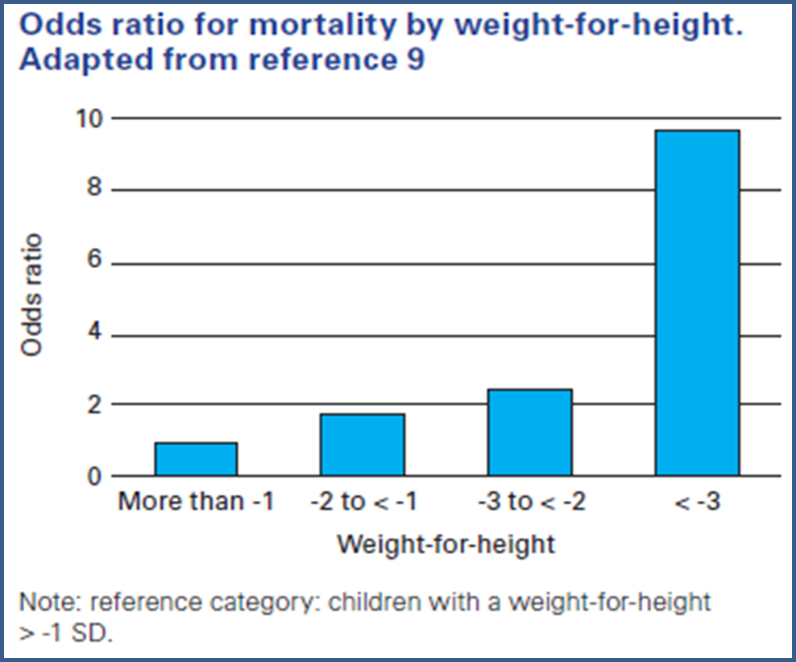
SAM and mortality
Black et al. Lancet, 2008

Slide 17
Pathophysiology

Slide 18
Reductive adaptation
Low intake leads to
  Catabolism
  “shutting down” of metabolic processes
Energy conservation
  Reducing activity & growth
  Decreased basal metabolism (protein turnover, ATP pump activity and number)
  Reducing inflammatory responses

Slide 19
Consequences
Reductions in:
  Liver: gluconeogenesis, protein synthesis
  Kidneys: sodium and fluid excretion
  Heart: cardiac output
  Gut: enzymes, motility, absorptive capacity
  Immune response
  ATP activity → K+ loss, Na+ excess

Slide 20
Implications for clinical management
Risk of death from:
  Hypoglycaemia
  Hypothermia
  Hypokalaemia
  Cardiac failure
  Sepsis

Slide 21
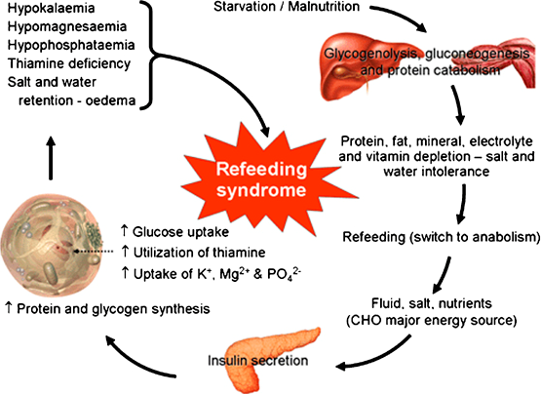

Slide 22
Management

Slide 23
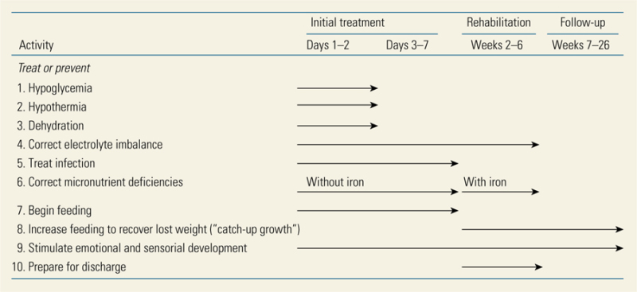
WHO 10 steps

Slide 24
Early management
Hypoglycaemia:
  Feed immediately (8-10 ml/kg starter formula / F75)
  Feed often (100 – 130 ml/kg/day)
  Monitor HGTs
Hypothermia:
  Incubator, Bair Hugger, etc
  KMC

Slide 25
Early management ctd
Fluids:
  IV only if shocked
  Be wary of sodium content – use ReSolMal
  Rehydrate slowly
  Monitor frequently
Shock:
  IV bolus: R/L at 15 ml/kg over 1 hour (can be repeated once)
  Monitor HR, RR, BP
  Consider septic shock

Slide 26
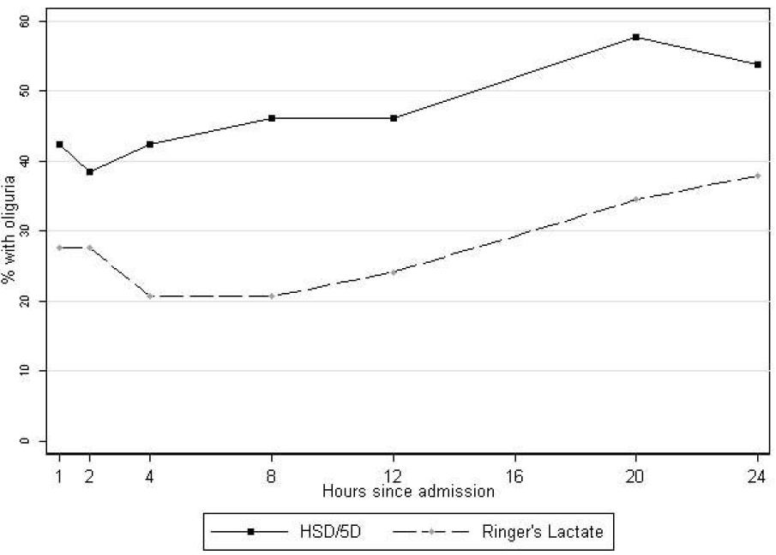
Hypovolaemic Shock Trial
WHO:
  15ml/kg HSD/5D bolus over 1 hour, max 2
Experimental group:
  10ml/kg RL bolus half-hourly, max 4
Trial terminated early because of high mortality and high prevalence of unresolved shock
Akech, BMC Pediatr, 2010

Slide 27
Further management
Anaemia: transfuse only if Hb<4g/dL
Antibiotics: assume infection
Feeds: start low, go slow, increase once clinical improvement
Electrolytes & micronutrients: replace K+, Zinc, Magnesium, Copper, Selenium, MVT
DEF T&H: Don’t forget TB & HIV

Slide 28
Outcomes
Looking at Case Fatality Rates

Slide 29
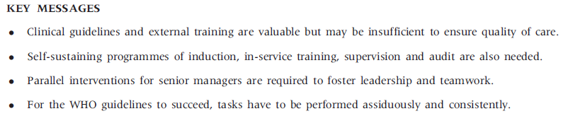
The 10 steps in rural SA
Puoane et al, Health Policy and Planning, 2008

Slide 30
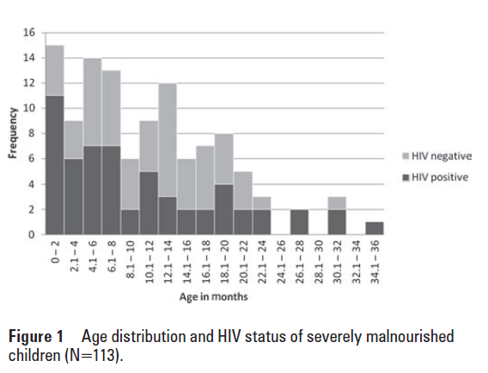
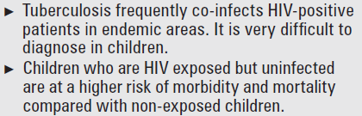
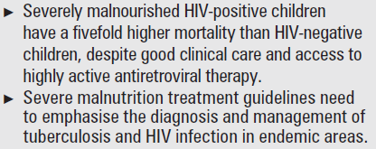
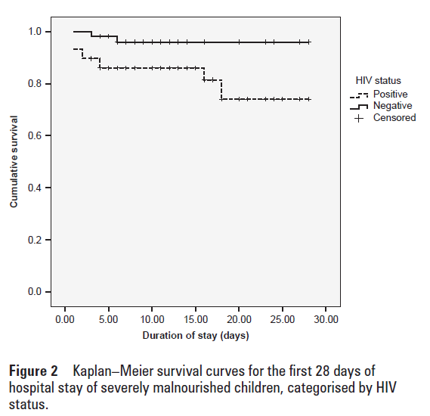
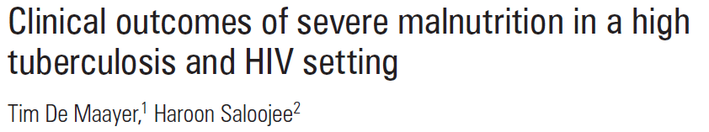
CFR
HIV negative: 3.6%
HIV positive: 19%
Poor prognostic factors: HIV, Pallor, Shock

Slide 31


