Slide 1




Some key points to improve Quality and Patient Safety in Primary Care
María Pilar Astier-Peña
Family Doctor
Chair of the Patient Safety Group of the Spanish Society of Family and Community Medicine (SEMFYC)
Chair of the WONCA Working Party of Quality and Safety (WWPQS)
@afroPHC
September 21st, 2021

Slide 2
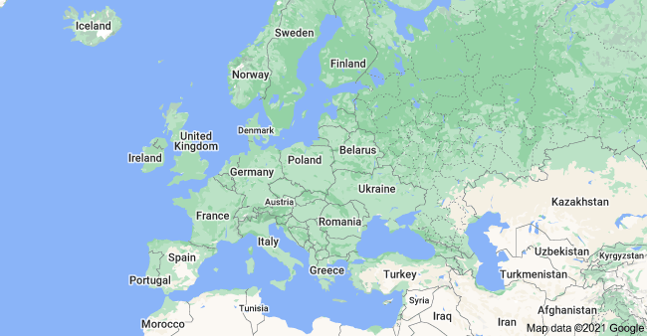
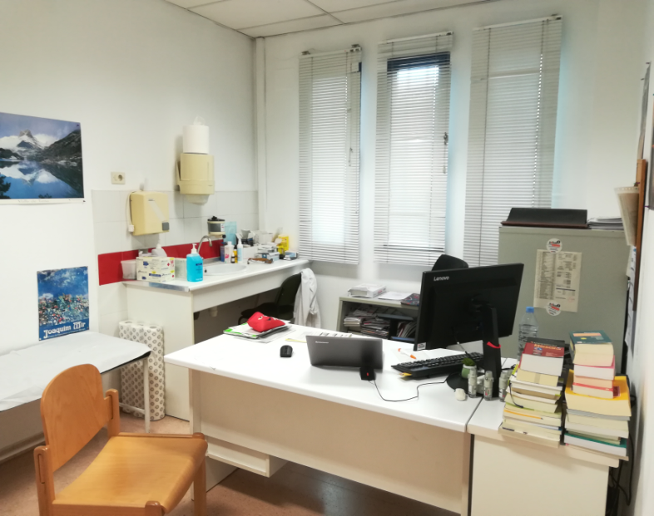
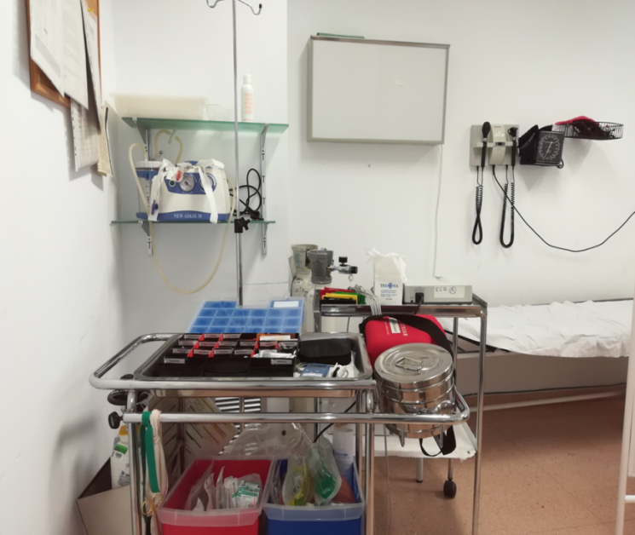
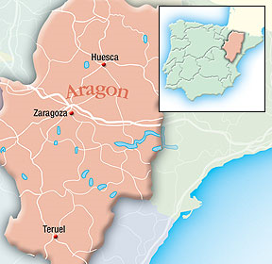
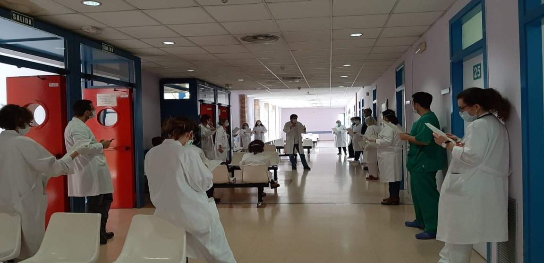
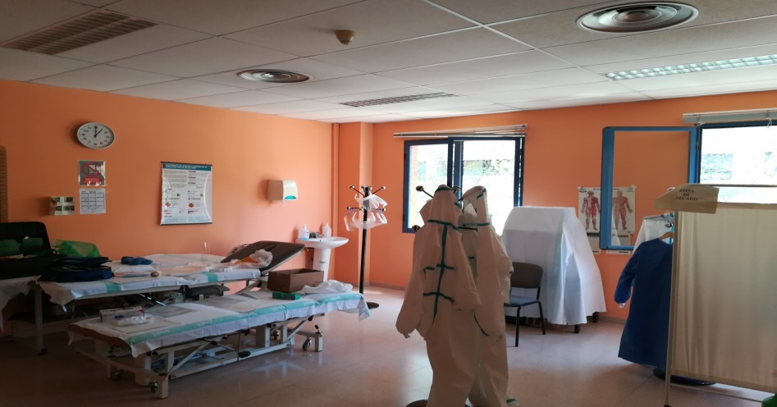

Family Doctor in a Public Health Center in Zaragoza (Aragón Region)in Spain
Comunidad Autónoma de Aragón

Slide 3
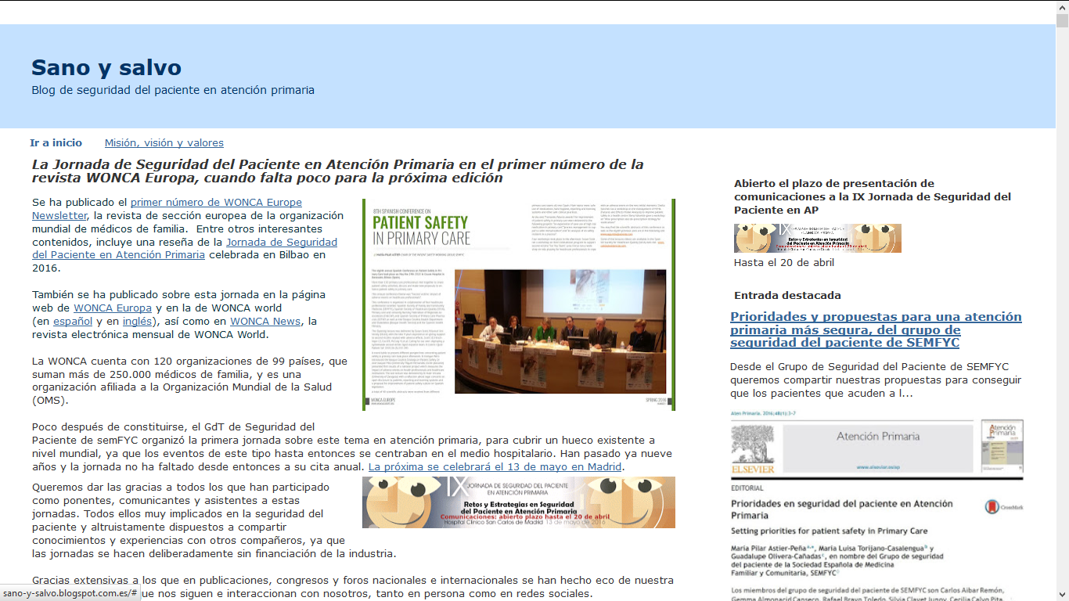


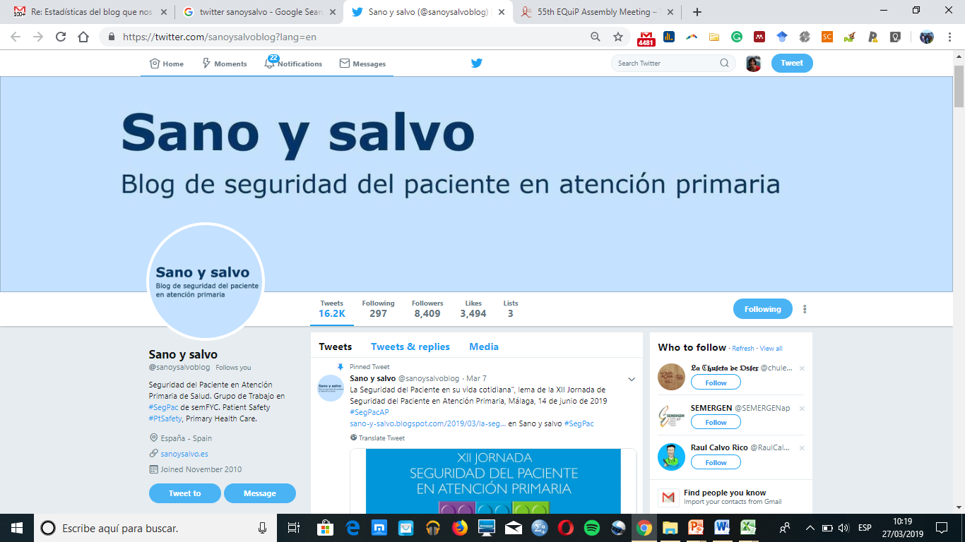
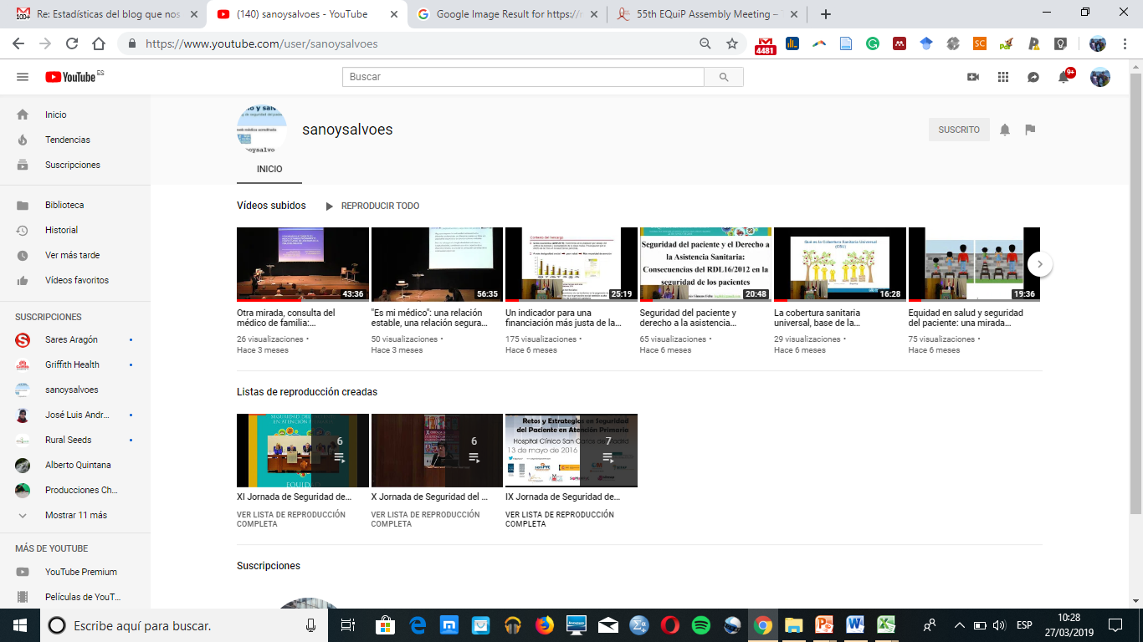
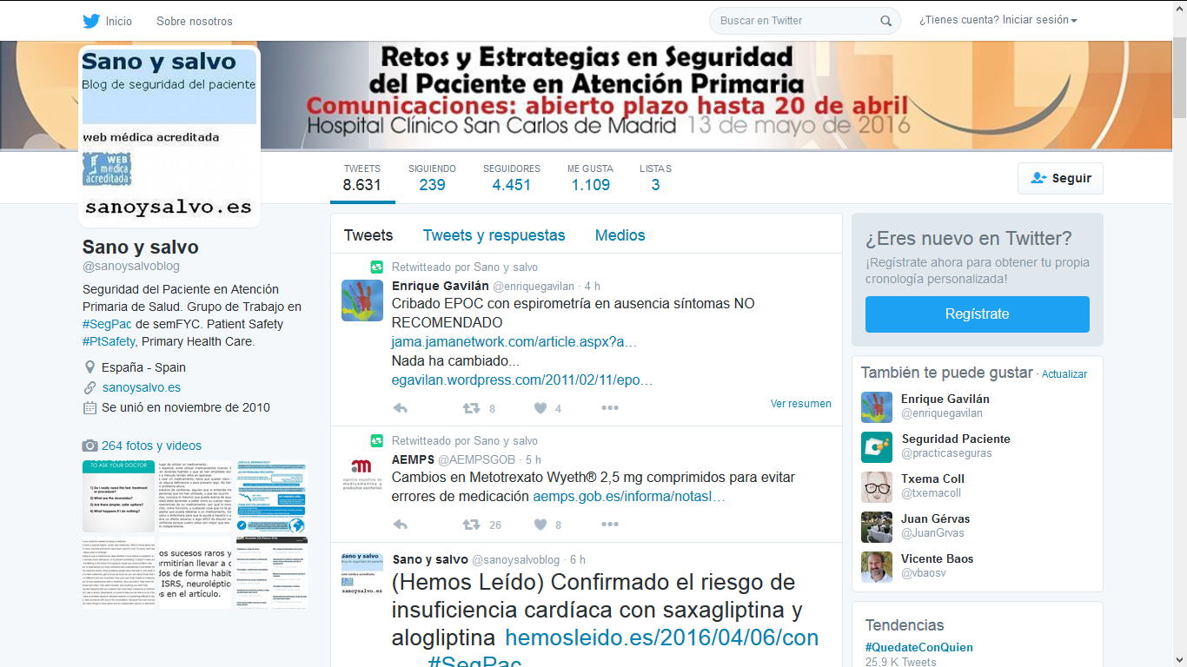

http://sano-y-salvo.blogspot.com/
#SegPac
#SegPacAP
#PtSafety
Blog, twitter, jornadas....
Grupo de Seguridad del paciente la Sociedad Española de Medicina Familiar y Comunitaria
Twitter: @sanoysalvoblog
sanoysalvoes

Slide 4
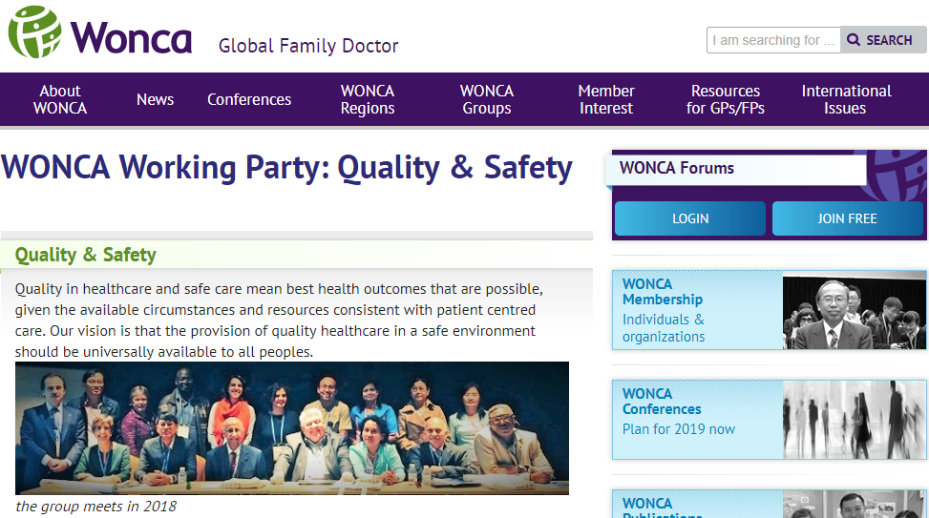

@WONCA_QSafety
#Ptsafety #Primarycare

Slide 5
Healthcare quality
Patient centered
Safe (Patient Safety)
Equitable
Effective
Timely
Efficient
Institute of Medicine (IOM). Crossing the Quality Chasm: A New Health System for the 21st Century. Washington, D.C: National Academy Press; 2001.
Notes:
Pilar

Slide 6

Health Systems, Quality and Safety….
Safe Healthcare: the prevention of errors and adverse effects to patients associated with health care.
(PSA/WHO. International Clasification for Patient safety. 2009, June)
Policy
Healthcare
Organizations
Healthcare
Professionals
Strategies
Programs
Procedures/activities

Slide 7

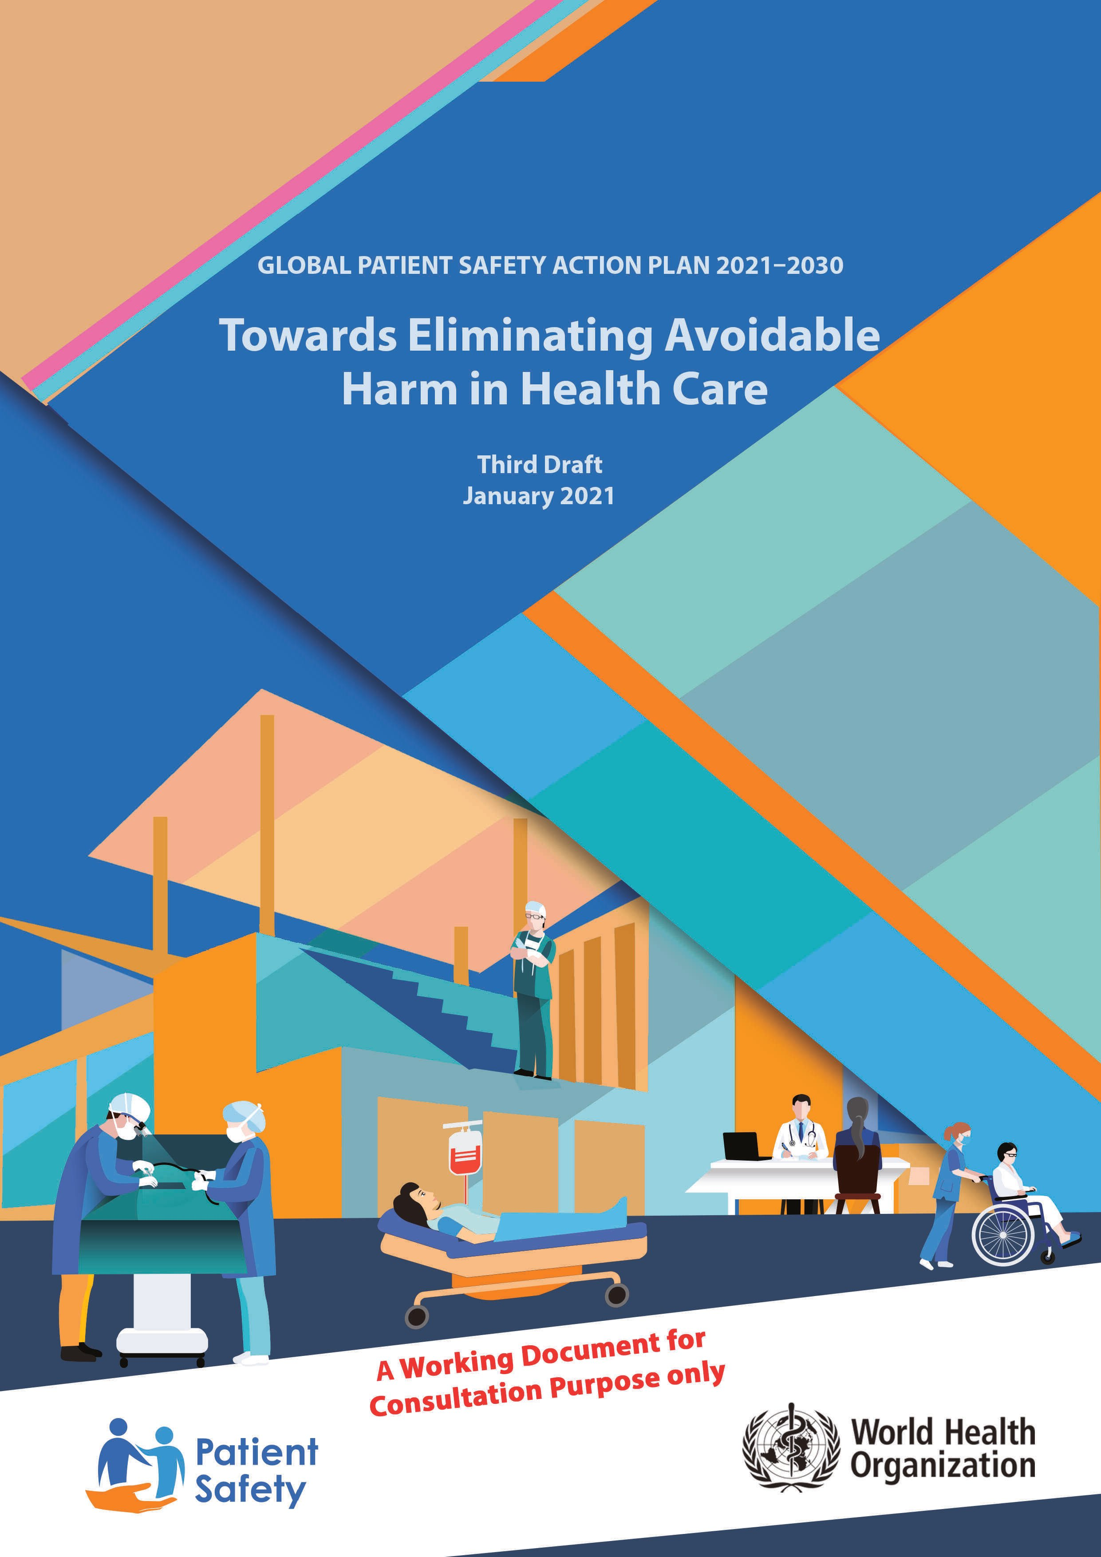

Slide 8
WHO definition of Primary Health Care (PHC)
“as socially appropriate, universally accessible, scientifically sound first level care provided by a suitably trained workforce supported by integrated referral systems and in a way that gives priority to those most needed, maximizes community and individual self-reliance and participation and involves collaboration with other sectors, including health promotion, illness prevention, care of the sick, advocacy and community development” [1].
Does this primary care definition meet the dimensions of quality of care and safety?
[1] World Health Organization. Conceptual framework for the international classification for patient safety. Contract No.: WHO/IER/PSP/2010.2. Geneva: WHO; 2009.

Slide 9

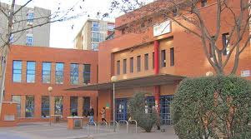
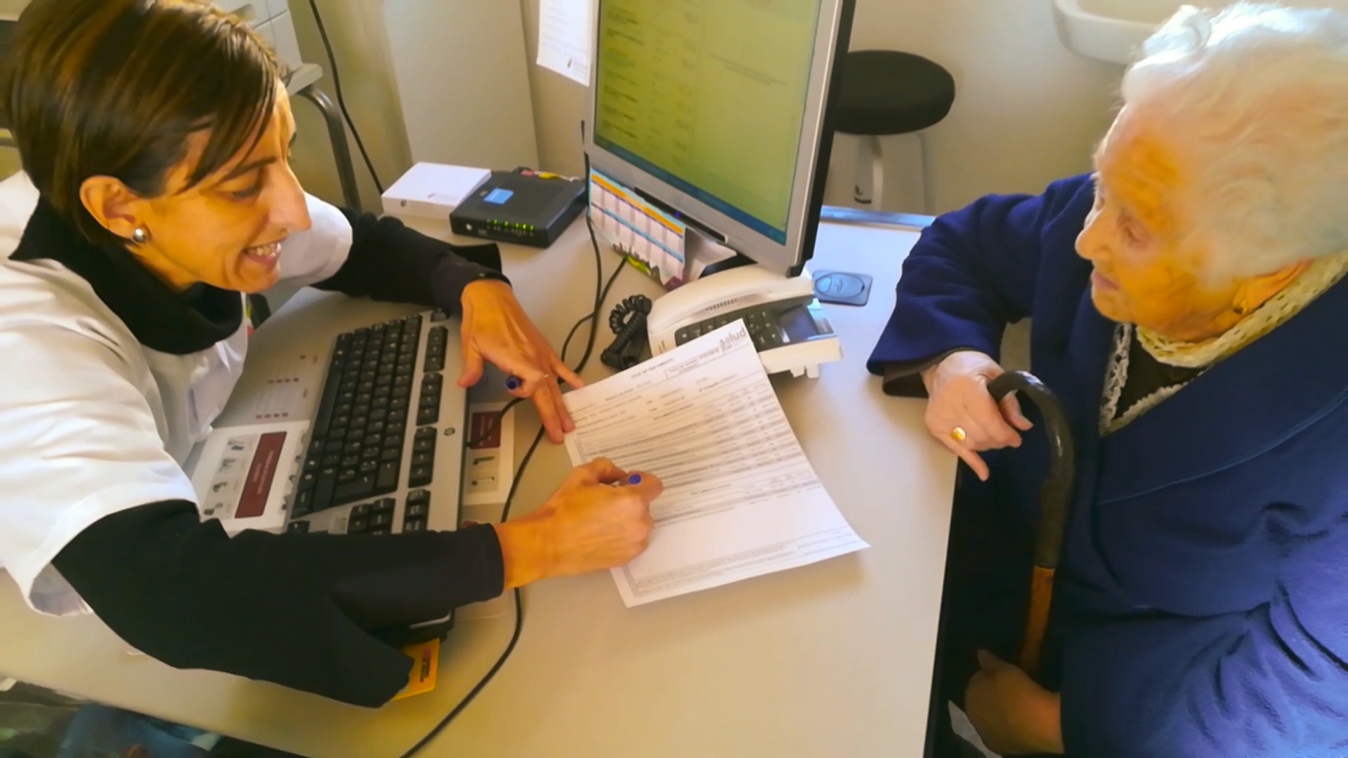
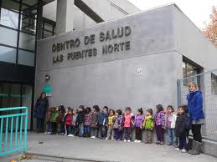
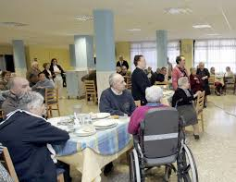
Socially aceptable and Universally accesible
WHO DEFINITION OF PRIMARY HEALTH CARE (PHC)
Patient and Community centered

Slide 10


PHC: Scientifically sound first level of care
PROSTATE CANCER
HIGH BLOOD PRESSURE
ACUTE MYOCARDIAL INFARCTION
DIABETES MELLITUS
DEATH OF THE PARTNER
DEPRESSION
ACCIDENT AT WORK WITH AFTER-EFFECTS
LUMBAR DISC HERNIATION
DIABETES MELLITUS
0
SEVERE RHEUMATOID ARTHRITIS
YEARS
throughout the patient's life

Slide 11

PHC: Provided by a suitably trained workforce
Primary care team
Family Doctors
Administrative staff
Nurses
Midwives
Social Worker
psychologist
physiotherapist
pharmacist

Slide 12
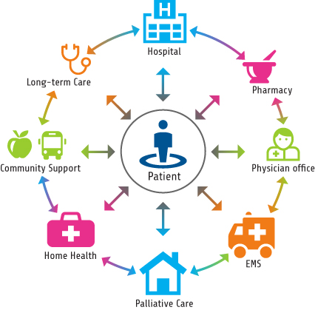

PHC: Supported by integrated referral systems
Primary care
Community and family support
Ambulatory Specialists care
Nursing Home

Slide 13
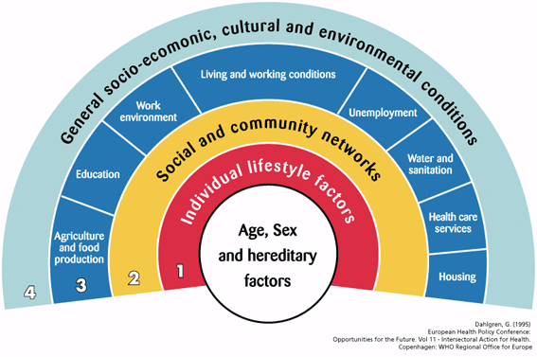

PHC: in a way that gives priority to those most needed, maximizes community and individual self-reliance and participation

Slide 14
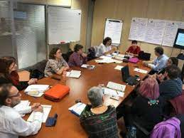

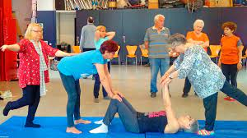
PHC: involves collaboration with other sectors, including health promotion, illness prevention, care of the sick, advocacy and community development
Patient and Community centered

Slide 15
Impact of low quality care in PHC
Primary care services are:
- Integrated people-centered healthcare services in many countries .
- they provide an entry point into the health system .
- And have directly impact on
people’s well-being and their use of other health and care resources.
Unsafe or ineffective primary care:
may increase morbidity and preventable mortality,
may lead to unnecessary hospitalization and specialist resources
and, in some cases, to disability and even death

Slide 16

Safety failures related to care are the 14th leading cause of the global burden of disease.
The cost to patients, health systems and societies is considerable. 15% of hospital expenditure and activity in OECD countries can be attributed to the treatment of safety failures which different origin (PHC or Hospital Care).
Most of the burden is associated with a few common adverse events:
healthcare-associated infections
venous thromboembolisms
pressure ulcers
medication errors
misdiagnoses or delayed diagnoses.
Organisation for Economic Co-operation and Development (OECD)

Slide 17
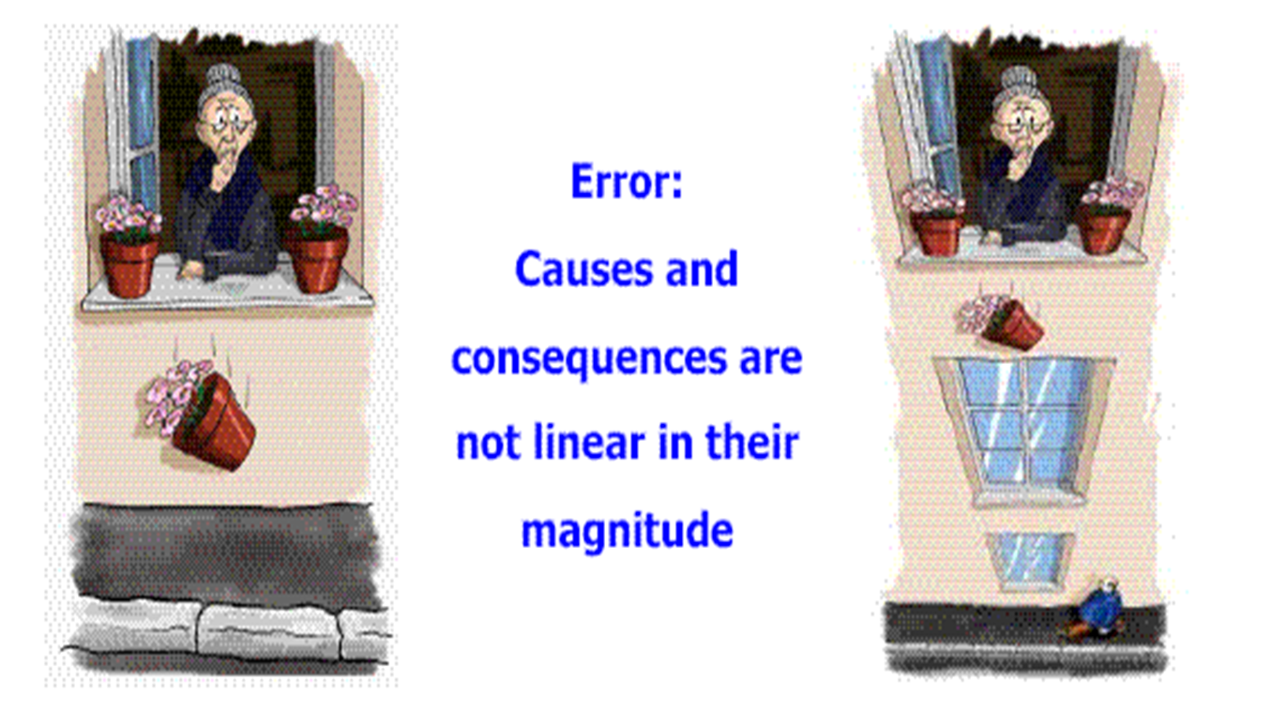
PHC increasing complexity care
Studies on patient safety traditionally focused on hospital care, where most serious incidents occurred.
Primary care has been perceived as a low technology environment where safety would not be a problem.
It is estimated that 85% of all healthcare contacts occur in primary care.
Multimorbidity, polypharmacy, use of high risk medications, ageing… make primary health care more complex every day.

Slide 18
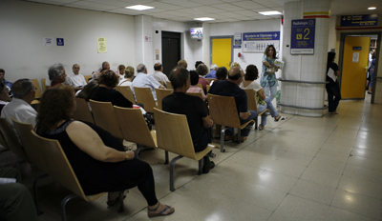

Health Risks in Primary Care
Near Miss
1–2% of general practice consultations may result in Adverse Events.
Potentially preventable in 45–76% of cases
Non preventable
Negligences
Litigations and lawsuits
Incidents without harm
Panesar SS, de Silva D, Carson-Stevens A, et al. How safe is primary care? A systematic review. BMJ Qual Saf. 2016;25:544–53.
Notes:
Seguridad clínica y prevención de EA
18

Slide 19
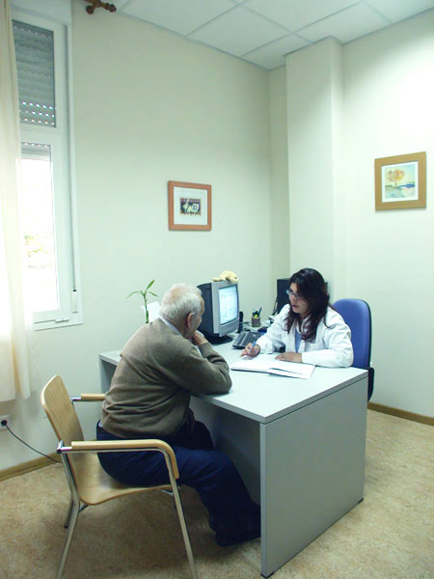
2 AE per week
…we don't know who would be harmed

Slide 20
PHC Patient Safety Incidents
In many studies, safety incidents in PHC are identified in three categories:
administrative and communication incidents:
  mistaken patient identity, acts of omission, lack of communication about patients…
diagnostic incidents:
  early closure of diagnostic process, misattributing presenting symptoms and signs to an obvious or readily available diagnosis may be a key issue…
prescribing and medication management incidents:
  Look alike or sound-alike medications, allergies, lack of supervision of medication list…

Slide 21

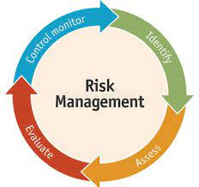
Managing risks to improve Q and S in PHC and reduce harm to patients
Notes:
How we can address risk to reduce patient safety incidents, particularly those causing harm? Quality tools may help: identify the incidents, adress them, evaluate change and monitoring

Slide 22
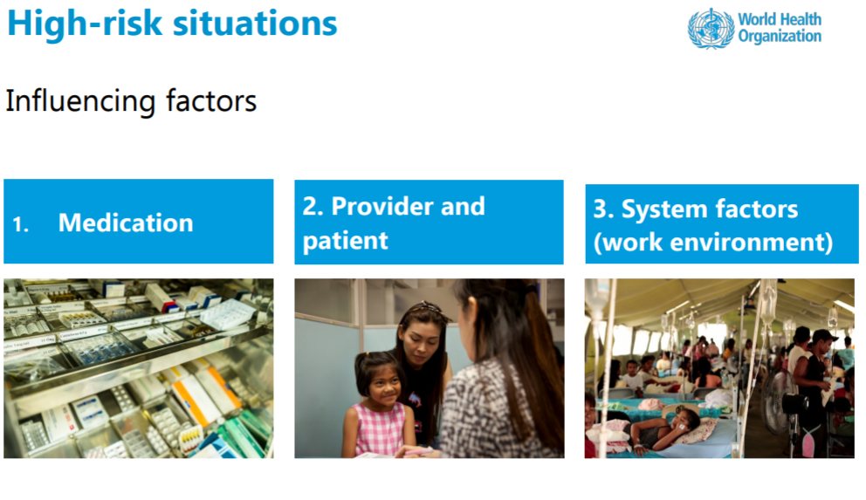
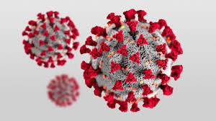
IN PRIMARY CARE
Pandemic changes the way we care
SARS-CoV2 at work and in the community
Lack of scientific evidence

Slide 23
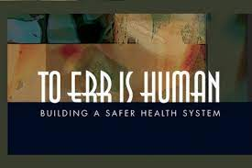
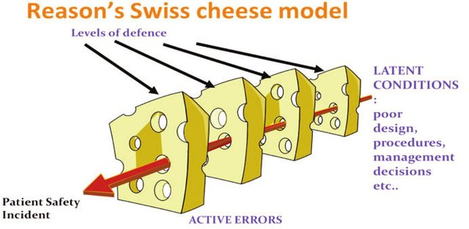
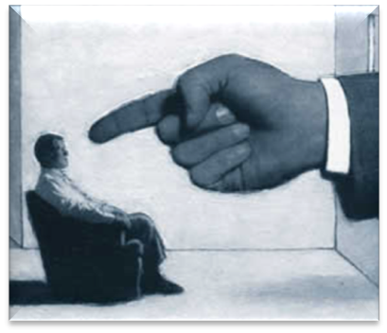
To err is human... but the perspective of the analysis is systemic.
Health System’s Barriers to reduce risks
Training
RISKS
Protocols
physical and electronic barriers
Supervision
PATIENT SAFETY INCIDENTS
Health Systems’ barriers to avoid harm are not perfect
CHEESE MODEL OF ERROR. JAMES REASON

Slide 24
Strategies to Improving Q and S in PHC
Professional training
Team work and communication
A Safe Use of Medication
REDUCING HARM AND INCREASIN SAFETY
Learning organization
Structure and resources
Involving patients and community

Slide 25


WHO
Continous Education and training
WHO Multiprofessional Patient Safety Curriculum Guide for univerisities (available in Chinese)
Training of family medicine residents in patient safety
Clinical sessions on patient safety with the primary care team

Slide 26

The team is a safety net in primary health care
Promote Non-Technical Skills (NTS): cognitive and social skills, exhibited by individuals and teams, needed to reduce error and improve human performance in complex
systems.
To promote teamwork, communication and emotional support
NTS:
Team oriented communication: Briefings, handovers, SBAR techniques (Situation, Background, Assessment, Recommendations)
Improving team performance through “role playing” “simulation techniques”
Team climate: acceptance of uncertainty, offers of help
Workload distribution and time off/on
Risk stratification for staff, as for patients

Slide 27
Promoting Reporting mechanism for medical errors in primary care through organizational o regional Reporting and Learning Systems (RLS).
Strategies to help improve clinical effectiveness and enhance patient safety :
  the Quality and Outcomes Framework (QOF)
  significant event analysis (SEA)
  critical incident reporting systems (CIRS)
  What happened?, Why did it happen?, What has been/can be learned?, How do we prevent it/ensure it happening again?, What to do?
Learning Organization
Speak up with the team about patient safety issues to learn

Slide 28


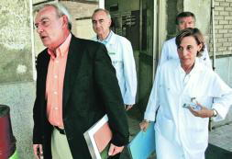
And if an adverse event happens…
PATIENTS AND FAMILY
FIRST VICTIM
HEALTHCARE PROFESSIONALS
SECOND VICTIMS
HEALTHCARE ORGANIZATIONS
THIRD VICTIMS
Health Care has not gone as planned...giving appropriate support to victims.

Slide 29
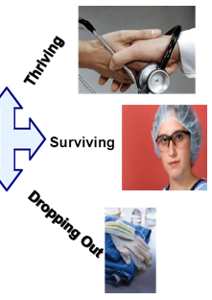







The Aftermath of No Support
Traumatized Clinician
Negative Personal and Professional Impact
Isolation
Prolonged Clinician Suffering
Limited Communication
Impaired Job Performance
Negative Impact on Teamwork
Low Morale

Slide 30
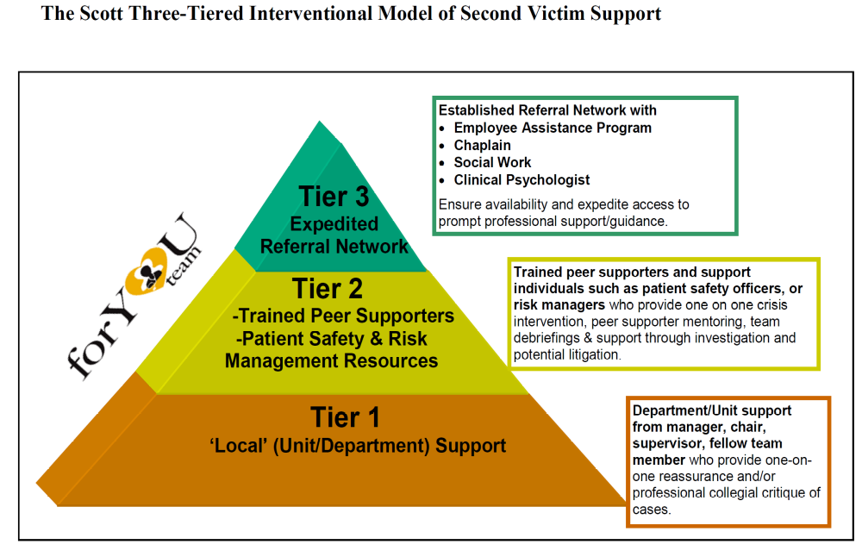
PRIMARY CARE TEAM
Scott, S. D., Hirschinger, L. E., Cox, K. R., McCoig, M., Hahn-Cover, K., Epperly, K. M., ... Hall, L. W. (2010). Caring for our own: deploying a system wide second victim rapid response team. The Joint Commission Journal on Quality and Patient Safety, 36(5), 233-240.
Notes:
Susan Scott in 2010 published her experience to tackle with this problem with a support model organize in 3 tier:
First Tier: close support: one on one reassurance
Second Tier: trained peer supporters on one on one basis, mentoring, team debriefing and support through investigation
Third Tier: a group that coordinate resources to prompt professional support

Slide 31
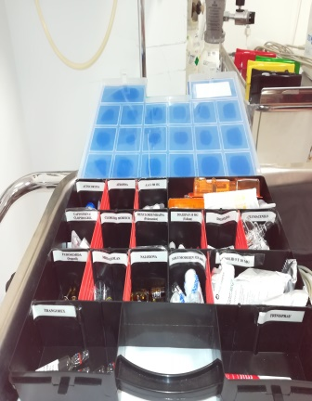
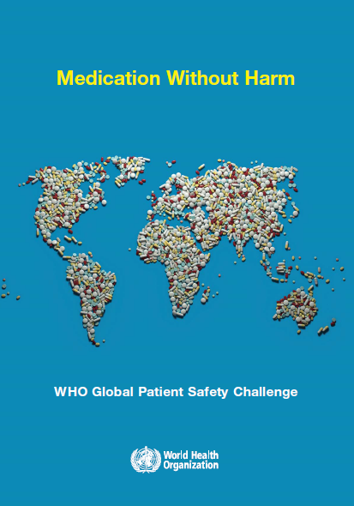
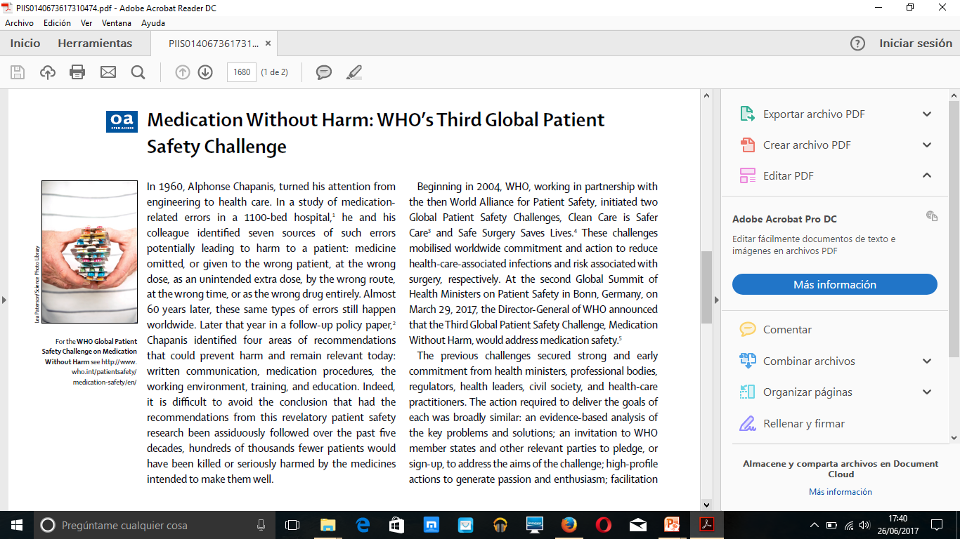
Medications:
Safe use of medications
Adherence to treatment
3rd
challenge
http://www.who.int/patientsafety/medication-safety/en/
Medications Without Harm (MWH)

Slide 32
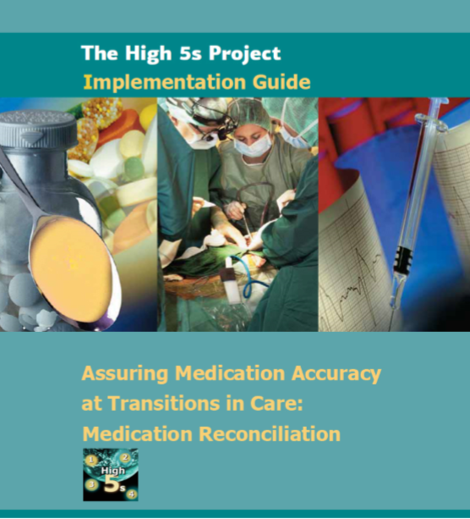
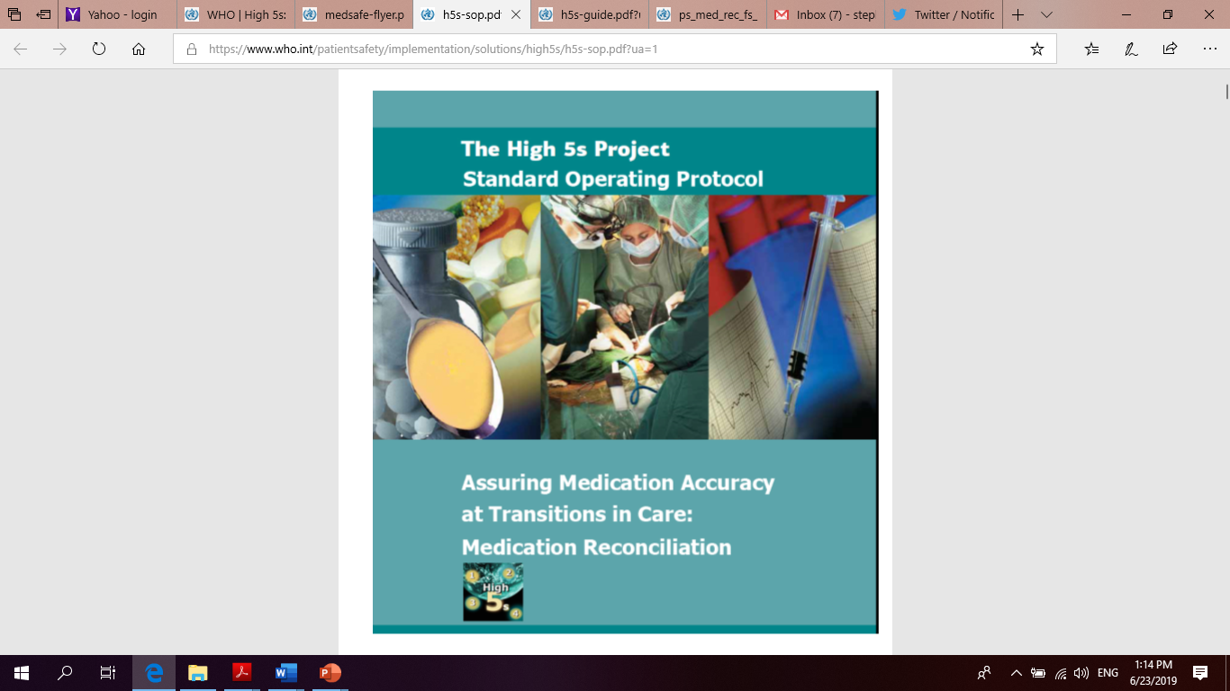
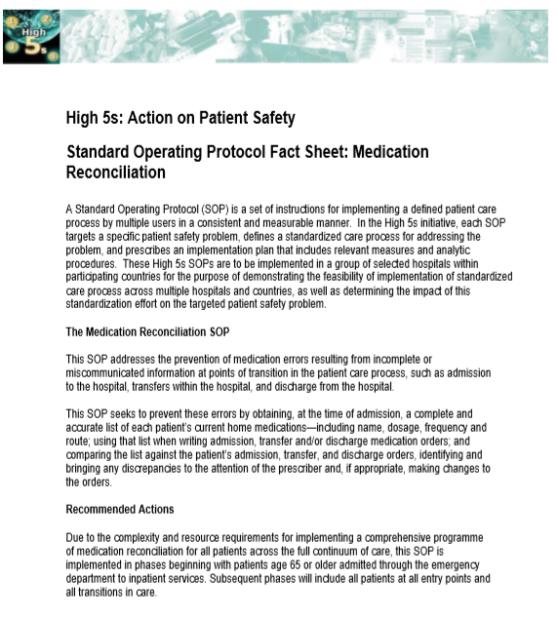
Medication Safety Resources
  Patient Safety Solutions
  Look-Alike, Sound-Alike Medication Names
  Control of Concentrated Electrolyte Solutions
  Assuring Medication Accuracy at Transitions in Care
The High 5s Project
Medication reconciliation
  High 5s Fact Sheet
  Standard Operating Protocol
  Implementation Guide
https://www.who.int/patientsafety/en/

Slide 33
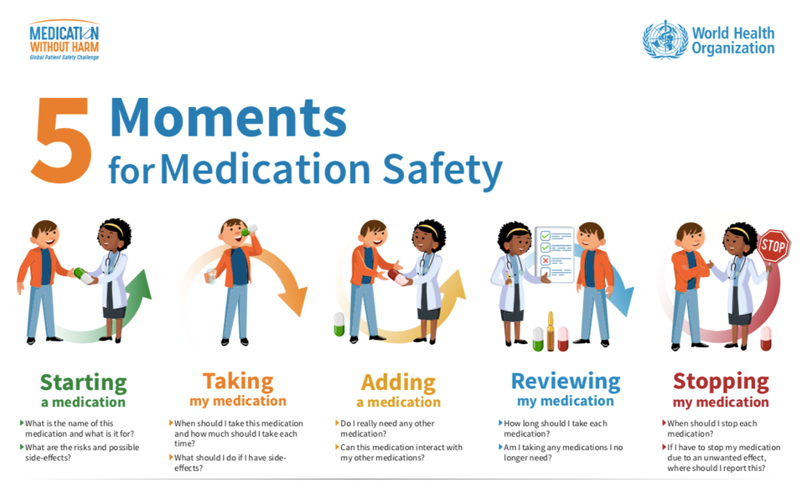
A tool for patient engagement to ensure medication safety
IN #COVID19 PANDEMIC, TOO

Slide 34
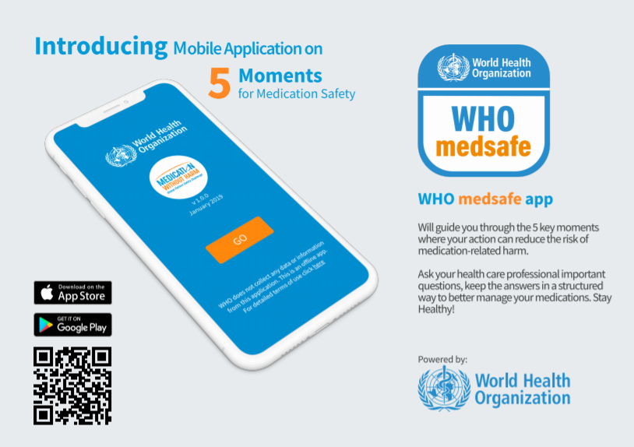

Slide 35
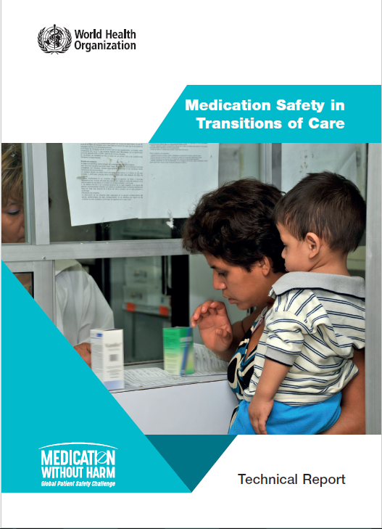
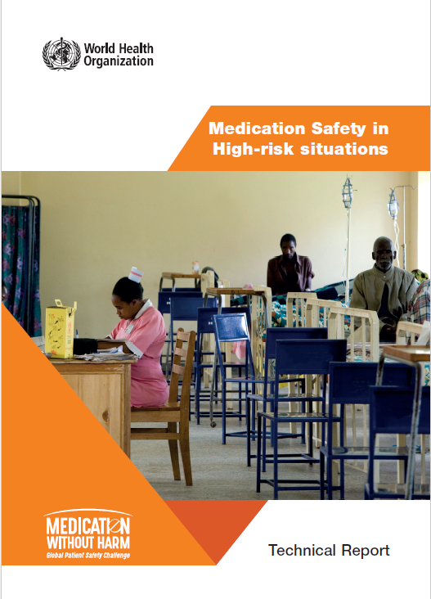
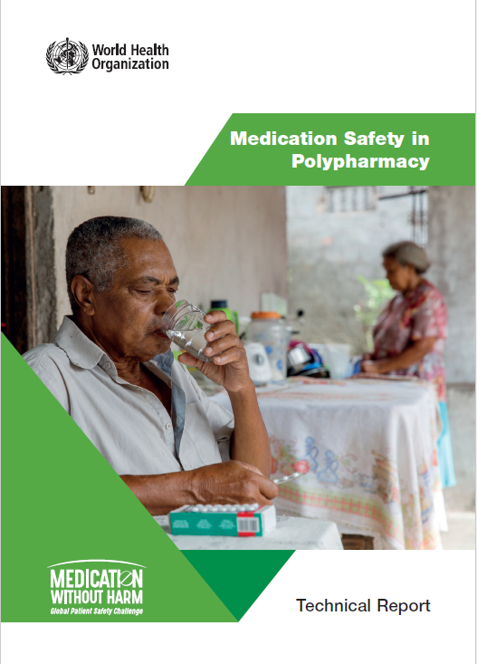
Key Action Areas – Technical reports
HIGH RISK MEDICATIONS AND FRAGILE PATIENTS
POLYPHARMACY:
MORE THAN 5 MEDICATIONS
HOSPITAL- PRIMARY CARE

Slide 36
To promote Patient Safety culture in the Community
Shared decision making with patients about health risks
Nursing Homes
Home Care
Health Literacy and Patient Safety
Social Media and patient safety awareness

Slide 37
Structure and Resources: minimum needs to work with Q and S
Medical Electronic Records
Information Technologies to connect with Pharmacist, Public Health…
Availability of diagnostic technologies and PPE
Telemedicine:
to keep track of chronic pathologies (diabetes, hypertension, COPD, etc.) and support to patients

Slide 38

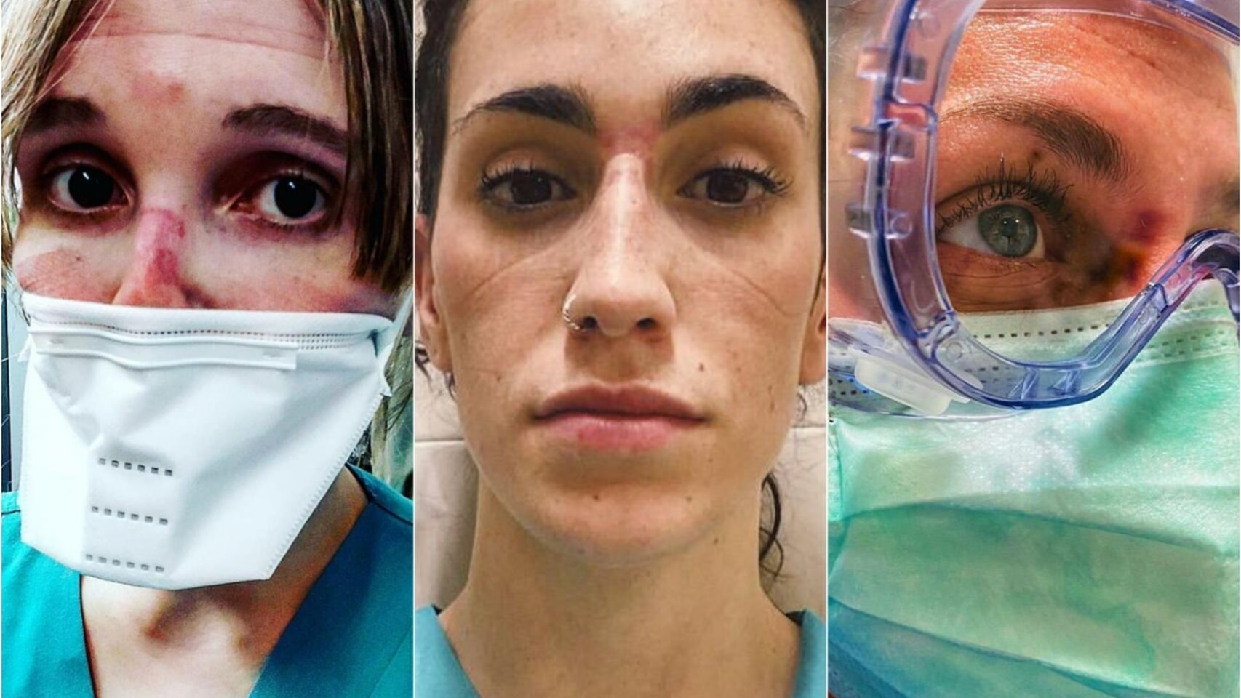


Developing Standards in primary care to guarantee a safe and quality service.
National or International Acreditation Systems for Primary Care Facilities
Quality Standards for Healthcare facilities
Measuring quality improvements:
Indicators

Slide 39
Improving Barriers in PHC: Safe Practices
SAFE USE OF MEDICATION
PATIENT INDENTIFICATION: documents, samples, consultations...
Avoiding unnecessary interventions: overdiagnosis and overtreatment
Reduction of infections
Hand hygiene/ Reduction of antibiotic resistance
TRANSITIONS OF CARE: VERIFICATION of medication and care at each transition
PATIENT INVOLVEMENT:
Promoting patient safety
With shared decision-making
REPORTING, ANALYSING (PSI ANALYSIS TOOLS: RCA, SIA, ...), LEARNING
PATIENT SAFETY INCIDENTS
SAFE CARE: review diagnostic criteria, list of problems, avoid pressure ulcers, falls...

Slide 40


“Technical Series on Safer Primary Care”
aiming at raising awareness about the underlying causes of safety incidents and consequences of unsafe primary care.
https://www.who.int/patientsafety/topics/primary-care/technical_series/en

Slide 41

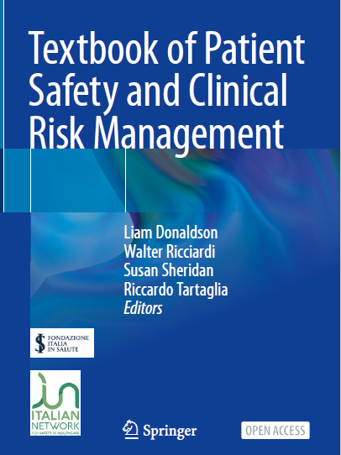
ESSENTIAL OPEN ACCESS BOOKS ON PATIENT SAFETY

Slide 42

THANK YOU
MERCI BEAUCOUP

