Slide 1
The role of Pharmacists in PHC A case study on NCDs
Tuesday March 15, 2022

Slide 2
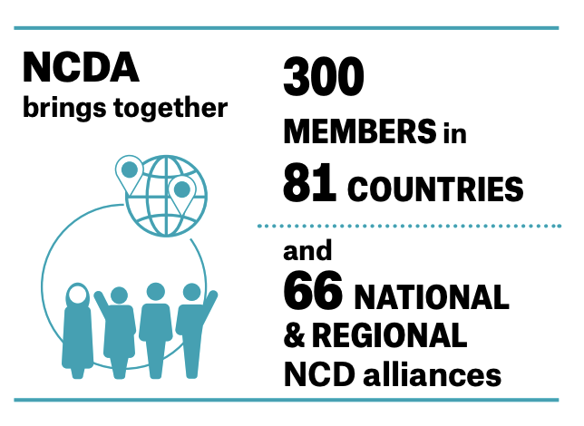
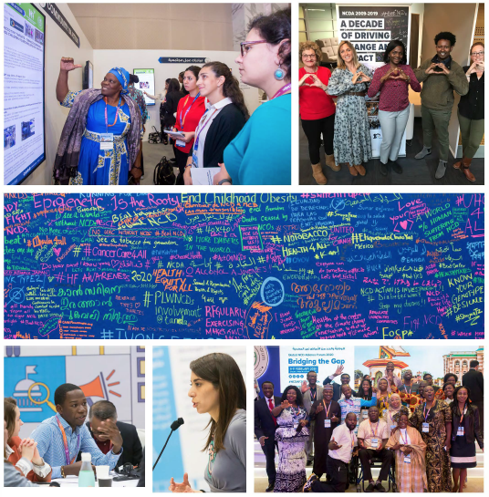
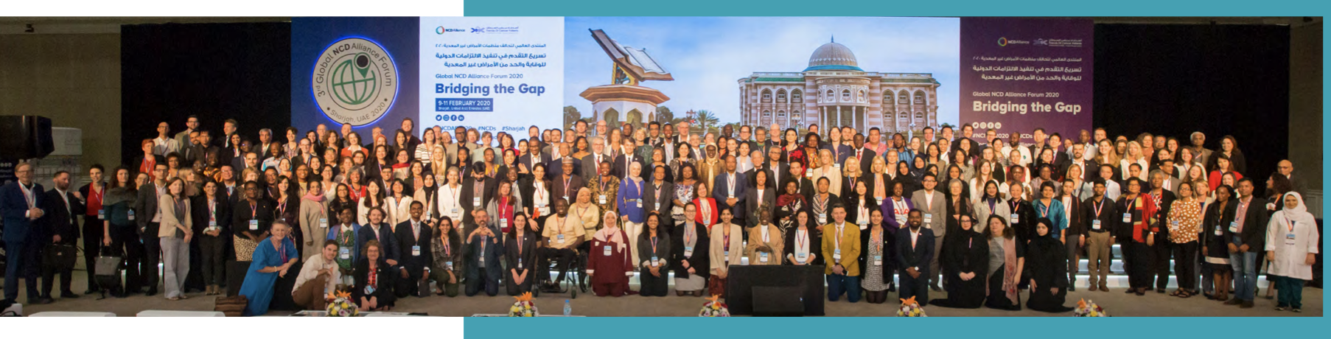
NCD Alliance at a glance
4 Founding federations - UICC, IDF, WHF, and The Union.
A unique global civil society network leading the way to a world free of preventable NCDs.
A growing membership base
A global network of 66 national / regional NCD alliances.
A multisectoral group of 28 supporters – private sector, foundations, academia, bilateral organisations and NGOs
Notes:
Founded in 2009 - by UICC, IDF, WHF, and The Union;
A unique global civil society network leading the way to a world free of preventable NCDs;
Transitioned to become a registered NGO in Switzerland in 2017;
A growing membership base, currently with 300 members across 81 countries
A unique network of 66 national / regional NCD alliances;
A multisectoral group of 27 supporters – private sector, foundations, academia and NGOs;
A team of 21 based across main offices of Geneva, London, New York;
A Board elected by the NCDA membership.
Amplifiy the views and voices of people living with NCDs since 2009

Slide 3
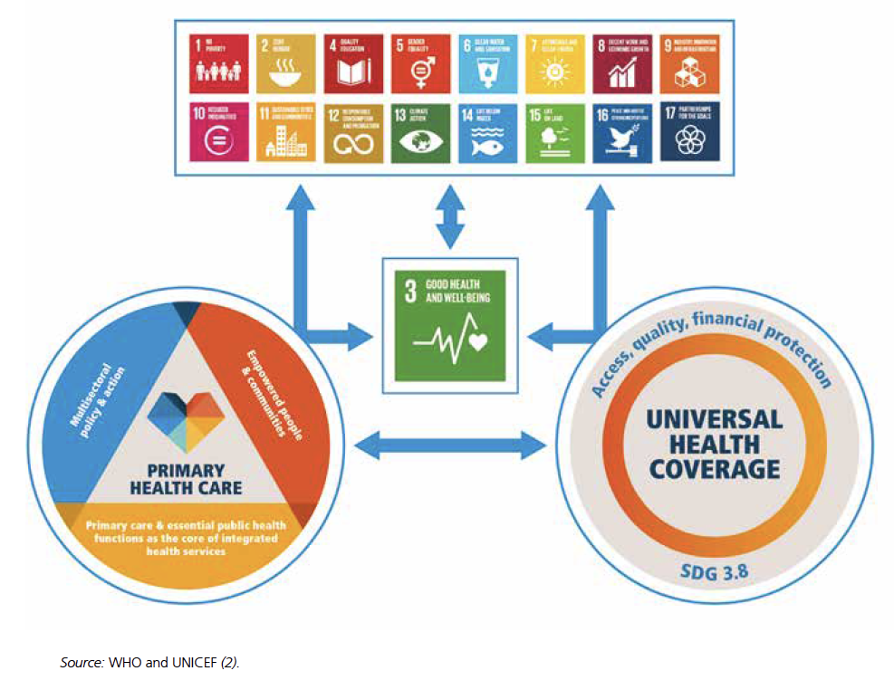
PHC - the cornerstone for achieving UHC and the SDGs
A whole-of-government and whole-of-society approach to health that combines three core components:
  multisectoral policy and action;
  empowered people and communities; and
  primary care and essential public health functions as the core of integrated health services
PHC creates the foundation for the achievement of universal health coverage (UHC) and the health-related Sustainable Development Goals (SDGs).

Slide 4
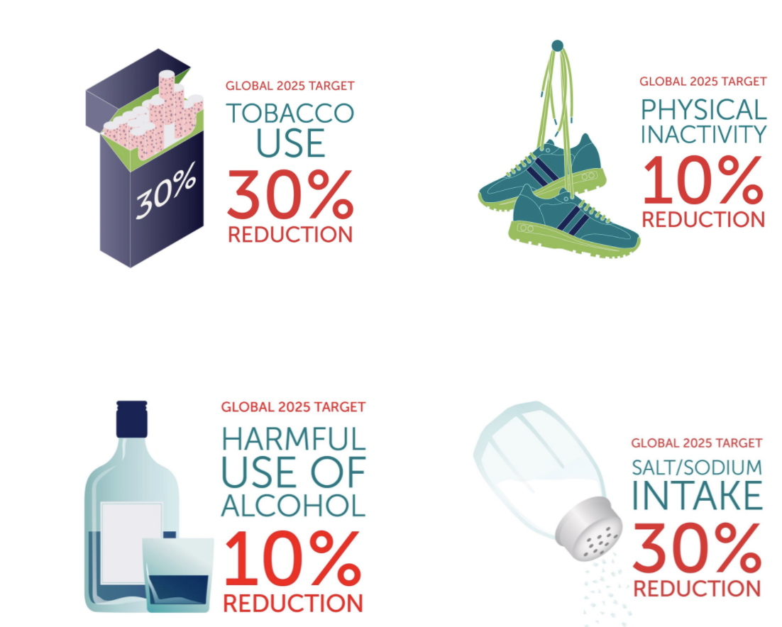
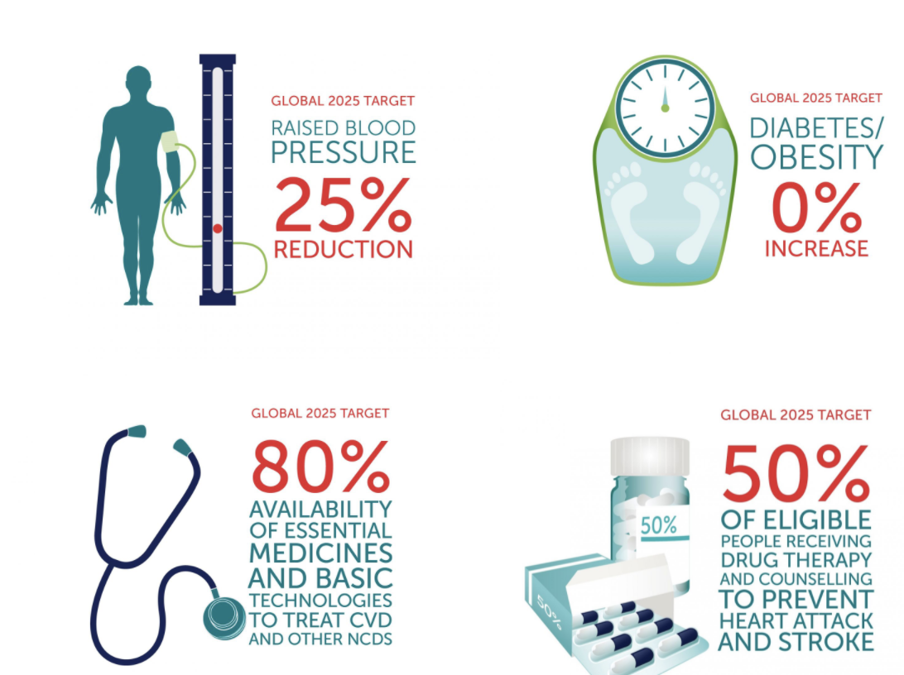
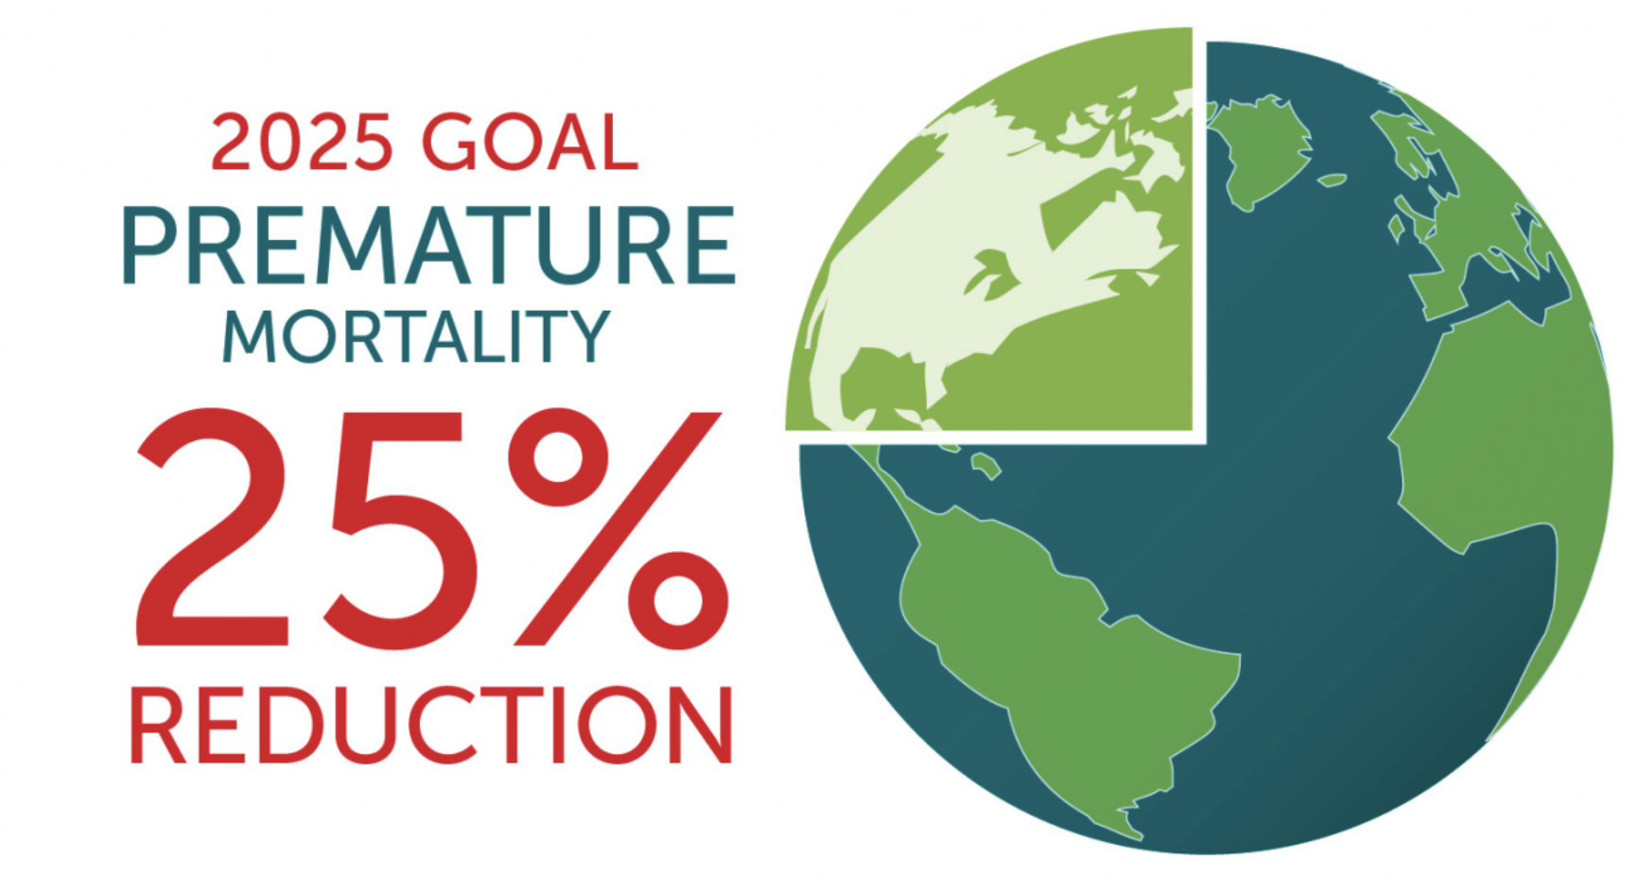
NCDs Global Action Plan: 9 global targets by 2025
At WHA75, WHO MS will approve the extension of the NCD premature mortality target 1 from 25% to a one third (33.3%) reduction in risk of dying from an NCD between the ages of 30 and 70 by 2030.
Notes:
Global NCD Targets were Called for by the 2011 Political Declaration.
It is at the core of the Global NCD Framework, provides a clear vision for action by 2025.
Member States formally adopted the global monitoring framework, including nine global targets and 25 indicators, as part of a comprehensive "Omnibus" Resolution at the 66th World Health Assembly in May 2013.
Global NCD Targets
Called for by the 2011 Political Declaration the global monitoring framework (GMF) is the centerpiece of the Global NCD Framework, providing a clear vision for action by 2025.
Member States formally adopted the global monitoring framework, including nine global targets and 25 indicators in May 2013.

Slide 5
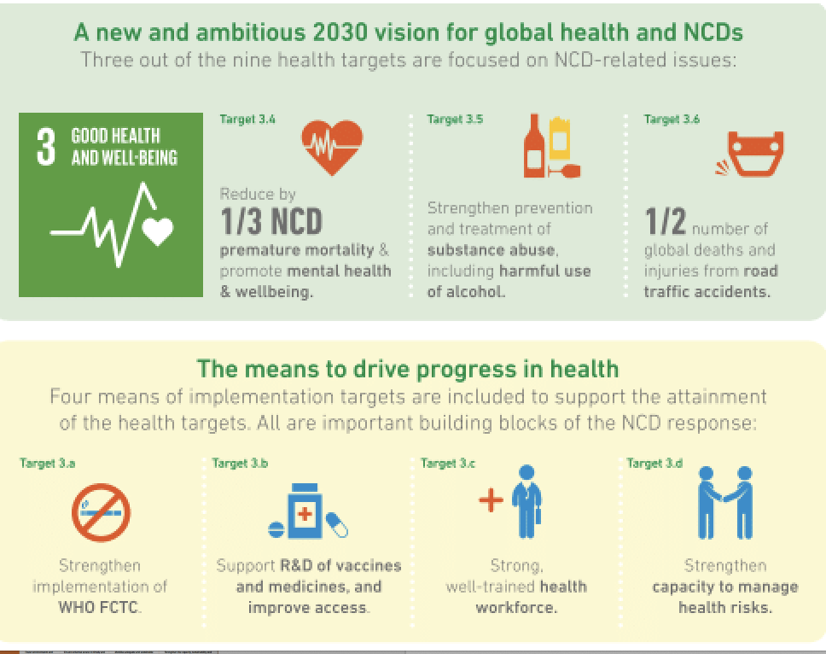
Global NCDs Mandate: UN SDG target 3.4
To reduce premature mortality from NCDs, through prevention and treatment, by one-third by 2030.
Source: Pinkney-Atkinson V, 2019/06/20; Moving forward, taking NCDs into the SDG era with political will, policy coherence and stewardship.

Slide 6
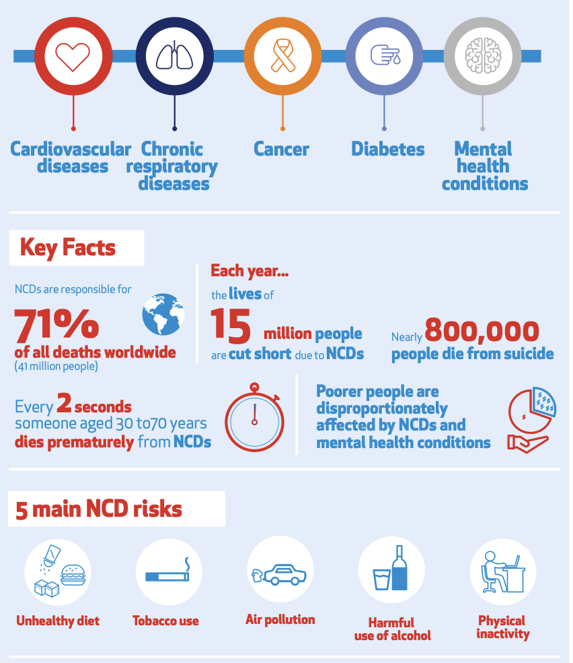
The Global burden of NCDs & Mental Health
NCDs are responsible for around 74% of global deaths every year
Leading cause of death and disability globally, 41 million deaths annually
NCDs are on track to become the leading cause of death in the African region
By 2030, deaths from NCDs in Africa will exceed deaths due to communicable, maternal, perinatal and nutritional diseases combined
In Mauritius, Namibia and Seychelles, NCDs cause over 50% of all reported adult deaths

Slide 7
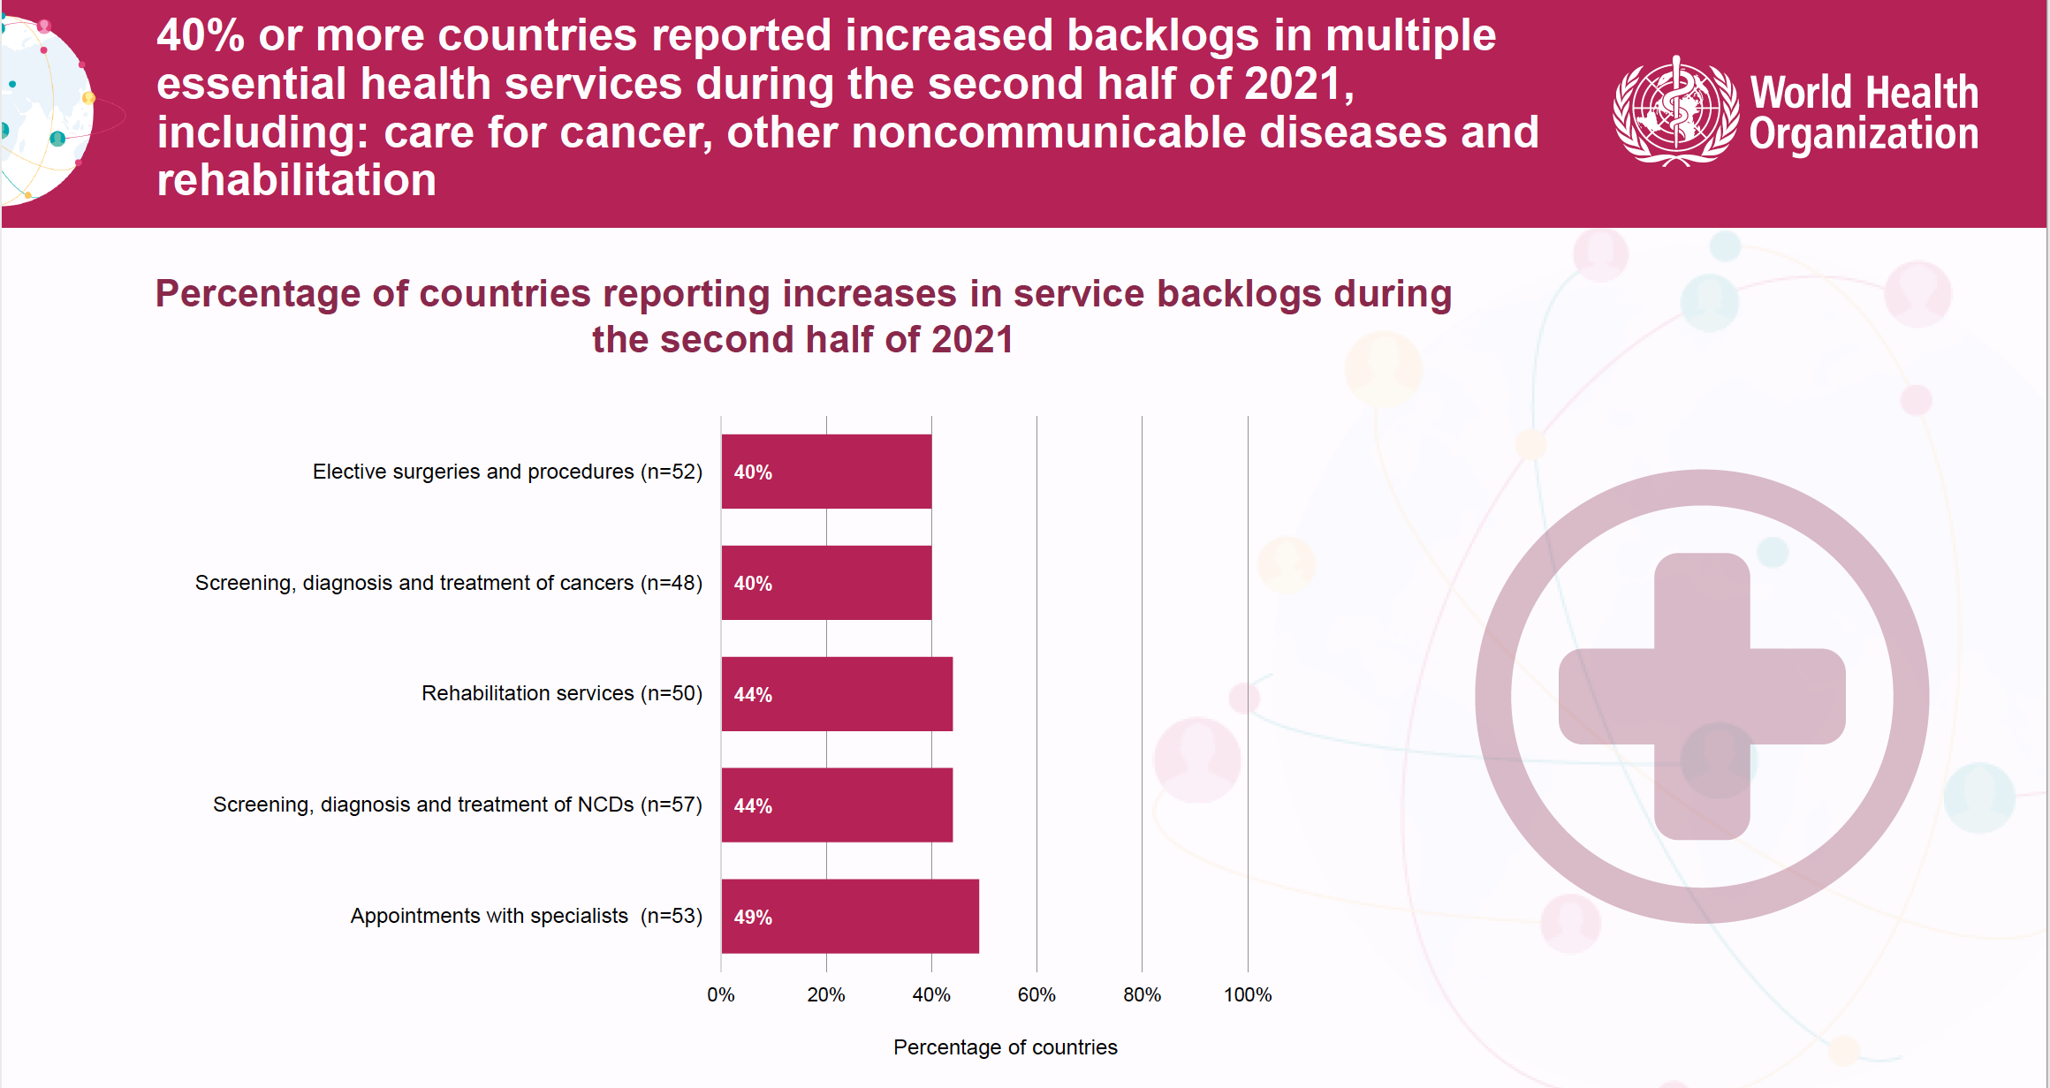
WHO Pulse survey 2022

Slide 8
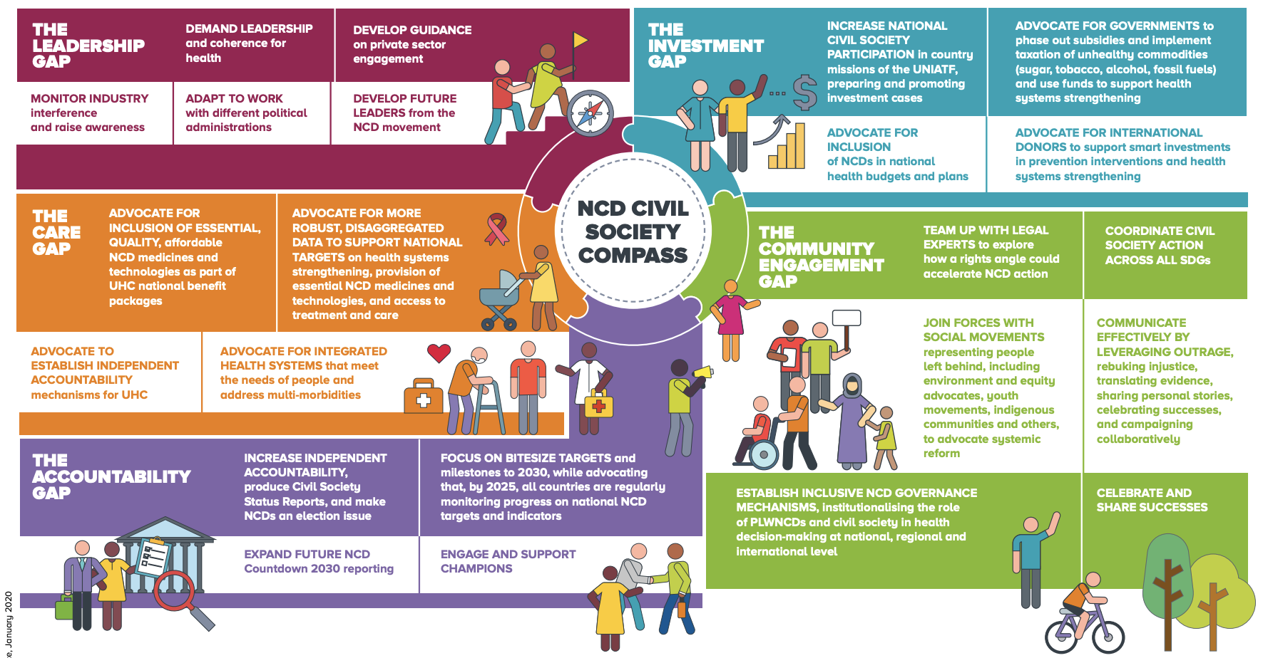
5 major gaps in the global NCD response
Notes:
These gaps represent immediate opportunities to act on NCDs, and pharmacists are uniquely positioned to act on all 5

Slide 9
The role of Pharmacists in PHC for NCDs
NCDs require a whole-of-govt, whole-of-society, health-in-all-policies approach
Pharmacists can:
Amplify the needs and views of people living with NCDs.
Lead and support multisectoral partnerships on NCDs at the global, regional and national levels.
Call for integrated, people-centred care delivered by high-quality primary health care systems that engage with people as equal partners in promoting and maintaining their health.
Seek and support partnerships to address the gaps in access to affordable, quality NCDs medicines; support global purchasing mechanisms to drive cost down.
Ensure that skills and competencies pertinent to NCDs prevention and control are fully integrated in pre-service curricula and clinical training.
Prioritize the development of a workforce is trained and empowered to provide quality health care that is effective, equitable, efficient, integrated, people-centred, safe and timely.
Notes:
Integrated care can be an effective and affordable way to strengthen the framework for preventing and treating NCDs. Integrated care places people and communities at its heart, consists of personal, continuous and holistic treatment for individuals living with NCDs.
Multidisciplinary teams are critical for effective NCD management because of the tendencies for comorbidities. Effective multidisciplinary care teams are characterised by shared goals, clear roles, mutual trust, effective communication and measurable processes and outcomes, with the patient and family at the centre of care.

