Slide 1
COUNTRY HWF DEVELOPMENT
Guiding Principles & Frameworks
Francis Omaswa
Afro PHC Workshop
16 March, 2021

Slide 2

Health Workers for All and All for Health Workers
"To ensure access to a motivated, skilled & supported health worker by every person, in every village, everywhere."
Dr LEE Jong-wook, 1945-2006
WHO Director-General

Slide 3
HRH: Global Wind of Change
Neglect to a Global Movement: GHWA
Milestones: African crisis, Northern professionals frustration, JLI, HLF, Oslo, WHR 2006, GHWA, KD/AGA, Bangkok
Initiatives: Task Shifting, SAMMS, Commsions, Socially Accountable Medical Education, WHO Global Guidelines on Transformative Medical and Nursing Education, MEPI & NEPI

Slide 4
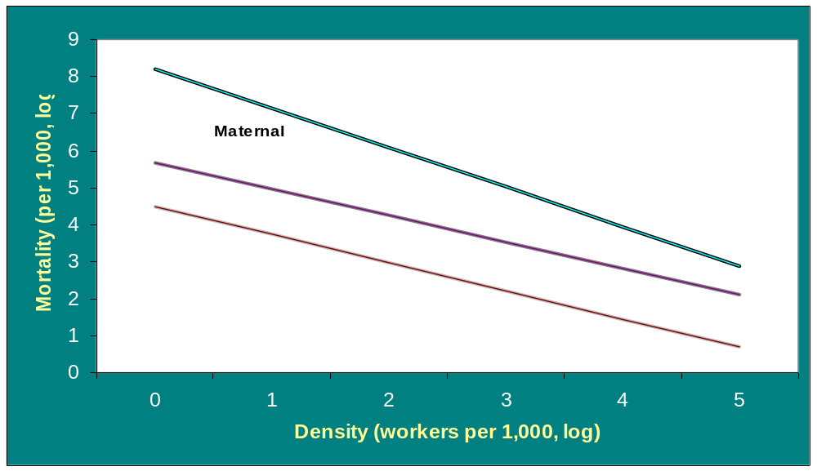
HRH availability and impact on MDG targets
Source: Anand & Barnighausen 2004

Slide 5
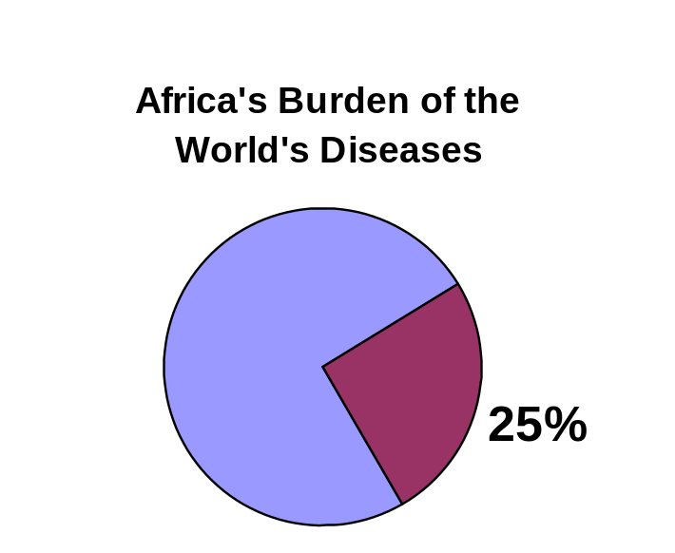
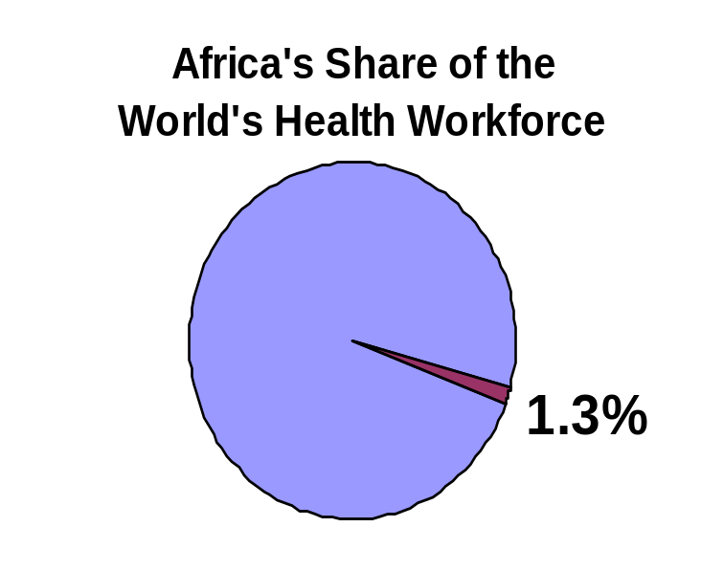

The overwhelming burden for Africa
Africa's share of the
global disease burden
Africa's share of the
world's health workforce
5

Slide 6
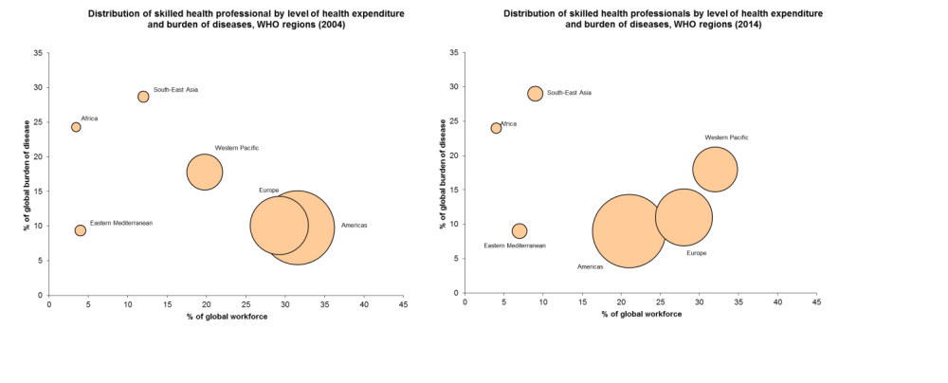


MDG era: but words don’t always translate to action……
“24% burden of disease, 3% global health workforce”
(2004-2005 vs 2013-2014)
Sources: WHR 2006; Global Health Observatory (2014 update)

Slide 7

Progress is Slow; Need is Growing!
Weak leadership and governance of HRH
Inadequate HRH regulatory capacity
Weak education and training capacity
Inadequate utilization, retention and performance of the available health workforce, migration growing
Insufficient information and evidence base
Insufficient financial resources
Uncoordinated partnerships and weak dialogue

Slide 8
Kampala Declaration and Agenda for Global Action
Key elements:
  Building coherent national and global leadership for health workforce solutions
  Ensuring capacity for an informed response based on evidence and joint learning
  Scaling up health worker education and training with needs based skill mix
  Retaining an effective, responsive and equitably distributed health workforce
  Managing the pressures of the international health workforce market and its impact on migration
  Securing additional and more productive investment in the health workforce
8

Slide 9
Critical success factors for scaling up
Study of GHWA Task Force on Education and Training
9 country experiences across regions
Critical factors identified:
Political commitment and good governance
  Sustained high level support, 'one' country-led health plan, significant financial investment
Workforce planning
  Plan long term, act short-term and update regularly, commitment to production / appropriate skill mix integrated teams, expansion of pre-service programmes
Enabling environment
  Good information systems, effective management and leadership, labour market capacity and policy
Notes:
9

Slide 10
Foundations of HRH Program
Comprehensive National Development Plan. Long term vision
National Health Sector Development and Investment Plan
National HRH Plan: “Health Worker for every person in every village, everywhere>” (JWLee)
CCF
Plan long term
Act short term
Review regularly. Quality Assurance.
Fit into resource envelop

Slide 11
Pillars of Country HRH Programme
Multi-sector Country Partnerships (Professionals, CSO, Politician, Private Sector)
Health Sector Strategic Plan (HSSP)
Comprehensive HRH Plan in line with HSSP (Tools)
HRH Information Systems (Observatories) with Annual Reporting and Response (Tools)
National, Regional, global, links/partnerships
Strong Civil Society led Advocacy for Health and HRH
Leadership and Management Capacity
Strong Professional Associations and Unions

Slide 12
Membership of the HRH Committee
HRH committees in countries should include professional
associations; training institutions; non-governmental
organizations (NGOs) and faith-based organizations
(FBOs); private sector partners; representatives from
Ministries of Finance, Education, Labour, local government
and other relevant entities; public service commissions
or agencies; multilateral and bilateral development
partners and regulatory bodies.
A stakeholder analysis should be employed to ensure

Slide 13
Expected Outcomes of the CCF
One comprehensive, costed, evidence-based HRH plan integrated with: National Vision, NDP, HSSIP, Swaps
Financing of the HRH plan
Capacity building of stakeholders
Consistency in implementation of the HRH plan
A unified monitoring and evaluation framework

Slide 14

Relevance: Skill Mix

Slide 15
Working lifespan strategies to build capacity and performance
ENTRY:
Preparing the
workforce
Planning
Education
Recruitment
WORKFORCE:
Enhancing worker
performance
Supervision
Compensation
Systems support
Lifelong learning
WORKFORCE PERFORMANCE
Availability
Competence
Responsiveness
Productivity
EXIT:
Managing attrition
Migration
Career choice
Health and safety
Retirement
Source: WHO (2006). The World Health Report 2006 – Working Together for Health.
Geneva, World Health Organization

Slide 16
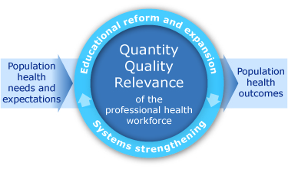
The guiding framework
Quantity
The Goal: To transform and scale-up the education and training of health professionals so as to contribute to health systems strengthening and to improve health outcomes.
Notes:
World Health Organization
16 March, 2021
16
The guiding framework of the initiative has been based on three pillars:
A deliberate choice to serve population health needs and expectations; in other words design the initiative to be responsive to the actual and evidence based needs of the communities
An imperative to reform the education systems in a way to address the quantity of health professional, their competence, and the relevance of the knowledge and skills to health needs of the community they serve and to the system where they work.
Inclusion of a measurement arm to the initiative through its impact on population health outcomes at large.

Slide 17
More than just a health issue
Super-specialists
Specialists
Mid-level
CHWs
Nat'l
referral
Contributing factors:
Good governance, law and order
Gender
Social justice
Social and economic development
Regional
referral
District level
Sub-district level
SHARED
Household & community

Slide 18
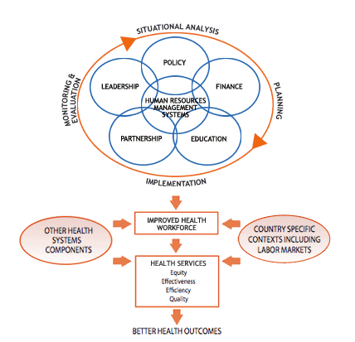

Slide 19
Scale-up framework
INDICATOR:
MDGs
GOAL: HEALTH OUTCOMES
BASIC PACKAGE OF SERVICES
SKILL MIX
"CLOSE-TO-CLIENT HEALTH TEAMS"
Defined within country context
EXISTING CAPACITY DEVELOPMENT OF NEW CAPACITIES
FINANCIAL | POLITICAL | TECHNICAL
- Resources - Incentives - Partnerships | - Supportive environment - Leadership - Commitment - Legislation - Policy - Partnerships | - Training - Institutions - Infrastructure - Connectivity - Partnerships
19

