Slide 1
An approach to Hypertensive Disorders in Pregnancy for the primary care physician
Dr. Ann Alagidede
Family medicine registrar
3rd year.

Slide 2
REFERENCES
¹Moodley J, Soma-Pillay P, Hlongwane T, Buchmann E, Pattinson R. Hypertension in pregnancy: National guidelines (2018/2019). SAMJ.
²Naidoo M, Pattinson R C,. 2020. An approach to HDP for primary care physician. SAFPJ.
³Brown et al. 2018. Hypertensive disorders of pregnancy: ISSHP classification, Diagnosis, and Management Recommendations for International Practice. Hypertension.

Slide 3
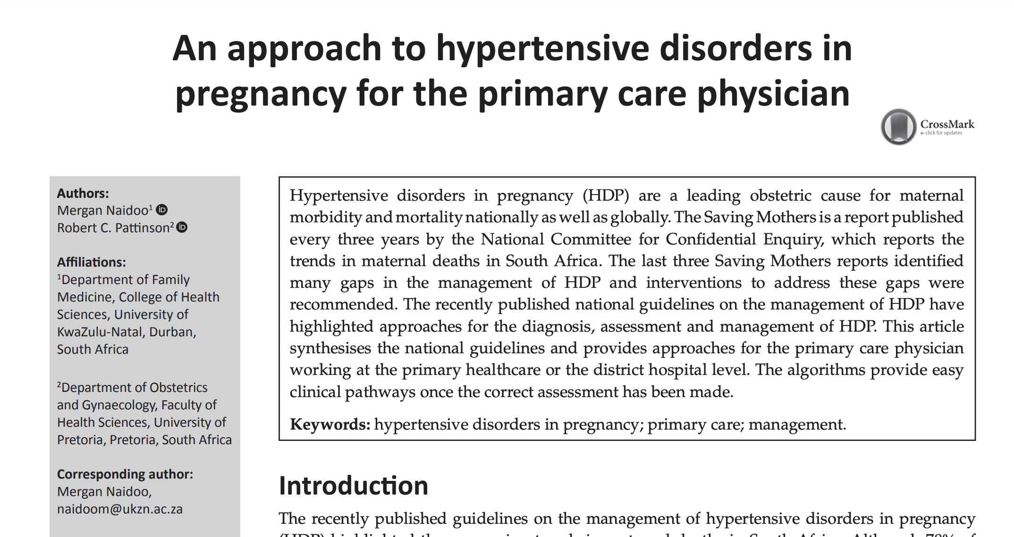
References

Slide 4
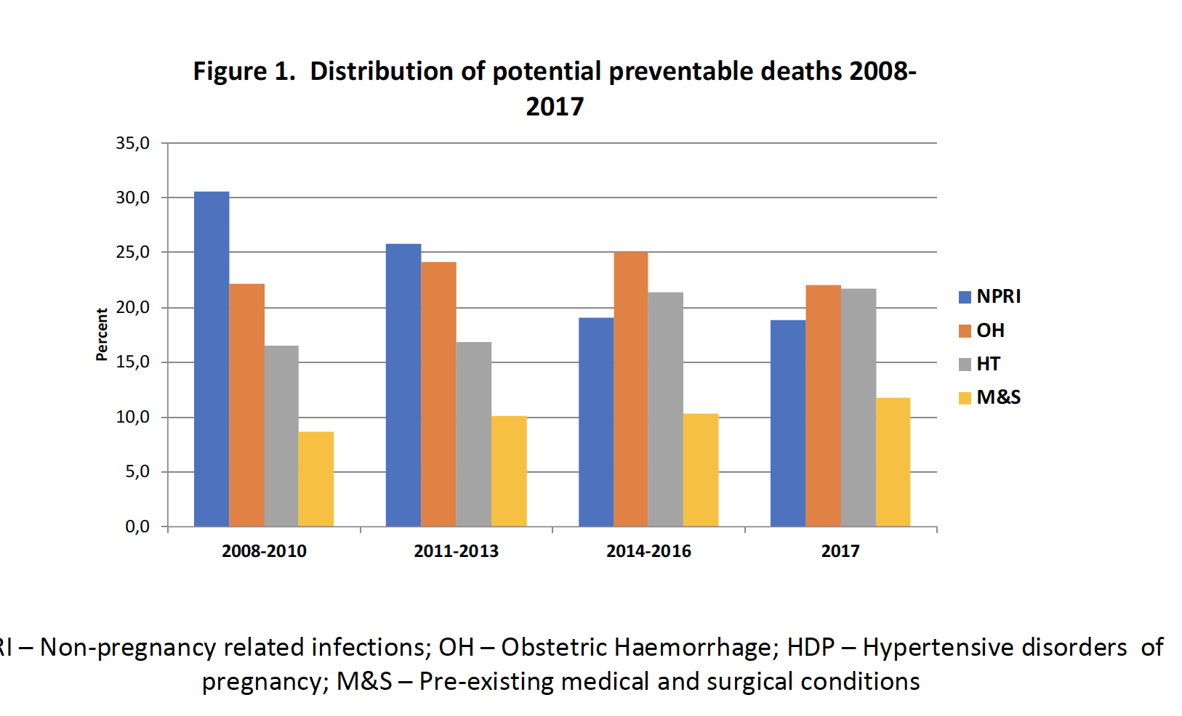

Slide 5
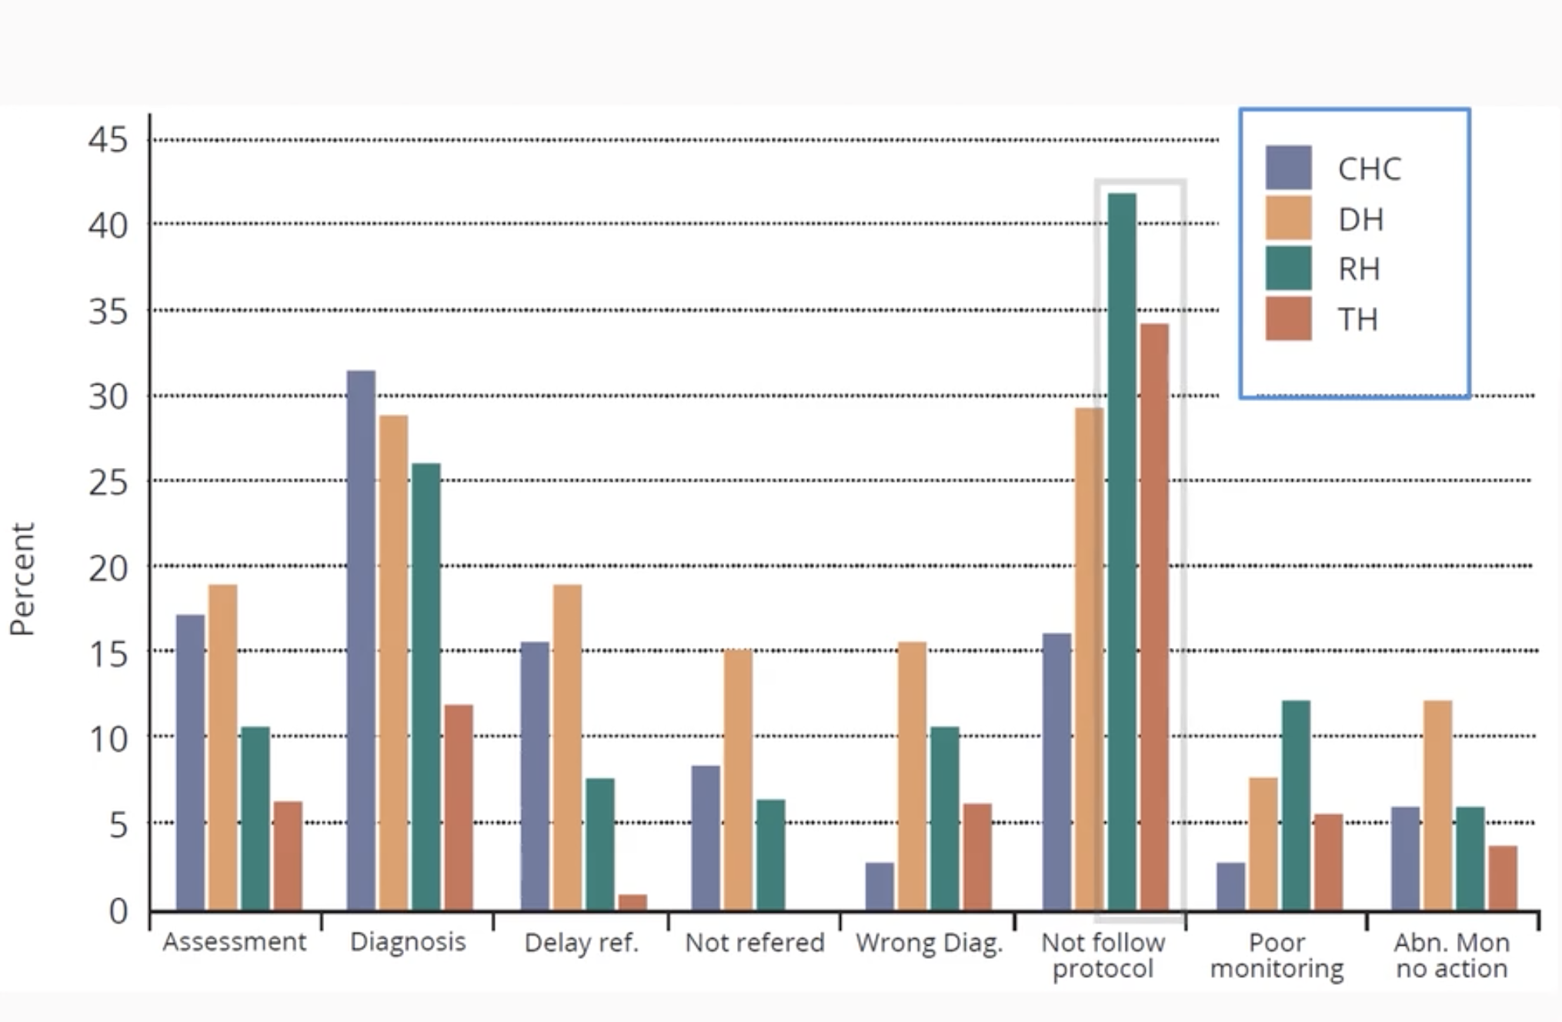

Slide 6
HT In Pregnancy
“This is defined as a clinical systolic BP≥140/90mmHg or diastolic BP≥90mmHg, based on the average of at least two measurements taken at least 15 minutes apart, using the same arm”.^{1,2,3}

Slide 7
1. International society for the study of hypertension in pregnancy( ISSHP) classification
Chronic hypertension:
HT predating pregnancy or diagnosed before 20 weeks GA
White coat hypertension:
Elevated office blood pressure levels ≥140/90 mmHg but normal BP measurements at home
Gestational hypertension: New onset hypertension after 20th week of pregnancy
Pre-eclampsia:
BP ≥140/90 mmHg but accompanied by proteinuria* or evidence of organ dysfunction after the 20th week of pregnancy
HELLP syndrome:
characterized by hemolysis, elevated liver enzymes and low platelets counts

Slide 8
Pre-eclampsia
Pre-eclampsia is Gestational HT accompanied by ≥1 of the ff new onset conditions ≥20 weeks gestation:
Proteinuria
Other maternal organ dysfunction:
AKI (creat≥90umol/L; 1mg/dl)
Liver involvement (AST or AST > 40IU/L ± RUQ or epigastric pain
Neurological complications (eclampsia, altered mental status, blindness, stroke, clonus, severe headache, and persistent visual scotomas
Hematological Cx (plt<150 000/uL, DIC, hemolysis)
Uteroplacental dysfunction ( fetal growth restriction, abnormal UA doppler waves or stillbirth

Slide 9
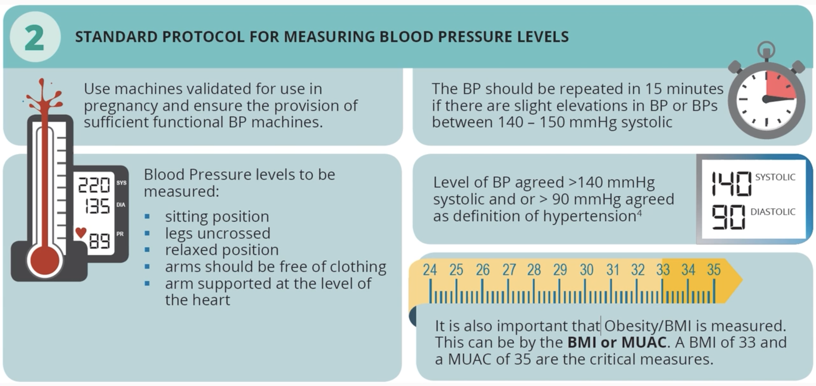

Slide 10
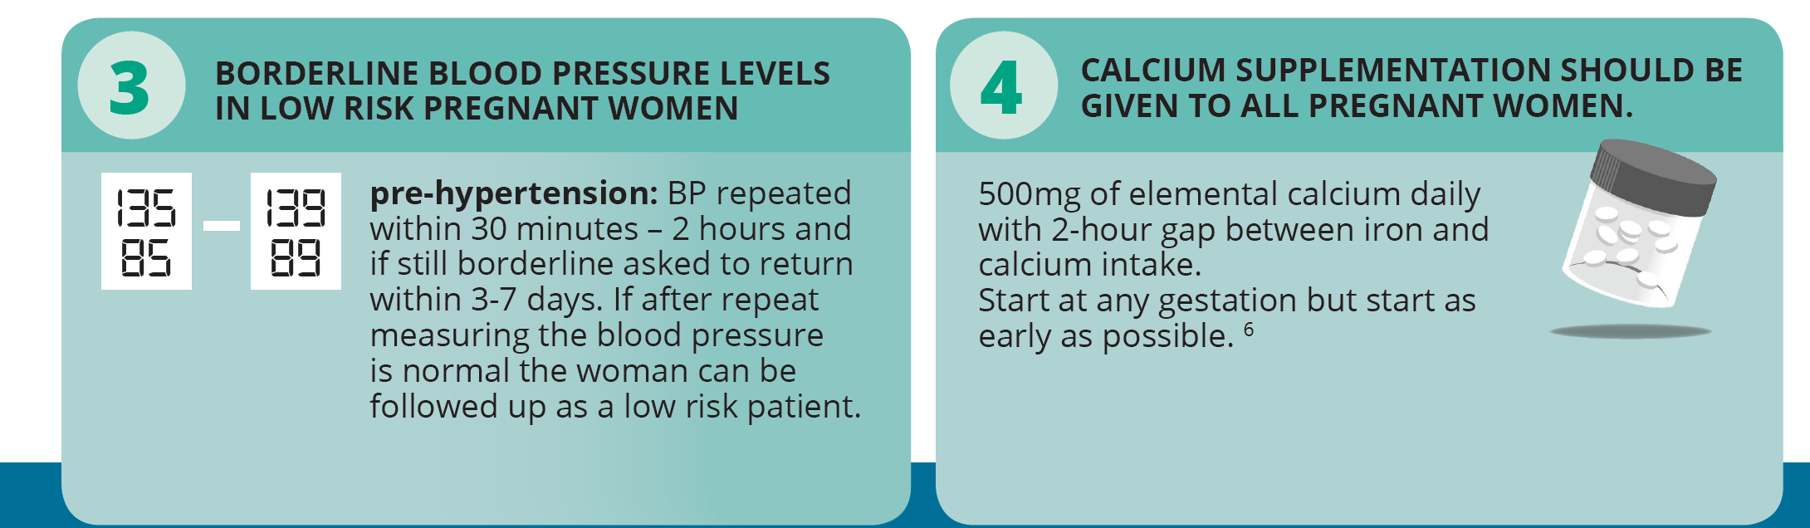

Slide 11
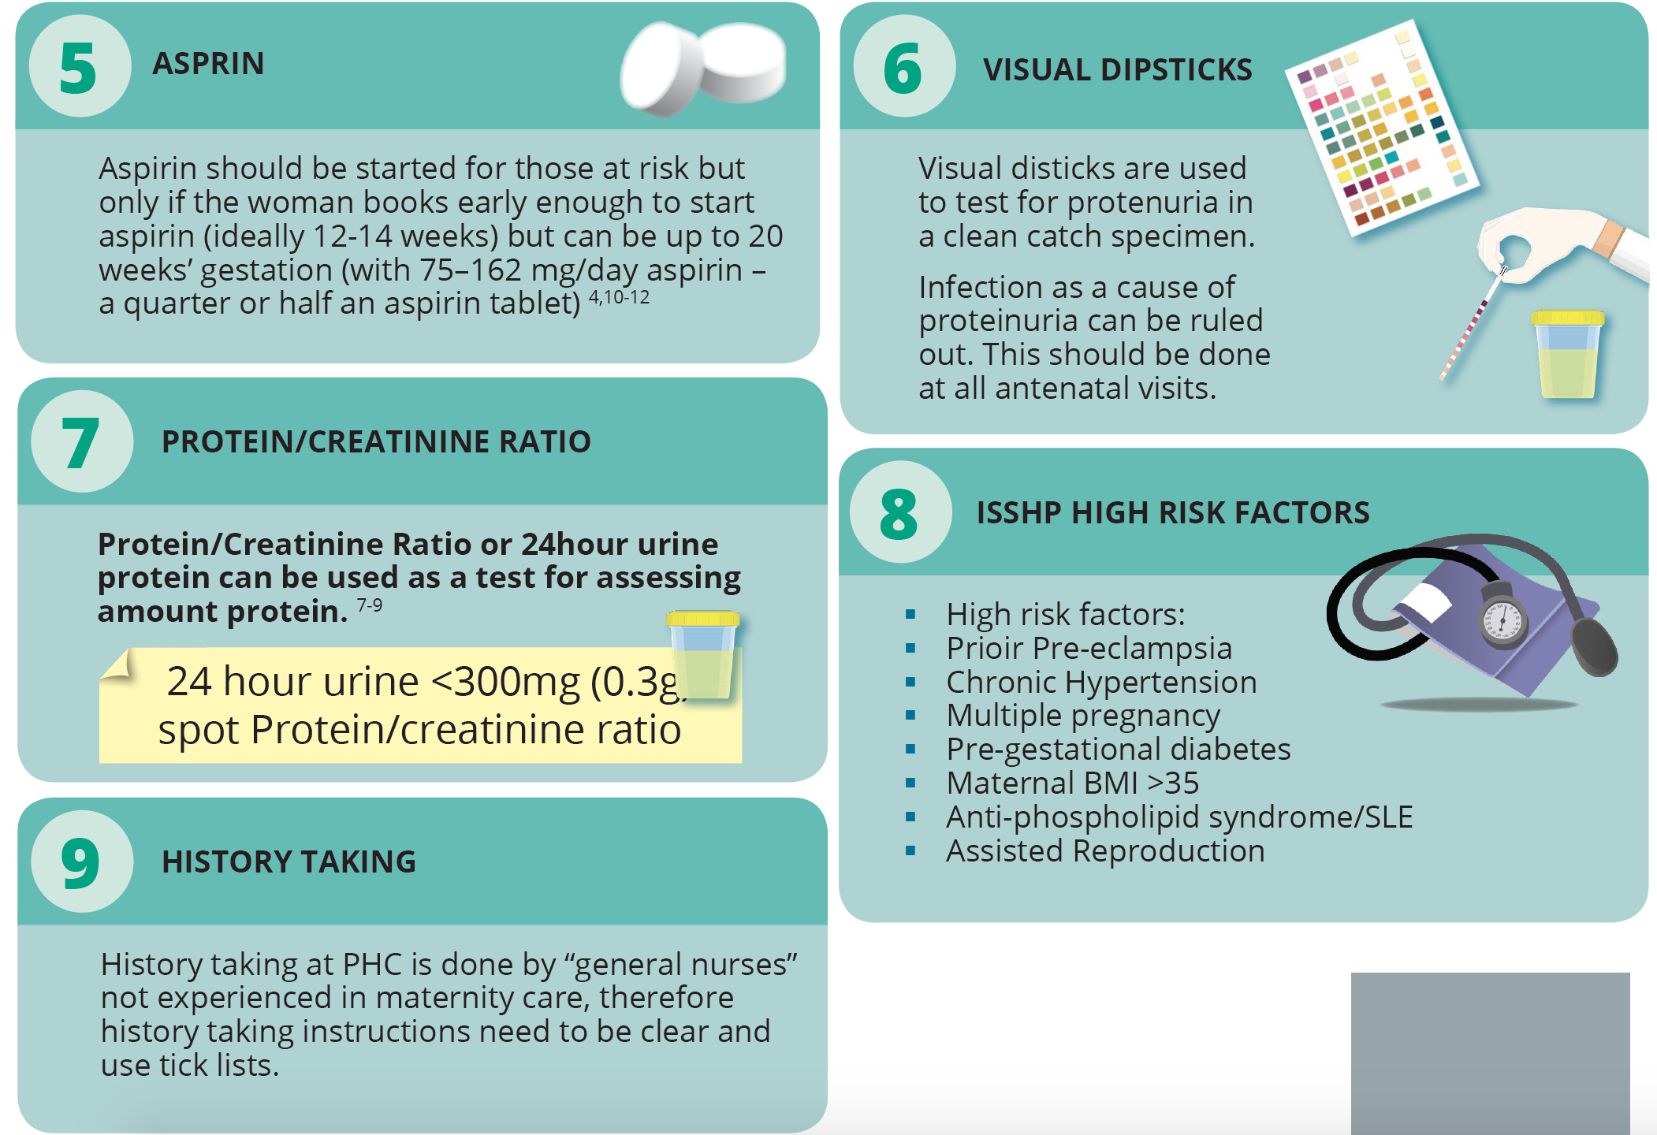

Slide 12
10. Next level of care
Advanced midwife
Family physician
Doctor dealing with pregnant women
Access to Hb, platelets, urea, creatinine, ALT urine mcs and sonar
The apex hospital in the catchment area should be involved in developing guidelines into protocols. Ideally the District clinical specialist should be involved and facilitate these discussions

Slide 13
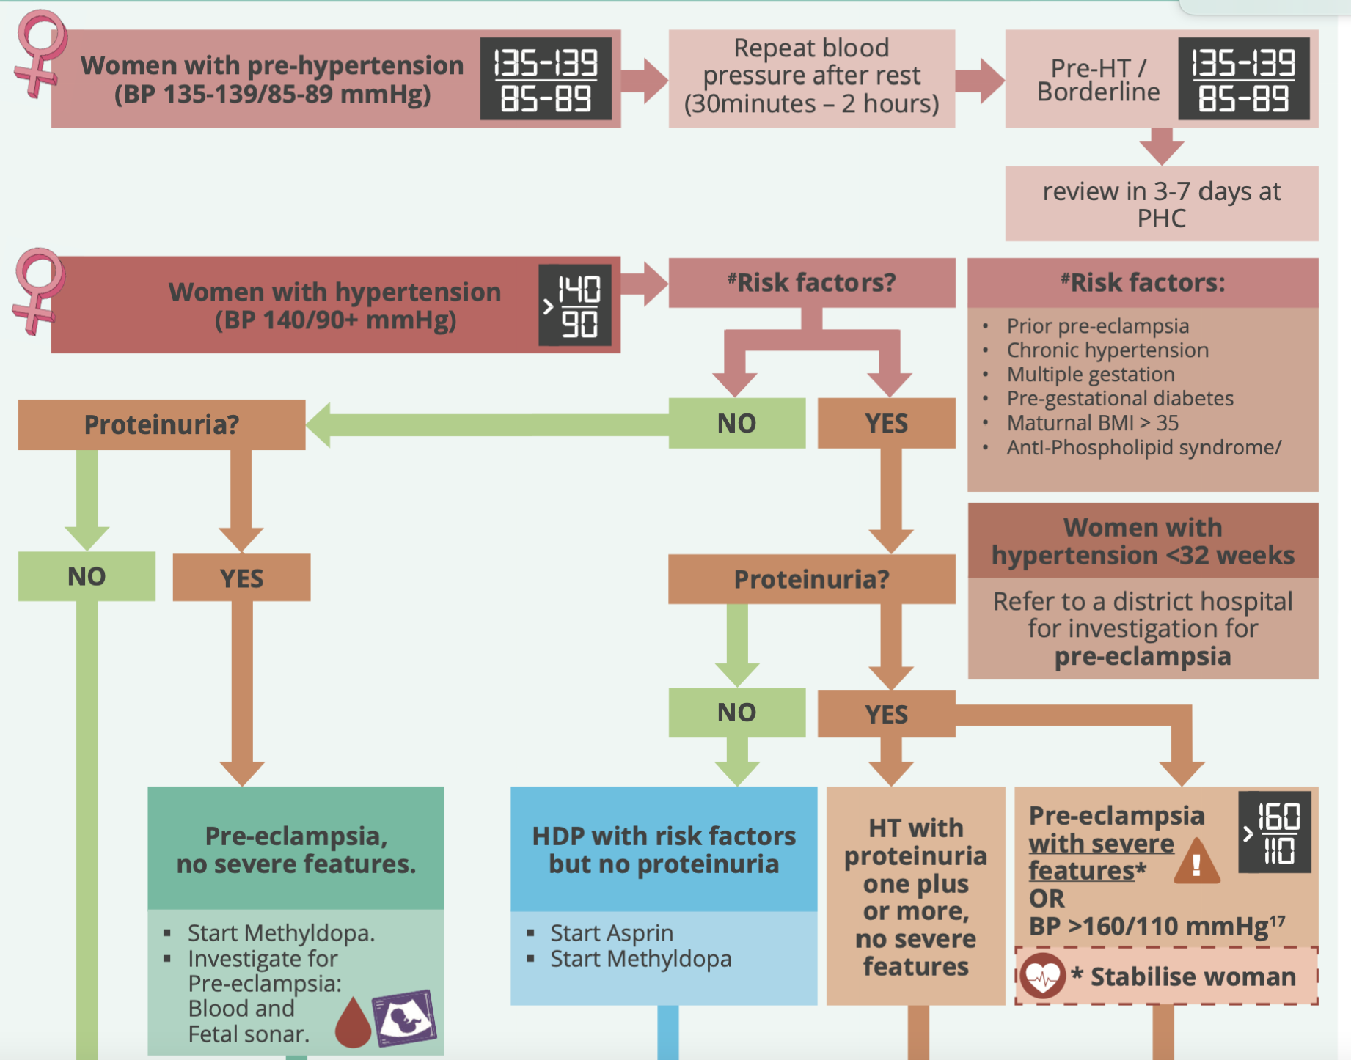
PHC level: initial assessment and management

Slide 14
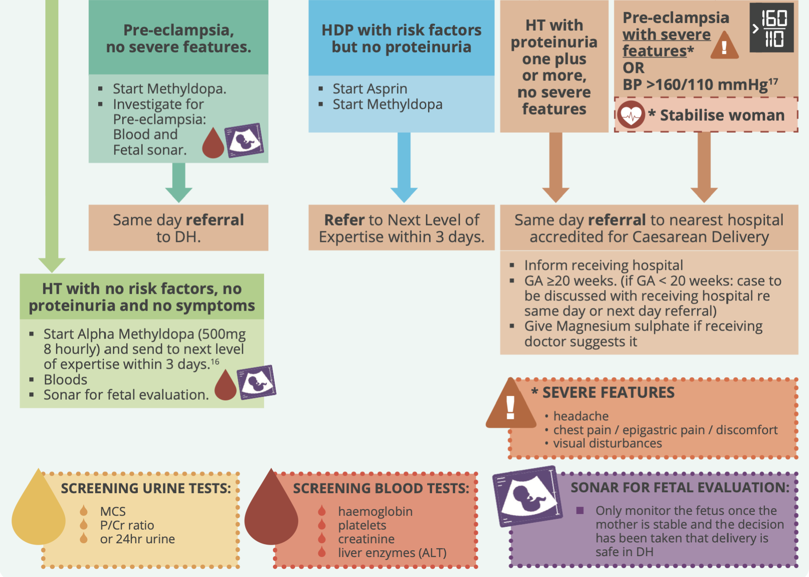

Slide 15
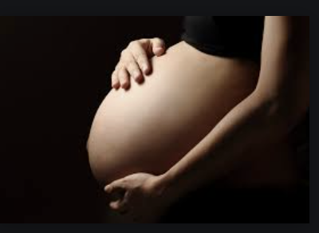
Essential steps in management of hypertensive emergency
Pre-eclampsia
with severe features
Or BP ≥ 160/110,
or eclampsia
Severe features:
Headache
Chest pain/epigastric pain/discomfort
Visual disturbance/scotomas

Slide 16
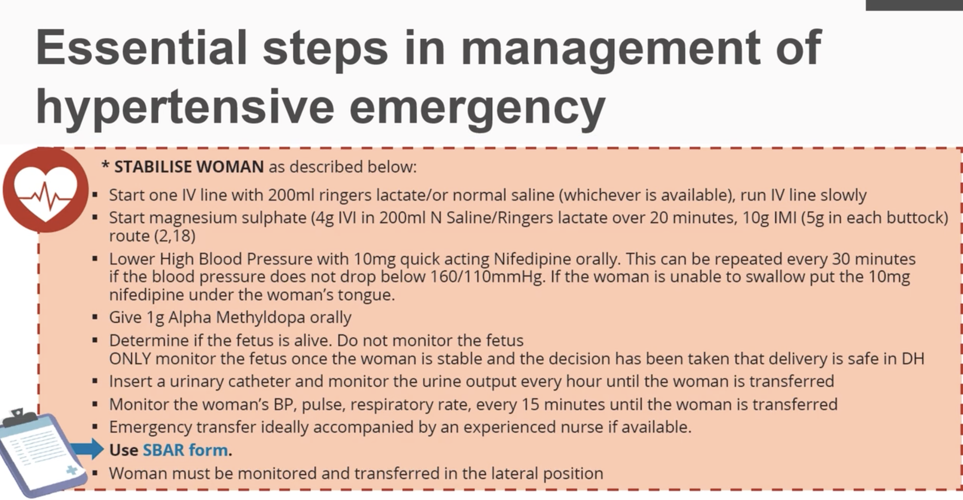
Notes:
History from woman or companion.
Examine fully. Big five. Cardiovascular system, respiratory system, CNS, GIT and Liver and renal system. forgotten 4 – Immune system, endocrine system, musculoskeletal system, and hematological system and core 1 – the uterus and the baby.
Temperature every 4 hours
Accompanied by an experienced midwife If possible

Slide 17
Case 1. Algorithm for HDP at PHC level
A 21-year-old P0G1 female with no medical co-morbidities presents to the antenatal care clinic for her first visit. Her BP = 110/60 mmHg and urine dipstick is normal. Her SFH = 20 cm, which is consistent with her dates. All other investigations are normal. The most appropriate next step is to:
Commence calcium
Commence calcium and iron
Commence calcium, iron and aspirin
Commence iron

Slide 18
Case 2. Algorithm for HDP at PHC level
A 30-year-old P0G1 comes for a first visit visit to primary care. She is HIV negative; BP is 135/86, her SFH is 29cm which is consistent with her dates. HR 88, RR 14 br/min, she has no symptoms, dipstick is normal.
Q. What will you do next?
Refer to next level of expertise
Repeat blood pressure in 2-hours
Start her on aspirin
Start her on alpha methyldopa

Slide 19
Case 2. Algorithm for HDP at PHC level
Repeat blood pressure is 136/86.
What is the next appropriate step?

Slide 20
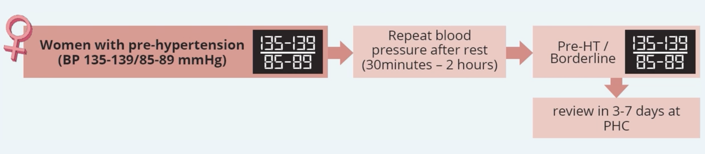
Borderline hypertension
The patients repeat blood pressure was 136/86mmHg. She was asked to come back within the week.

Slide 21
Scenario continued
At 33 weeks:
Her BP is now 150/91mmHg
She is asymptomatic with no proteinuria
Q. What is the most appropriate next step to do?
Start her on alpha methyl dopa and refer immediately
Lower the blood pressure with nifedipine and refer immediately
Start on alpha methyldopa and review in 1 week
Start on alpha methyldopa and refer within 3 days to the NLE

Slide 22
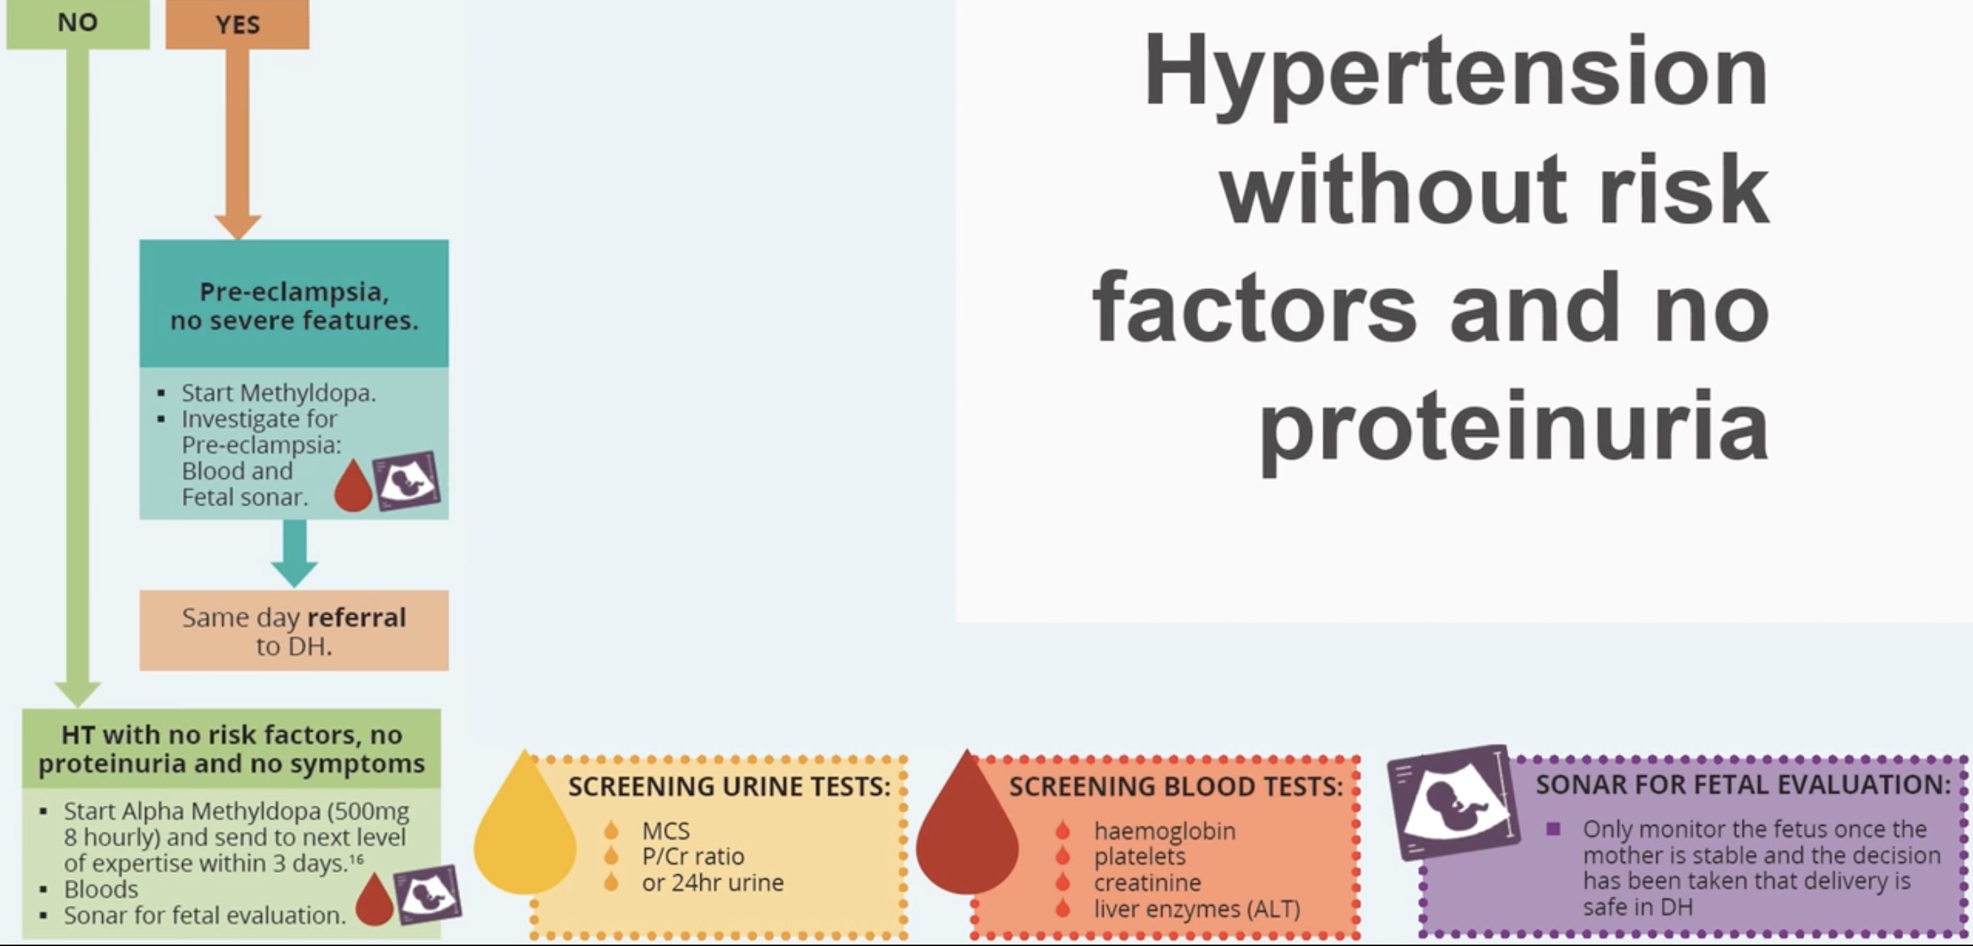
Proteinuria?

Slide 23
Correct answer
Start on alpha methyl dopa and refer within 3 days to NLE

Slide 24
Case 3
A woman comes to PHC complaining of epigastric pain and pedal edema. She is obviously pregnant and unbooked. During the history taking, she has a generalized convulsion. After preventing her from falling,
What is the most appropriate next step?
A. Place her in recovery position
B. Abort the seizure with IVI diazepam
C. Abort the seizure with IVI MgSO₄
D. Secure the airway with an OPA
Notes:
Fits are self limiting and only last 30 to 40 secs. MgSo4 is necessary but comes at a later point.

Slide 25
Mnemonics to remember: Essential steps in managing obstetric emergencies (ESMOE)
Immediate actions
Shake and shout
Call a cab
Big 5, forgotten 4, core 1
Notes:
Shake and shout ; is to assess the neurological condition
Call a cab; circulation airway and breathing
Big 5, 4 and core 1. complete history and examination

Slide 26
Immediate actions
Call for help
Protect the airway and put in recovery position
Extend the neck, suction the airway and insert an OPA if possible, give oxygen by facemask
Assess her circulation - take her blood pressure
Assess her airway- to ensure that it is open
Assess her breathing - listening to her lungs, pulse oximetry

Slide 27
Scenario continued
After your immediate actions you find that:
BP is 190/105mmHg, pulse is 118 and RR is 26bpm.
Q. What is the next best step?
A. IV labetalol
B. Load her with IVI and IM MgSO₄
C. Abort the seizure with IVI diazepam
D. Lower the BP with oral nifedipine

Slide 28
Correct answer
IVI and IM MgSO4

Slide 29
Scenario continued
Patient is postictal but responds to verbal commands. BP is 165/110mmHg, HR Is 111bpm, RR is 24bpm, lungs are clear. No sats monitor in the ANC room. She has 3+ proteinuria with scanty urine. Glucose is 6mol/L. SFH is 35, lie is longitudinal, cephalic presentation, adequate liquor, and FH is 150bpm. She is not in labour.
What is the next most appropriate step?
Oral enalapril
Oral nifedipine
C. IV MgSO4
D. Oral alpha methyldopa

Slide 30
Correct answer
Oral nifedipine

Slide 31
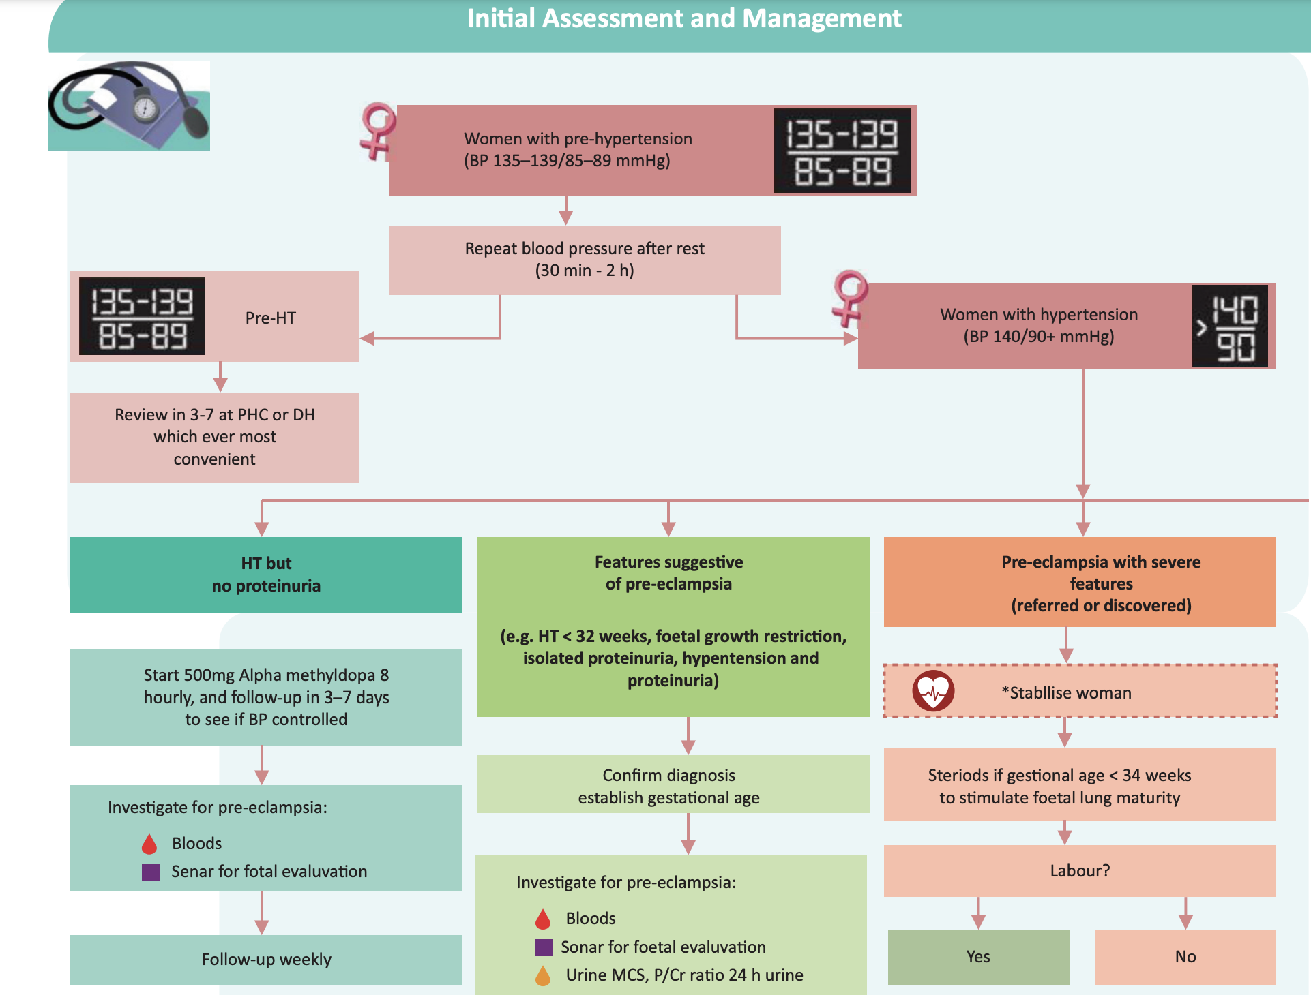
Application at the district hospital level with C/S capability

Slide 32
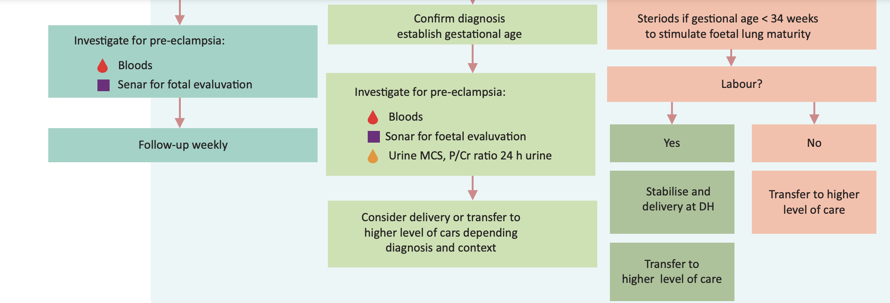
Application at the district hospital level with C/S capability

Slide 33
Case 4: Application at the district hospital level
A 21-year-old G1P0 arrived at your district hospital after being discussed with you. She had been followed up at the clinic, initially with borderline hypertension, and then she developed HPT at 33 weeks gestation and was started on alpha methyldopa 500mg tds.
Her blood pressure was well controlled on alpha-methyldopa till her visit today when it was raised to 150/105mmHg and she developed proteinuria (1+). At 34 weeks, Hb was 13g/dl. Plts 225, creat 65, ALT is normal. Sonar shows normally grown fetus at 36weeks, EFW 2.8kg.

Slide 34
What is the most appropriate next step?
A. Induce labour
B. Refer to a regional hospital
C.Repeat a full history, clinical examination, blood tests and sonar
D. Give corticosteroids

Slide 35
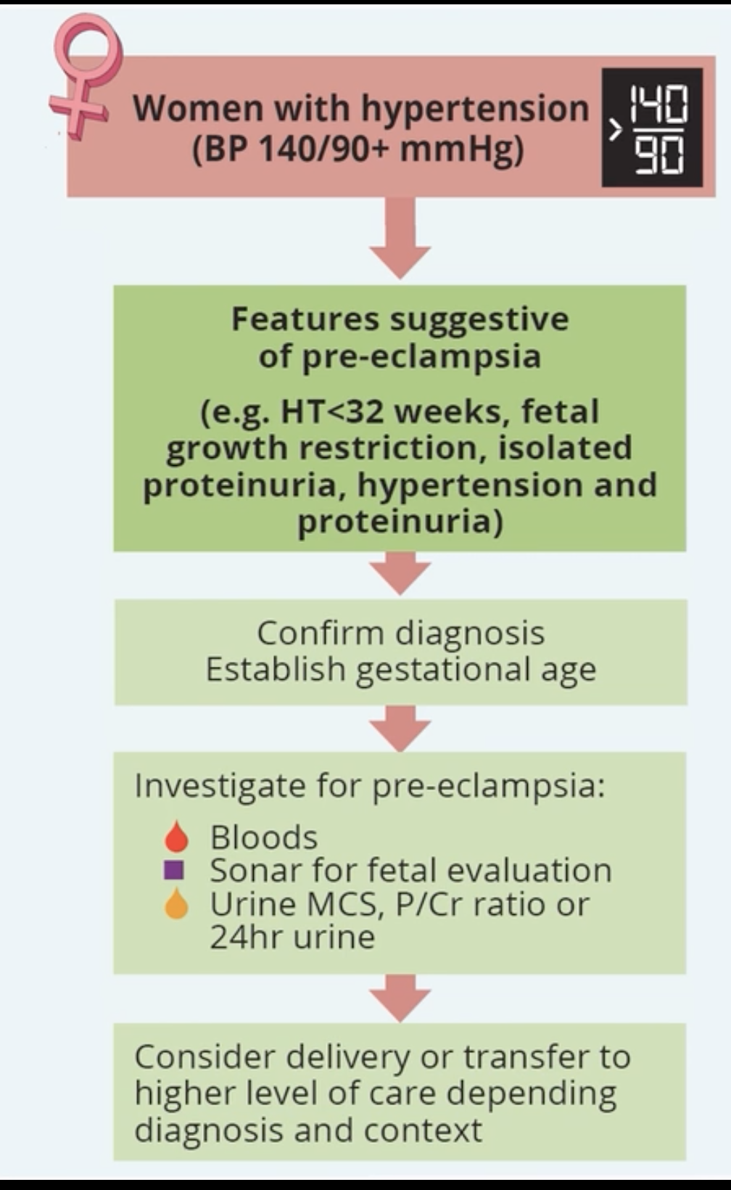
Hypertension and features of pre-eclampsia

Slide 36
Pt scenario continued..
A full history and examination were conducted.
She was awake and alert, had no symptoms. BP 150/100mmHg, pulse 85, RR 18, epigastric tenderness, ALT 100,
Urine 0.6g protein/24 hrs., creat 102, passing over 40mls/hr, Hb is 13g/dl, plts 105, HIV neg, temp 36.8, glucose 5.3mmol/l, pedal edema. SFH measurement 35cm, fetal heart rate 150bpm, longitudinal lie, cephalic presentation and adequate liquor, not in labour.

Slide 37
What is the most likely diagnosis?
pre-eclampsia with no signs or symptoms at 36 weeks gestation
Pre-eclampsia with HELLP syndrome
Eclampsia
Gestational hypertension

Slide 38
Correct answer
Pre-eclampsia with HELLP syndrome

Slide 39
What is your next step?
Induce labour
Refer to a regional or tertiary hospital whichever is closest
Do a cesarean delivery
Give corticosteroids

Slide 40
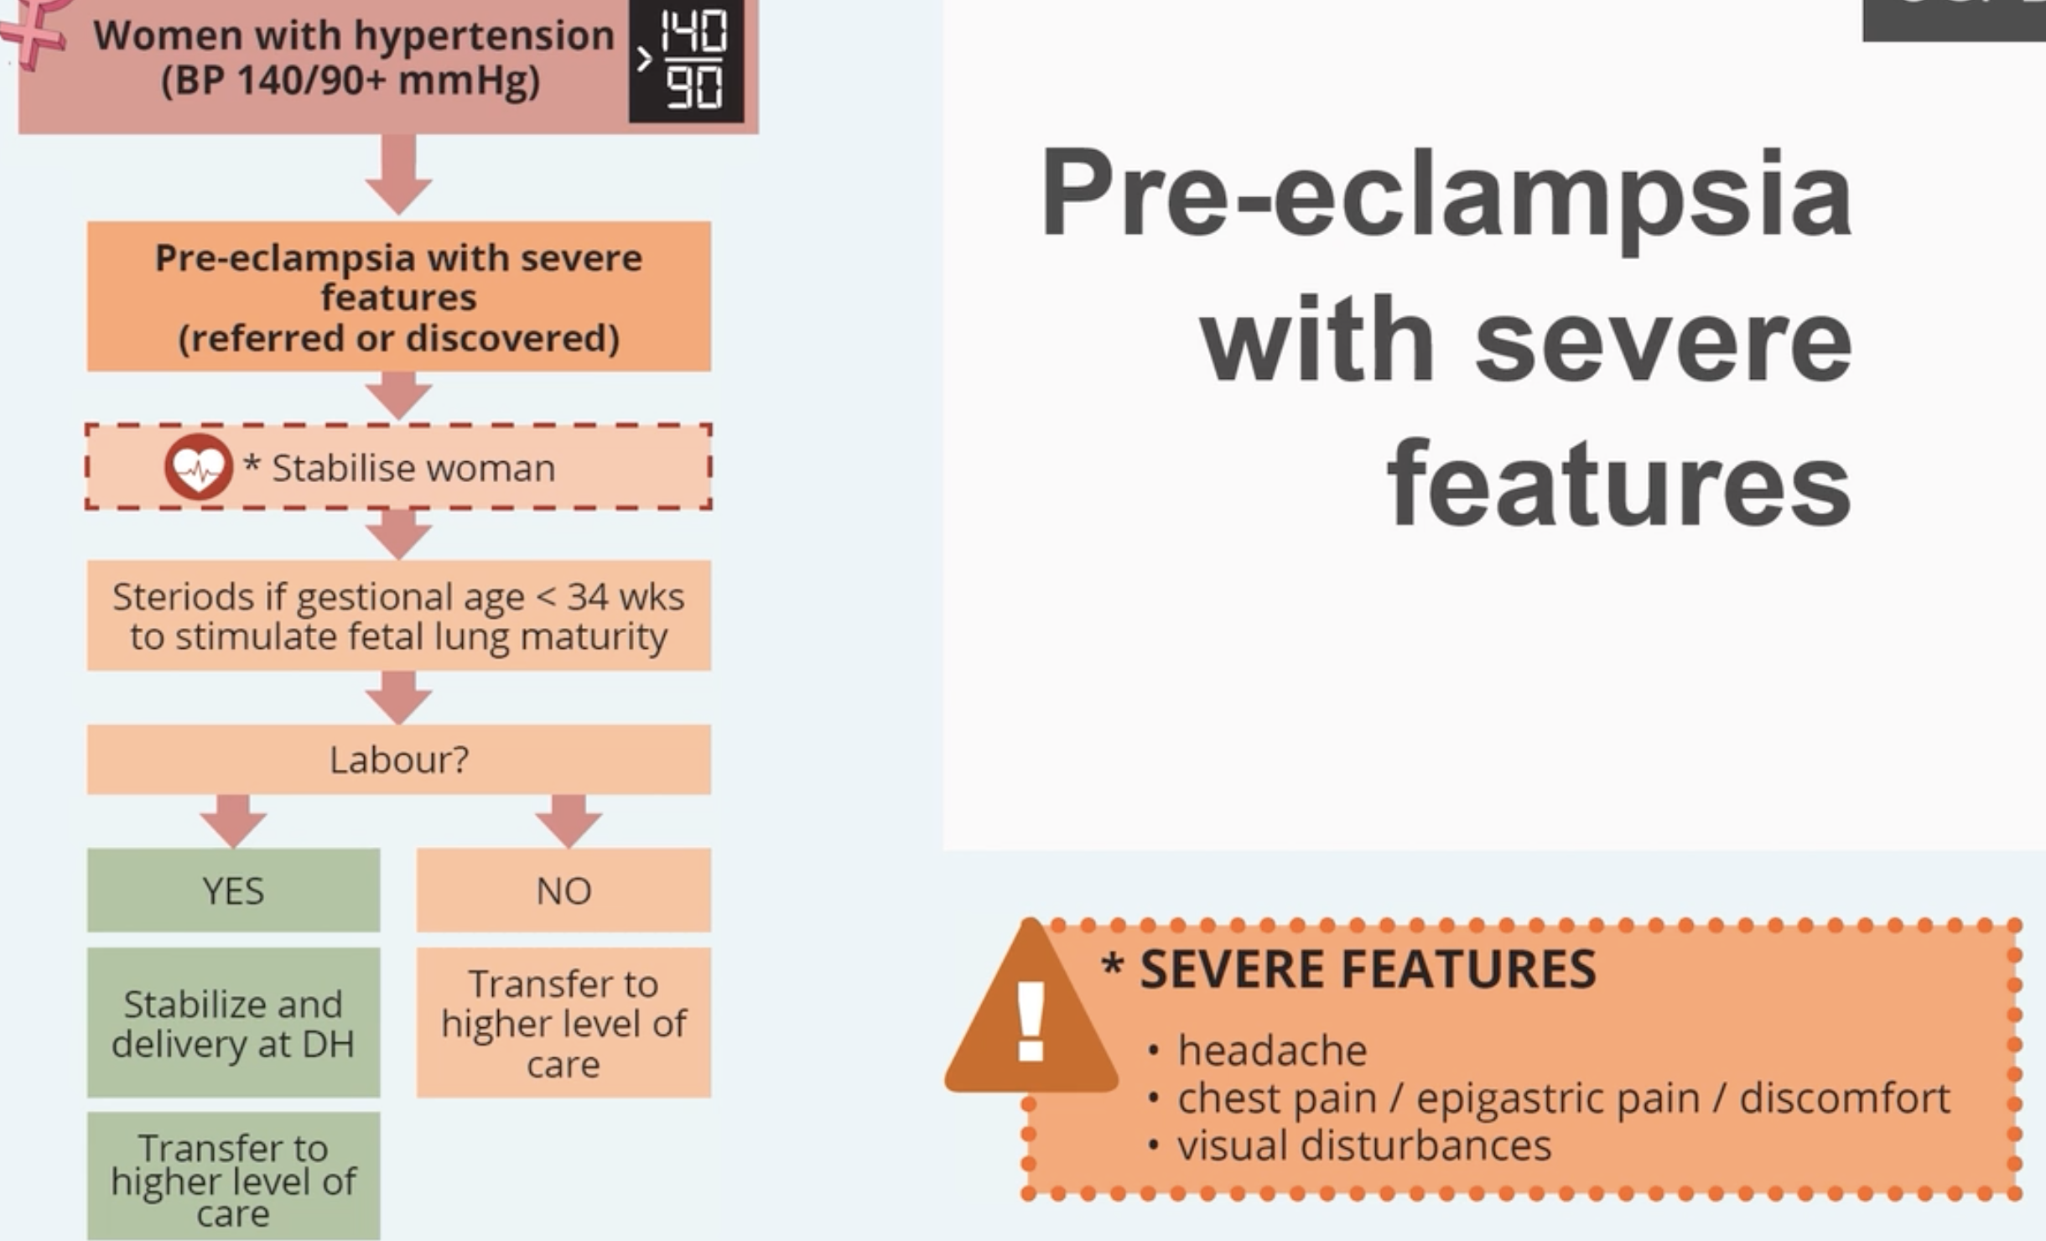

Slide 41
Correct answer
Refer to a regional or tertiary hospital, whichever is closest

Slide 42
Case 4.
A 36-year-old patient, 34 weeks pregnant, presents to the Emergency Centre with a BP = 165/100 mmHg, HR = 130 b/min, RR = 45 br/min. She talks with difficulty. She has widespread crepitations and wheeze and oxygen saturation = 85%. You administer oxygen. The most appropriate next step is to administer:
IVI furosemide
IVI labetalol
IVI MgSO₄
Oral alpha-methyldopa

Slide 43
ESMOE STEPS
Shake and shout.
Call a cab
Big 5, forgotten 4, core 1
Protect airway and place in semi fowlers position

Slide 44
Immediate findings
Talks with difficulty, BP is 167/101mHg, PR 131bpm, RR 35cpm.
She has widespread crepitations, wheezes and her oxygen saturation is 86%. You administer oxygen.
What is the next most appropriate step?
IV furosemide
IV labetalol
Oral alpha-methyl dopa
IVI Mg SO₄

Slide 45
Correct answer
IVI furosemide urgently

Slide 46
Patient scenario continued…
Further history, she is G3P2, her SOB started early morning and has gotten worse, and she has a heavy feeling in her chest. She was diagnosed with hypertension 1 year ago and is well controlled ever since. Has been on low dose calcium and aspirin since she started ANC at 12 weeks.

Slide 47
Examination and side ward investigations
Patient is distressed, but alert. BP=150/105, PR=120bpm, apex beat is in 6th ICS MAL, RR=8bpm, sats 95% on 40% oxygen after IV furosemide. She has 1+ proteinuria. Hb = 10g/dl. Temp =36.5⁰C.
Gluc =6mmol/l. She has edema in both legs
She is not in labor. SFH=32cm, EFW=2kg,longitudinal lie, cephalic presentation, fetal heart rate is 140bpm.
FBC, U and E and LFT are all normal.

Slide 48
What is the next most appropriate step?
Arrange urgent cesarean section at the district hospital
1
Admit and manage the hypertension
2
Refer to a higher level of care
3
Give corticosterods
4

Slide 49

Correct answer
Refer to a higher level of care

Slide 50
Thinking beyond pre-eclampsia
Onset of super imposed pre-eclampsia
Pulmonary embolus
Myocardial infarction
Cardiomyopathy
Pneumonia/TB
Notes:
It is important to think of these differential and exclude because rushing to perform a cesarean section in a woman with pulmonary embolism will most likely kill her.

Slide 51

Thank you

