Slide 1




Modelling the Integration of Pharmacists in Primary Healthcare towards realization of SDG 3
Dr Odhiambo David
Curator, African Pharmaceutical Network (APN)
  Email: africanpharmanetwork@gmail.com

Slide 2
Introduction
“Primary Healthcare (PHC) is a whole-of-society approach to health that aims at ensuring the highest possible level of health and well-being and their equitable distribution by focusing on people’s needs as early as possible along the continuum from;
  health promotion and disease prevention to
  treatment, rehabilitation and palliative care, and
  as close as feasible to people’s everyday environment." WHO and UNICEF. A vision for primary health care in the 21st century: Towards UHC and the SDGs.
Pharmacists are often the first point of contact for most patients with healthcare systems with pharmacies as the most accessible healthcare outlets.
SDG 3 – Good Health and Wellbeing for All.

Slide 3
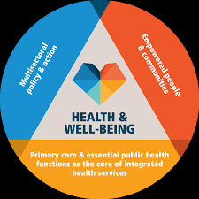
Pharmacists Interventions
  Pharmacists play a critical role in advancing access to quality healthcare services. Some of pharmacists interventions include:
    Health education & awareness creation
    Access to health products & technologies
    Pharmaceutical care: medication therapy monitoring, medicines reconciliation, adherence counseling etc.
    Health programs management
    Pharmacovigilance
    Referral/signposting

Slide 4
Integration of Pharmacists in PHC
  To deliver on pharmacists’ contribution to PHC, pharmacists have to be integrally positioned to deliver on their mandate.
  This can be achieved through the transformation of pharmacy practice centers into primary healthcare units which would entail:
    Establishment of a pharmacy service charter
    Capacity building & up-skilling of pharmacists to deliver on the services
    Community engagement
    Evidence generation & advancement of science
    Financing
    Policy leadership, advocacy and strategic partnerships

Slide 5
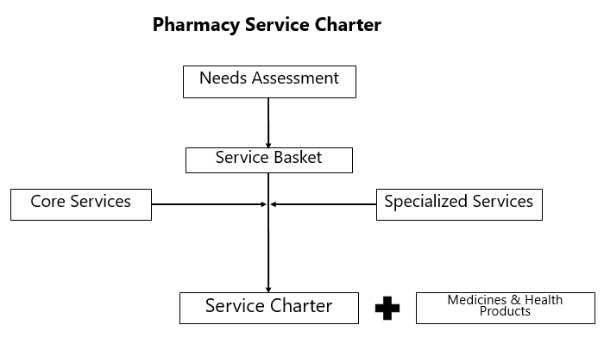
Integration of Pharmacists in PHC

Slide 6
Emerging Areas of Practice
  Some of the areas in which pharmacists can deliver value as key players in primary healthcare include:
    Mental Health – First Aid, Referral Services & Medicine Use
    Sexual & Reproductive Health – Contraceptive Use, Fertility Care, Sexual Health etc.
    Non Communicable Diseases – Diagnostics, Management, Referral/Collaborative Practice etc.
    Neglected Tropical Diseases – Vector Control, Health Communication, Diagnostics, Treatment, Referral services & Follow Up Care.
    Infectious Diseases – IPC, Curative care, Referral services etc.
    Cosmetology & Skin care
    Immunization programs
    Emergency response and preparedness
    Pharmaceutical Supply Chain Management
    *Patient Safety
    *Self Care
  Systems thinking and strategic focus on service delivery for optimal health outcomes is the intended outcome for pharmacists’ integration in primary healthcare (PHC).

Slide 7

Thank You!
  Email: africanpharmanetwork@gmail.com

