Slide 1
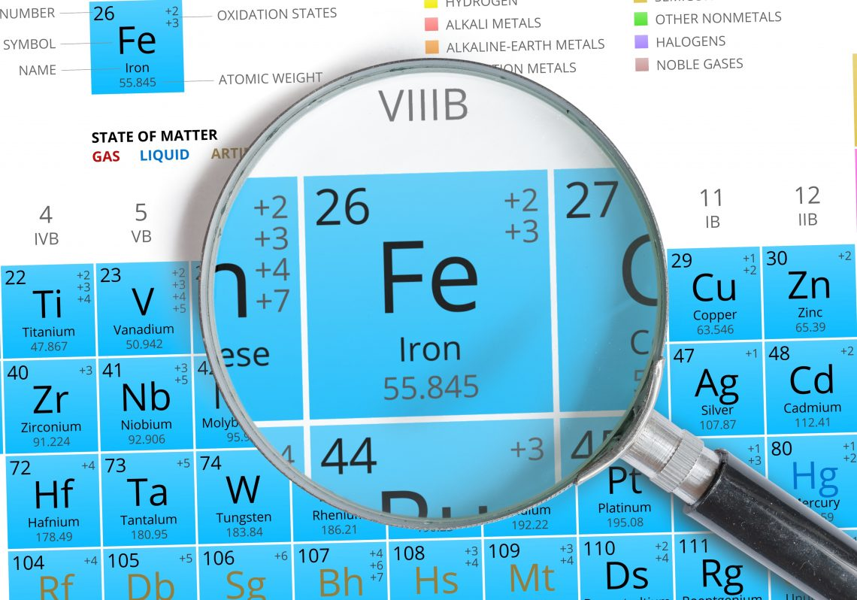
NUTRITIONAL ANEMIAS: a focus on Iron Deficiency
Garrick Laudin
Clinical Haematology
CHBAH: Department of Clinical Haematology
Garrick.laudin@gmail.com

Slide 2
Case 1
Lab Parameter | 14 Feb 2021 | Lab parameter | 14 Feb 2021
WCC x 10⁹/L N = 3.90 - 12.60 | 26.03 (H) | Neutrophils x 10⁹/L N = 1.60 – 6.98 x 10^9/L | 23.74
Red cell count x 10¹²/L N = 3.93 – 5.30 | 3.11 (L) | Lymph x 10⁹/L N =1.40 - 4.2 x 10^9/L | 0.91
Hb (g/dL) N= 11.6 - 16.4 | 5.3 (L) | Monocytes x 10⁹/L N = 0.20 – 0.80 | 1.04
MCV |  | Mentzer index = 20
MCH (pg) N= 26.1 - 33.5 | 17.0 (L) | Mentzer index = 20
MCHC g/dL N = 32.7 - 34.9 | 26.6 (L)
RDW % N = 12.4 - 17.3 | 23.4 (H)
Platelets x 10⁹/L N = 186 - 454 | 434
Retic count x10¹²/L N = 0.050 - 0.100
18-year-old female
History of heavy menstrual bleeding

Slide 3
Case 1
LAB INDICES
Labs | 14 Feb 2021
Vitamin B 12 (pmol/L) N = 145 – 569 | 216
Serum Folate (nmol/l) N= 8.8 - 60.3 | 50.5
Iron N = 9.0 – 30.4 umol/L | 1.6 (L)
Transferrin N = 2.0 – 3.6 g/L | 4.95
% Sat N = 15 – 50 % | 1
Ferritin (ug/L) N = 13 - 150 | 7

Slide 4
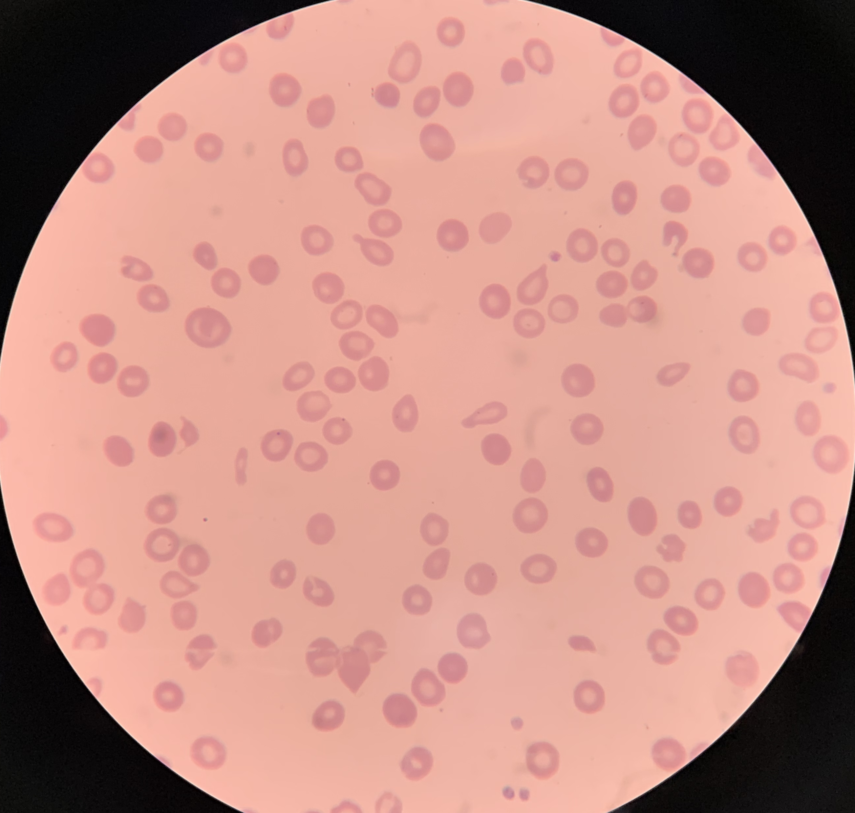
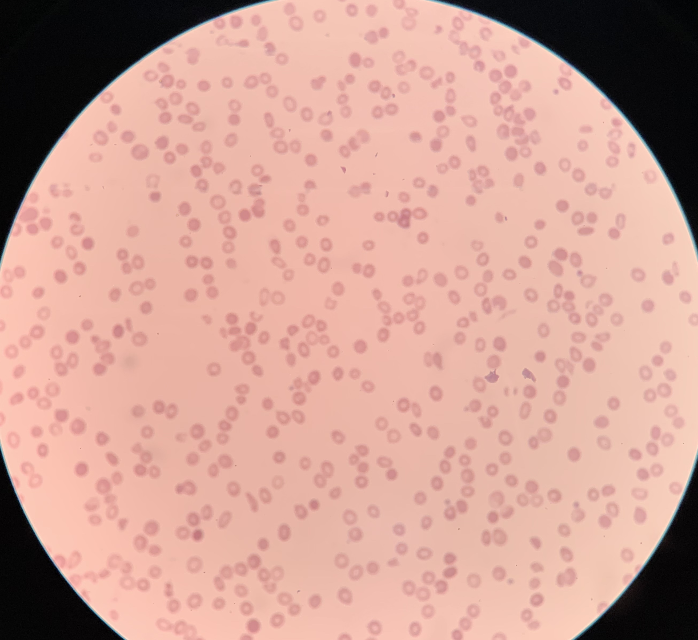
Peripheral blood morphology
Images from National Health Laboratory (NHLS)

Slide 5
Case 2
Lab Parameter | 16 April 2021 | Lab parameter | !6 April 2021
WCC x 10⁹/L N = 3.90 - 12.60 | 6.14 | Neutrophils x 10⁹/L N = 1.60 – 6.98 x 10^9/L | 3.75
Red cell count x 10¹²/L N = 3.93 – 5.30 | 1.09 | Lymph x 10⁹/L N =1.40 - 4.2 x 10^9/L | 2.21
Hb (g/dL) N= 11.6 - 16.4 | 2.7 | Monocytes x 10⁹/L N = 0.20 – 0.80 | 0.061
MCV (fL) N = 80 – 100 | 78.9 | Mentzer index = 72
MCH (pg) N= 26.1 - 33.5 |  | Mentzer index = 20
MCHC g/dL N = 32.7 - 34.9 | 26.7
RDW % N = 12.4 - 17.3 | 23.6
Platelets x 10⁹/L N = 186 – 454 | 58
RPI | 0.2
40-year-RVD (on ART (TDF/3TC/Dolutegravir)
CD4 of 763 cells/uL and an HIV viral load of 27 RNA copies/mL)
Severe symptomatic anaemia & found to have a bicytopenia.
No lymphadenopathy or hepatosplenomegaly, and there is no overt
source of blood loss clinically.

Slide 6
Case 1
LAB INDICES
Labs | 16 April 2021
Vitamin B 12 (pmol/L) N = 145 – 569 | 184
Serum Folate (nmol/l) N= 8.8 - 60.3 | 33.8
Iron N = 9.0 – 30.4 umol/L | 2.1
Transferrin N = 2.0 – 3.6 g/L | 2.69
% Sat N = 15 – 50 % | 12
Ferritin (ug/L) N = 13 - 150 | 7

Slide 7
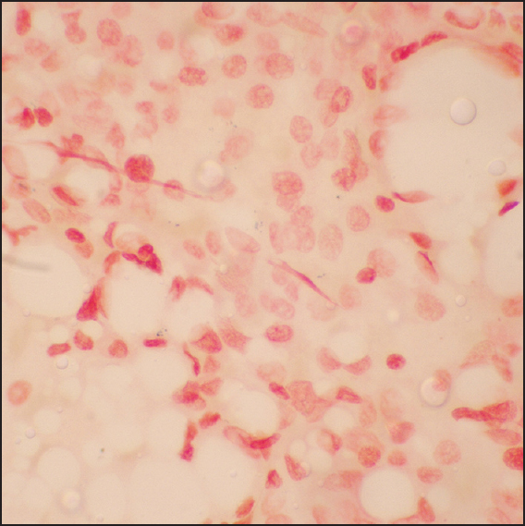
Trephine
Perls/Prussian Blue: absent iron stores
Study of sideroblasts and iron stores in bone marrow aspirates using Perls' stain
Dharwadkar Arpana, Vimal Shruti, Panicker Narayanan Krishnakutty, Chandanwale Shirish S, Viswanathan Vidya, Kumar Harsh

Slide 8
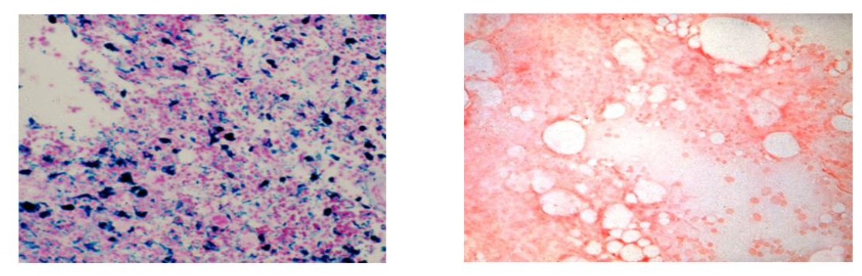
Normal trephine: iron stains
BMA
Perls/Prussian Blue
Images from: ASH Lecture Series 2021

Slide 9
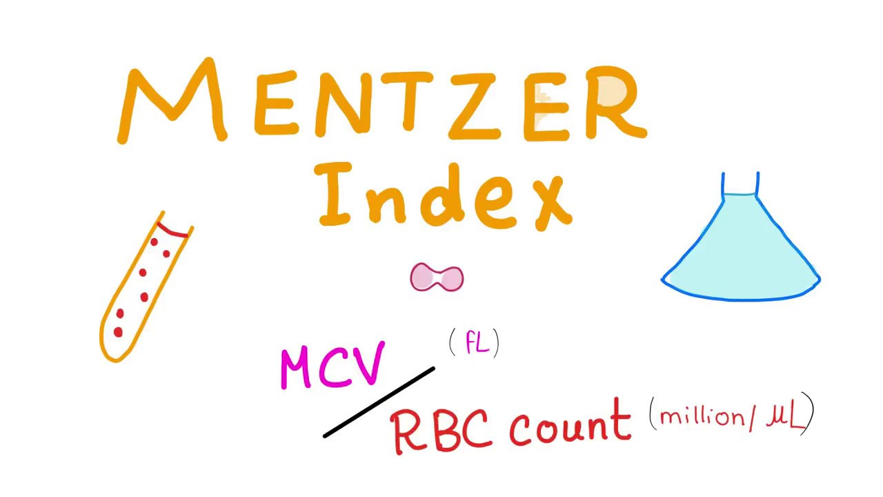
Differential for microcytosis
★TAILS-13★
THALASSEMIA
ANEMIA OF CHRONIC DISEASE
infection, malignancy, inflammatory disorders
IRON DEFICIENCY
LEAD POISONING
SIDEROBLASTIC
< 13 = THAL
> 13 = IDA
Hui, D., Leung, A. K. C., Padwal, R., & Ma, C. (2016). Approach to internal medicine: A resource book for clinical practice.

Slide 10
Iron deficiency

Slide 11
The role of iron
Essential nutrient for all living organisms.
  Reversible binding of O2: hemoglobin, myoglobin
  Enzyme systems:
    heme (cytochromes, catalase, glutathione peroxidase, NO synthase)
    non-heme (ribonucleotide reductase, aconitase)
  Immunity: free radicals to destroy microbes
World Health Organization

Slide 12
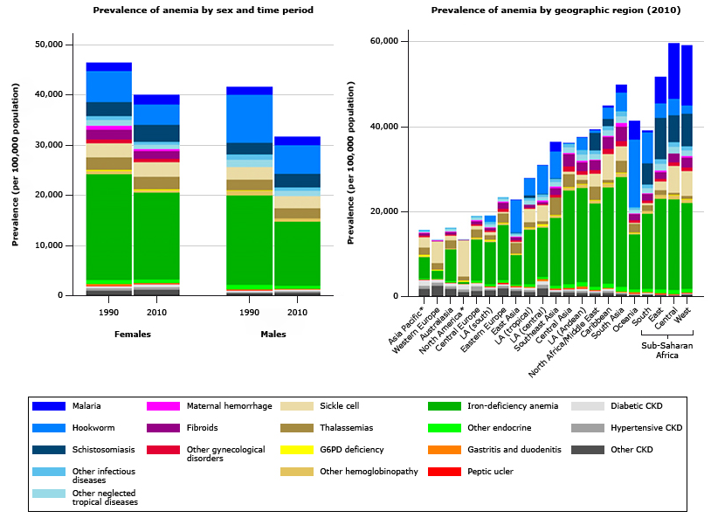
Global burden of disease (prevalence)
Anaemia in Africa
Iron deficiency
Males + females – parasitic infections (hookworm)
Females – maternal hemorrhage
Malaria
South and East Asia
- More than ½ world’s anaemia cases
Auerbach M. Causes and diagnosis of iron deficiency and iron deficiency anemia in adults. UpToDate (2021)

Slide 13
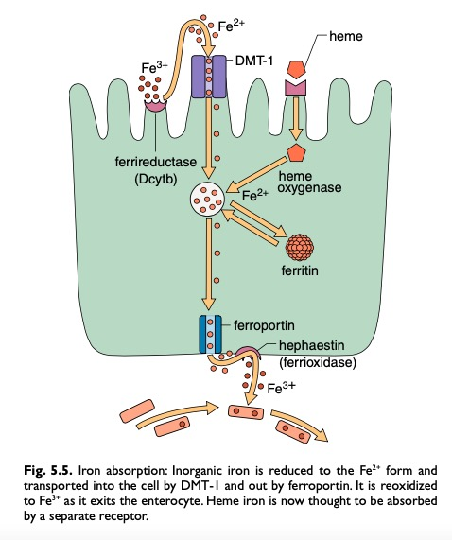
Iron absorption
DMT-1 and Ferroportin upregulated by
hypoxia-inducible factor 2-alpha
Hoffbrand, A. V., & Pettit, J. E. (2001). Color atlas of clinical hematology. London: Mosby.

Slide 14
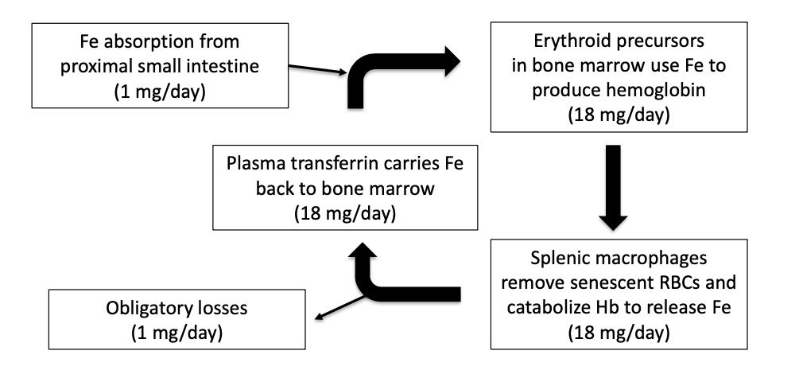
Cycling of iron
Iron: Hb, myoglobin, enzymes
Storage: liver, spleen, marrow
Take home message: no clear way to excrete iron therefore tight haemostatic controls exist to regulate iron absorption, recycling, and storage
Auerbach M. Causes and diagnosis of iron deficiency and iron deficiency anemia in adults. UpToDate (2021)
(2) ASH Lecture series (2021)
Shuoyan Ning, Michelle P. Zeller; Management of iron deficiency. Hematology Am Soc Hematol Educ Program 2019; 2019 (1): 315–322. doi: https://doi.org/10.1182/hematology.2019000034

Slide 15
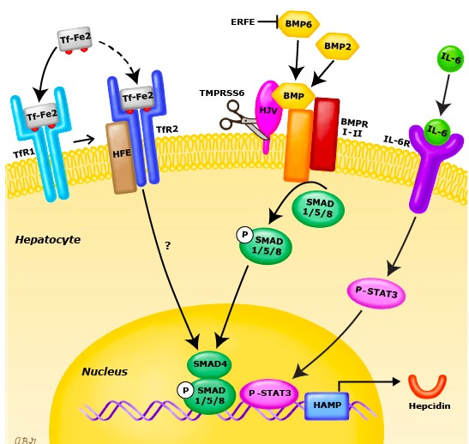
Hepcidin: master regulator
Hepcidin
– Binds ferroportin on enterocytes and macrophages and decreases iron export to plasma
– Expression stimulated by INCREASED Fe and inflammation
– Expression suppressed by INCREASED erythropoiesis
Up-regulation of hepcidin
– HFE, TfR2, Hemojuvelin, BMP6, BMPR, SMAD4
– IL-6
Down-regulation of hepcidin
– TMPRSS6 (matriptase-2)
– Erythroblast-derived: erythroferrone, GDF- 15, GDF-11
Auerbach M. Causes and diagnosis of iron deficiency and iron deficiency anemia in adults. UpToDate (2021) & (2) ASH Lecture series (2021)

Slide 16
Approach to iron-deficiency anaemia (IDA)
Identification
Investigation
Iron repletion
I³ Approach
Shuoyan Ning, Michelle P. Zeller; Management of iron deficiency. Hematology Am Soc Hematol Educ Program 2019; 2019 (1): 315–322. doi: https://doi.org/10.1182/hematology.2019000034

Slide 17

Sequence of events in iron deficiency
Depletion of iron stores
Iron deficient erythropoiesis
Iron Deficiency Anaemia
Tissue effects of iron deficiency
Normal Hb, Ferritin low
MCV/MCH normal, Ferritin <15 ug/L
Low MCV, MCH
Epithelial changes, other
Hoffbrand, A. V., & Pettit, J. E. (2001). Color atlas of clinical hematology. London: Mosby.

Slide 18
Identification

Slide 19
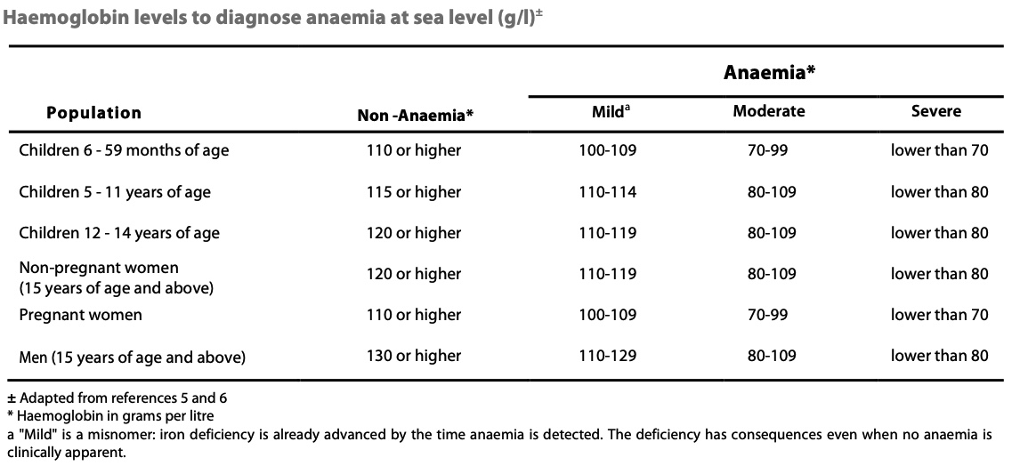
World Health Organization: Grading of severity of anaemia
World Health Organization

Slide 20
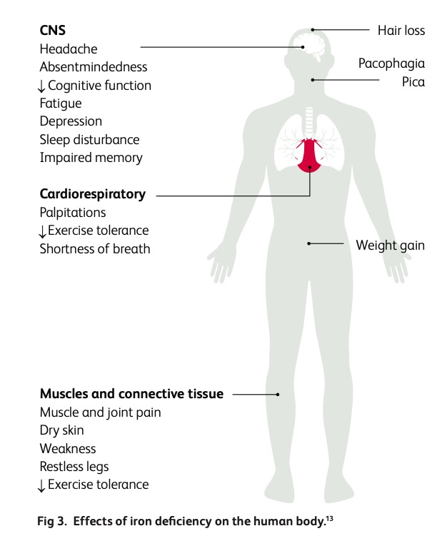
Symptoms of iron deficiency anaemia
Al-Naseem A, Sallam A, Choudhury S, Thachil J. Iron deficiency without anaemia: a diagnosis that matters. Clin Med (Lond). 2021;21(2):107-113. doi:10.7861/clinmed.2020-0582)

Slide 21
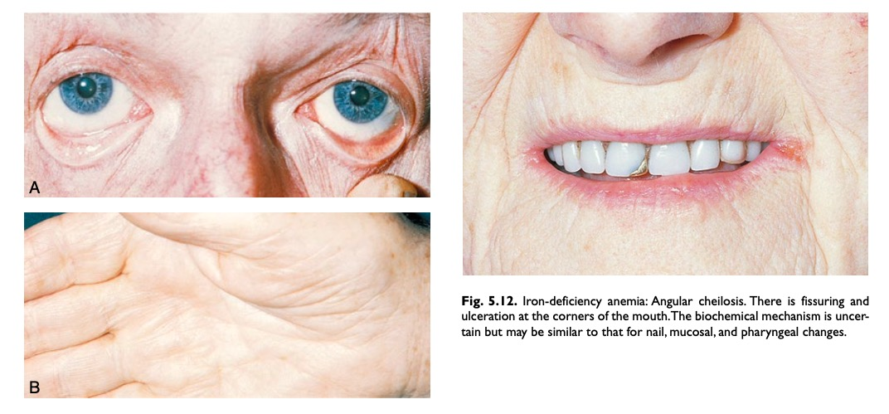
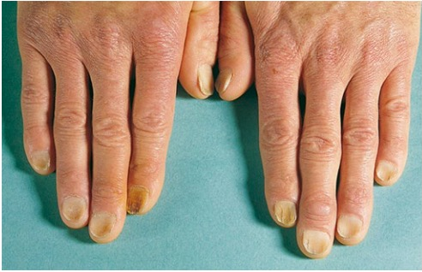
Signs of iron deficiency anaemia
Hoffbrand, A. V., & Pettit, J. E. (2001). Color atlas of clinical hematology. London: Mosby.

Slide 22
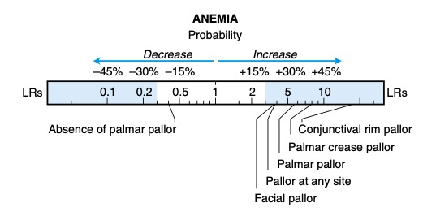
Signs of iron deficiency anaemia
Hoffbrand, A. V., & Pettit, J. E. (2001). Color atlas of clinical hematology. London: Mosby and McGee, S. R. (2018). Evidence-based physical diagnosis.

Slide 23
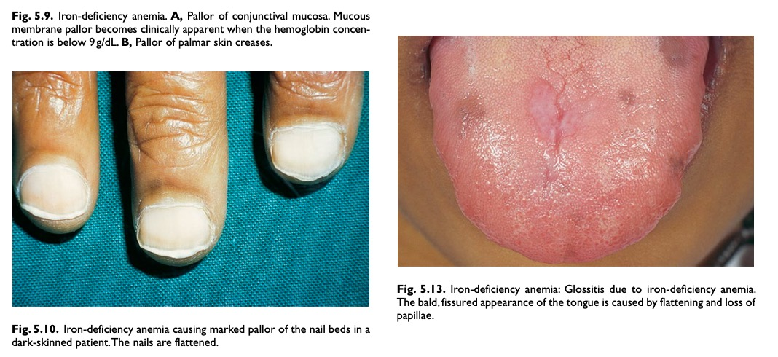
Signs of iron deficiency anaemia
Hoffbrand, A. V., & Pettit, J. E. (2001). Color atlas of clinical hematology. London: Mosby.

Slide 24
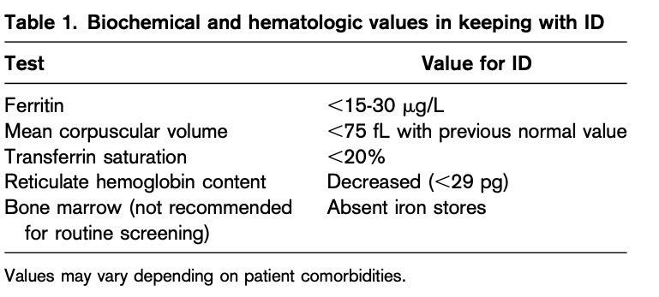
Laboratory values in defining iron deficiency
NOTE:
(1) A threshold of ferritin <30 mg/L achieves a higher sensitivity (92%) while maintaining a high 98% specificity for the diagnosis
(2) An earlier marker of ID is the reticulated hemoglobin content
Pasricha, S.-R., Tye-Din, J., Muckenthaler, M. U., & Swinkels, D. W. (2020). Iron deficiency. The Lancet. doi:10.1016/s0140-6736(20)32594-0

Slide 25
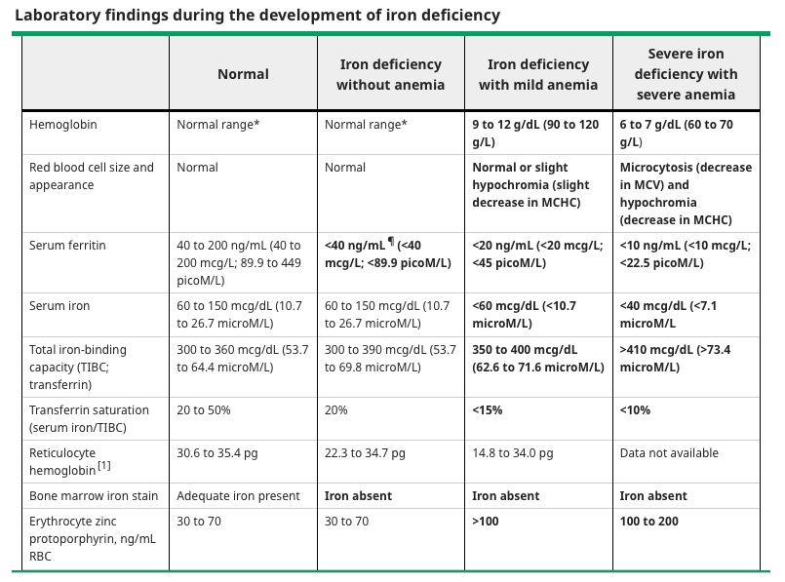
Sequence of events in iron deficiency
Auerbach M. Causes and diagnosis of iron deficiency and iron deficiency anemia in adults. UpToDate (2021

Slide 26
Anemia of chronic disease/inflammation with concomitant Iron deficiency
The diagnosis of ID becomes more challenging with concomitant inflammatory conditions and in the elderly because ferritin is an acute-phase reactant that increases with age
Chronic condition | Ferritin value (ug/L) | TSAT (%)
Inflammation | <100 ug/L | <20%
Heart failure | <100 ug/L OR <300ug.L | / <20%
Pre-operative setting | <100 ug/L | <20%
CKD (KDIGO) | < 500 ug/L
CKD on dialysis | <200 ug/L | <20%
Shuoyan Ning, Michelle P. Zeller; Management of iron deficiency. Hematology Am Soc Hematol Educ Program 2019; 2019 (1): 315–322. doi: https://doi.org/10.1182/hematology.2019000034

Slide 27
Investigation

Slide 28
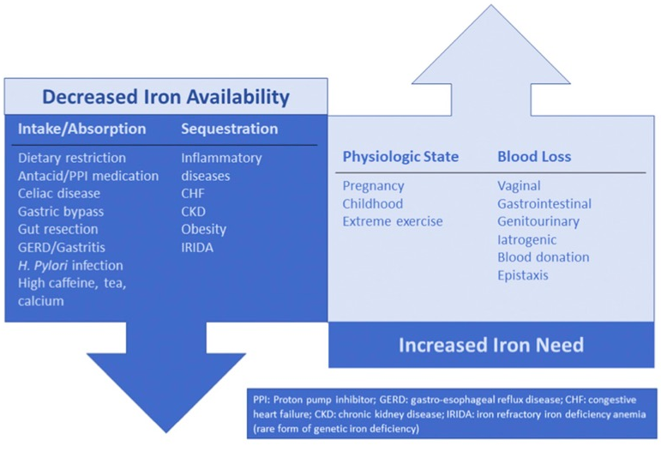
Causes of iron deficiency
Shuoyan Ning, Michelle P. Zeller; Management of iron deficiency. Hematology Am Soc Hematol Educ Program 2019; 2019 (1): 315–322. doi: https://doi.org/10.1182/hematology.2019000034

Slide 29
Causes of iron deficiency
“Chronic stuff”
Auto-immune gastritis: gastrin levels & anti-parietal cell Ab; Coeliac: anti-endomyseal Ab; H.pylori: (Ab+/Urease breathe test)
GI: decreased absorption (PPI), gluten-induced enteropathy, auto-immune atrophic gastritis, H. pylori
Genetic: IRIDA
“Water water everywhere and not a drop to drink”
CKD
Chronic Heart Failure
Chronic infections
Malignancy
Inflammation
Infants, adolescent & pre-school
Pregnancy: 2nd & 3rd trimester
ESA Rx
Need more!
Urinary loss (intravascular hemolysis)
GIT Loss
GU Loss
Hemodialysis
Blood donation
Malnutrition
Diet: vegetarianism and veganism
IN
OUT > IN
Adapted from: (1) Clara Camaschella; Iron deficiency. Blood 2019; 133 (1): 30–39. doi: https://doi.org/10.1182/blood-2018-05-815944; (2) ASH Review Series (2021)

Slide 30
Iron repletion

Slide 31
Blood transfusions
RBC transfusion for severe IDA should be restricted for cardiovascular compromise and/or debilitating symptoms
Shuoyan Ning, Michelle P. Zeller; Management of iron deficiency. Hematology Am Soc Hematol Educ Program 2019; 2019 (1): 315–322. doi: https://doi.org/10.1182/hematology.2019000034

Slide 32
Oral iron formulations
Oral iron generally preferred (iron salts)
Treatment duration depends on (1) ongoing loss, (2) iron deficit
Typical duration of treatment is 6 weeks to 6 months
Dosing three times a week: Monday, Wed, Friday (or simply alternate day dosing)
Auerbach M. Causes and diagnosis of iron deficiency and iron deficiency anemia in adults. UpToDate (2021)

Slide 33
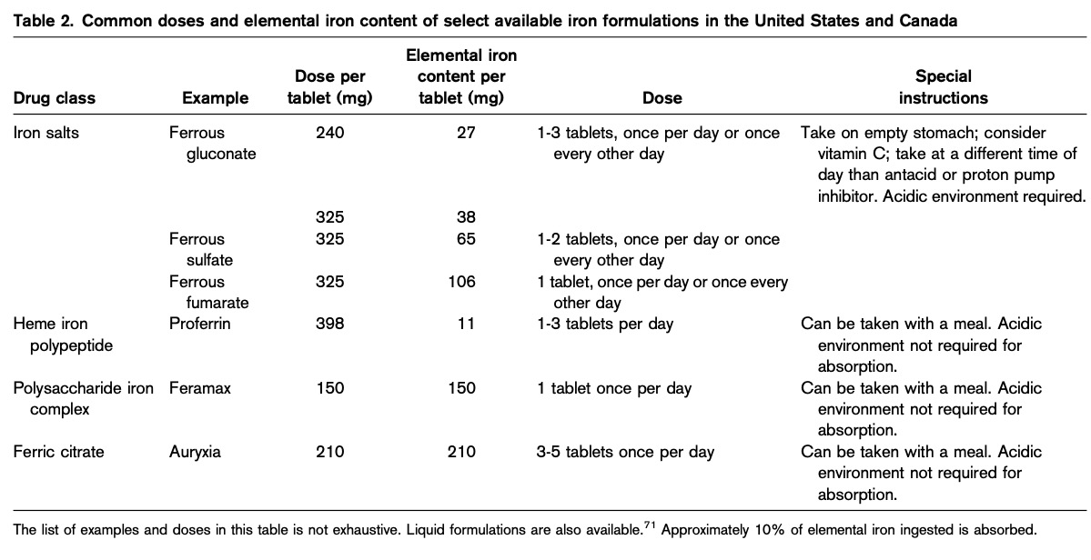
Oral iron formulations
ASH Review Series 2020

Slide 34
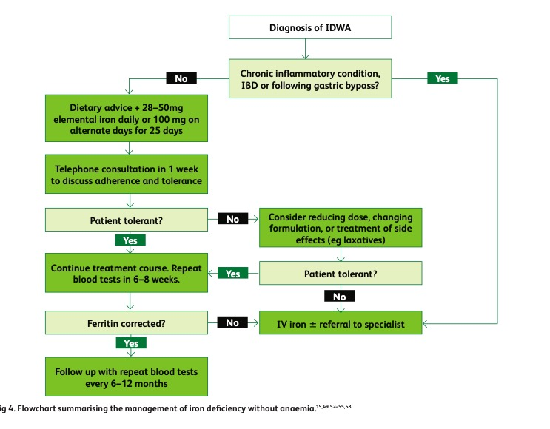
Iron deficiency without anaemia
Al-Naseem A, Sallam A, Choudhury S, Thachil J. Iron deficiency without anaemia: a diagnosis that matters. Clin Med (Lond). 2021;21(2):107-113. doi:10.7861/clinmed.2020-0582

Slide 35
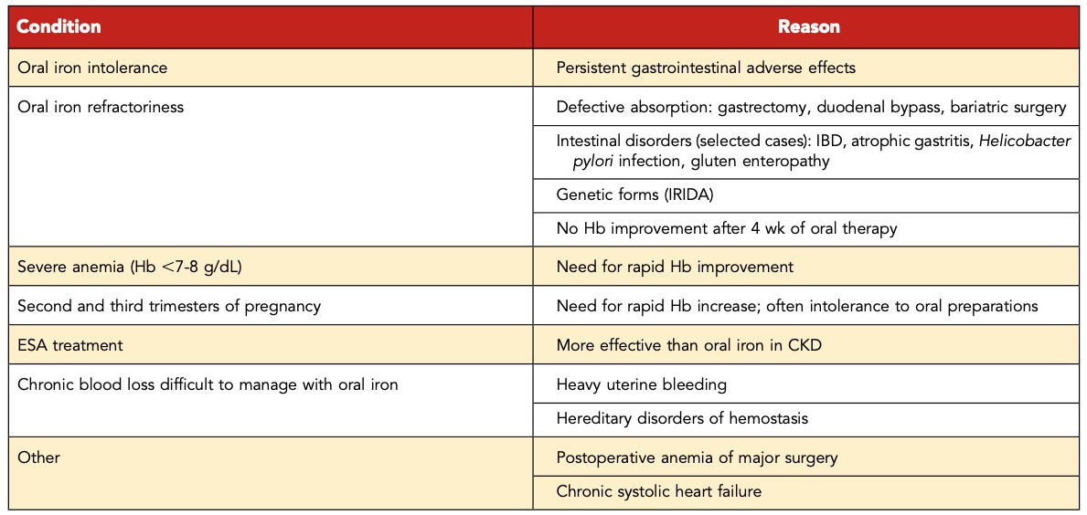
Intravenous iron
Clara Camaschella; Iron deficiency. Blood 2019; 133 (1): 30–39. doi: https://doi.org/10.1182/blood-2018-05-815944

Slide 36
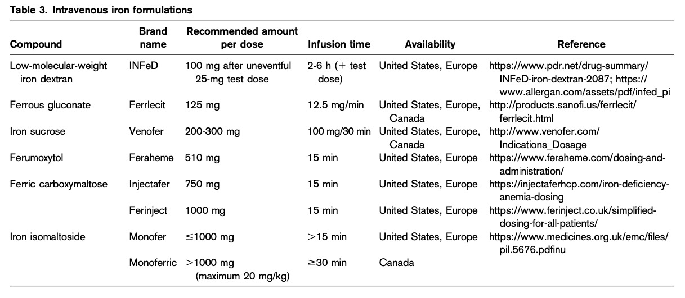
Intravenous iron
NOTE:
There is no evidence that total doses above 1000 mg of elemental iron are clinically useful (FIRM trial)
Delay IV iron administration in patients with active infection until the infection is resolved
Auerbach M. Treatment of Iron deficiency in Adults. UpToDate (2021)

Slide 37
Monitoring response to iron supplementation
Haemoglobin concentration will rise slowly:
Rise begins approximately one to two weeks of treatment
Hb will rise approximately 2 g/dL over the ensuing three weeks
Haemoglobin deficit should be halved by approximately one month & the haemoglobin level should return to normal by six to eight weeks
Intravenous iron supplementation
Patients are seen four to eight weeks after the iron has been administered.
Disappearance of symptoms & signs of tissue alteration
Pica symptoms resolve
Tongue papillation returns
Restless leg syndrome (assoc with IDA) resolves within 72 hrs of iron replacement
Auerbach M. Causes and diagnosis of iron deficiency and iron deficiency anemia in adults. UpToDate (2021)

Slide 38
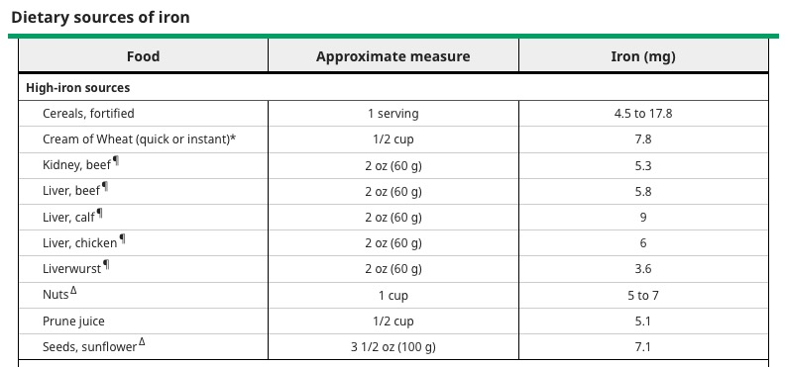
Food source with high iron content
Auerbach M. Causes and diagnosis of iron deficiency and iron deficiency anemia in adults. UpToDate (2021)

Slide 39
Troubleshooting: failure to respond to therapy
Address S/E of oral iron: consider dose change, change formulation (tab → liquid), admin with milk, stool softener
Compliance
Absorption
Co-existing disease
Ongoing Loss
Re-evaluate diagnosis
Consider alternative diagnoses e.g. coeliac disease
HHT
Enteric coated tablet
Administered with meds/food decreasing absorption: PPI, antacid, tea
Rapid intestinal transport
Inflammation
Auerbach, M. Causes and diagnosis of iron deficiency and iron deficiency anaemia in adults. UpToDate (2021)

Slide 40
References
UpToDate
Postgraduate Haematology
ASH Image Bank
Centre of Clinical Haematology: https://cfch.com.sg/bone-marrow-aspiration-2/
Hoffbrand, A. V., & Pettit, J. E. (2001). Color atlas of clinical hematology. London: Mosby.
Hoffbrand, AV. Postgraduate Haematology.
Shuoyan Ning, Michelle P. Zeller; Management of iron deficiency. Hematology Am Soc Hematol Educ Program 2019; 2019 (1): 315–322. doi: https://doi.org/10.1182/hematology.2019000034
Auerbach, M. Causes and diagnosis of iron deficiency and iron deficiency anemia in adults. UpToDate (2021)
Pasricha, S.-R., Tye-Din, J., Muckenthaler, M. U., & Swinkels, D. W. (2020). Iron deficiency. The Lancet. doi:10.1016/s0140-6736(20)32594-0
Auerbach M. Causes and diagnosis of iron deficiency and iron deficiency anemia in adults. UpToDate (2021)
Hui, D., Leung, A. K. C., Padwal, R., & Ma, C. (2016). Approach to internal medicine: A resource book for clinical practice.
McGee, S. R. (2018). Evidence-based physical diagnosis.
Al-Naseem A, Sallam A, Choudhury S, Thachil J. Iron deficiency without anaemia: a diagnosis that matters. Clin Med (Lond). 2021;21(2):107-113. doi:10.7861/clinmed.2020-0582

