Slide 1

Research Meeting
Literature Review + Introduction
Prof. S. Moosa
7th June 2022

Slide 2
Agenda
Conducting a literature review and writing an introduction
Reports on APCC / eHealth Study

Slide 3
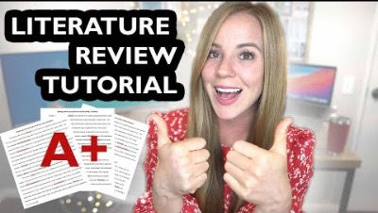
Conducting a literature review (V1)

Slide 4

Conducting a literature review (V1)

Slide 5
Developing a critical voice
https://learningcommons.lib.uoguelph.ca/item/how-integrate-critical-voice-your-literature-review

Slide 6
Additional Points
Google Scholar –library link – write search terms (alts)”*” databases…
Annotated Bibliography - Purpose Method Quants Finding Similarities Uniqueness Hypotheses – Agree/Disagree? Evaluate – Pros/Cons
Organise / Synthesise / Argue! [Not list / summary] Build outline by highlight/copy/code by themes (cut) (refs)] Use short bullets
Not YOUR ideas! → For Discussion [reflections on Results/Lit]
Review aim/objectives? = research question?
Introduction (after) – background / lit [from wide to narrow]
Referencing – Mendeley / Endnote / Zotero /Refworks

Slide 7
Group work
http://peakwriting.com/litreview/Index.html
Step 1: Extract Summaries
Step 2: Reorder Summaries
Step 3: Divide Into Body Paragraphs
Step 4: Shape the Paragraphs
Step 5: Add Introduction & Conclusion

Slide 8
More resources
https://gradcoach.com/how-to-write-a-literature-review/ [v 40m]
https://www.sagepub.com/sites/default/files/upm-binaries/29986_Chapter3.pdf [art]
https://advice.writing.utoronto.ca/types-of-writing/literature-review/
https://libguides.unf.edu/litreview/steps
https://libguides.reading.ac.uk/literaturereview/starting#s-lg-box-11005360
https://www.citewrite.qut.edu.au/write/writing-well/litreview.html
https://libguides.unisa.ac.za/literature_review/process

Slide 9
More resources
https://www.ncbi.nlm.nih.gov/books/NBK481583/ [art]
https://blog.wordvice.com/how-to-write-a-literature-review/ [v12m]
https://guides.lib.uoguelph.ca/c.php?g=130964&p=5000948 [v]
https://www.sciencedirect.com/science/article/pii/S0148296319304564 [art]
https://www.scribbr.com/methodology/literature-review/ ***
https://www.ed.ac.uk/institute-academic-development/study-hub/learning-resources/literature-review#:~:text=A%20literature%20review%20establishes%20familiarity,is%20unknown%20within%20your%20topic. [useful handouts]
http://www.docs.hss.ed.ac.uk/iad/Student_resources/Editing_proofreading/IAD_reverse_outlines_CC_2020.pdf [Reverse Outline]

