Slide 1
AfroPHC Policy Webinar
Supporting Community Health Workers in the African PHC Team
Early review of WHO’s Handbook on Social Participation for UHC
Ravi Ram, PHM/Africa &
Health Workers for All Coalition

Slide 2
OUTLINE
Background on the Handbook
Overview of chapters
Implications for PHC, CHWs and civil society

Slide 3
Background
WHO worked with civil society (SPTN) to develop handbook
Step forward for WHO & CS
New ‘baseline’
Strengthens technical guidance on social accountability for health

Slide 4
Background
UHC ≠ PHC
Focus on government and policy-makers, not health workforce
Still provides an accountability basis within the health system

Slide 5




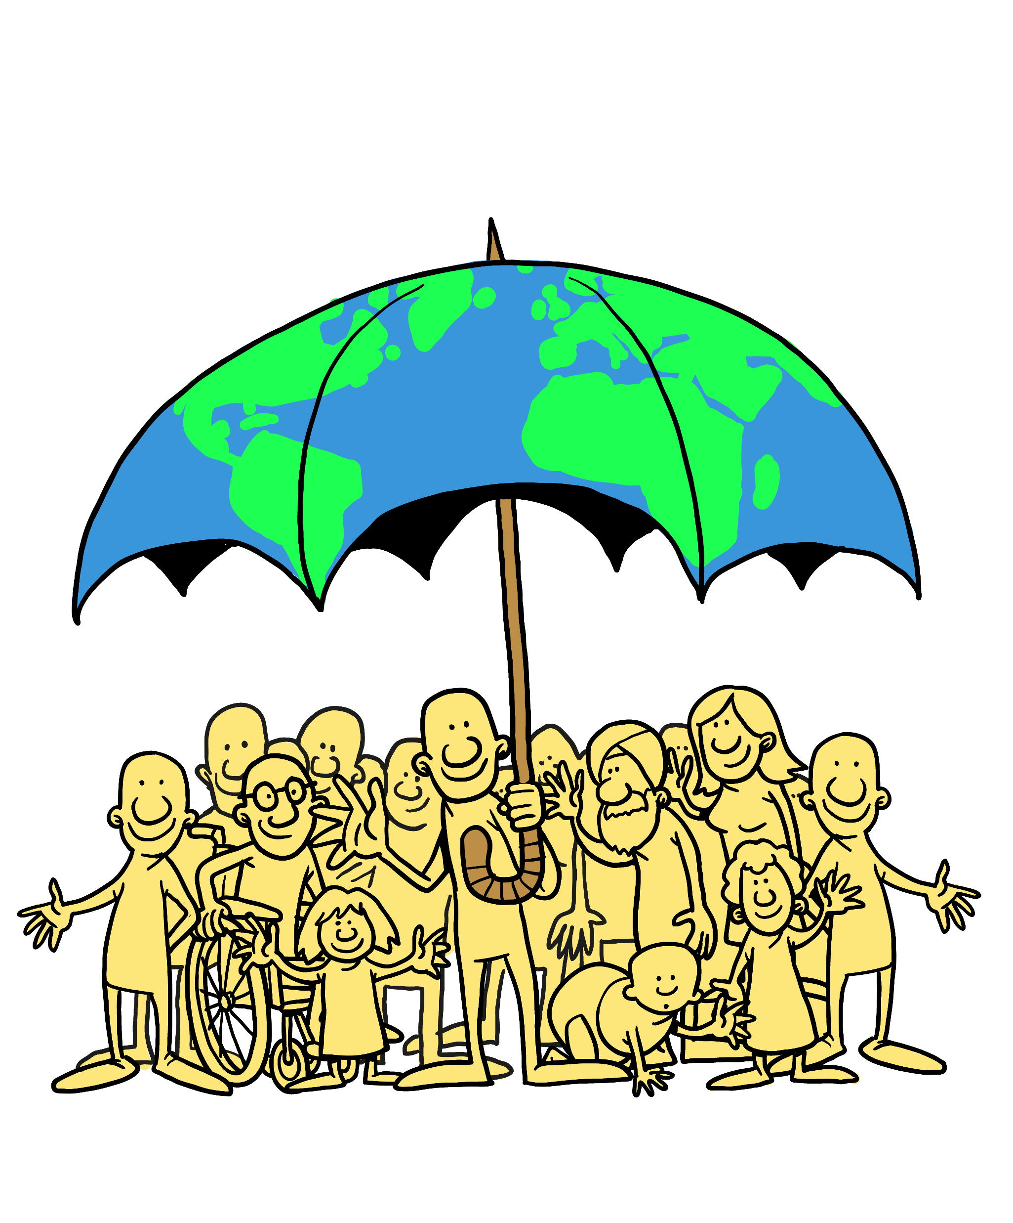



Handbook outline
Chapter 1: Participation: voice, agency and empowerment
Chapter 2: An enabling environment for participation
Chapter 3: Representation in participation
Chapter 4: Engagement government, communities and civil society
Chapter 5: From population engagement to decision-making
Chapter 6: Legal frameworks for participation
Chapter 7: Sustaining participatory engagement over time

Slide 6
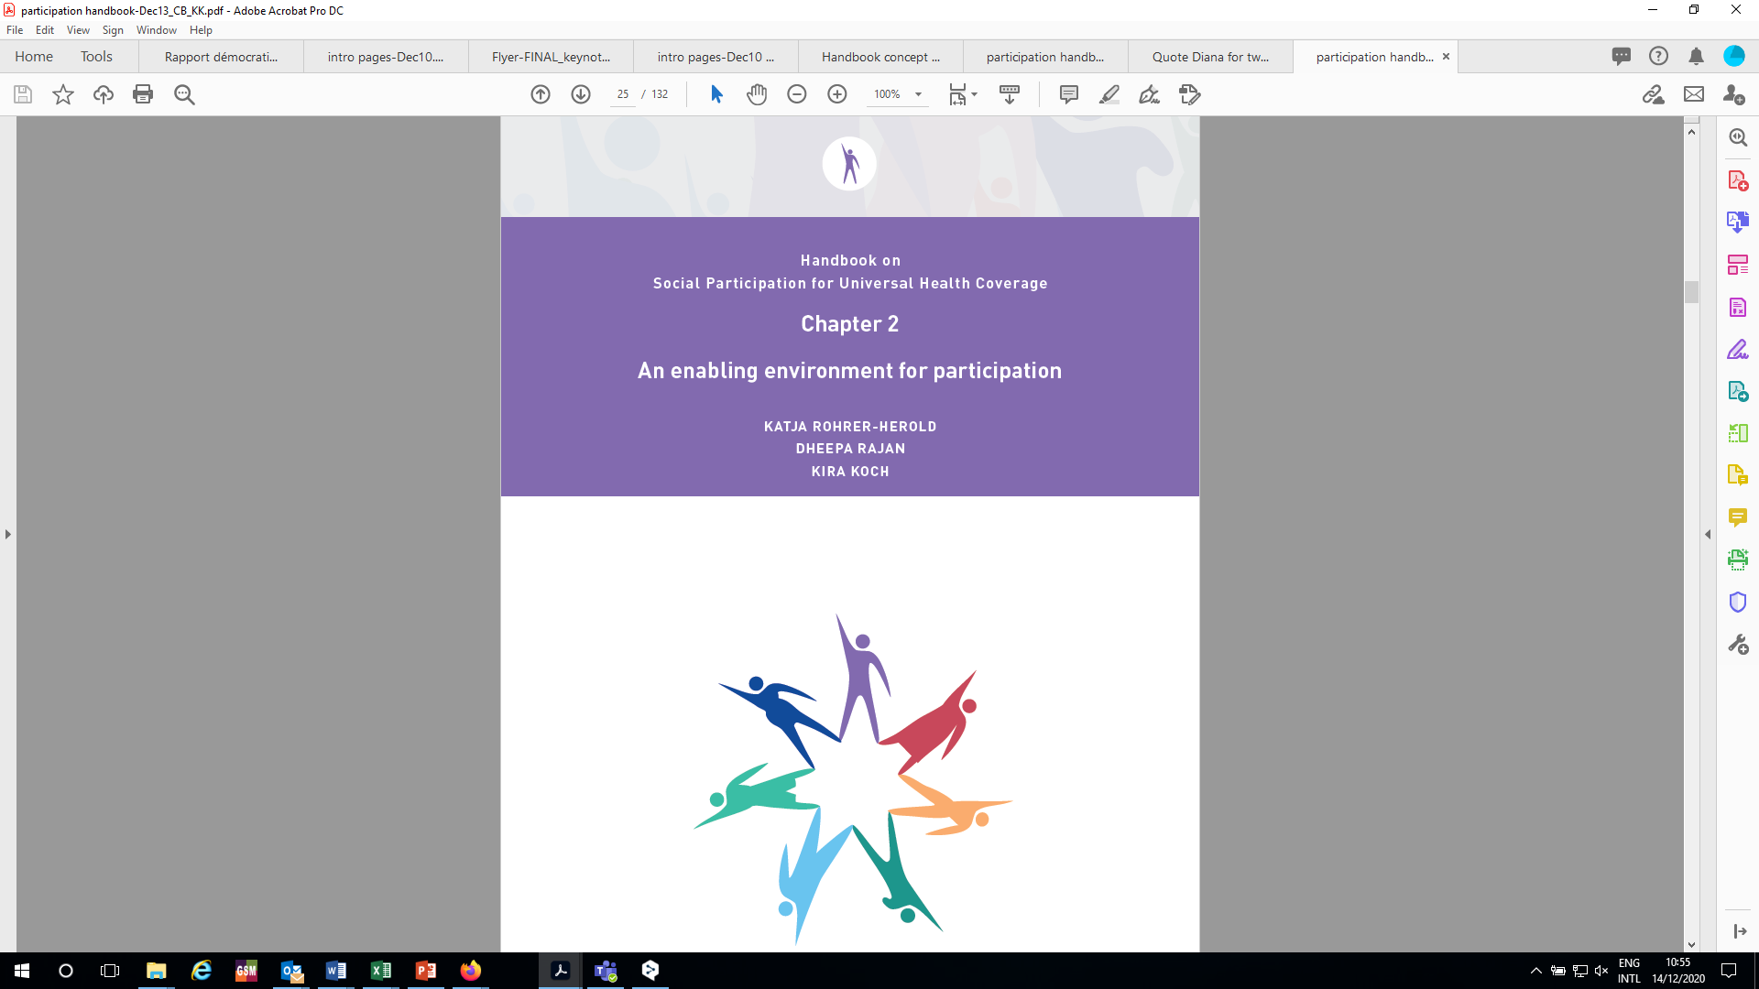
Power dynamics create unequal conditions for participation
  structural barriers to participation for some
  increasing access to for others
Selected key messages
enabling environment for participation → evening out the playing field with the aim of empowering those who are weaker and less powerful
A participatory space → potent tool to minimize power asymmetries if designed in a way that counters formal and informal barriers for equal participation.
HGF Department Meeting
Geneva, 5 March 2019
WHO internal working group on community participation
Geneva, 21 March 2019

Slide 7
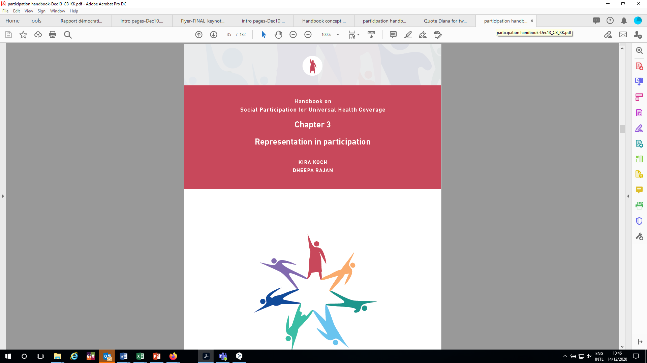
Challenges in finding the ‘right’ representatives:
  Considered legitimate
  Able to represent a constituency, idea, and/or their own individual experience
Selected key messages
  Format which lends legitimacy to participants
    Neutral facilitator
    Homogenous focus groups
    Meeting location
    Speaking time
    Preparatory material
HGF Department Meeting
Geneva, 5 March 2019
WHO internal working group on community participation
Geneva, 21 March 2019

Slide 8
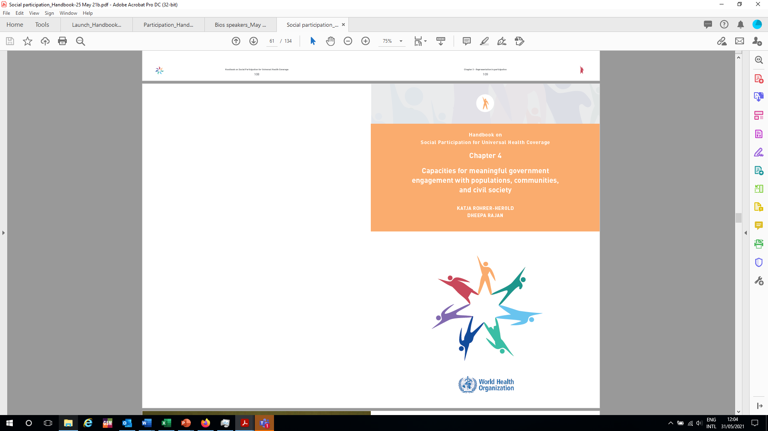
Recalibrating the balance of power which is rooted in expertise, knowledge, and speaking skills
Selected key messages
  Quality of exchanges → determined by the competency and capacities of the participants
  Level playing field →
    stakeholders/participants on an equal footing
    more frank and fruitful discussions
    policy influence
  Recognition is the most fundamental dimension of capacities for equal interaction but is the most difficult to build
HGF Department Meeting
Geneva, 5 March 2019
WHO internal working group on community participation
Geneva, 21 March 2019

Slide 9
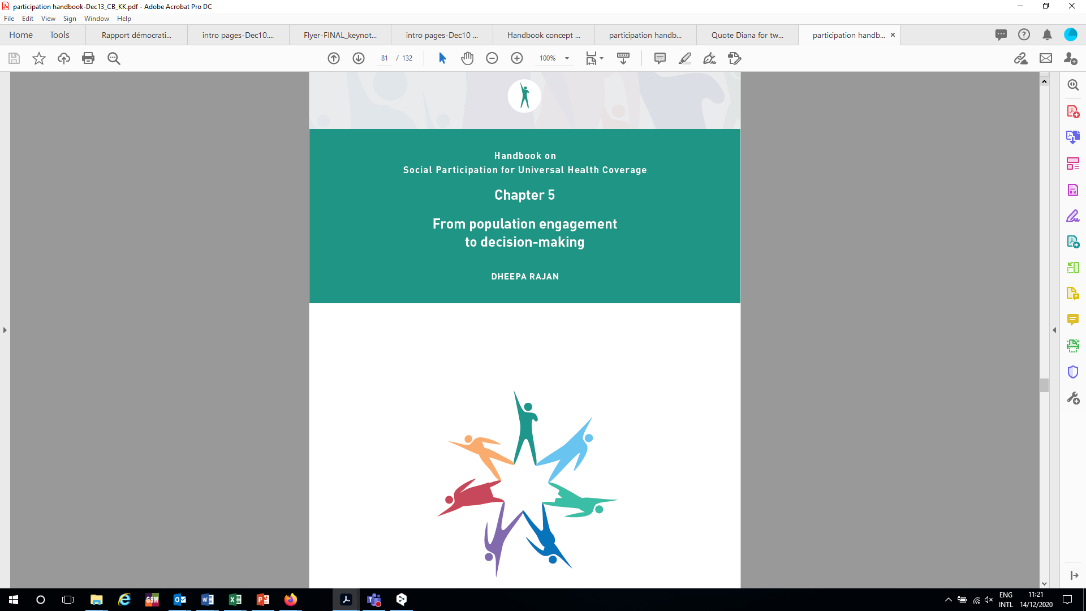
  Public participation initiatives have insufficient influence on decision-making
  ‘Deliberation-to-policy gap’
Selected key messages
  Policy uptake is not always the priority in participatory governance processes
  Value-driven argument → participation is a value in and of itself, an intrinsic goal
  2 complementary approaches to participation: governance vs. service delivery objectives
  Policy uptake → level of government involvement is critical
  Institutionalized government-initiated and/or -supported spaces for participation → higher policy uptake
HGF Department Meeting
Geneva, 5 March 2019
WHO internal working group on community participation
Geneva, 21 March 2019

Slide 10
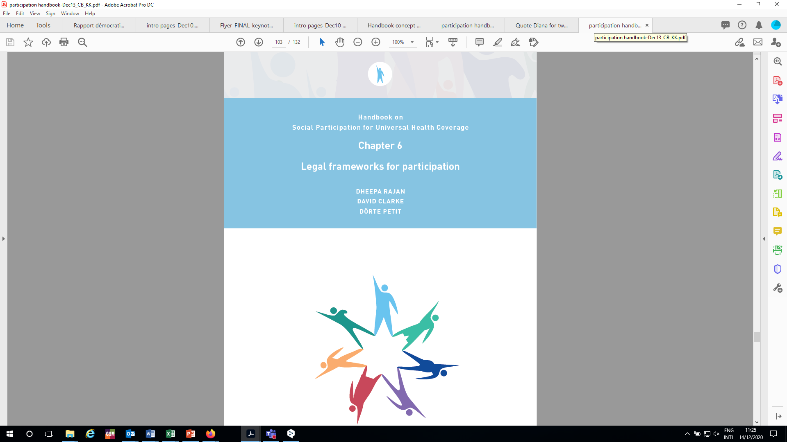
UN High Commissioner for Human Rights: “….The right to participate in political and public affairs should be enforceable by law...”
Examples: legal frameworks relevant for participation
  Decentralization legislation
  Right to health laws
  Health Acts
Selected key messages
Participation can and does take place even when legal frameworks do not exist→ BUT better to have participation embedded in legal framework than not
Legal frameworks do not guarantee participation per se → just one of several elements needed to ensure participation
WHO internal working group on community participation
Geneva, 21 March 2019

Slide 11
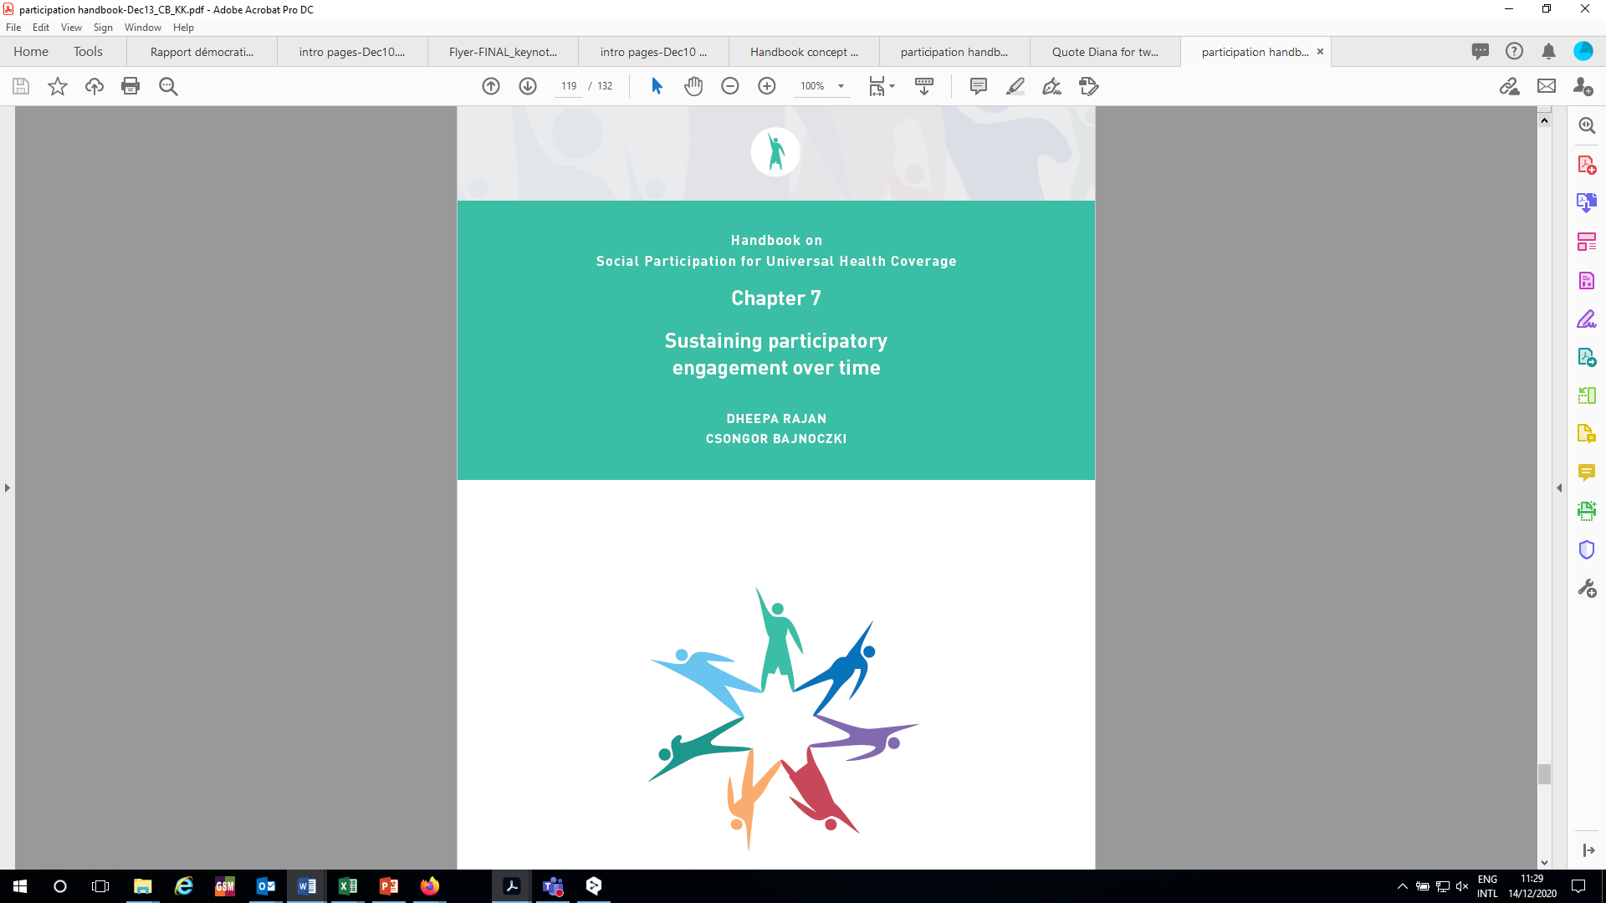
Long-term sustainability of participatory spaces → actions required are most effective when reflected on as part of its set-up and operationalization.
  Participation mostly largely voluntary
  Participation as a regular modus operandi in health can only happen if people stay engaged
  Long-term sustainability ←→ culture of participation
Selected key messages
  Formalization and institutionalization of participatory spaces can contribute to long-term sustainability → funding & capacity boost
  Long-term, stable funding for participatory spaces and for civil society
  People and civil society are motivated when their participation leads to results
  Locally respected and trusted community representatives are crucial resources
HGF Department Meeting
Geneva, 5 March 2019
WHO internal working group on community participation
Geneva, 21 March 2019

Slide 12
CONCLUSION
CHWs can use Handbook to build discussion with government
Underlines the need for CHWs to organize & be recognized
Use handbook as starting point

Slide 13
Q&A
Asante

Slide 14
AfroPHC Policy Webinar
Supporting Community Health Workers in the African PHC Team
Key points:
SPTN Handbook is a tool for CHWs
Builds social accountability for health
New starting point for civil society

